Slide 1



Fall 2
Reporting & Certification
Submission Requirements
Certification Errors
Reports
Notes:
Welcome to the Fall 2 Reporting and Certification training. We will cover the
Submission Requirements
Certification Errors
Reports
and answer any additional questions pertaining to the Fall 2 submission.

Slide 2


Target Audience
Data Coordinators
New to CALPADS
Notes:
This training is intended for data coordinators, those doing the routine maintenance and submission of CALPADS records. This training would also be beneficial for those of you who are new to CALPADS reporting.

Slide 3
CALPADS Training Road Map
Introduction
System Overview
Basics
Submission: Data Population
File Type: Data Population
Data Collections
Fall 1&2 Reporting and Certification
EOY 1-2 Reporting and Certification
Skill Building
Skill Building
Data Privacy
Data Population
CALPADS Basics
CALPADS Basics (SELPA)
4 Year Cohort
Notes:
The CSIS training model is designed to be segmented to provide organization of specific topics and concise delivery. We aim to provide focused trainings with relevant information and instruction.
- This slide reflects the CALPADS course catalog. In the top we have the various Subject Areas and their respective Programs shown below each one.
- The first three skill areas contain programs that are the prerequisite for the Data Collection programs and today's courses is part of the Fall 1 & 2 Reporting and Certification program.
-We are currently designing Skill Building courses which will develop targeted CALPADS competencies and skills.

Slide 4




Objective
Identify
Transform
Resolve
Lead
the source systems to connect data and stakeholders across the ecosystem. BUILD a COALITION to form alliances that exhibit collective, adaptive intelligence
data so that it conforms to standards and requirements. Through DATA CURATION gather, inventory, organize and validate during a submission
certification errors using a systematic approach and analytical mindfulness. With the benefit of CRITICAL THINKING rationally perform correlations between data elements and reports.
the submission and approval process to develop local procedures for reporting. As a DATA LEADER establish a network of stakeholders to assess the data's value and accuracy prior to certifying the Fall 2 Snapshot
Notes:
At the end of this session, with the student program reporting requirements and submission process described, LEAs should be able to:
Identify the programs collected during the different submission periods throughout the academic year
Determine the eligibility criteria for each of the student program codes
Perform the reporting process through online maintenance and batch upload
Resolve submission errors with ease with the help of available resource documents

Slide 5






Agenda
Overview
Certification Validation
Details
Reports Review
Wrap-Up
Notes:
Here is the agenda for this training. We will discuss the following:
An overview of the submission
Discuss the details of the business rules related to student program reporting
Spend some time on how data is reported in CALPADS
Lastly discuss the submission error validations before wrapping it up.

Slide 6

Overview
Discuss key concepts and background information

Slide 7







Overview of Collection
School Accountability Report Card (SARC)
UC/CSU course enrollment comes from certified CALPADS data
Every Student Succeeds Act (ESSA)
Title III of the ESEA, as amended by ESSA, requires LEAs and SEAs to report on a variety of key EL-related measures (see Sections 3121 and 3122) that can be used to improve local or state programs for Els
U.S. Department of Education’s Office for Civil Rights (OCR)
CA Commission on Teacher Credentialling (CTC)
Assignment monitoring.
Certified CALPADS course enrollment data is used for the number of classes by size
Number of unduplicated students enrolled in the total AP Courses comes from certified CALPADS data
Inexperienced teachers
To meet and monitor legal obligations to Els
Course data is compared with CTC’s credential data using the Statewide Educator Identification (SEID) number
Notes:
Fall 2 submission will be used to produce state and federal reports, public postings, for accountability and potentially for funding or grant eligibility. Fall 2 provides data for reporting and accountability to meet both state and federal requirements. Among these requirements the data is used for:
School Accountability Report Card (SARC)
UC/CSU course enrollment comes from certified CALPADS data
Certified CALPADS course enrollment data is used for the number of classes by size
Number of unduplicated students enrolled in the total AP Courses comes from certified CALPADS data
Every Student Succeeds Act (ESSA) Consolidated State Plan
Title III of the ESEA, as amended by ESSA, requires LEAs and SEAs to report on a variety of key EL-related measures (see Sections 3121 and 3122) that can be used to improve local or state programs for Els
Inexperienced teachers
U.S. Department of Education’s Office for Civil Rights (OCR)
To meet and monitor legal obligations to Els
California Teacher Credentialing (CTC)
Course data is compared with teacher assignments Commission on Teacher Credentialing for assignment monitoring
Perkins V
Survey of CTE pathway completers
EDfacts
Staff FTE
RESOURCES
SARC data usage retrieved from https://www.cde.ca.gov/ta/ac/sa/documents/definitions18.docx.
ESSA data retrieved from https://ncela.ed.gov/files/english_learner_toolkit/OELA_2017_ELsToolkit_508C.pdf at https://www2.ed.gov/about/offices/list/oela/english-learner-toolkit/index.html, https://www.cde.ca.gov/pd/ee/documents/equityplan2017.docx, https://www.cde.ca.gov/re/es/documents/essastateplan2018.pdf
U.S. Department of Education’s Office for Civil Rights (OCR) LEAs EL services and programs must meet civil rights requirements.
https://www.cde.ca.gov/ta/cr/documents/elcalpads.pdf and
https://www2.ed.gov/about/offices/list/oela/english-learner-toolkit/index.html
CTC data retrieved from https://www.ctc.ca.gov/docs/default-source/commission/files/rfo-rfp/rfo-saas-desc.docx?sfvrsn=6

Slide 8




Who are Involved in Data Collection?
School Sites
Help gather and maintain student profile data within SIS
Human Resource
Help determine the staff credentials appropriate for the courses taught, FTE information
CALPADS
LEA Coordinator
Other Staff
Programs, EL, HR, Curriculum, SPED
Help determine the course content, EL services provided, assign students in courses
Notes:
Let’s talk about who is involved in the Fall 2 data collection. At the center of CALPADS reporting is the data coordinator, you have the responsibility of not only reporting the data to CALPADS but also managing relationships with data stewards and data owners. Among the many stakeholders involve din the Fall 2 data collection are personnel and staff at school sites, Human resource staff and additional district staff. This staff doesn’t often submit data to CALPADS, they may not even have access to CALPADS, but usually help with:
gathering and maintaining student profile data within SIS
determining the staff credentials appropriate for the courses taught, verify FTE information
develop the course content, EL services provided, assign students in courses
Cultivating relationships, mapping data sources and identifying data stewards prior to the submission is the foundation for Fall 2 success.

Slide 9
Fall 2 Key Dates
Fall 2 Data submission in underway. However, the Fall 2 certification snapshot revision will not be activated until after the Fall 1 initial deadline. There won’t be any amendment window for Fall 2
Dec. 15, 2025
FEB. 06, 2026
Feb. 27, 2026
Oct. 1
Census Day
Snapshot Revision Start
0 Fatal Errors Milestone
Certification Deadline

Slide 10
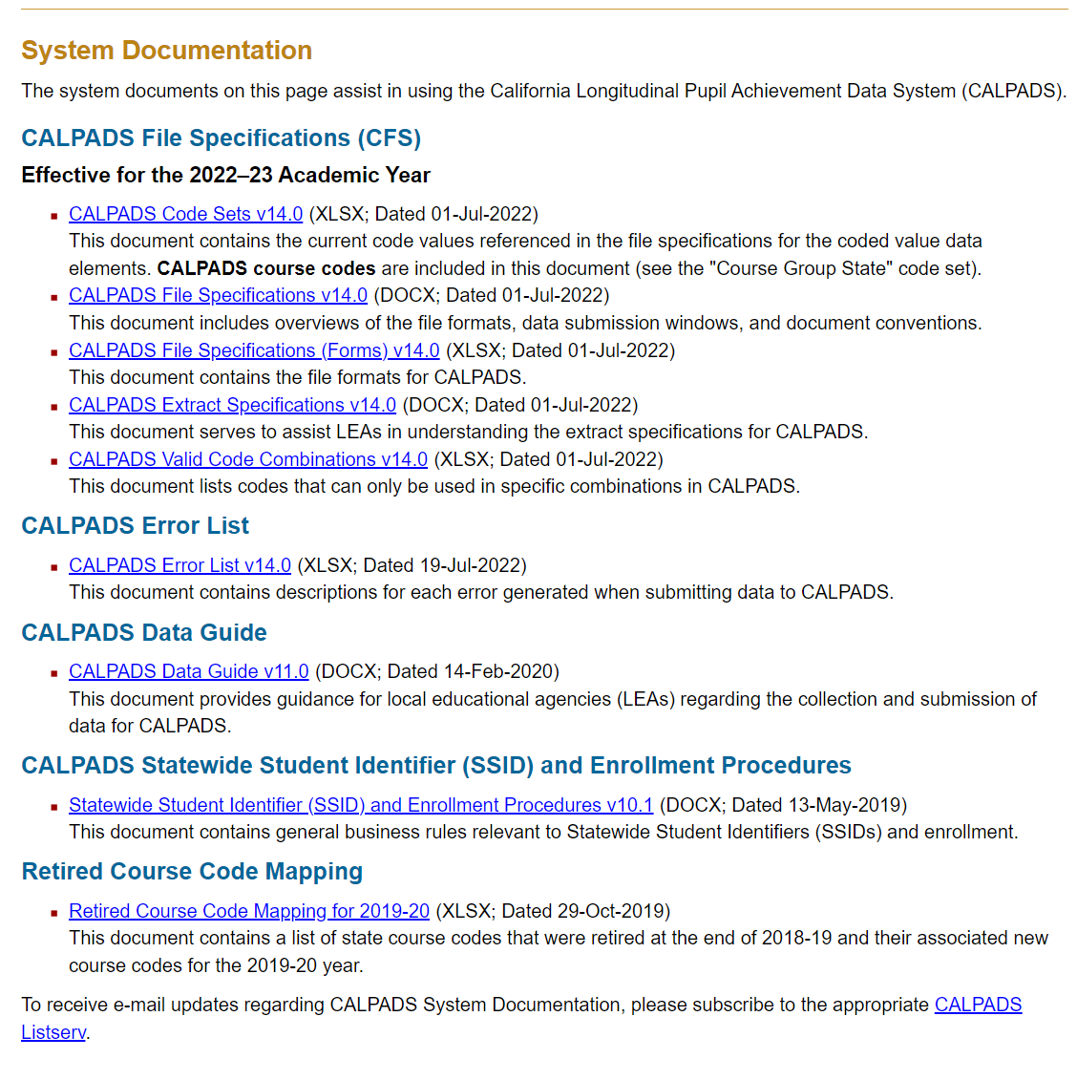
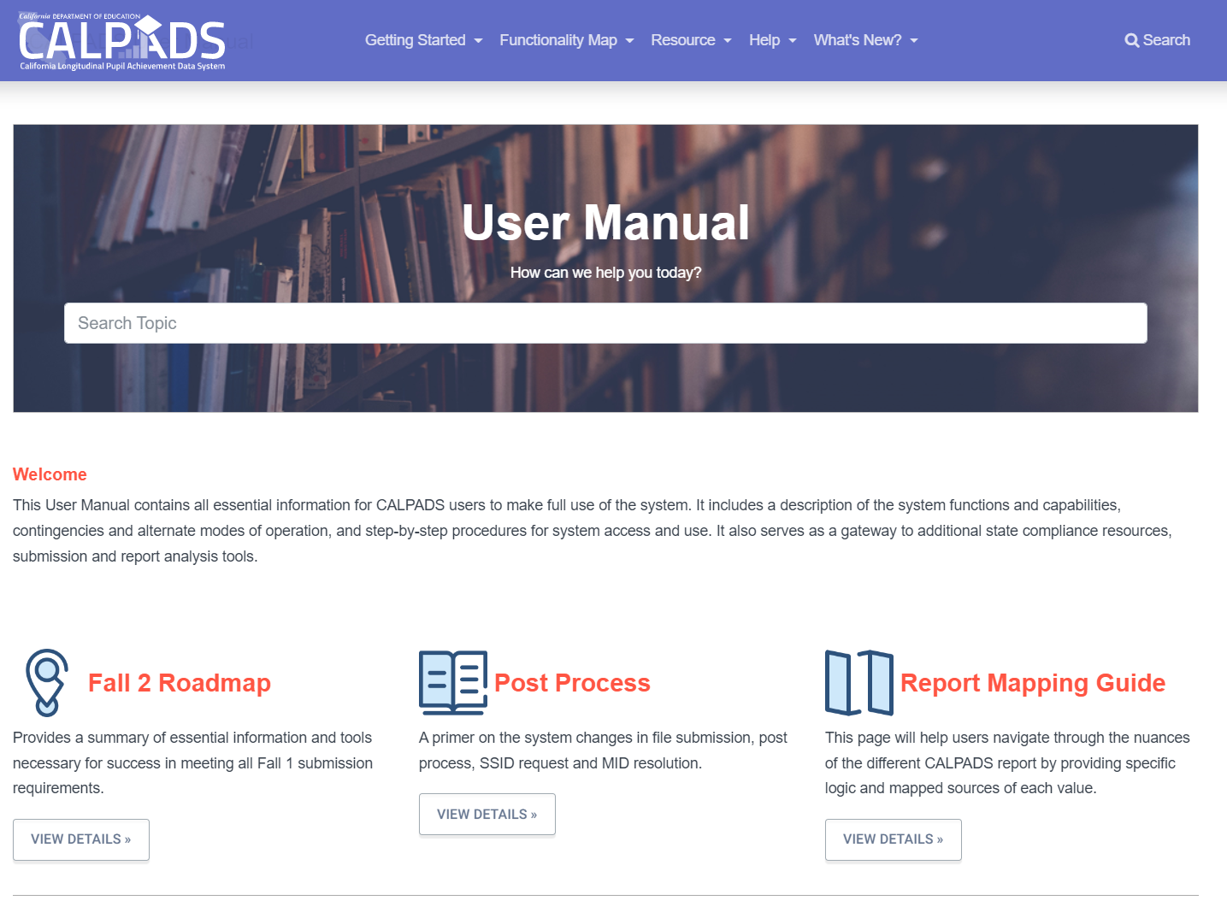
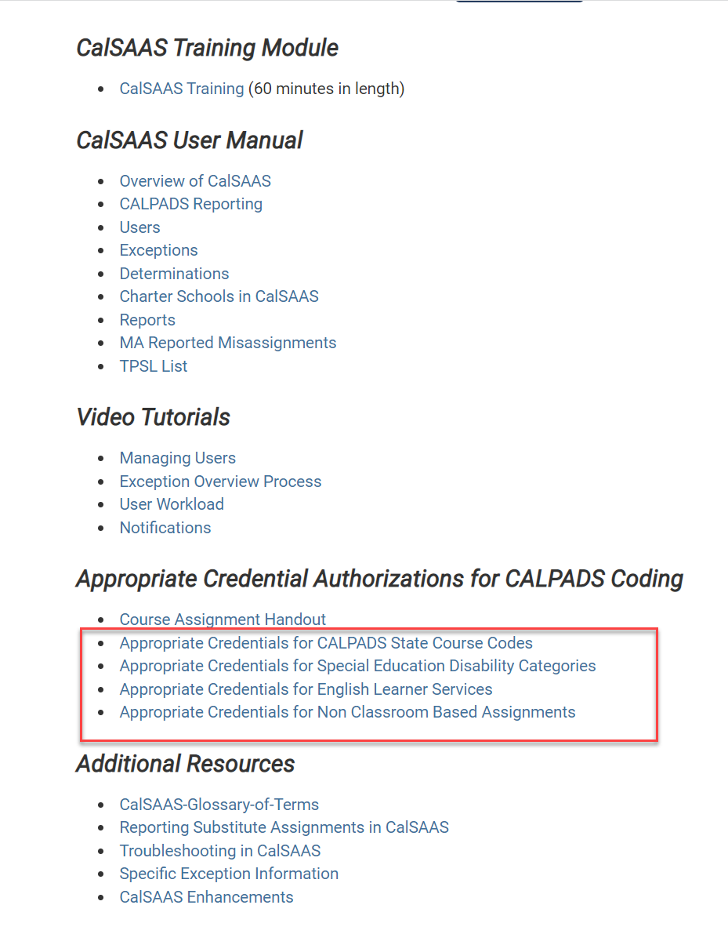
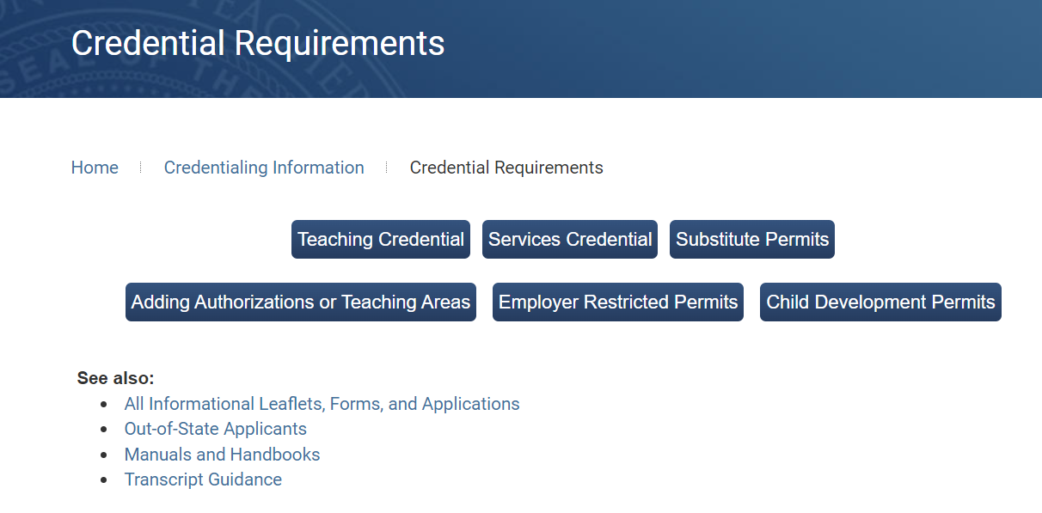
Fall 2 Tool Kit
Notes:
Resources:
CDE CALPADS:
https://www.cde.ca.gov/ds/sp/cl/systemdocs.asp
CALPADS User Manual:
https://documentation.calpads.org/Training/Fall2Primer/#fall-2-reporting-roadmap
https://documentation.calpads.org/Reports/SnapshotODSReports/#fall-2-report-mapping-guides
CTC Resources:
https://www.ctc.ca.gov/credentials/req-credentials
https://www.ctc.ca.gov/credentials/calsaas-information
Assignment Monitoring:
https://www.cde.ca.gov/pd/ee/peat.asp
https://www.cde.ca.gov/pd/ee/peatvideos.asp
https://www.cde.ca.gov/pd/ee/tamoreportsvideos.asp

Slide 11

Data Overview
Fall 2 involves reporting of Certificated Staff employment, job classifications, and course assignments that are occurring on Census; Postsecondary CTE survey results, and EL services data
SDEM
  Reporting teacher of record
  End Date Employment for staff no longer employed
  include only certificated staff active as of Census Day and course sections that are occurring on Census Day
SASS
  Job classification and FTE
  Non-Classroom Based Job Assignment
CRSE and SCSE
  Course attributes, standard grade level range, subcategories, SPED & Home and Hospital, English learner services, distance learning, independent study indicators
  For school tracks that are not in session on Census Day, staff and course data are collected within 30 calendar days after Census Day to account for active enrollments and employed staff on intersession
PSTS
  During Fall 2, LEAs will submit PSTS Survey response data collected from High School completers who exited secondary education in 2024 – 2025 who completed a CTE Pathway at anytime during their enrollment at the LEA
Notes:
The Fall 2 Course Enrollment/Staff Assignments/EL Services/Postsecondary Data Submission has these important functions:
Provide LEA class enrollment counts that include every student actively enrolled in the class on Census Day in the current academic year
Identify the number of staff in the following job classifications: Teacher, Administrator, Pupil Services, Non-certificated Administrator Charter School Non-certificated Teacher, and Itinerant or Pull-out/Push-In Teacher with a Statewide Educator Identifier (SEID)
Report the count of ELs and instructional services provided for them (if any) and the count of teachers providing those services
Report PSTS survey response of Career Technical Education (CTE) completers, and students participating in the California Partnership Academy Program six months after exiting secondary education

Slide 12
Data Submission Sequence
Staff Assignment*
(SASS)
Course Section
Enrollment*
(CRSE)
Staff Demographic
(SDEM)
Student Course Section
Enrollment*
(SCSE)
Postsecondary Status*
(PSTS)
File types in asterisk* are replacement type files
File types must be submitted in this sequence
Records for each file needs to be posted first before uploading the next
File Type | Operational Keys
SASS | School of Assignment, Academic Year ID
CRSE | School of Course Delivery, Academic Year ID, Academic Term Code
SCSE | SSID, School of Course Delivery, Academic Year ID, Academic Term Code
PSTS | Reporting LEA, Education Program Participation Type, Academic Year
Notes:
Fall 2 batch files must be submitted then posted in order. While the SASS, CRSE require the SDEM to be posted first and not each other, there are Certification validations between the SASS and the CRSE that can be avoided by submitting in sequence. The SCSE requires that first the CRSE is posted and that the SSID records have an enrollment record at the school of course delivery on census day. So the SCSE requires the CRSE and the SENR be posted inn the ODS first.
For Fall 2 it is important to understand the relationship between record types. Record types shown below are dependent on the records types above them. For example, you must submit and post a staff demographic record prior to submitting either staff assignment or course section records. Breaking his rule will usually result in rejected record errors such as SASS0121, CRSE0220 and SCSE0139.
The SEID from the staff Demographics is used to associate the Staff Assignment and the Course section record to the staff member.
The Course Section’s Course Section ID ties the Student Course Section Record to the Course record.
The SSID Enrollment record’s SSID ties the Student Course Section record to the student.

Slide 13

Staff Data Submission
Staff Demographics & Assignments
Notes:
Okay, now let’s get into the Staff submission. We discuss the records types, key data elements and the sequence of submission.

Slide 14
Staff Data Types
STAFF DEMOGRAPHICS
Basic information about staff members who are providing services to students
Staff Demographics
Staff Assignments
Course Section
STAFF ASSIGNMENTS
Indicates the staff member’s general role (teacher, pupil service, administrator)
Non-Classroom based Job Assignments
Student Course Section
Notes:
There are two components to Staff Data. All certificated staff require Demographic and Assignment records.
Staff Demographics (SDEM)
This part includes demographic information on certificated staff, including employment start and end dates, total years of service in the education field, and total years of service in the given LEAs.
Staff Assignment (SASS)
This group includes job classification information and FTE (full time equivalent) all certificated staff, as well as job assignment information for certificated staff in non-classroom based assignments.
NOTE: Classroom-based or teacher assignment data are submitted in the Course Section Files.

Slide 15


Reportable Staff
Report certificated staff who have SEIDs.
  Certificated positions in school districts, county offices of education, charter schools, schools administered by the Department of Corrections, Division of Juvenile Justice, or State Special Schools. Note that even if a given employee is on temporary leave, they should still be included
  University interns or district interns authorized by the Commission on Teacher Credentialing and employed in certificated positions
  Non-certificated teachers and administrators who obtain a certificate of clearance and were issued SEIDs
  Substitute teachers (long-term and short-term) as defined by the individual districts.
  Itinerant teachers teaching at multiple sites within a district. Itinerant teachers may or may not be in the master schedule at a site
  “Pull-out/push-in” teachers, also known as “resource teachers,” teaching at multiple sites or at one site. Generally, these teachers are not in the master schedule
  Individuals on provisional internship permits, short-term staff permits, or teacher/emergency permits
Do NOT report classified staff
Do NOT report Preschool teacher staff. However, if they have other non-classroom job assignments you will need to report them
Notes:
Fall 2 includes only certificated staff active as of Census Day and course sections that are occurring on Census Day.
Who should be reported
Certificated employees employed in certificated positions in school districts, county offices of education, charter schools, schools administered by the Department of Corrections, Division of Juvenile Justice, or State Special Schools. Note that even if a given employee is on temporary leave, they should still be included.
University interns or district interns authorized by the Commission on Teacher Credentialing and employed in certificated positions in school districts, county offices of education, charter schools, schools administered by the Department of Corrections, Division of Juvenile Justice, or State Special Schools.
Non-certified instructors who are employed in charter schools and who are providing non-core, non-college prep instructional services, and who have SEIDs.
Non-certificated administrators in school districts or county offices of education working at the levels of assistant, deputy, associate superintendent, or higher, who have SEIDs.
Non-certificated administrators in charter schools, who have SEIDs.
Substitute teachers (long-term and short-term) as defined by the individual districts.
Itinerant teachers teaching at multiple sites within a district. Itinerant teachers may or may not be in the master schedule at a site.
“Pull-out/push-in” teachers, also known as “resource teachers,” teaching at multiple sites or at one site. Generally, these teachers are not in the master schedule.
Individuals on provisional internship permits, short-term staff permits, or teacher/emergency permits.

Slide 16

Staff Not Employed by the LEA
Report all staff in certificated positions including:
Course sections that are taught by privately contracted teachers if the teacher has a SEID
Courses taught by individuals who are employed by another LEA such as a Regional Occupational Center (ROC) or County Offices
Course sections that are taught by teachers who are employed and paid directly through another school or another district
Support Staff not under the direct administration of the reporting LEA and not under the direct administration of the reporting LEA
Notes:
Course sections that are taught by privately contracted teachers should be reported even if they do NOT possess a SEID. If the teacher has a SEID, the LEA should report it on the course section record as well as the staff demographics and staff assignment. This is true for courses taught by individuals who are employed by another LEA such as a Regional Occupational Center (ROC) or County Offices and not under the direct administration of the reporting LEA and not under the direct administration of the reporting LEA.
Local educational agencies are responsible for ensuring all staff serving the LEA's students have the appropriate credentials to do so, including contracted staff. If the staff member providing instruction and/or services to students does not hold the appropriate credentials and authorizations, then the misassignment will be attributed to the reporting LEA.

Slide 17

SEIDs for Non-certificated Teachers & Admins
If a district has used a “local assignment option” to assign a non-certificated staff member to a position requiring certification, or employs a non-certificated teacher, the individual can apply for a Certificate of Clearance from the Commission on Teacher Credentialing. A SEID will then be assigned to the individual
All charter school-teachers must obtain a certificate of clearance and demonstrate their professional fitness
July 1, 2025, All charter school-teachers must obtain the credential certificate required for the teacher’s certificated assignment (EC Section 47605.4)
Notes:
The Certificate of Clearance (COC) is a document issued by the California Commission of Teacher Credentialing to an individual who has completed the Commission's fingerprint character and identification process, whose moral and professional fitness has been shown to meet the standards as established by law. The COC is not the same as a clear teaching or services credential. The COC does not authorize the holder to provide any instruction or services in schools; its sole purpose is to provide verification that the holder has completed a professional fitness review.
Apply for a COC to get a SEID at https://www.ctc.ca.gov/credentials/submit-online.
California Education Code (EC) Section 47605.4 now requires that all charter school teachers must obtain the certificate required for the teacher’s certificated assignment by July 1, 2025. In addition, EC also requires that by July 1, 2020, all charter school teachers must obtain a certificate of clearance and demonstrate their professional fitness.
This bill includes provisions that allow educators already employed in non-core or non-college preparatory teaching assignments at charter schools during the 2019–20 school year up to five additional years to obtain the credential required for the teacher’s certificated assignment. These educators must earn the appropriate credential for their assignment by July 1, 2025. Charter school teachers that are newly hired for their assignment in the 2020–21 school year (and beyond), or who maintain employment at the same charter school but are assigned to a new teaching assignment, are required to hold the appropriate certification for their assignment.
When applicants apply for a certificate of clearance online, their Statewide Educator Identifier (SEID) is generated; or when applicants submit applications via mail, their SEIDs are generated a few days after the application is received. Since charter school teachers are required to have SEIDS, LEAs must now submit staff demographic and staff assignment records for those teachers to CALPADS. Therefore, during Fall 2, Certification Validation Rule (CVR) CERT053 will trigger if there are no staff assignment records submitted for a school, and CERT054 will trigger if a course section includes a SEID for which there is no demographic information
Https://www.cde.ca.gov/be/pn/im/documents/aug20eeed02.docx
https://www.cde.ca.gov/ds/sp/cl/calpadsupdflash191.asp

Slide 18



Staff Demographics
Key Fields
Employment Status
  Required for all teachers
Staff Service Years LEA
  Must be updated yearly
Staff Service Years Total
  Must be updated yearly
  Used to identify inexperienced teachers
Staff Highest Degree
  A Degree is any type of degree, honorary degree, title of any designation, mark, appellation, series of letters or words
Notes:
In addition to the staff demographics, the SDEM is used to submit employment information related to the staff member.
Some of the Key Fields are:
Employment Status
Required for all teachers
Staff Service Years LEA
Must be updated yearly
Staff Service Years Total
Must be updated yearly
Used to identify inexperienced teachers
Staff Highest Degree
A Degree is any type of degree, honorary degree, title of any designation, mark, appellation, series of letters or words

Slide 19

STAFF Service Years
The Staff services years of active staff must be updated yearly by the LEA. It will be used to determined inexperienced teachers for the ESSA
Does a sabbatical (leave of absence) get counted toward the Staff Service Years LEA (Element 7.30)?
  One year of service counts for the staff member if the staff member is employed in a certificated position at any part of the year. If the leave of absence prevents the staff member from service for the entire year, the period of leave should be omitted from the years of service total
How are "Staff Service Years LEA" and "Staff Service Years Total" counted?
  "Staff Service Years LEA" is a count of the years that a staff member has worked at a specific LEA in a certificated position.
  "Staff Service Years Total" is the total count of the years that a staff member has worked at any public or private educational institution in a certificated position, including the time worked at your LEA, other districts, other states, and countries. Therefore, this number should always be equal to or greater than "Staff Service Years LEA“
  For both fields, count any partial year as one year. Do not count years during which the teacher did not work (e.g., was on sabbatical the entire year). Substitute teaching should be counted if the teacher was certificated
Notes:
Staff demographics provides key data and is required for each teacher reported.
The Staff services years must be updated yearly. This requires a SDEM submission for all staff
Staff Service Years Total is also used to determined inexperienced teachers for the ESSA. Teacher with 2 years or less of experience are considered inexperienced
The Every Student Succeeds Act (ESSA) Section 1112(b)(2) requires each LEA receiving ESSA funds to submit a plan to the state educational agency that describes how it will identify and address any disparities that result in low-income and minority students being taught at higher rates than other students by ineffective, inexperienced, or out-of-field teachers; also referred to as equity gaps.

Slide 20
California Definitions for Equity Data under the ESSA
Ineffective Teacher - A teacher who is: (a) misassigned (placed in a position for which the employee does not hold a legally recognized certificate or credential, or a certificated employee placed in a teaching or services position in which the employee is not otherwise authorized by statute to serve), or (b) teaching without a credential
Out-of-Field Teacher - A teacher who has not yet demonstrated subject matter competence in the subject area(s) or for the student population to which he or she is assigned. Under this definition, teachers with the following limited permits would be considered out-of-field:
  General Education Limited Assignment Permit
  Special Education Limited Assignment Permit
Inexperienced Teacher - A teacher who has two or fewer years of teaching experience
Notes:
ESSA Section 1112(b)(2) requires each LEA receiving ESSA funds to submit a plan to the state educational agency that describes how it will identify and address any disparities that result in low-income and minority students being taught at higher rates than other students by ineffective, inexperienced, or out-of-field teachers; also referred to as equity gaps. To meet ESSA requirements, California developed definitions for “ineffective” and “out-of-field” teachers that built on LCFF Priority 1 by focusing on credential and assignment status, specifically whether teachers are teaching without a credential or teaching outside of their field of preparation.
https://www.cde.ca.gov/be/pn/im/documents/aug20eeed02.docx

Slide 21




SASS Data Collected
The LEAs must provide any of the appropriate data for submission to CALPADS.
Job Classification
Non-Classroom Based Assignments
School of Assignment
FTE Percentage
Job Classification is the classification of a specific occupation of an individual, such as teacher, administrator, and pupil services
Job assignments that have been designated as support service assignments or that are not based in the classroom
A unique identifier for the school where an Educator is assigned
The percentage of time spent on each job classification in relation to a full-time position

Slide 22



Staff Assignment Types (SASS)
Staff Job Classification
Teachers
12 - Teacher
26 - Charter School Non-certificated Teacher
27 - Itinerant Teacher/Pull-Out/Push-In Teacher
Administrators
10 - Administrator
25 - Non-certificated Administrator
Pupil Service
11 - Pupil Services
Notes:
The types of staff reported include Teachers, Administrators, and Pupil Service.
A teacher is an employee of the LEA who holds a position requiring certification and whose duties require direct instruction to the pupils, mentor teachers, itinerant teachers and possibly substitute teachers.
Administrators are employees of the LEA in a position requiring certification, but who is not required to provide direct instruction to pupils or direct services to pupils (services such as those provided by a pupil services employee. This category does not include mentor teachers.
Pupil Service is someone who is in a position requiring a standard designated services credential, health and development credential who performs direct services to pupils (counselors, guidance and welfare personnel, psychologists, etc.).

Slide 23


Teaching Assignments
By default, teaching assignments are the courses assigned to their SEIDs. If a staff member has a teaching job classification (12, 26, 27), then a course must be reported with the staff member SEID
Otherwise, if a teacher is not assigned to a class, a non-classroom job assignment code should be reported in the SASS

Slide 24
Job Classification FTE Percentage
The reporting of FTE is by Job classification and by School of assignment. In addition, the sum of the FTE percentage for each staff member cannot exceed 200% or be less than 5% total
If ... | Then ...
All of the staff time is devoted to the job classification of “Administrator” (10) … | Report 100% to the job classification of “Administrator.”
All of the staff time is devoted to one of the teaching classifications (12, 26, 27)… | Report 100% to the teaching job classification identified.
Half of the staff time is devoted to teacher (12), and: The other half of the time is devoted to itinerant teacher (27)… | Report 50% to the job classification of “Teacher (12)” and 50% to the job classification of “Itinerant Teacher (27).”
Half of the staff time is devoted to administration (10), and: The other half of the time is devoted to teaching (12) … | Report 50% to the job classification of “Administrator” and 50% to the job classification of “Teacher.”
If Itinerant Teacher (27) is assigned to 3 school sites … | Report allotted % to of Itinerant Teacher at 3 school sites. (e.g. Site 1 (40%), Site 2 (40%) Site 3 (40%))
All of the staff time is devoted to one of the teaching classifications (12, 26, 27) AND have additional Non-classroom Job Assignments… | Report allotted FTE % to the teaching job classification identified using only one SASS record.
Notes:
For each staff member reported, LEAs must report the percentage of full-time equivalency spent in each job classification, by school. The total Full Time Equivalent (FTE) % for all of a staff member's Job Classifications should not exceed 200% or should not be less than 5%. For examples:
For a staff member that is working half time (or 50%), it should be submitted as “50” or “50.0.”
If a principal works full time as a principal, then “100” should be reported, because 100% of the FTE is spent working in the classification of principal.
Review the Staff Assignment data and adjust the FTE so that the total for all classifications is equal to or less than 200% and greater than or equal to 5%..
See Report 4.4 - Staff Profile - List
See Report 4.5 - Staff Non-Classroom Based or Support Assignment - Detail

Slide 25

Staff on Leave
Employee on leave 6018 non-classroom-based assignment code must be reported with FTE% reflective to their active time
The FTE percentage has to be greater than 1 (recommended to use regular FTE).
  SASS0118 - Staff Job Classification FTE Percentage Less than 1 or Employee on Leave Percentage Greater Than 0
Staff reported on leave need an additional non-classroom-based job assignment or a teaching assignment (course record)
Notes:
LEAs are encouraged to update SDEM records every year, but they don't always do this because there isn't a validation requiring it. While this might seem acceptable if there weren't changes to the record, two fields should be updated every year - Staff Service Years LEA and Staff Service Years Total. This is now even more important as these fields are used in the TAMO (assignment monitoring) reports, SARC, federal reporting, state plans, etc. If the staff member has a SASS record in the AY it means that they are active. Therefore, if they have a qualifying SASS record for the AY, then they will be required to update to the SDEM Effective Start Date (update or a new record) before the Fall 2 Report Through Date (usually Nov 1 of the AY).
Currently teachers on leave (6018) don't enter FTE, but they are associated with CRSE records. Substitute teachers are in their place, but they don't have FTE associated with those classes. By allowed FTE for employees on leave, it have some time associated to the course records so the FTE is more accurate.
SASS0118 : The system is validating to make sure the Staff Job Classification FTE Percentage for an individual staff member who is not on leave (Nonclassroom Based or Support Assignment Codes 1-7 does not equal 6018) is not less than 1 or if employee is on leave (Nonclassroom Based or Support Assignment Codes 1-7 = 6018) is not greater than 0.

Slide 26

How should teachers be reported?

Slide 27
Teacher Reporting Scenarios
Teaching Scenarios | SASS Job Classification | SASS Non-Classroom Job Assignment | CRSE
Regular teacher of record | 12 | Optional if teacher ALSO has a non-instructional assignment, otherwise N/A | Assign appropriate state course code for class
Teacher of record (on leave) | 12 | Report Non-classroom job code 6018 (on- leave) with regular FTE% reported during active employment. | Assign appropriate state course code for class
Charter School Non-Certificated teacher of record | 26 | Optional if teacher ALSO has a non-instructional assignment, otherwise N/A | Assign appropriate state course code for class
Substitute who is teacher of record for the class because there is no permanent hire for that class (vacancy) | 12 or 26 or 27 | Optional if LEA wishes to ADDITIONALLY identify the teacher as a long-term or day-to-day sub use 6014, otherwise N/A | Assign appropriate State course code for class
Permanent employed Substitute who is NOT currently assigned to any course section | 12 or 26 or 27 | 6014 (Day to Day substitute teacher - permanent emp.) | N/A
Pull-Out/ Push-In Teachers | 27 | N/A | Assign appropriate State course code for class For Elementary EL classes, you may use state course code 9103 or 9104 For RSP use state course code 9231
College Teachers NOT employed by LEA | n/a | N/A | Assign appropriate State course code for class and use SEID 9999999999. This will not be a misassignment if appropriate course codes are used.
Teachers not employed by LEA (Teaching ROPC, Distant learning, 3rd party | 12 or 26 or 27 | N/A | Assign appropriate State course code for class and report valid SEID for teacher if compliance, or use SEID 9999999999 but will be a misassignment

Slide 28
22-23 Non-Classroom Based Assignments
New Non-Classroom Based Assignments
Code | Name | Definition | Examples | Job Classification
6028 | Teacher on Special Assignment | A teacher who has consented to serve in a non-instructional assignment. | A teacher on special assignment is an experienced teacher who steps outside the classroom to take on a specialized role. A TOSA provides support for implementation of the district’s educational mission through, content and curriculum development, provides leadership in the planning, coordination and implementation of a subject area, special project, coaching, mentoring or grade level instructional program | 12, 26, 27
6029 | Special Education Case Manager (non-instructional) | A staff member who manages and coordinates individualized education program (IEPs) for students with disabilities. This staff member does not provide instruction to students with disabilities. | A special education case manager is responsible for ensuring services and supports are in place and provided as determined by the student’s Individualized Education Program (IEP) and may act as a liaison between the student’s teachers and parents. For example, the case manager may be: Coordinating services as the individual overseeing the IEP for the student | 10, 12, 26, 27
6030 | Program Coordinator – School Site Level | A staff member at the school site level charged with development, direction, implementation, and coordination of programs designed to improve instruction and enhance student learning. | These positions often oversee instruction of specific subjects or academic programs. Common duties of this position include, but are not limited to: Developing, coordinating, and supervising programs; Developing curriculum or program parameters; Evaluating and assessing programs; and Managing programs and the personnel within the program at a school site, district, or county level. | 12, 26, 27
Notes:
Teacher on Special Assignment
Teacher on Special Assignment (TOSA) credential requirements are a local level decision if the TOSA is not:
Offering instruction to students- if so they need to hold the appropriate credential for the subject/disability area
Serving as a staff developer on the basis of Title 5 §80020.4- if so they need to be authorized or have the governing board verify qualifying experience
If the TOSA is serving as a program director at the school site level they can use Title 5 §80020.4.1 to authorize the assignment with no credential subject requirement. However, program directors serving at the district or county level must hold a credential that authorizes administrative services. Pursuant to Education Code §447270.2, TOSAs cannot serve as program directors for Pupil-Personnel Service programs.

Slide 29
Special Education Teachers
Special day classes where Courses specifically designed for students with disabilities where all students enrolled are students with disabilities:
If the teacher is providing instruction in ALL subjects to a group of students in the class all day, then the State Course Code should be 1000 - Self-contained and the Instructional Strategy Code should be populated with 700 - Special Education;
If the teacher is providing the student's primary instruction in ONE subject to multiple groups of students with disabilities throughout the day (departmentalized), then LEAs should select the appropriate State Course Code that aligns with the content that the teacher is teaching. Additionally, the Instructional Strategy Code should be populated with 700 - Special Education;
Special Education Support - Resource Specialist Programs assignments:
If the teacher is providing SUPPORT instruction (supplementary to their primary instruction) in any subject to students with disabilities (pull-out or push-in), the teacher should be reported with:
  State Course Code 9231 - Special Education Support-Resource Specialist Program (RSP)
  Instructional Strategy Code should be populated with 700 - Special Education.
  LEAs may, but are not required to submit Student Course Section Enrollment records for students that are receiving the support instruction from this teacher, as long as the Staff Job Classification Code for the teacher is 27 - Pull-Out/Push-In/Itinerant.
RSP Teachers should NOT be reported as "co-teachers" when they are providing pull-out or push-in support for students with disabilities who have been mainstreamed into general education classes.
Instructional Strategy code 700 should ONLY be used for courses specifically designed for students with disabilities where all students enrolled are students with disabilities
29

Slide 30

Course Submission
Course and Student Course Section
Notes:
The course and student course section data should follow the staff data submission. Let’s look at the sequence of submission, record relationships and data elements for these two file types.

Slide 31
Course Data Submission
COURSE SECTION
A unique instance of a course taught by one or more teachers, in a specific location, at a particular time
Staff
Demographics
STUDENT COURSE SECTION
Conveys which students are taking reported course sections.
Staff
Assignments
Course Section
Student Course Section
Notes:
Course data has two parts, Course Section data and the Student Course Section data. The Course Section, which conveys the Course Sections that your school is offering, and the Student Course Section, which conveys which students are taking those course sections.

Slide 32

Course Enrollment Students Reported
Enrollment Status
10
20
30
Fall 2 Course Enrollment includes students with primary, secondary, or short-term enrollments who are active on Census Day in grades: TK -12

Slide 33

Course Data
Self-contained
Departmentalized
Multiple subjects
Single subject
3rd Grade
Algebra
Biology
English
Theater

Slide 34

Courses Reported
The State course codes have been changed to facilitate assignment monitoring. They are grouped by:
1000 series – Self-contained (multi-subject)
  TK – 6th grade primary level
  independent study
7000 – 8000 series – CTE courses
9000 series – Academic content areas (Core/non-core)
  Math
  Foreign language
  Science
Notes:
New State course codes have been introduced because:
The existing State Course Codes for non-career technical education courses are significantly outdated
State Course Codes lack enough detail for the CTC to determine whether or not staff are appropriately assigned
With so many variations of courses throughout the state, a new model was needed to provide a manner of collecting course attributes without having to add more State Course Codes
Pervasive use of the “Other” codes made the data relatively meaningless

Slide 35
College Courses
Only the following State course codes listed below may be used for college course reporting.
9020 - College Credit Course - Visual Arts
9082 - College Credit Course - Dance
9096 - College Credit Course - Theatre
9120 - College Credit Course - English
9154 - College Credit Course - World Languages
9200 - College Credit Course - History/Social Science
9227 - College Credit Course - Other
9273 - College Credit Course - Mathematics
9303 - College Credit Course - Music
9358 - College Credit Course – Science
Any CTE State Course Code 7000-8999 with
Course Instructional Level populated with either :
Codes 23 (College Credit Only)
Code 24 (Dual Credit)
OR

Slide 36

College Courses That Should Be Reported
CTC/ CALSAAS Definition:
College-level courses are those where the LEA/school has courses open for students to enroll in. This is not when a student takes a college course independently on their own that has no association or oversight with the school/LEA
2023 Dashboard Technical Guide Definition:
Dual or concurrent enrollment programs are innovative partnerships between public schools and local community colleges that allow high school students to earn both high school and college credit as part of an alternative education option
Notes:
CTC Definition: Dual or concurrent enrollment programs are innovative partnerships between public schools and local community colleges that allow high school students to earn both high school and college credit as part of an alternative education option.
Education code (EC) sections 48800 and 76004 authorize such programs and allow college instructors to serve students participating in dual or concurrent enrollment programs without requiring an appropriate credential issued by the Commission on Teacher Credentialing for the assignment. These sections of statute are specific to local community colleges and do not apply to four-year institutions.
Employers should note that Education code section 76004 requires the school district and community college district partners to comply with state and federal reporting requirements regarding the qualification of the teacher or faculty member teaching the course offered for high school credit. The partnership agreement between the school district and the community college district must specify which district will be the employer of record for assignment monitoring and reporting purposes.
https://www.ctc.ca.gov/credentials/assignment-resources/dual-or-concurrent-enrollment-programs
CA School Dashboard Technical Guide definition: College Credit Courses (formerly known as Dual Enrollment)
Students are considered for completing a college credit course if they:
Pass a college-level course with a grade of C minus or better (or Pass),
Earn college credits upon completion of the course by the time the students graduate, and
Complete a minimum number of semesters, quarters, or trimesters of college coursework.
College-level courses are those where the LEA/school has courses open for students to enroll in. This is not when a student takes a college course independently on their own that has no association or oversight with the school/LEA.
These courses may be in either academic disciplines (e.g., English) or CTE disciplines (e.g., welding). Physical education courses are not counted. The courses do not have to be taken in sequential order. For example, three classes taken during one fall quarter will be counted as completing three quarters of college coursework. One class taken during the fall semester and one class taken during the spring semester will be counted as completing two semesters of college coursework.
Year-long and summer courses are also included in this measure. One full year term is equivalent to one semester. One summer term is equivalent to one quarter.
https://www.cde.ca.gov/ta/ac/cm/documents/dbguidecci23.docx

Slide 37
Use of SEID 9999999999
    SEID 9999999999 may only be used for the flowing without being flagged as a misassignment:
    Courses with Field 9.19 - Course Instructional Level Code populated with:
      Code 23 – College Credit Only, or Code 24 – Dual Credit
    College Credit Course codes:
      9020, 9082, 9096, 9120, 9154, 9200, 9227, 9273, 9303, and 9358
    For all other Scenarios
    LEAs that were using SEID 9999999999 because the teacher teaching the course was not paid by the LEA reporting the CRSE or CRSC record:
    Must now obtain the staff’s SEID
    Submit Staff Demographic (SDEM) and Staff Assignment (SASS) records for the teacher.
    Make sure the Full-Time Equivalent (FTE) percentage in the SASS should reflect the teacher’s FTE at that specific school of assignment
    If Staff data is not available, you may still use SEID 9999999999 but it will be an automatic exception and potential misassignment
Notes:
• Using a SEID of 9999999999
- Will generate a “pre-determined exception” of vacancy. Vacancy = MISASSIGNMENT
• Appropriate use of SEID of 9999999999
Should only be used for Specific college state courses and CTE courses that dual credit or college credit and
- Learner-led courses (self-directed online courses)
- Courses taught by college professors
- Courses taught by teachers paid by another LEA
• Inappropriate use of SEID of 99999999999
Non-certificated charter school teachers – all charter school teachers must obtain a certificate of clearance (and a SEID) by July 1, 2025.
• Although CALPADS will continue to allow the use of 9999999999 , wherever possible, LEAs should:
Use the teacher’s actual SEID
Submit a Staff Demographic Record for the teacher at the LEA in which they are providing instruction
Submit a Staff Assignment Record for the teacher at each school in which they are providing instruction
Dual Credit and College Credit Guidance: https://www.ctc.ca.gov/credentials/assignment-resources/dual-or-concurrent-enrollment-programs
NOTE: CalSAAS misassignments were generated for any course section reported with a generic SEID of 9999999999.
Why this happens: CalSAAS has no information to determine whether or not the teacher is appropriately authorized, therefore, the system will predetermine these as “vacancies” which are misassignments.
Resolution:
Obtain the SEID, demographic, and staff assignment data for the teacher and report it to CALPADS; OR
Be prepared to provide the teacher’s SEID to the Monitoring Authority when the CalSAAS monitoring window opens. The MA can clear this vacancy as an “appropriate assignment”.

Slide 38
Generic SEID CALSAAS Predetermination
Certified in CALPADS as… | Displays in CalSAAS as… | Action Taken in CalSAAS | ESSA Reporting Category
College credit/dual credit course sections with generic SEID | Predetermined as LAO 76004; this LAO is not editable in CalSAAS | No action to take | Out-of-Field (All LAOs are categorized as Out-of-Field except for LAO 80005(b)*)
Non-college credit/dual credit course section with generic SEID | Predetermined Vacancy Exception | LEA looks up SEID; MA reviews assignment and clears assignment as appropriate | Clear - unknown**
Non-college credit/dual credit course section with generic SEID | Predetermined Vacancy Exception | LEA looks up SEID; MA reviews assignment and clears assignment as appropriate | Out-of-Field or Ineffective
Non-college credit/dual credit course section with generic SEID | Predetermined Vacancy Exception | LEA does not look up SEID; takes no action | Ineffective
Notes:
The use of the generic SEID #99999999 will result in an Automatic CALSAAS exception unless used for a College credit Dual enrollment course.
https://www.cde.ca.gov/ds/sp/cl/calpadsupdflash218.asp
* LAO 80005(b) are those courses for which there is no path to a credential/authorization
**These assignments were determined to be appropriately assigned by the Monitoring Authority. The “unknown” designation simply differentiates these clear assignments from assignments identified as clear by CalSAAS

Slide 39

Picking the correct Course code
Determine content of the course
Which standards were used to develop the course?
What are the grade level standards being taught?
DO NOT choose the course code based on the teacher’s credential or student grade levels
Identify the method of online instruction if any part of the course is provider online (pupil and instructor are in different locations and interact using computer and communications technology)
Fall 2 Reports and Certification v1.0 Jan 19, 2021
39

Slide 40
Reporting English Learner Services Key Elements
SELA
Status must be EL
To report EL services for a student, three steps must be completed:
Report student as EL (SELA)
The course record (CRSE) should have an Education Service code populated in the Education service field based on the teacher’s credentials OR report No English services provided
Submit the SCSE record to associate the student to the course
CRSE
must
have
Education Service code
SCSE
Must have student Course Enrollment
Notes:
To report EL services for a student, three steps must be completed:
Report student as EL (SELA)
The course record (CRSE) should have an Education Service code populated in the Education service field based on the teacher’s credentials OR report No English services provided.
Submit the SCSE record to associate the student to the course.
ALL Course section records should have an Educational Service Code reported regardless if EL services code is provided or not to avoid CRSE0690F2
NOTE: For course sections that are taught by more than one teacher, the value in this field should represent all of the services provided in the course section (a combination of the services those teachers provide).
Human resources and program staff should ensure that teachers teaching courses with English learner services attributes have the appropriate credentials and authorizations to provide the specific English language services. The data are also provided to the Commission on Teaching Credentialing to monitor whether teachers hold the appropriate authorizations to provide the specified English learner services.
Common EL exceptions: CTC English Learner Exceptions Reference: (https://www.ctc.ca.gov/credentials/calsaas-information/specific-exception-information)

Slide 41

Postsecondary Status
Key PSTS information
Notes:
The Postsecondary submission is for students who were CTE pathway completers at any time during high school.

Slide 42

Postsecondary (PSTS)
The Postsecondary file format is used to submit Post-secondary employment and educational status six months after exiting secondary education in the prior academic year. For fall 2 the file will be used to report:
Career Technical Education pathway (CTE) completers
Students participating in the California Partnership Academy Program (optional)
You can submit multiple PSTS records for a student to reflect multiple possible outcome after graduation (e.g. in college, military, working)
LEAs with NO Secondary grade levels are not required to report this file.
Notes:
Any student who :
Completed HS or exited in 2023-2024); AND
Who were or were not part of this year’s 4-year cohort; AND
Who exited with E230 and any of the following:
Graduated, standard high school (HS) diploma (100)
Students with Disabilities Certification of Completion (120)
Adult education HS diploma (250)
Received a HS Equivalency Certificate (320)
Passed the California HS Proficiency Exam (and no standard diploma) (330)
Completed grade twelve without completing graduation requirements, not grad (360) ; AND
Completed a CTE pathway completers at any point during HS enrollment at the LEA

Slide 43


How to identify CTE students to survey?
Run CALPADS Reports
OR
Run ODS Report 8.1a – Student Profile Exits - List
Run Snapshot Report 3.20 - Career Technical Education Completers - Student List
  for CTE Completers in the following year:
  AY 2024-2025
  AY 2023-2024
  AY 2022-2023
Check SIS
Your SIS may have functionality to identify these students.
Notes:
So how do you identify these students? There are two ways of identifying students who will require a PSTS file submitted to CALPADS, and will need to be surveyed.
First, if you are fortunate enough to have a robust SIS and are able to query with parameters that meet the PSTS reporting requirements, you are able to get this information from your local SIS.
Outside of the SIS, CALPADS has a way to identify a list of students who will require the PSTS file reported. There are three reports you will need to run.
The first thing you will need to find out is who your completers are – this is done by running ODS Report 8.1a for AY2021-2022 – this is to determine the students who completed high school.
Within that set, you will need to determine who your CTE pathway completers are. This is done first by running Snapshot Report 3.20 for AY 2022-2023, AY2021-2022 and AY2020-2021 to determine which high school completers also completed a CTE pathway in their final year.

Slide 44
Survey List in a Nutshell
From Fall 1 RealTime Report 8.1a 2025-2026
Enrollment Status: 10, 30
Who exited with E230 and any of the following completion codes:
  (100), (120), (250), (320), (330), (360)
Grade level: 12 and 11
12th Grade CTE Pathway completer
(2024-25)
11th Grade CTE Pathway completer
(2023-24)
10th Grade CTE Pathway completer
(2022-23)
From Report EOY 1 Report 3.20 (2024-2025)
Filter for
Perkins/CTEIG Fundable: ALL
AY 2024-2025 (Filter for 12th grade)
AY 2023-2024 (Filter for 11th grade)
AY 2022-2023 (Filter for 10th grade)
Notes:
Here is a visual aid helpful in generating your PSTS student list from CALPADS reports.
First, in order to determine your high school completers, run Fall 1 ODS Report 8.1a 2022-2023. Filter for Exit Reason Code E230 – Completer Exit, and Completion Codes of 100, 120, 250, 320, 330, and 360. And filter also for Grade Level of 11 and 12. That will cast the widest net possible for high school completers.
Within that completers group, you will have to determine who your CTE completers are. You do this by running Snapshot Reports 3.15 & 3.20. In both reports, filter for completers and Perkins/CTEIG fundable all.
You will run Snapshot Report 3.20 twice, the first time for AY2023-2024, filtering for 12th grade, in order to determine which of your high school completers also completed a CTE pathway in their last AY. Run Snapshot report 3.20 a second time for AY2022-2023, filtering for 11th grade, to identify your high school completers who also completed a CTE pathway in their Junior year. Then, run Snapshot report 3.20 a third time for AY2021-2022, filtering for 10th grade, to identify your high school completers who also completed a CTE pathway in their sophomore year. AS 9th grade CTE completers are quite rate, this will likely be the only Snapshot report you will run to determine your CTE completers. However, this report doesn’t contain CTE completer information prior to AY2021-2022. As such, you are able to do your due diligence and run report 3.15 filtering for AY2020-2021 in addition, to determine which of your high school completers completed CTE pathways in their freshman year. It’s always a good idea to do your due diligence – however, 9th grade CTE pathway completers are quite rare.

Slide 45
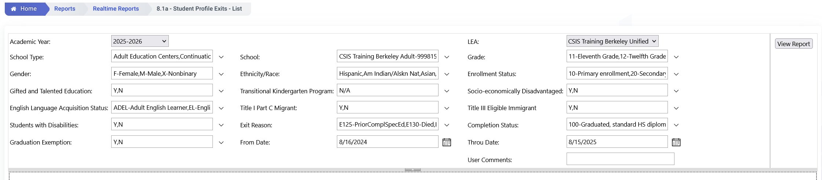
Identifying Student Survey List
LEAs can use CALPADS to assist in identifying these students:
  Step 1: Find students who completed secondary education in 2024-2025
    Use Realtime Report 8.1a
    Apply the following filters:
    Academic Year: 2025-2026
    Enrollment Status: 10, 30
    Grades: 12 and 11
    Exit Reason Code: E230
    School Completion Status = 100, 120, 250, 320, 330, or 360
    From Date 8/16 of Prior Year to 8/15 of Current Year
Notes:
On screen is a detailed visual of the filtering of ODS Report 8.1a to determine students who require a PSTS file reported to CALPADS.
So again we are filtering for the academic year prior to current, in our case 2023-24. Then we have the grade level, which should be filtered for 11 and 12. Then, filter for enrollment status 10 and 30, Exit Reason Code E230 and the completion statuses listed on the bottom of the slide: 100, 120, 250, 320, 330, or 360.
The last two fields are key to generating your list. Filter for your completion period from and through dates, for the 23-24 AY normally tracked from 8/16/22 to 8/15/23.

Slide 46
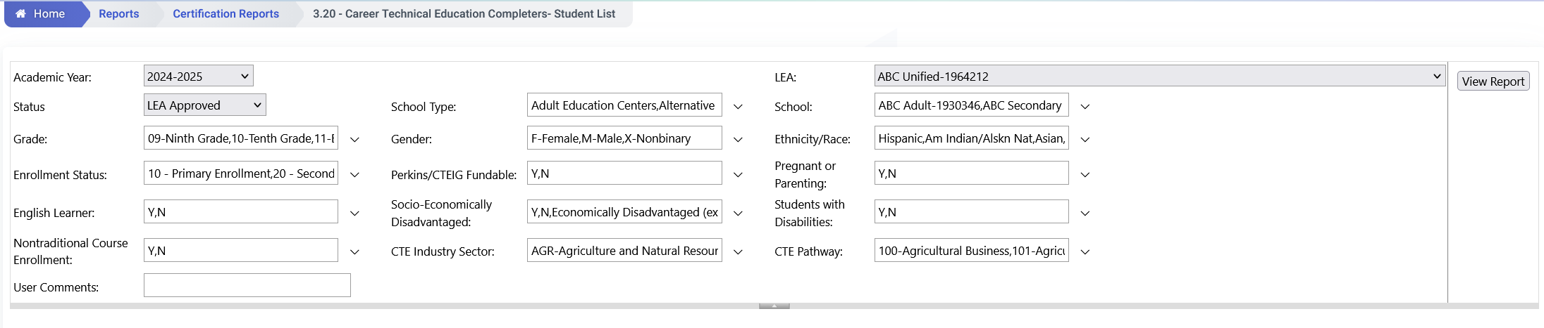
Identifying Student Survey List
  Step 2: Find students who were identified as CTE Completers in any grades 9-12
    Run Certification Report 3.20 - Career Technical Education Completers- Student List, and filter as follows:
      Academic Year: 2024-25;
      Grade: 12
      Perkins/CTEIG Fundable: All
    Run Certification Report 3.20 - Career Technical Education Completers- Student List multiple times, and filter as follows:
      Academic Year: 2023-24; 2022-23
      Grade: 11; 10
      Perkins/CTEIG Fundable: All
    Make sure to change the Academic Year and Grade filters using these pairings:
      AY 2023-24 & Grade 11; AY 2022-23 & Grade 10
Notes:
Once you’ve determined your high school completers, you will need to determine which of them are also CTE completers. You do this first by running report 3.20 – Career Technical Education Completers – Student List. When generating this report, filter for AY2023-2024, grade 12, and Perkins/CTEIG fundable Y,N (all).
Report 3.20 filtered as such, will provide a list of 12th graders who completed a CTE pathway in their senior year. You’ll then want to run report 3.20 a second time, filtering for AY2022-2023 and grade 11 to determine your graduates who completed a CTE pathway in their Junior year. Then, run report 3.20 a third time, filtering for AY2021-2021 and grade 10 to determine your graduates who completed a CTE pathway in their sophomore year.
This will tell provide a list of all cohort graduates that completed a CTE pathway, and will thus need to be surveyed.

Slide 47
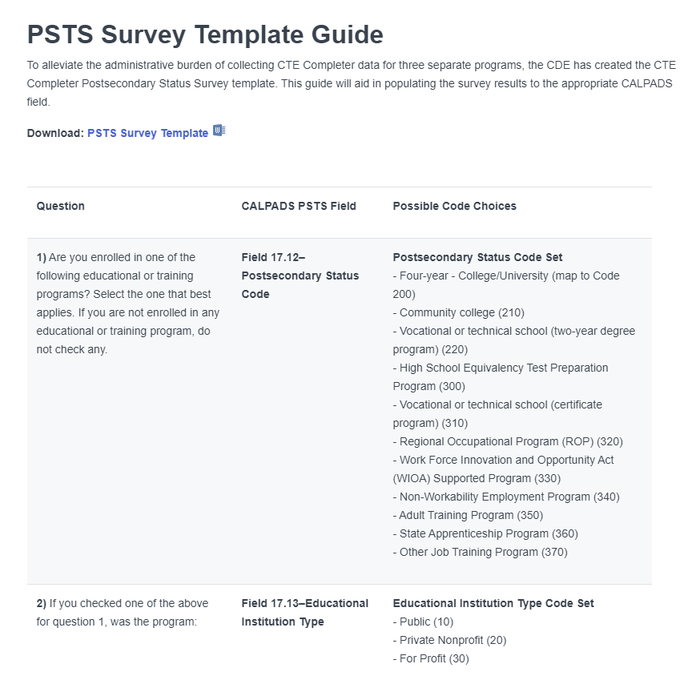
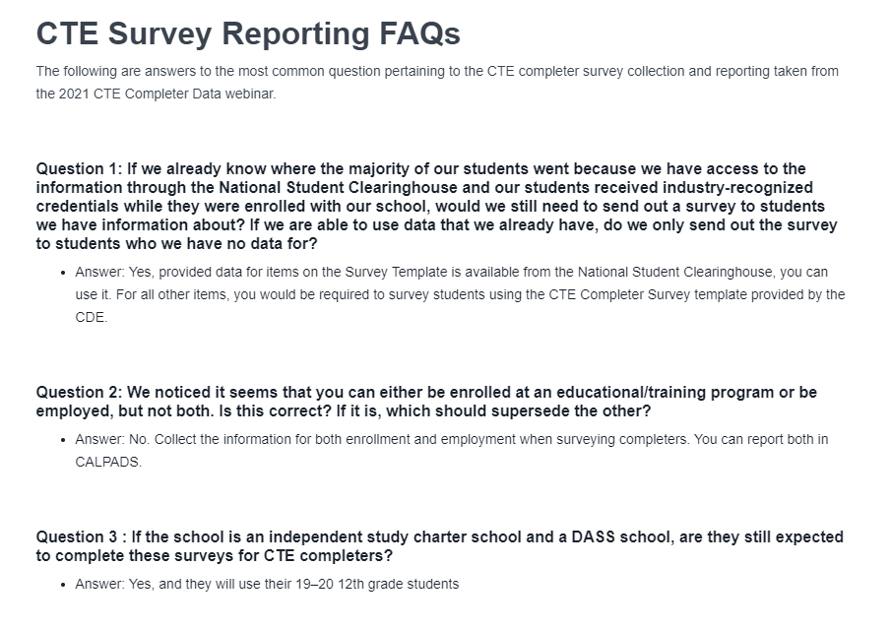
Survey Template and more
Please refer to the User Manual PSTS page for additional references
Notes:
The PSTS survey template can be downloaded from the PSTS page of the user manual.
https://documentation.calpads.org/OnlineMaintenance/StudentDataMaintenance/StudentDetailsPSTS/#postsecondary-status-psts

Slide 48

How to Submit Fall 2 PSTS Records
Batch Upload
One or more student records
Enter data in SIS or Excel; then upload extract using CALPADS portal
Fall 2 PSTS CTE completer data will come from SIS
Online Maintenance
Ability to add, modify, delete PSTS records online in the student detail section

Slide 49

Certification Process
Discuss Errors, Reports and more
Notes:
Now, for the main event. Let’s talk about the steps required to certify the Fall 2 data submission

Slide 50
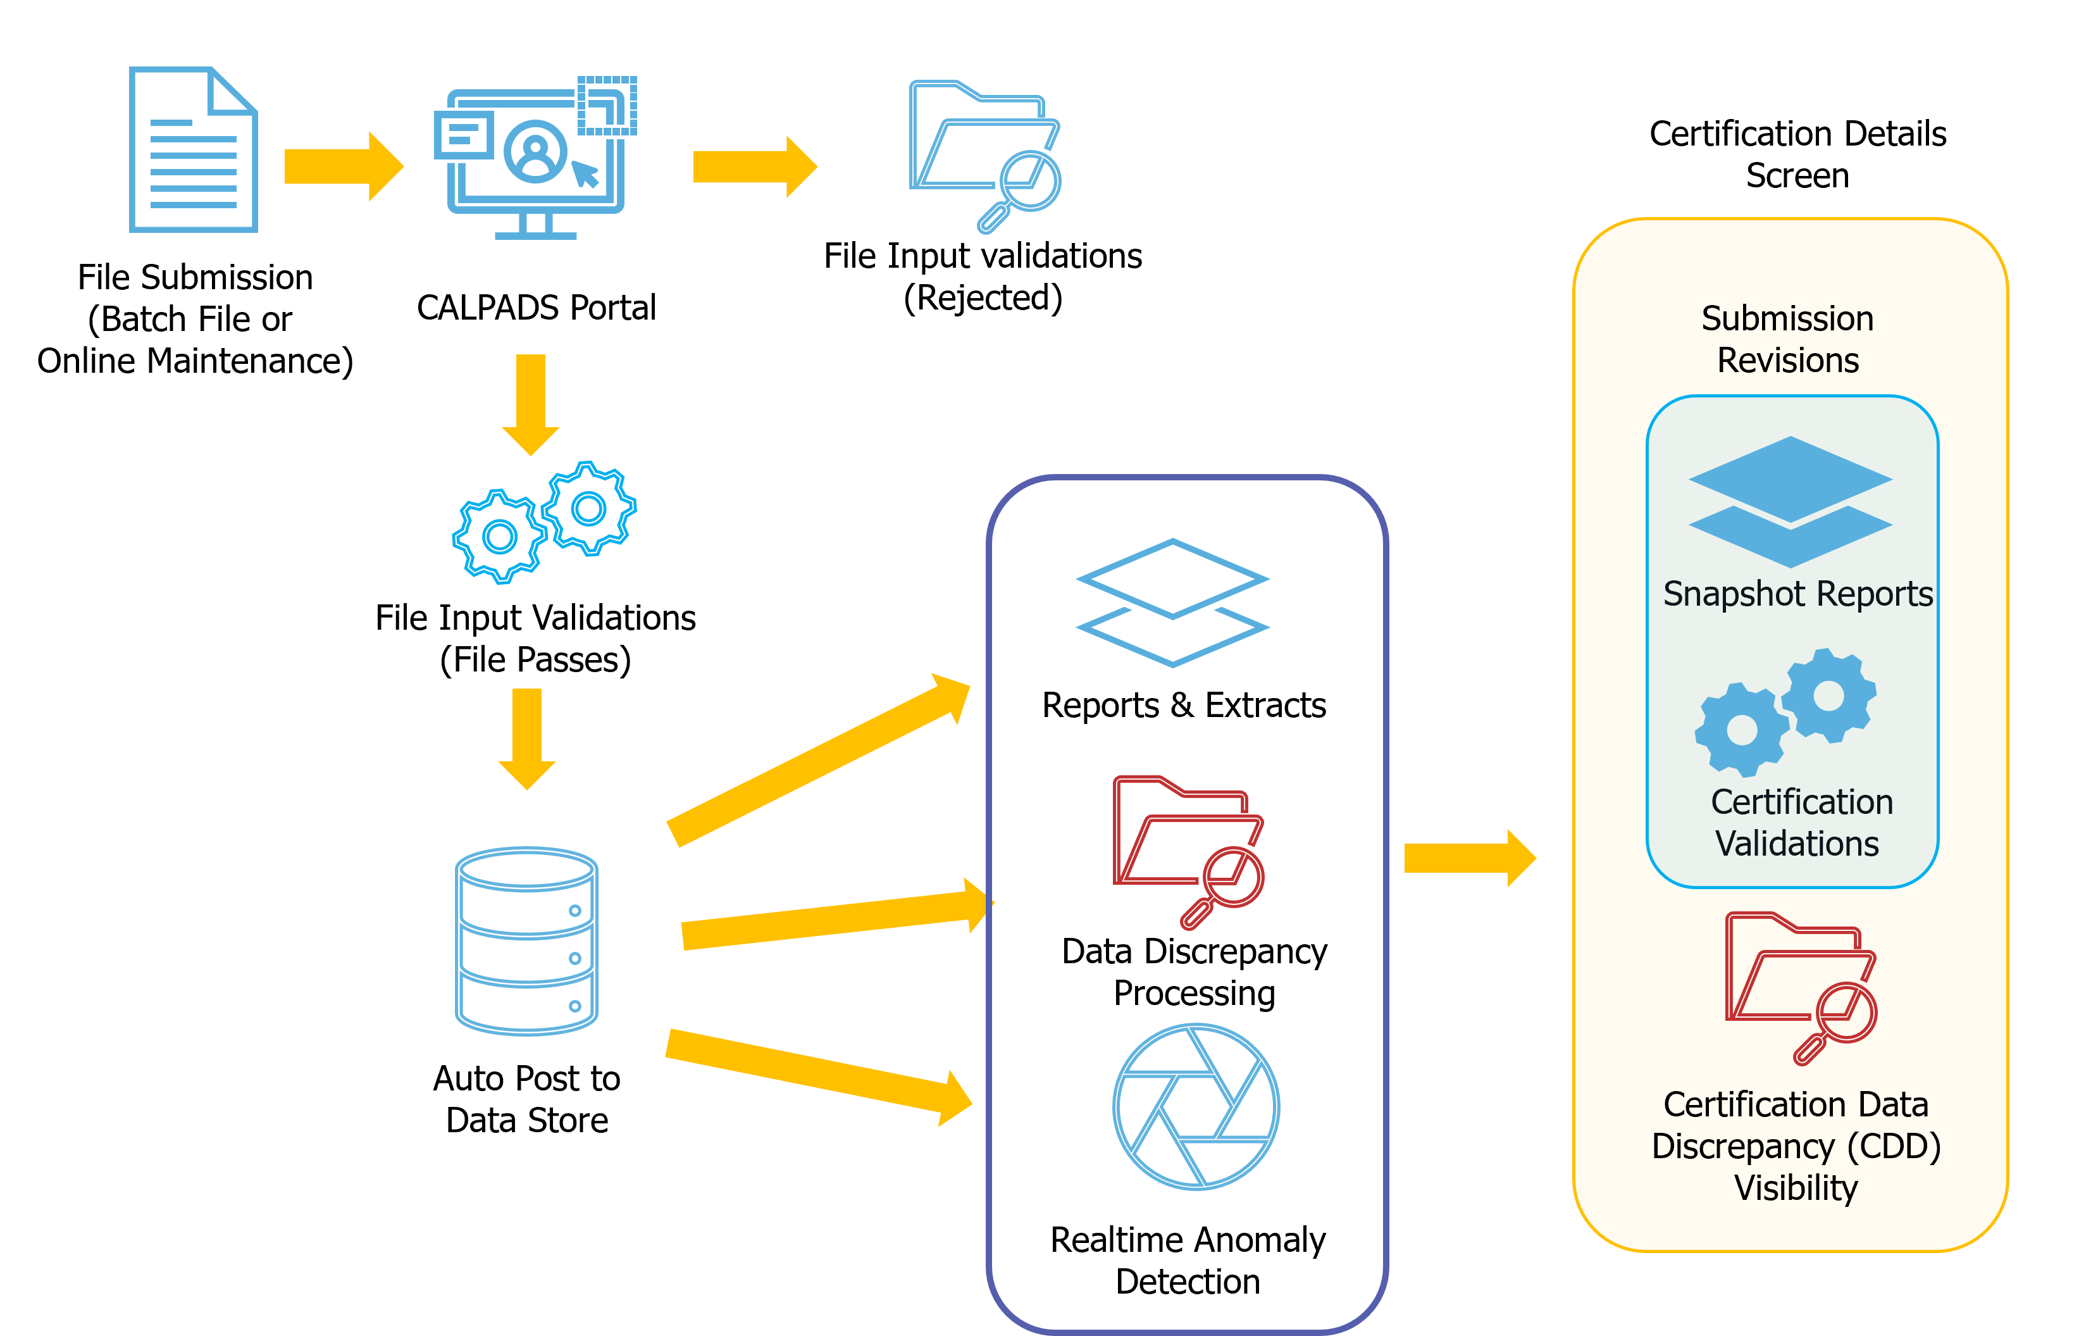


Post- File Submission Work and Certification
Correct CDDs, CERT Errors and any report discrepancies
LEA Approval/ Certification
Notes:
The LEA data coordinators certification workflow remains the same as always. The LEA will:
Submit student records and resolve validation errors
After the submission is complete the LEA will resolve CDDS and CERT errors
Sometimes, CDDS take longer than usual to clear from the snapshot revisions. A faster way to see if the CDDs corrections cleared is by looking at the Data Discrepancies errors for Fall 2.
Once all certification errors are resolved the LEA will disseminate reports for review
After the reports have been reviewed, the LEA can certify by clicking on the LEA Approve button.
A revision can only be certified with an LEA approval.

Slide 51
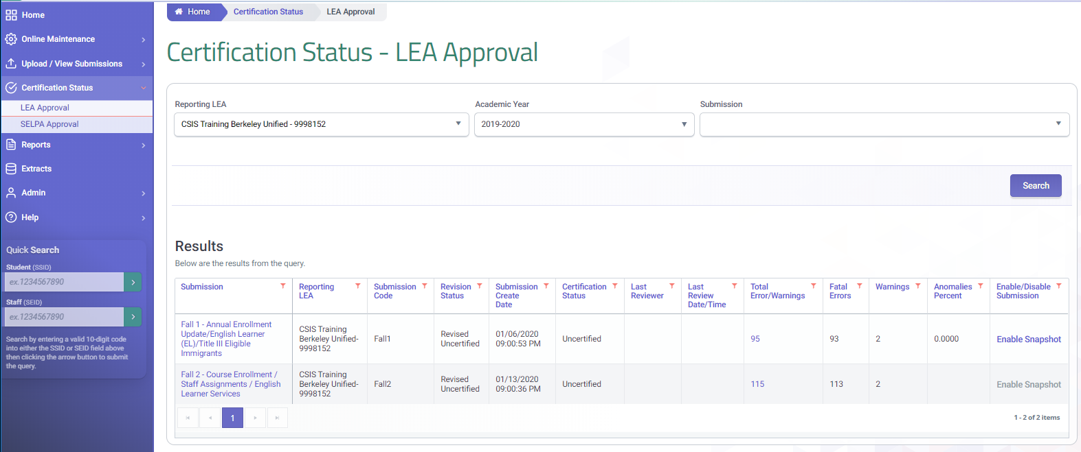
Fall 2 Certification Status
Access the Fall 2 certification details by selecting the submission link
Review the Fall 2 errors by selecting the linked number
2
A
B
A
B

Slide 52
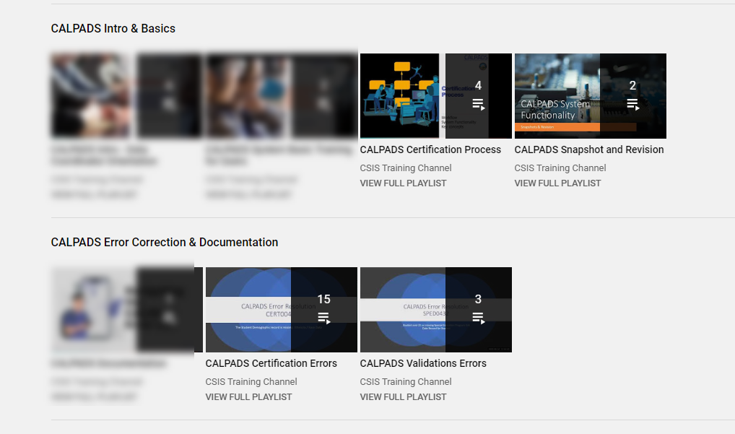
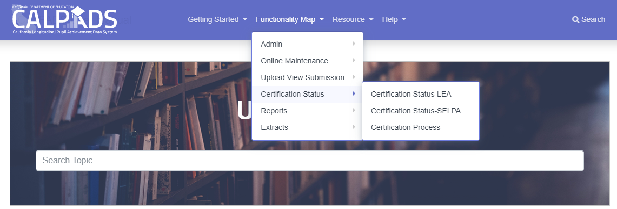
Error Resolution and
Snapshot Revision Resources
YouTube Channel
1
2
3
4
User Manual

Slide 53
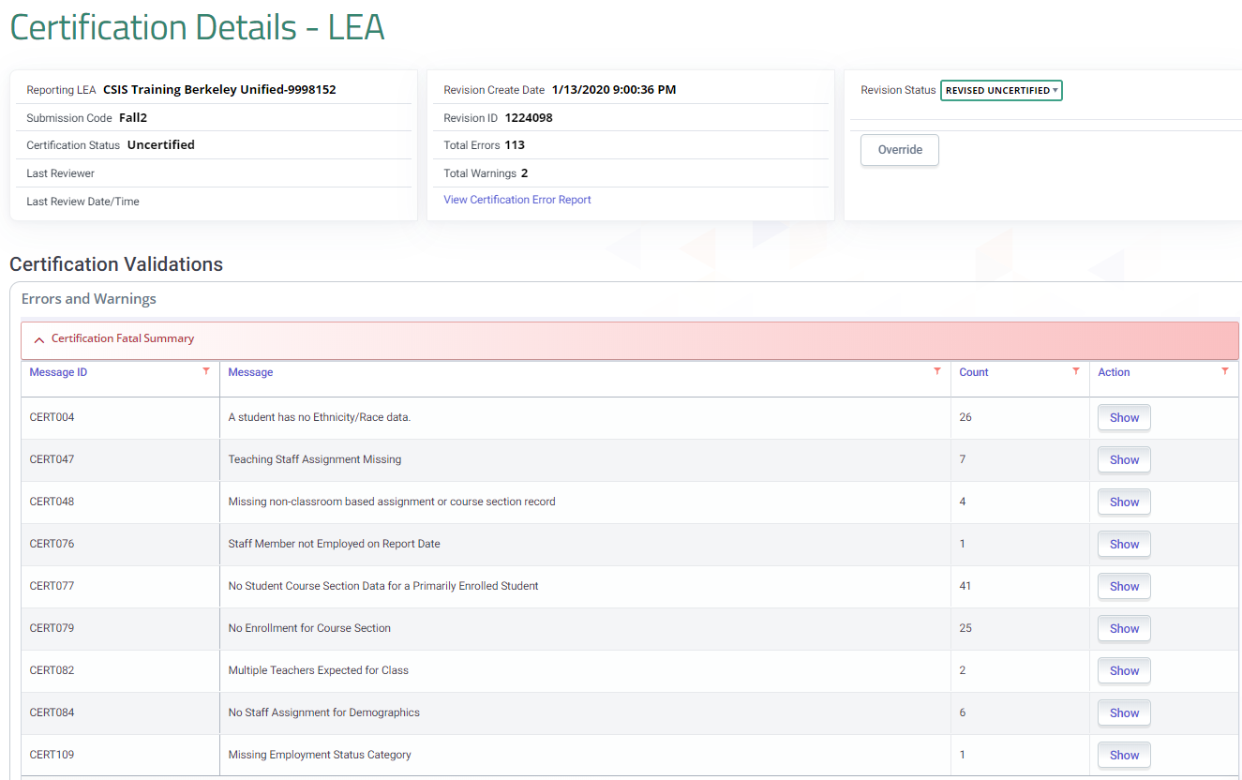
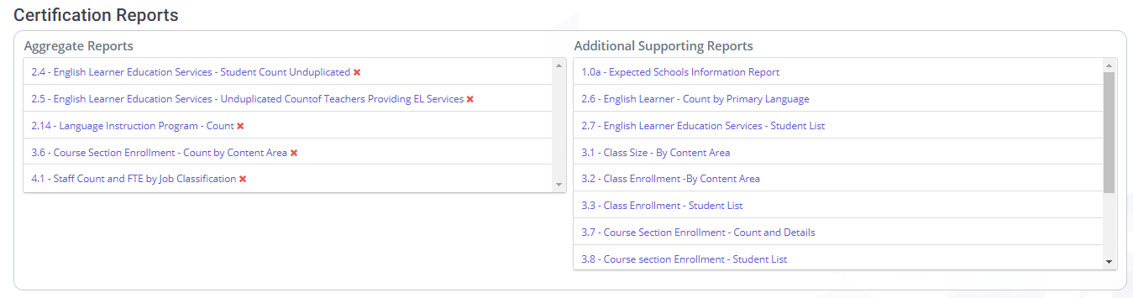
Certification Steps
3
Error Resolution
Resolve all F errors and Ws
Review Reports
All aggregate reports must be reviewed. The data can be verified by reviewing the supporting reports for student level detail
1
Revision Status
Revisions can be marked IN Review to preserve a set of reports for certification or comparison
2
4
4
Approve Revision
When all requirements have been met and the LEA has given affirmation, the approve button appears. Revisions can only be approved after checking the box affirming the accuracy of reports
Notes:
Certification Process
Recheck that all F and Ws certification errors have been resolved:
Click on the Fall 2 Snapshot link to get to the Certification reports.
All 4 aggregate reports must be reviewed. It is the LEA’s responsibility to verify the data on the 4 F2 aggregate reports are an accurate representation of your LEA’s demographics.
You may also review the supporting reports as a way to double check accuracy of the aggregate reports.
For large LEAs or those who prefer to focus on static errors and reports, the system provides an option to mark the current revision as “In Review”. Applying this mark will preserve the revision for ongoing review.
Typically, a LEA would use this feature near the end of their certification process as they get closer to having accurate reports. Once you send the reports out for review by your data stewards, you may want that revision to be saved while the reports are being verified.

Slide 54
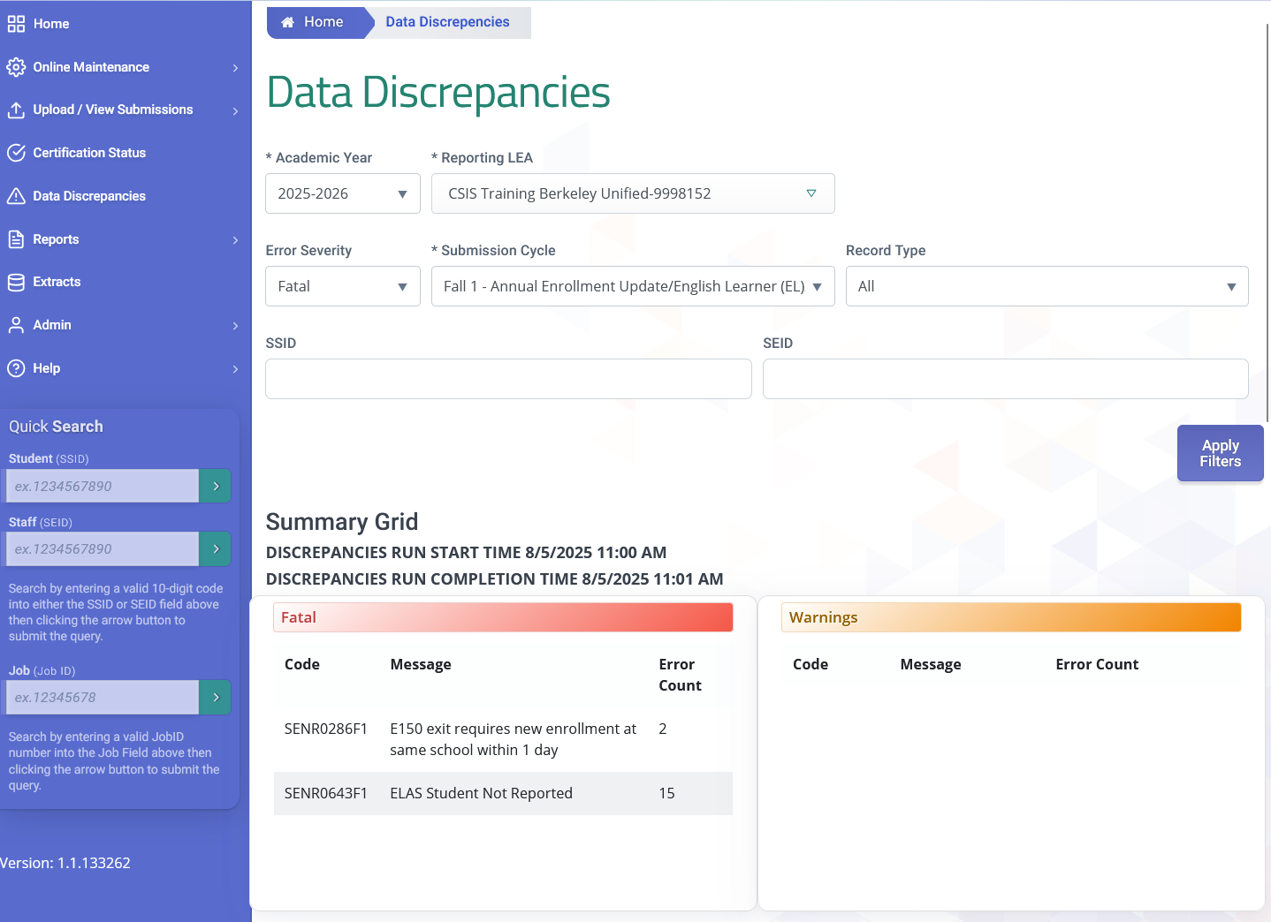
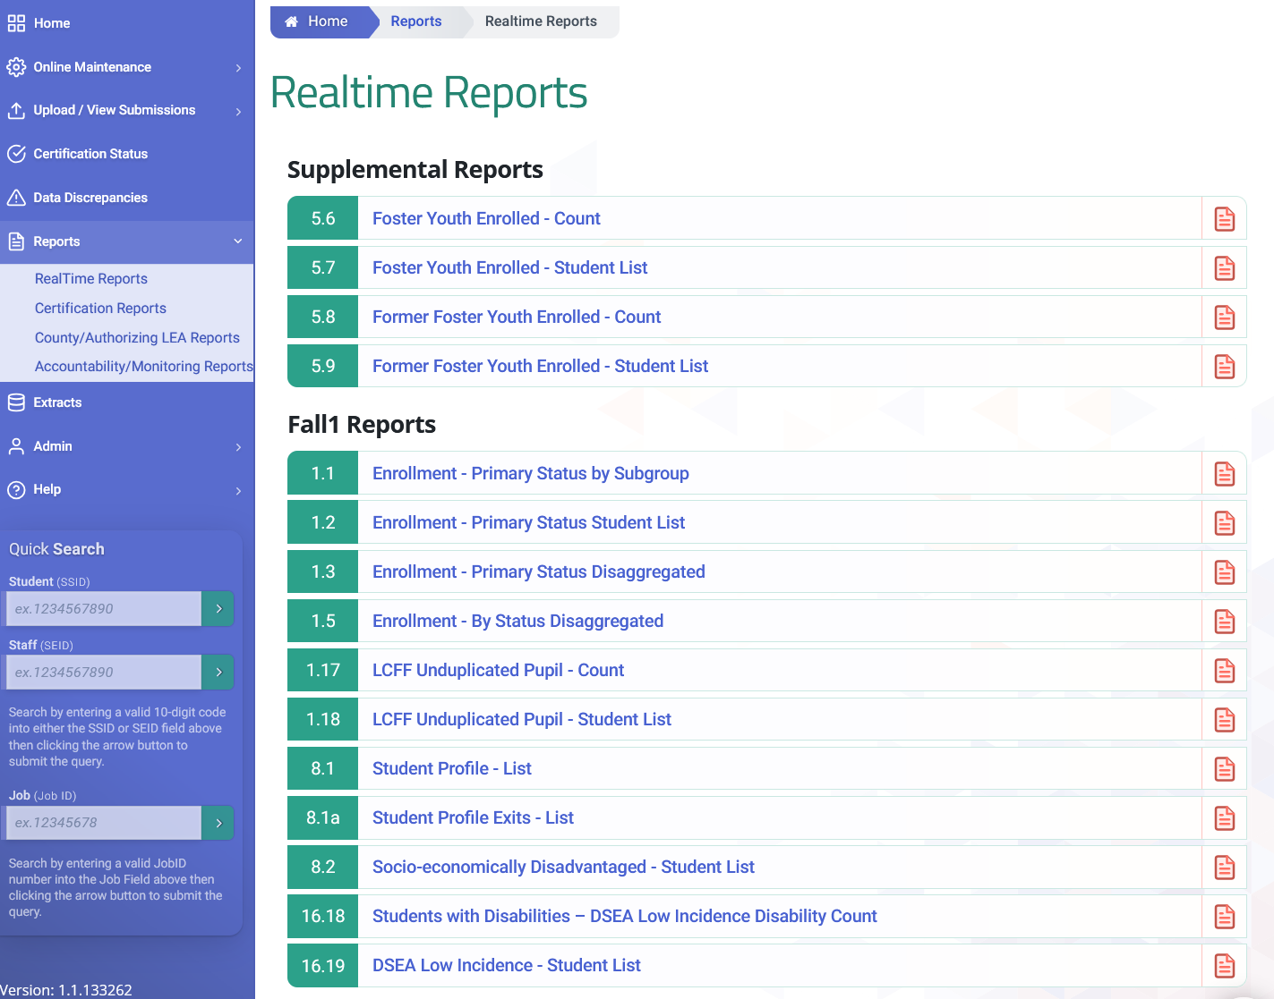
Data Discrepancies Correction and Real Time Reports
LEAs can clear data discrepancies and review reports in advance of the activation of snapshot revisions on December 15.

Slide 55
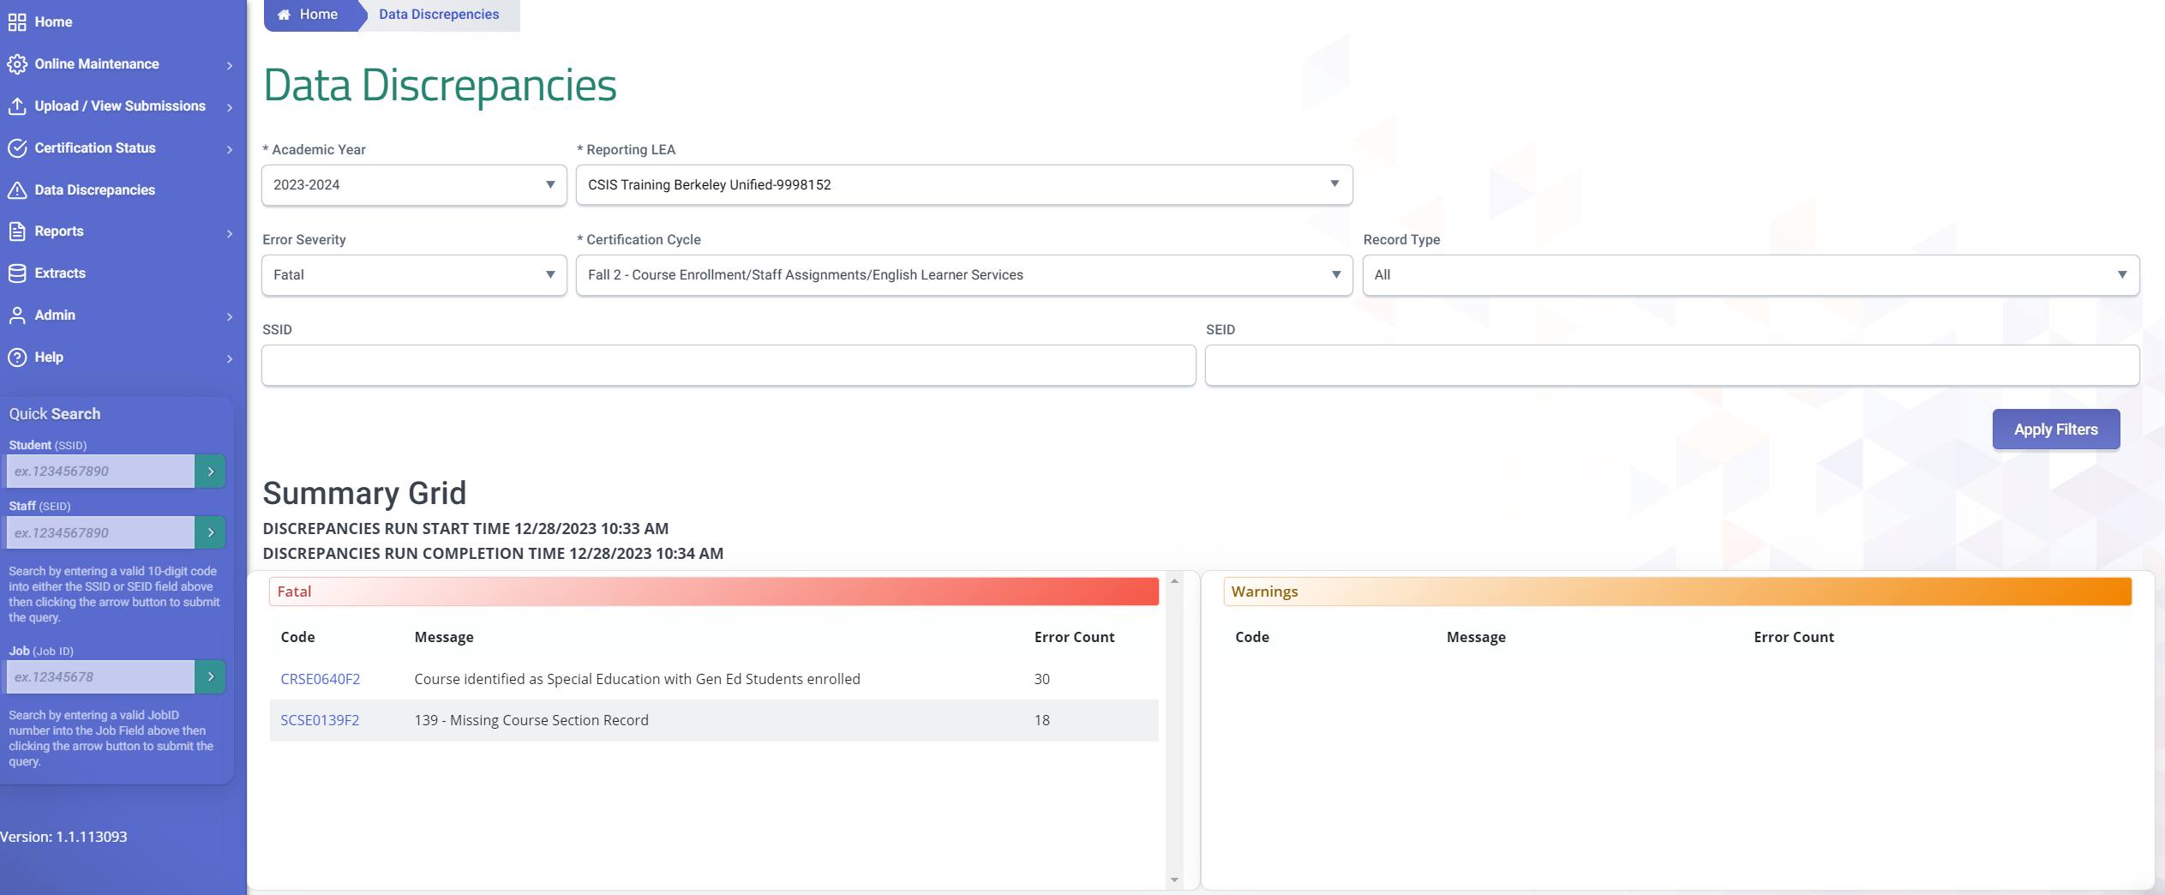
Data Discrepancies Dashboard
LEAs should take advantage of the CALPADS Data Discrepancies Dashboard to anticipate and correct potential CDDs without waiting for a new snapshot revision. DD refresh is quicker than the snapshot revision refresh
Video Tutorial Resource https://documentation.calpads.org/DataDiscrepancies/DataDiscrepancies/

Slide 56
Cert Errors
Error # | Error Name | Error Description | Severity
CERT046 | Staff FTE > 200% or <5% | The sum of Staff FTE for all Job Classifications for an individual staff member in the LEA is either more than 200% or less than 5%. | Fatal
CERT075 | Teacher not Employed on Report Date | A teacher with a course section assignment was not employed for the Report Period. | Fatal
CERT076 | Staff Member not Employed during the Report Period | A staff member with a non-classroom/support assignment was not employed for the Report Period. | Fatal

Slide 57
Cert Errors
Error # | Error Name | Severity
CRSE0274F2 | More than one Education Service Code submitted for the same Course Section | Fatal
SENR0453F2 | Invalid Combination of Parent/Guardian1 First Name, Last Name and Highest Education Level fields. | Fatal
CRSE0639F2 | More than one Class ID submitted for the same Course Section ID | Fatal
CRSE0640F2 | Course identified as Special Education with Gen Ed Students enrolled | Fatal
CRSE0683F2 | Teaching Staff Assignment Missing | Fatal
CRSE0686F2 | No Enrollment for Course Section | Fatal
CRSE0688F2 | Multiple Teachers Expected for Class | Fatal
CRSE0692F2 | Multiple Teacher Code Missing | Fatal
PSTS0480F2 | CTE student must have exited SENR record | Fatal
PSTS0482F2 | Invalid Postsecondary Status Code 950 or 960 | Fatal
PSTS0694F2 | CTE PSTS student must have previous a SCTE record | Fatal
SASS0121F2 | Missing Staff Demographic Record | Fatal
SASS0582F2 | SEID cannot have simultaneous records with Job Classifications of 10 and 25 | Fatal
SASS0583F2 | SEID cannot have simultaneous records with Job Classifications of 12 and 26 | Fatal
SASS0691F2 | Missing Employment Status Category | Fatal
SASS0695F2 | SASS record does not have an SDEM record with Dates for the same Reporting Period. | Fatal
SCSE0139F2 | Missing Course Section Record | Fatal
SCSE0681F2 | Student Course Section for SSID Not Enrolled on Census Day | Fatal
SDEM0684F2 | Missing non-classroom based assignment or course section record | Fatal
SDEM0689F2 | No Staff Assignment for Demographics | Fatal
SENR0635F2 | Invalid Combination of Parent/Guardian2 First Name and Last Name. | Fatal
SENR0641F2 | No Student Course Section Data for a Primarily Enrolled Student | Fatal
SENR0661F2 | Invalid Student Race Missing Indicator and Student Race Code Combination | Fatal
SENR0693F2 | No Student Course Section Data for a Non-SWD Student Primarily Enrolled at the District Level | Fatal
SENR0716F2 | Invalid Student Ethnicity Missing Indicator and Student Hispanic Ethnicity Indicator | Fatal
SENR0717F2 | Missing overlapping SINF record | Fatal

Slide 58
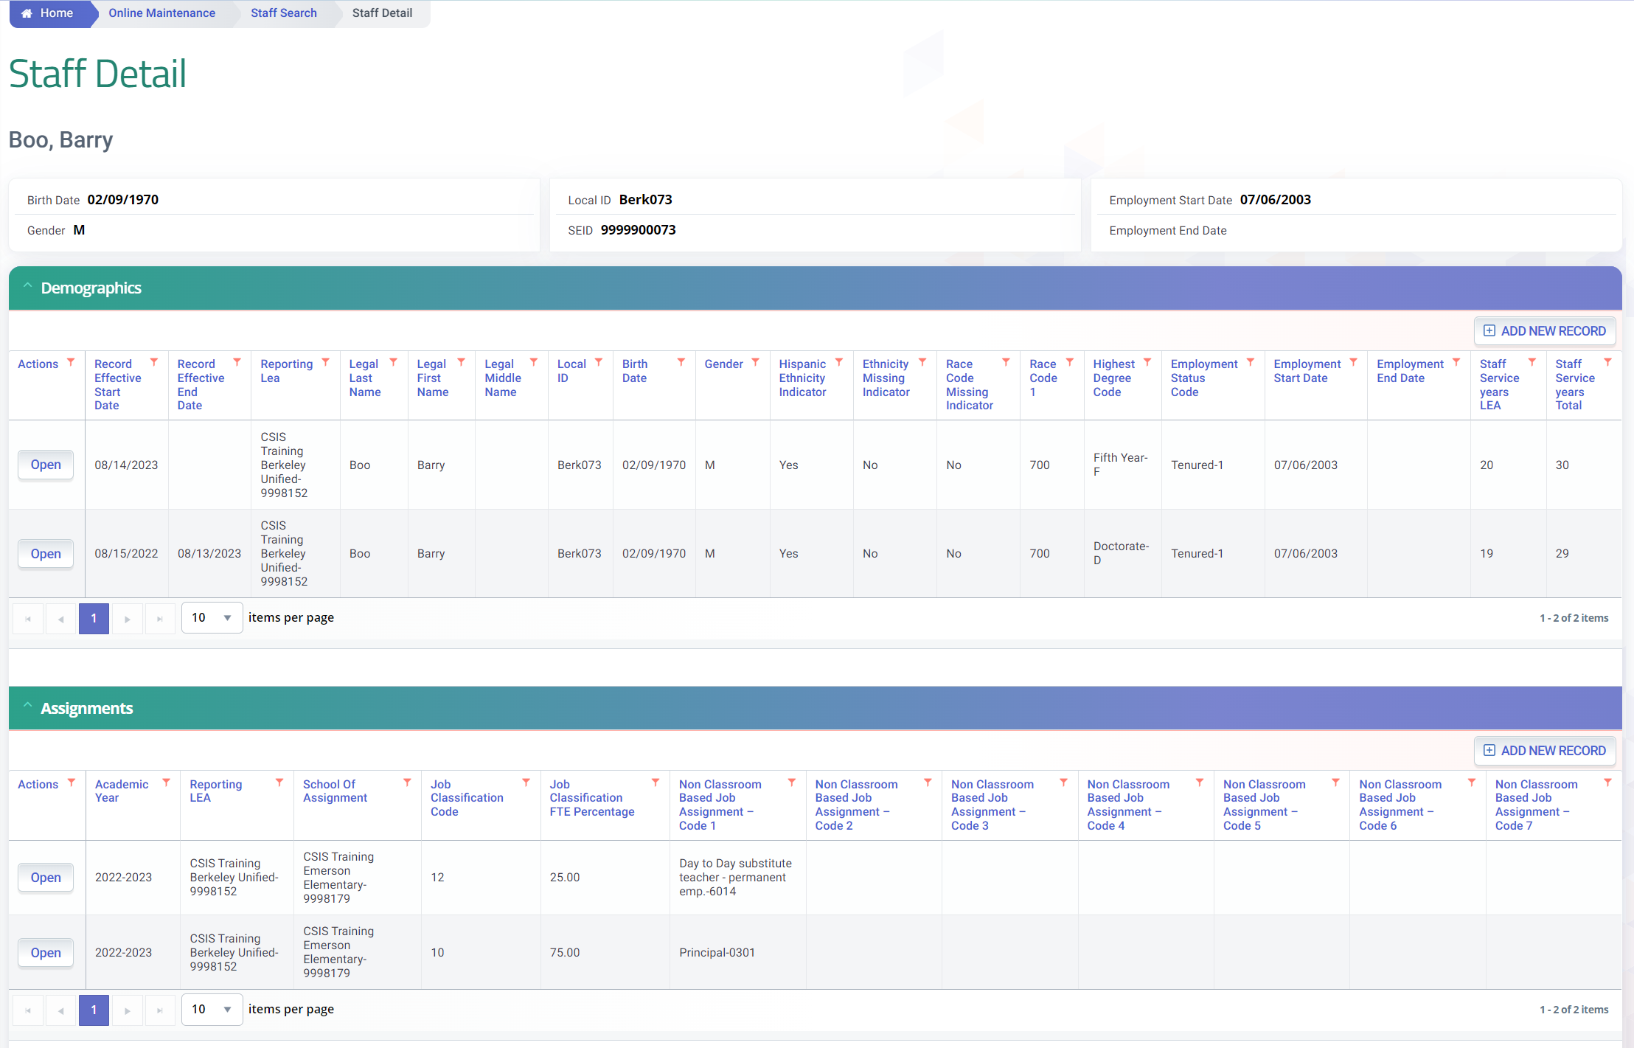
SENR0661F2 - No Staff Assignment for Demographics
Staff No longer employed or Staff on Leave scenarios
Cause of Error
A staff has an active SDEM record overlapping Census day. But no Staff assignment record were reported for the current academic year
1
Solution:
1. If Staff is no longer employed, enter the employment end date in the SDEM record
2. If staff is employed, submit a SASS record for the current academic year representing their job assignment
2
Notes:
The CERT084 often triggers on staff who have left the LEA and the demographic record has not been properly closed. If the demographic record’s staff employment period overlaps census day then a staff assignment is required. Closing a demographic record requires the end date to be populated. Resolving the CERt084 may require the end date to be populated prior to census day or adding a staff assignment if the staff member was employed.

Slide 59
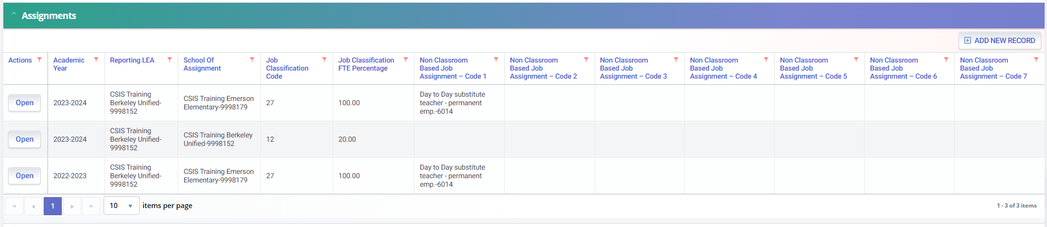
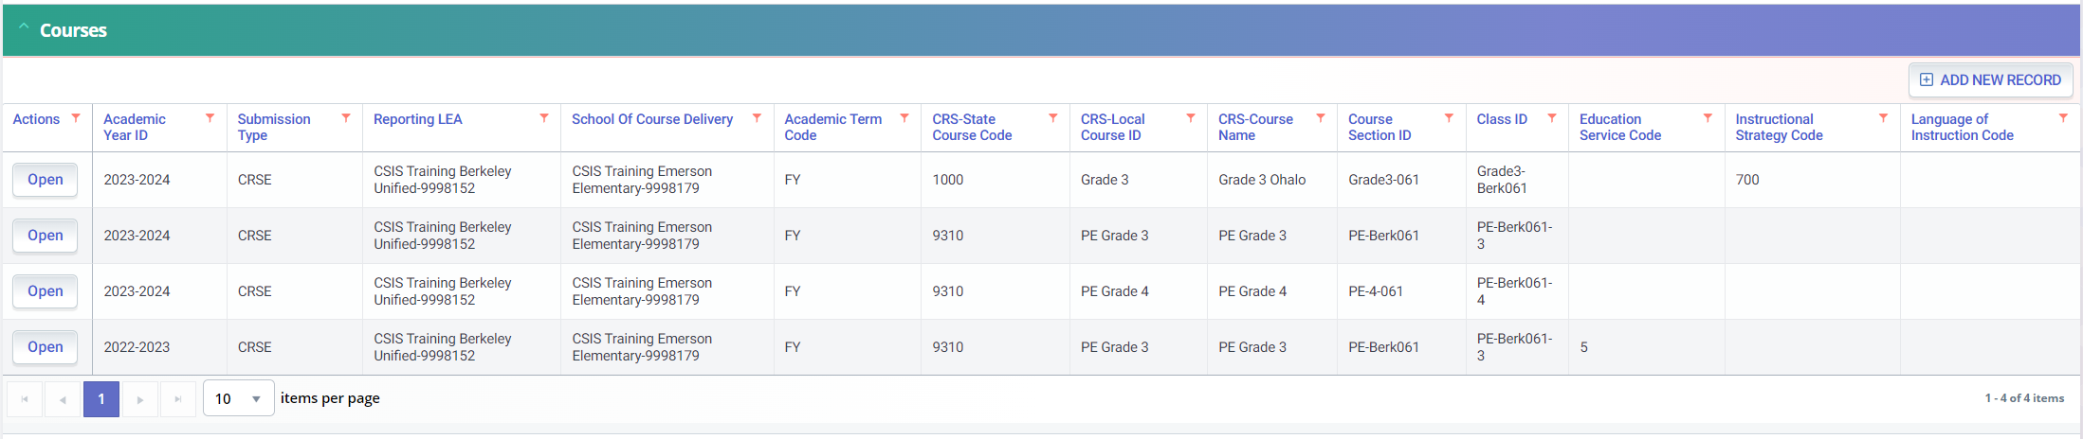
SDEM0684F2 - Missing non-classroom based assignment or course section record
2
1
Cause of Error
A staff was assigned a Teaching Job classification(12, 26, 27) but:
1) No CRSE record was reported to reflect assignment to a course OR
2) No Non-classroom based job assignments
Notes:
The CERT048 triggers most often on itinerant staff. CALPADS knows that staff members are teacher because a SASS record with a teaching job classification code has been submitted.
12 – teacher
27 - Itinerant teacher
26 – non certificated teacher
A teaching assignment is the course record with the teacher SIED. The CERT048 triggers when the teacher has no course, this frequent error among teachers not on the master schedule like itinerant teachers.

Slide 60
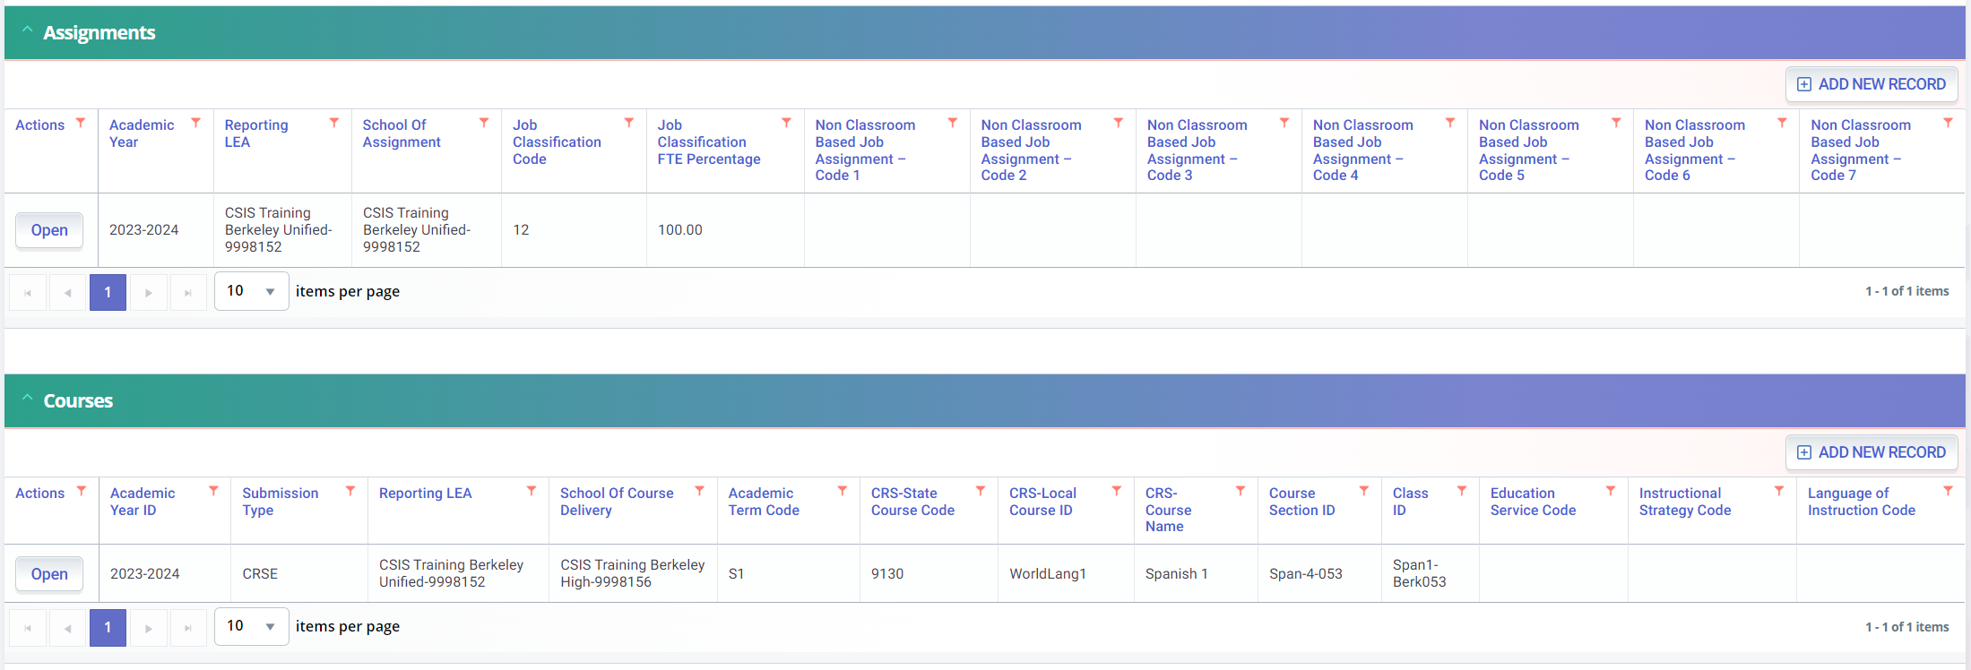
CRSE0683F2 - Teaching Staff Assignment Missing
Cause of Error
A staff member’s SEID was assigned to a course record CRSE in the current academic year at a specific school at the LEA but no Teaching Staff Assignment (12, 26, 27) was reported at said school

Slide 61
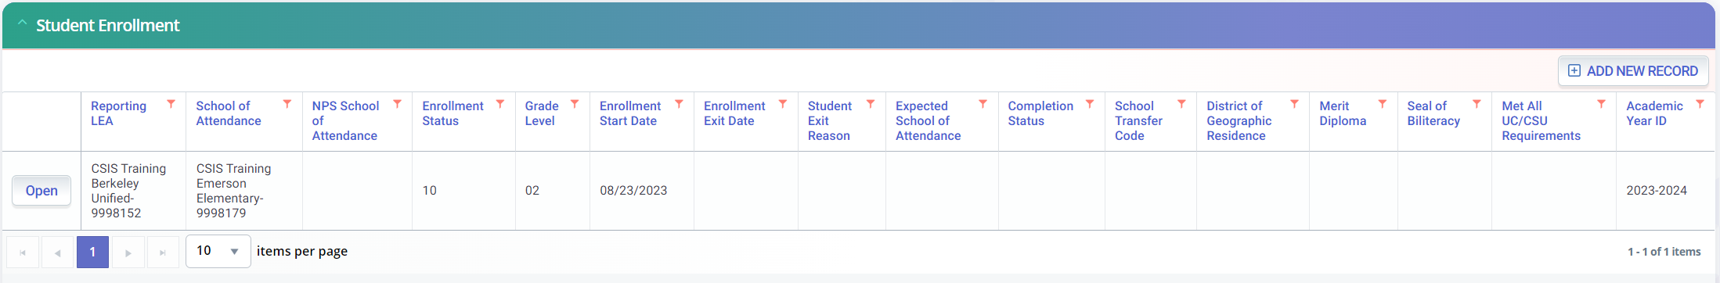
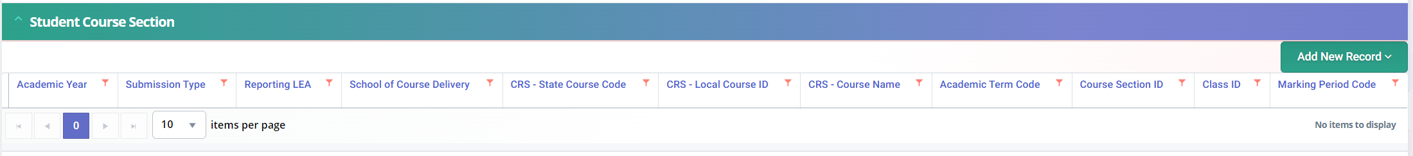
SCSE0641F2 - No Student Course Section Data for a Primarily Enrolled Student (SCSE)
Cause of Error
A student reported as Primary enrolled in CALPADS on census day (SENR) but no SCSE records were reported for current academic year

Slide 62
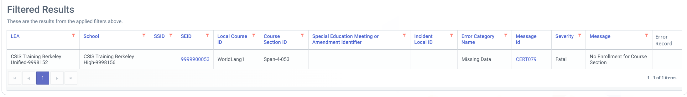
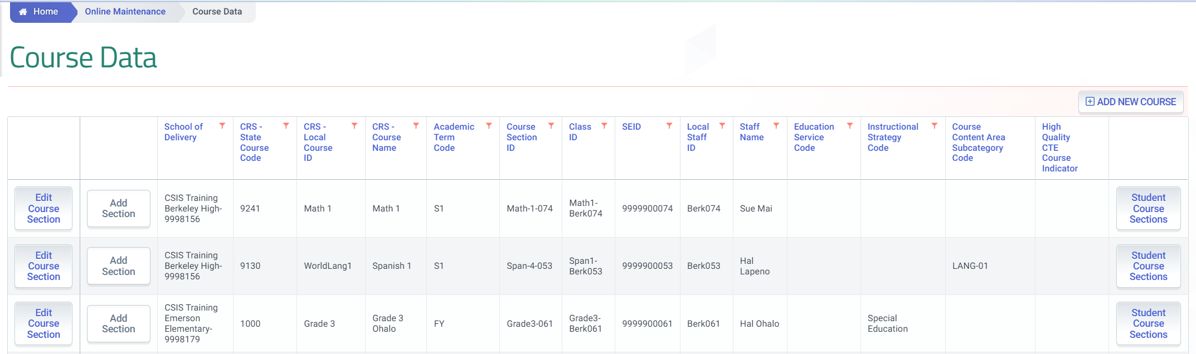
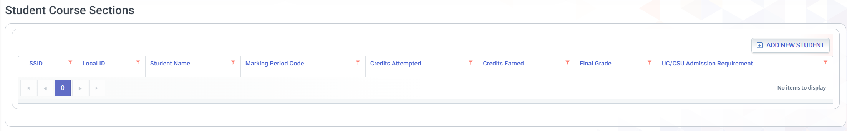
CRSE0686F2 - No Enrollment for Course Section
Cause of Error
No SCSE record was submitted for a Course Section record that a staff member is assigned to

Slide 63
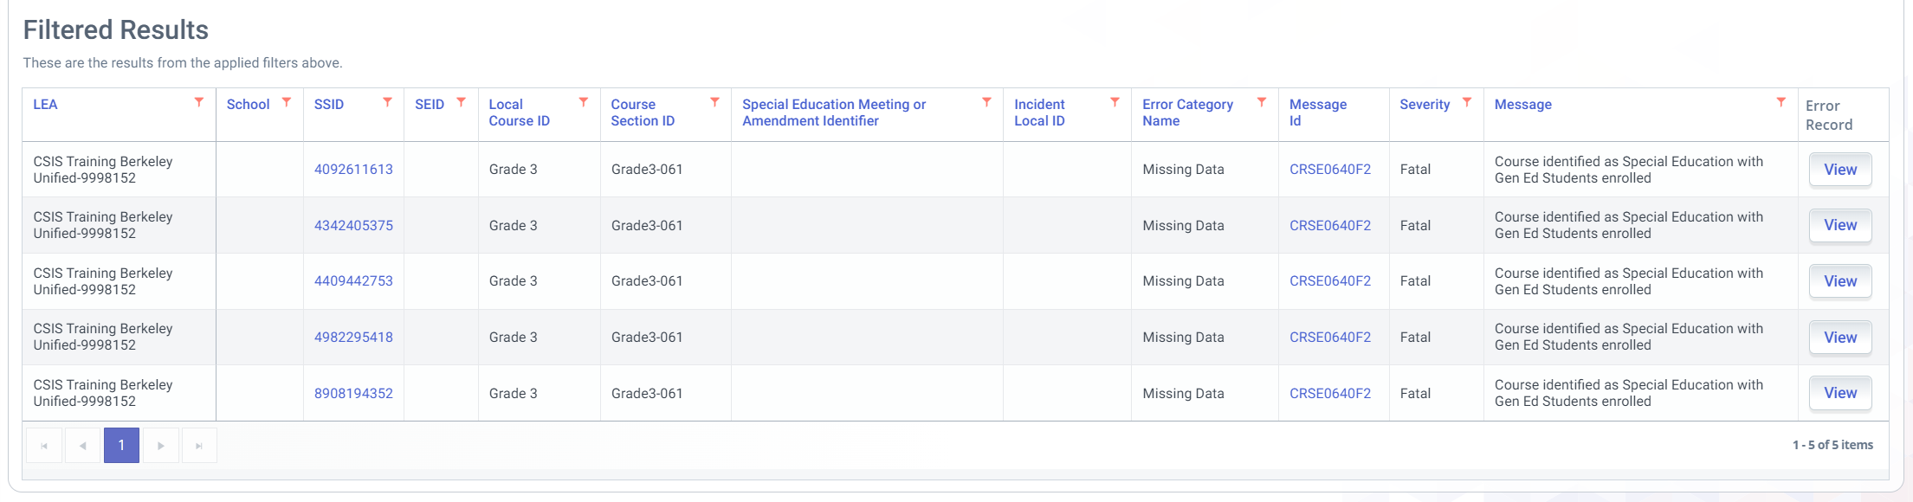
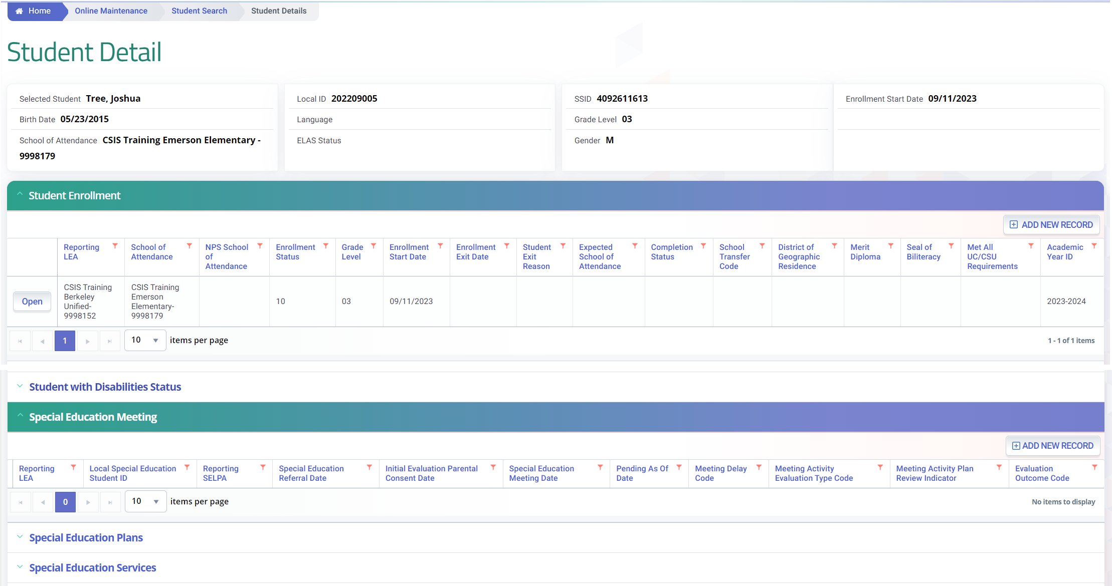
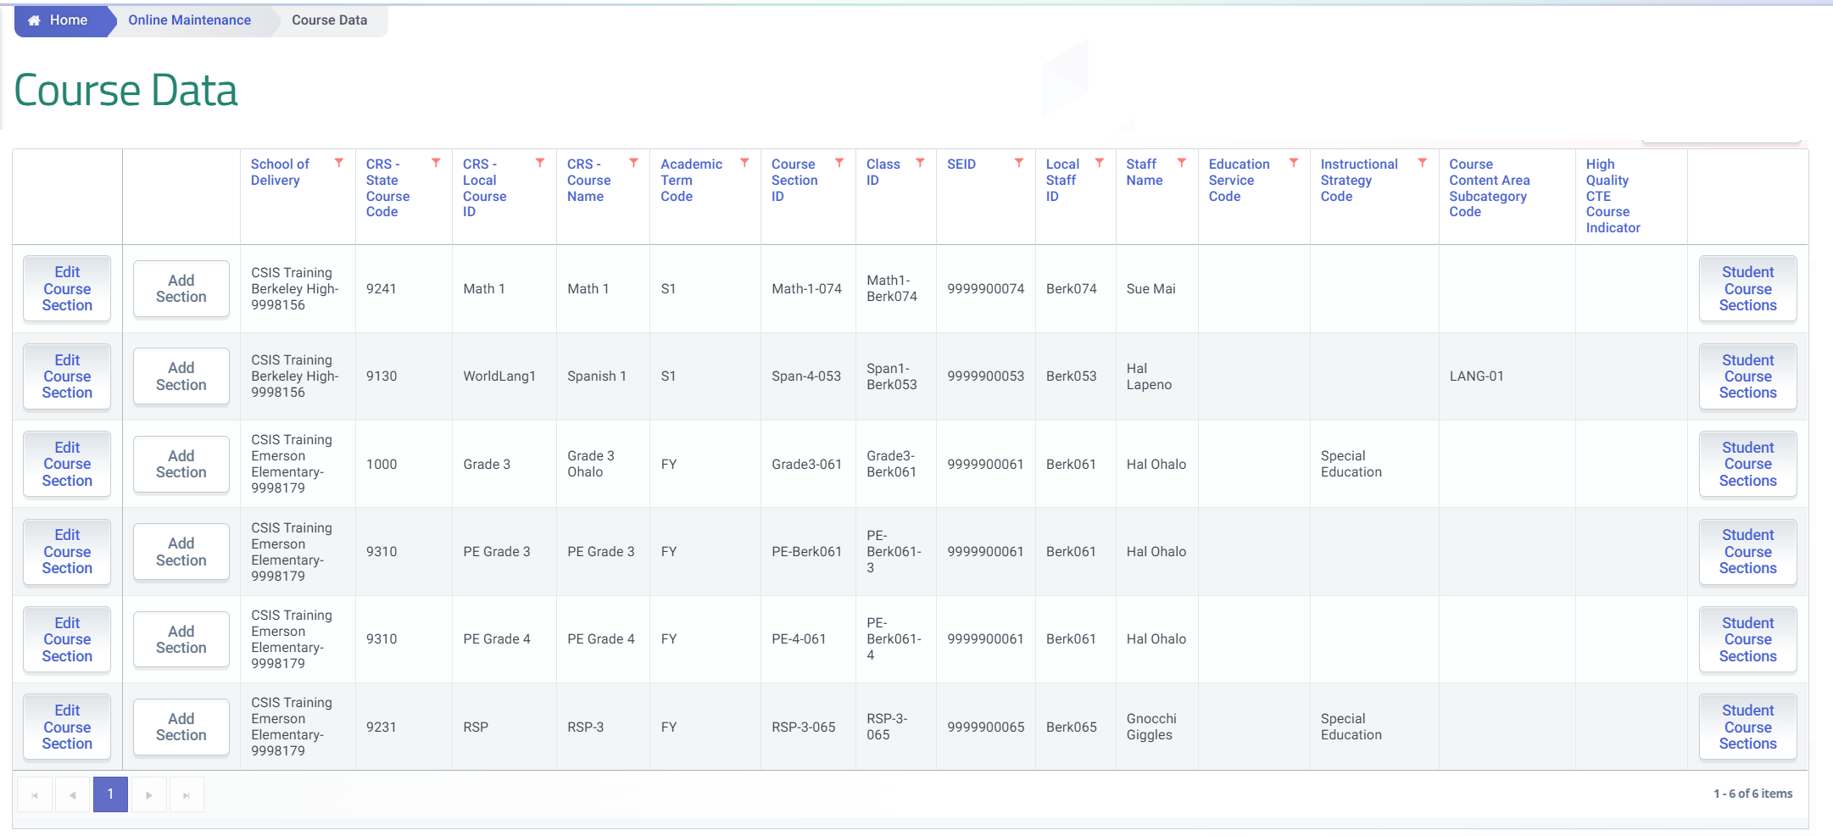
CRSE0640F2
Cause of Error
A course may only be identified as Special Education course (700) if all students enrolled, have a MEET record identifying them as SPED.
Solution:
Remove the Instructional Strategy code of 700 from the CRSE record if the class is not a designated SPED only class. OR
If the class was indeed a special ed class and the student is missing the MEET record, submit relevant MEET record for students triggering the error.
1
2

Slide 64
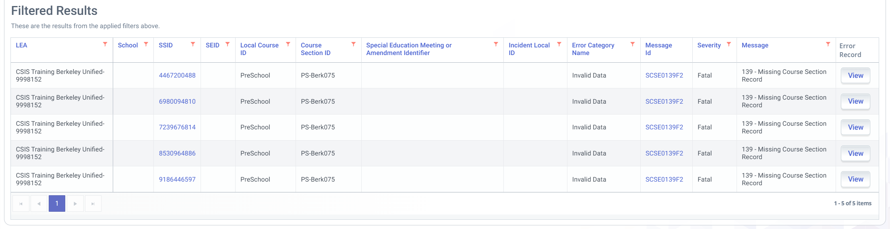
SCSE0139F2
Cause of Error
A course may only be identified as Special Education course (700) if all students enrolled, have a MEET record identifying them as SPED.
Solution:
Ensure the CALPADS ODS has a Course Section record for the submitted SCSE Local Course ID and Course Section ID. OR
If the CRSE record exist with the matching Local Course ID, ensure that the following fields values match between the SCSE and CRSE records:
  10.05 School of Course Delivery
  10.06 Academic Year ID
  10.13 Local Course ID
  10.14 Course Section ID
  10.15 Academic Term Code
1

Slide 65


Fall 2 Reports
Discuss Report Specs and Nuances

Slide 66
Fall 2 Reports
Report 2.4
Report 2.7
EL Education Services Student Count - Unduplicated
EL Education Services Student List
Report 2.5
Report 4.3
Report 4.4
EL Education Services - Unduplicated Count of Teachers Providing EL Services
Staff Teaching Assignments - Detail
Staff Profile - List
Report 3.6
Report 3.7
Report 3.8
Course Section Enrollment - Count by Content Area
Course Section Enrollment - Count and Details
Course section Enrollment - Student List
Report 4.1
Report 4.2
Report 4.4
Staff Count and FTE by Job Classification
Staff Teaching Assignments - Detail
Staff Profile - List
Report 17.1
Report 17.1
Postsecondary Status Outcome - Count
Postsecondary Status Outcome - Student List
66

Slide 67
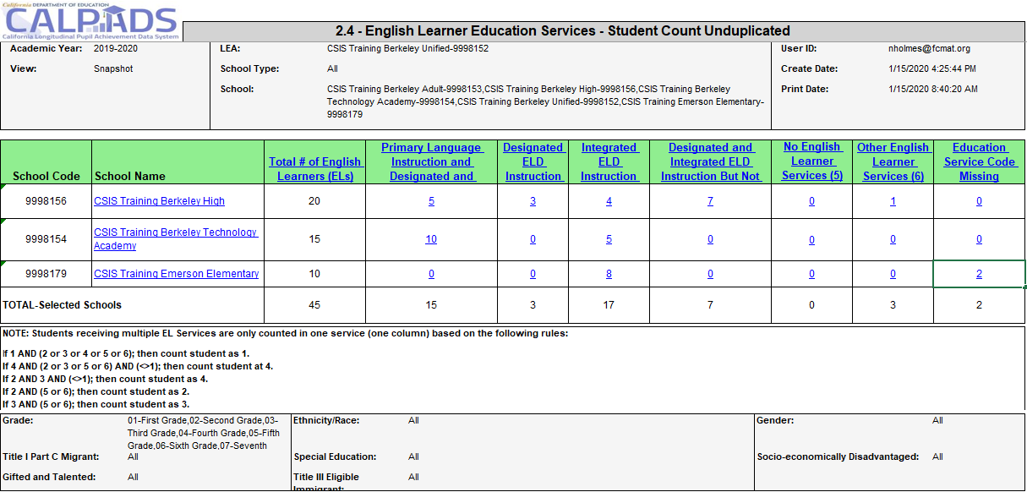
Report 2.4 EL Education Services - Student Count Unduplicated
1
2
3
Notes:
Certification Report 2.4 summarizes the services provided to English Learners. The data is derived from the student English language acquisition status (indicating which students are English Learners), the course-section and student course-section (indicating the courses the students are enrolled in and the services provided in those courses).
1. Total number of EL students enrolled at the school on Census day based on ELAS status.
2. Total number of students receiving EL services from classes. Count is based on hierarchy indicated on 3.
3. If student is receiving multiple types of EL services due to teacher credentials, CALPADS will use the hierarchy rules to identify the EL service student is counted under.
EL students appearing in the Education Service code missing column is generally an indication the CRSE file did not contain which services were provided to an EL student.

Slide 68
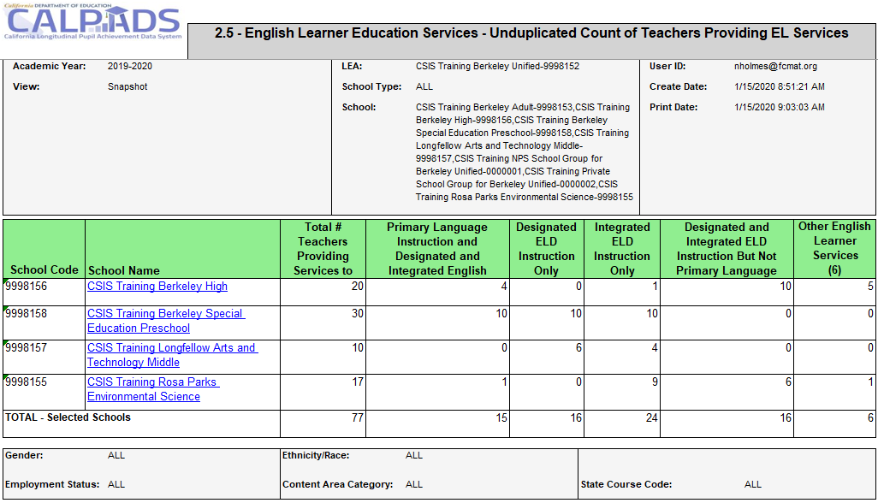
Report 2.5 EL Education Services - Unduplicated count of Teachers
NOTE: Students receiving multiple EL Services are only counted in one service (one column) based on the following rules:
If 1 AND (2 or 3 or 4 or 5 or 6); then count student as 1.
If 4 AND (2 or 3 or 5 or 6) AND (<>1); then count student at 4.
If 2 AND 3 AND (<>1); then count student as 4.
If 2 AND (5 or 6); then count student as 2.
If 3 AND (5 or 6); then count student as 3.
If 5 AND 6; then count student as 6.
Notes:
Certification report 2.5 counts the teachers providing services to English Learners. The EL services code should be based on the teacher’s EL credentials.
This is from the Glossary -An Education Service provided to an English Learner that is delivered through a course section.
Same as previous Hierarchy:
Counting Student English Learner Education Services (EL Services):
If a student is receiving multiple EL Services at a school, the student is counted in only one service.
Calculation Rules:
1) If a student is receiving "Primary Language Instruction" (1) and any
other EL Service, the student is counted as (1).
2) If a student is receiving “ELD Instruction and SDAIE Instruction But
Not Primary Language Instruction" (4) and one or both of 2 and 3
(and not 1), the student is counted as 4.
3) If a student is receiving "ELD Instruction Only" (2) and "SDAIE
Instruction Only" (3) without 1 or 4, the student is counted as 4.
4) If a student is receiving "Other English Learner Services" and none of the services described in codes 1,2,3, or 4, then the student is counted as 6.
5) If a student is receiving "Other English Learner Services" (6) and any of the services in codes 1-4, then follow the applicable calculation rules outlined in bullets 1-3.
6) If a student is receiving "No English Learner Services" (5) and none of the services described in codes 1,2,3,4, or 6, the student is counted as a 5. 7) If a student is receiving "No English Learner Services" (5) and any services described in codes 1, 2, 3, 4, or 6, then follow the applicable rules outlined in bullets 1-5.
If a student is receiving only one EL Service at a school, the student is counted in that service
If a student does not have an Education Service Code reported, the student is included in the "Education Service Code Missing" count.

Slide 69
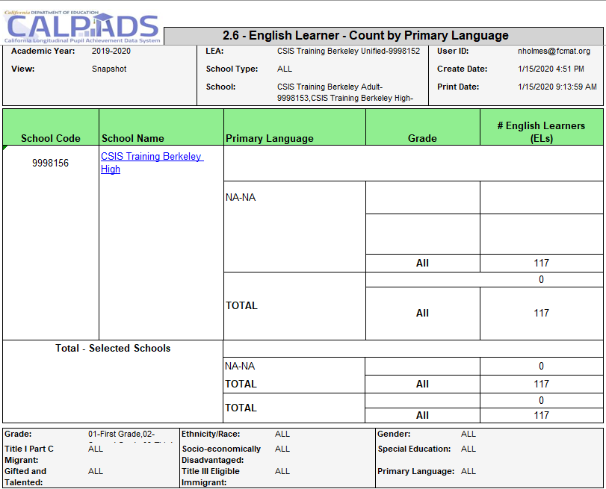
Report 2.6 EL – Count by Primary Language
Notes:
Reports the number of English Learners as of Fall 2 Census Day. The count is reported at the school level by grade level within Primary Home Language. It aggregates school level data to the LEA level.

Slide 70
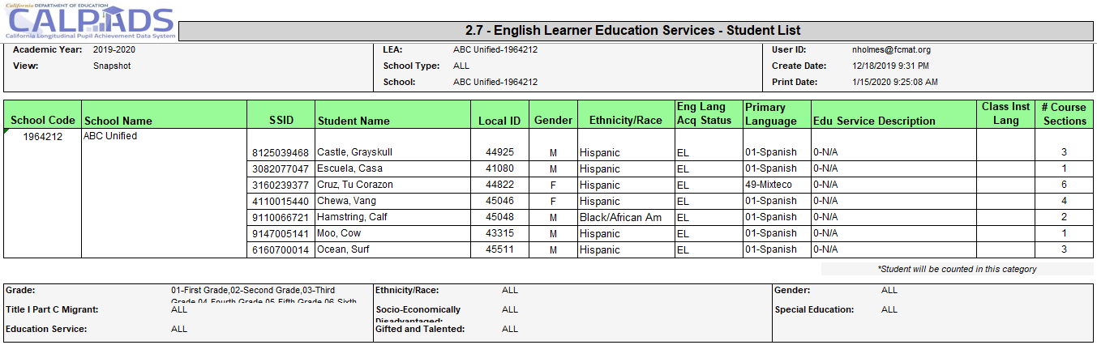
Report 2.7 EL Education Services - Student List
1
2
1
NOTE: Students receiving multiple EL Services are only counted in one service (one column) based on the following rules:
If 1 AND (2 or 3 or 4 or 5 or 6); then count student as 1.
If 4 AND (2 or 3 or 5 or 6) AND (<>1); then count student at 4.
If 2 AND 3 AND (<>1); then count student as 4.
If 2 AND (5 or 6); then count student as 2.
If 3 AND (5 or 6); then count student as 3.
If 5 AND 6; then count student as 6.
2
Count of course sections in which the student is reported to be receiving the service(1-4 and 6) or No services (5). Courses with blank Education service code field are not included.
Notes:
Report 2.7 is the supporting report for 2.4 and list all students receiving services.
Counting Student English Learner Education Services (EL Services):
If a student is receiving multiple EL Services at a school, the student is counted in only one service.
Calculation Rules:
1) If a student is receiving "Primary Language Instruction" (1) and any
other EL Service, the student is counted as (1).
2) If a student is receiving “ELD Instruction and SDAIE Instruction But
Not Primary Language Instruction" (4) and one or both of 2 and 3
(and not 1), the student is counted as 4.
3) If a student is receiving "ELD Instruction Only" (2) and "SDAIE
Instruction Only" (3) without 1 or 4, the student is counted as 4.
4) If a student is receiving "Other English Learner Services" and none of the services described in codes 1,2,3, or 4, then the student is counted as 6.
5) If a student is receiving "Other English Learner Services" (6) and any of the services in codes 1-4, then follow the applicable calculation rules outlined in bullets 1-3.
6) If a student is receiving "No English Learner Services" (5) and none of the services described in codes 1,2,3,4, or 6, the student is counted as a 5. 7) If a student is receiving "No English Learner Services" (5) and any services described in codes 1, 2, 3, 4, or 6, then follow the applicable rules outlined in bullets 1-5.
If a student is receiving only one EL Service at a school, the student is counted in that service
If a student does not have an Education Service Code reported, the student is included in the "Education Service Code Missing" count.

Slide 71
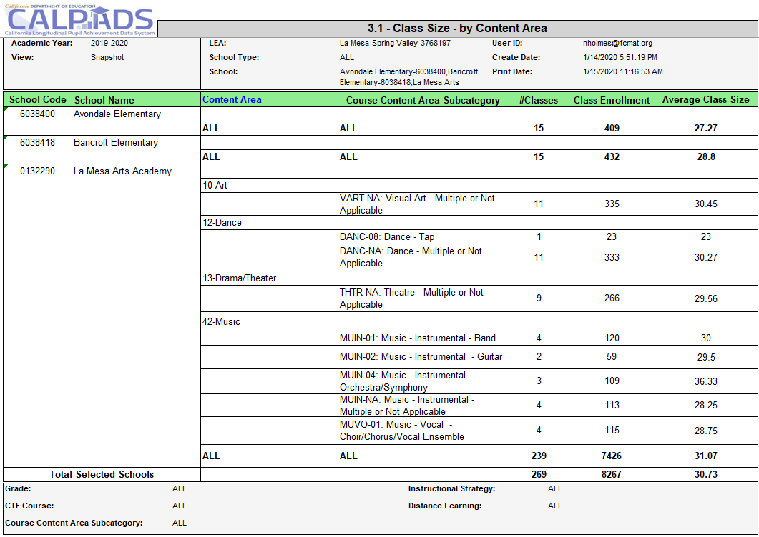
Report 3.1 Class Size– by Content Area
Number of unique Class IDs in Course Section record
Notes:
Reports number of classes, class enrollment and average class size by content area category for each school as of Fall 2 Report Period.

Slide 72
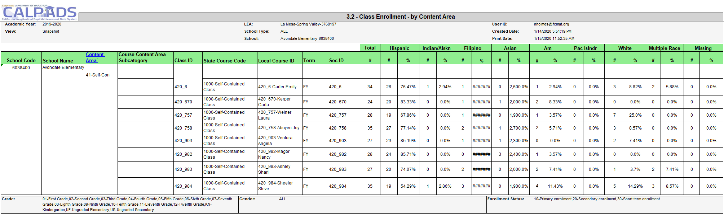
Report 3.2 Class Enrollment – by Content Area
Notes:
Reports class size by content area category as of Fall 2 Report Period. Students are disaggregated into ethnicity/race categories. Count of students in each Class.

Slide 73
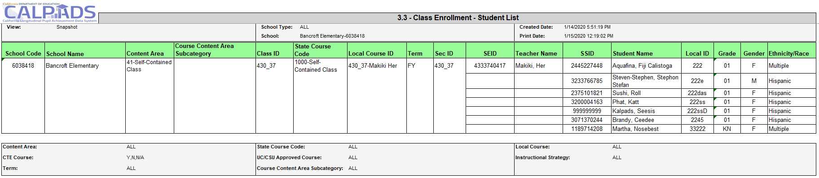
Report 3.3 Class Enrollment – Student List
Student class enrollment listed by class, course section and school
Notes:
Reports list of students, active as of Fall 2 Report Period, in each class by course section and by school

Slide 74
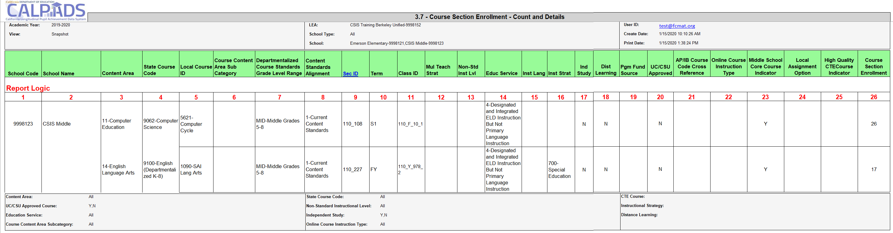
Report 3.7 - Course Section Enrollment – Count and Details
Notes:
Reports the details of local course sections by Content Area and State Course Code as of Fall 2 Report Period. Included are education services, language of instruction, instructional strategy, education program fund source and course section enrollment.

Slide 75

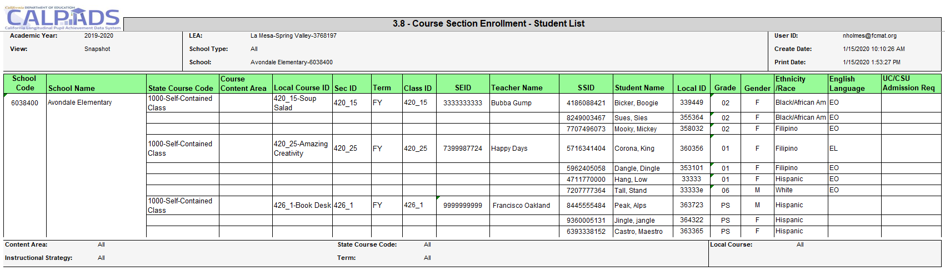
Report 3.8 - Course Section Enrollment – Count by Content Area
Assignment Monitoring
Report
Notes:
Report 3.8 is a supporting report for 3.7. Reports a list of students in each course section and class by school who are active as of the Fall 2 Report Period.
Assignment monitoring Report checklist: https://www.cde.ca.gov/ds/sp/cl/calpadsupdflash201.asp

Slide 76
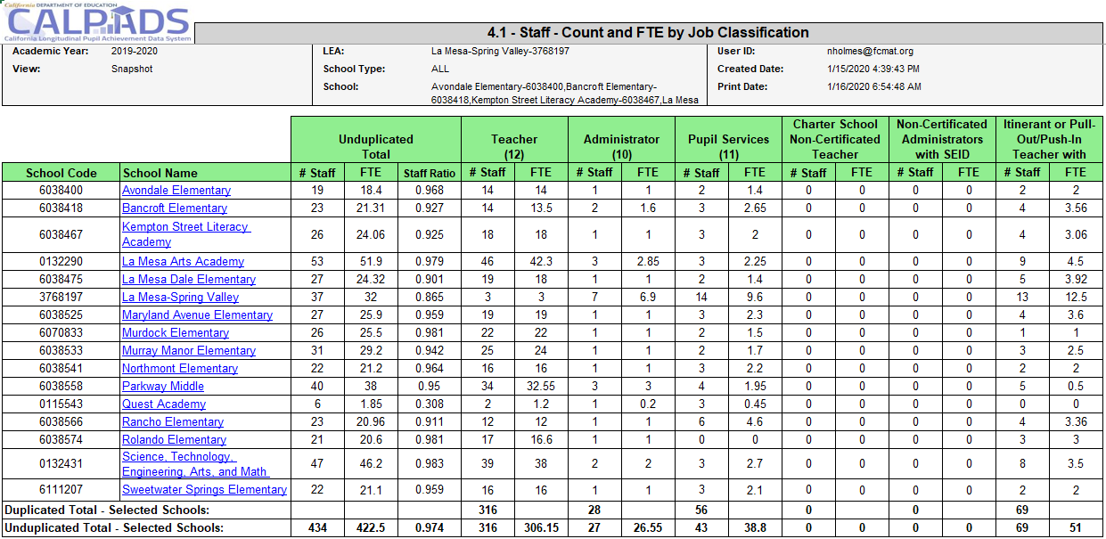
Report 4.1 Staff – Count and FTE by Job Classification
2
1
2
A SEID may have multiple assignments and are counted under each Staff Assignment category reported. Staff on Leave are NOT included.
1
Counts are based on unique SEIDs. SUM of FTE Percentages
Notes:
Report 4.1 reflects the number of staff and total FTE by job classification active for the Fall 2 Report Period. Included are SEIDs employed as of Census Day and, for school tracks that are not in session on Census Day.
Reported is certificated staff in the following job classifications:
1.Administrators
2. Pupil Services
3. Teachers and Itinerant or Pull-out/Push-In Teachers
It also include Non-certificated staff, who have a SEID, in the following job classifications: Non-certificated Administrator and Charter School Non-certificated Teacher
NOTE: For Snapshot only; Non-Classroom based or Support Assignment Codes in fields 1-7 are included EXCEPT for Non-classroom code 6018 (Employee of Leave).

Slide 77
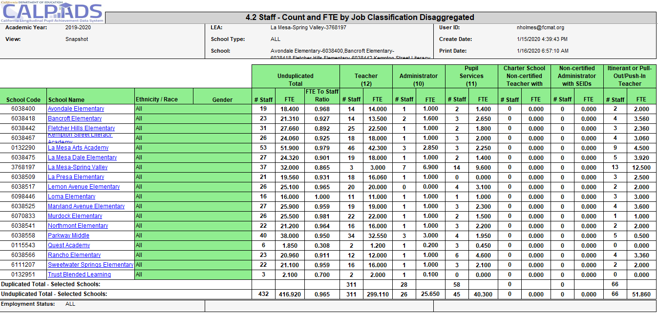
Report 4.2 Staff – Count and FTE by Job Classification Disaggregated
Notes:
Report 4.2 reflects the number of staff and total FTE by job classification active for the Fall 2 Report Period by race and ethnicity. Included are SEIDs employed as of Census Day and, for school tracks that are not in session on Census Day, but within 30 days after Census Day. Reported is certificated staff in the following job classifications: Administrators, Pupil Services, Teachers, and Itinerant or Pull-out/Push-In Teachers as well as non-certificated staff, who have a SEID, in the following job classifications: Non-certificated Administrator and Charter School Non-certificated Teacher.
NOTE: For Snapshot only; Non-Classroom based or Support Assignment Codes in fields 1-7 are included EXCEPT for Non-classroom code 6018 (Employee of Leave).

Slide 78
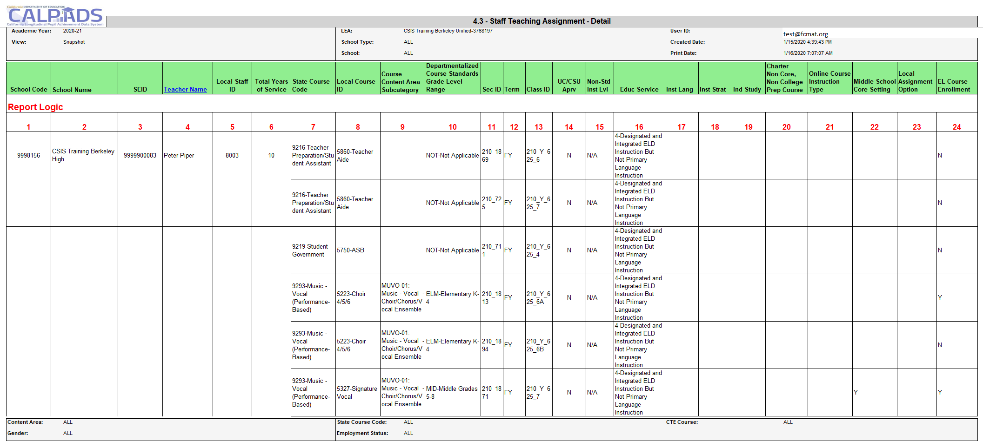
Report 4.3 Staff Teaching Assignment – Detail
Assignment Monitoring
Report
In relation to EL services, Report 4.3 reflects the EL service provided and if there are any EL students enrolled
Notes:
Report 4.3 reflects the teaching assignments for each SEID as of the Fall 2 census day. It reflects each of the staff member’s course, the EL service provided and if there are any EL students enrolled.
This is the report used for assignment monitoring. There are new versions of the report, C/A 4.3 and ODS 4.3 that may help LEAs be more proactive in assignment mapping.
Assignment monitoring Report checklist: https://www.cde.ca.gov/ds/sp/cl/calpadsupdflash201.asp

Slide 79
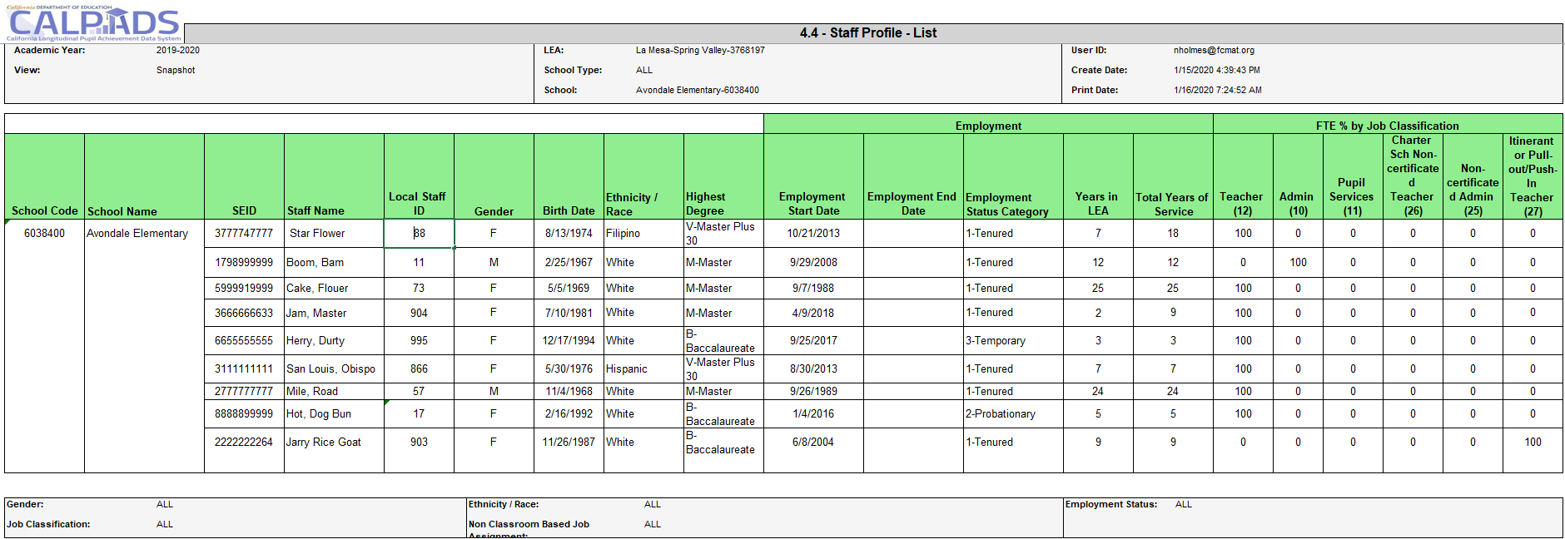
Report 4.4 Staff Profile – List
Notes:
Reports demographics, employment status, and FTE by job classification for each SEID active as of Fall 2 Report Period.

Slide 80
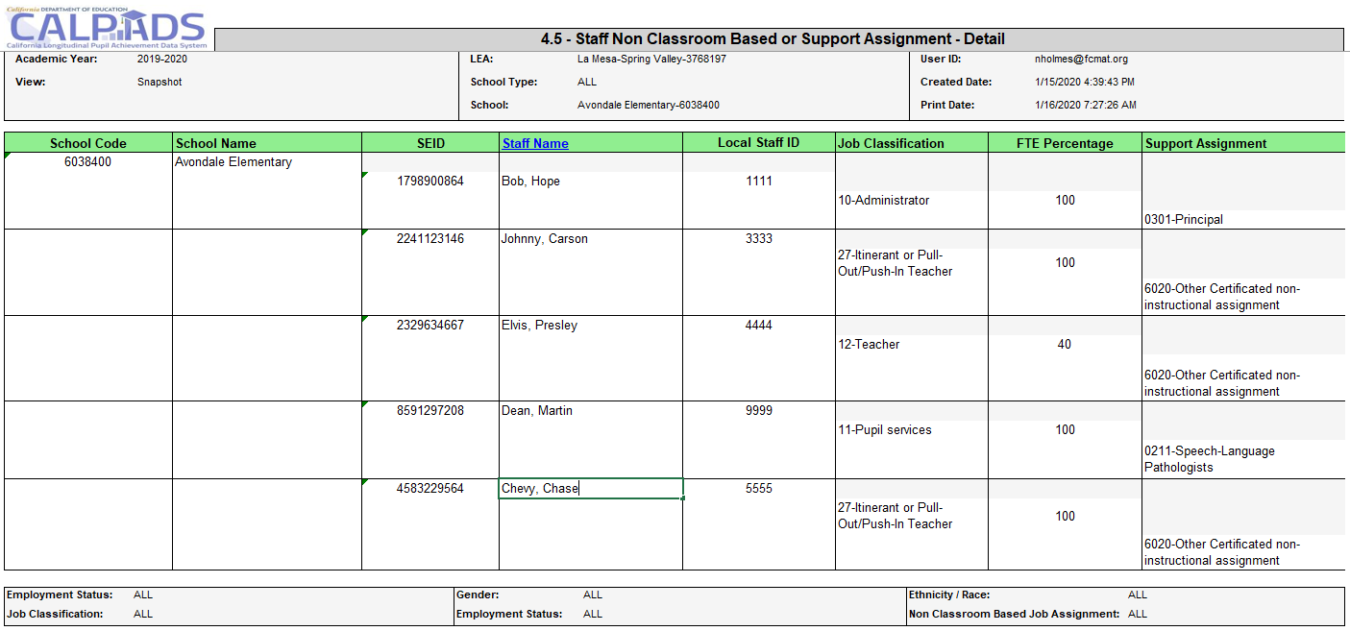
Report 4.5 - Staff Non-Classroom Based or Support Assignment – Detail
Assignment Monitoring
Report
Notes:
Reports the staff assignments for SEIDs employed as of Fall 2 Report Period. Reported is certificated staff job classifications and Non-Classroom based or Support Assignment Codes 1-7 does not equal 6018 (Employee of Leave).
Assignment monitoring Report checklist: https://www.cde.ca.gov/ds/sp/cl/calpadsupdflash201.asp

Slide 81
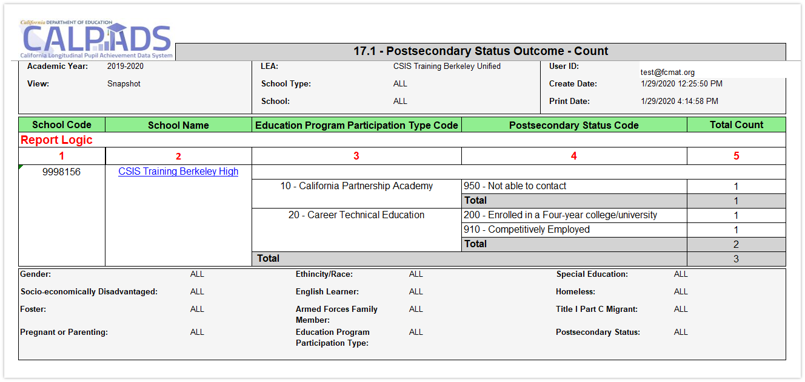
Report 17.1 - Postsecondary Status Outcome - Count
Notes:
Reports the total number of CTE completers and CPA students identified in the Postsecondary (PSTS) survey outcome.

Slide 82
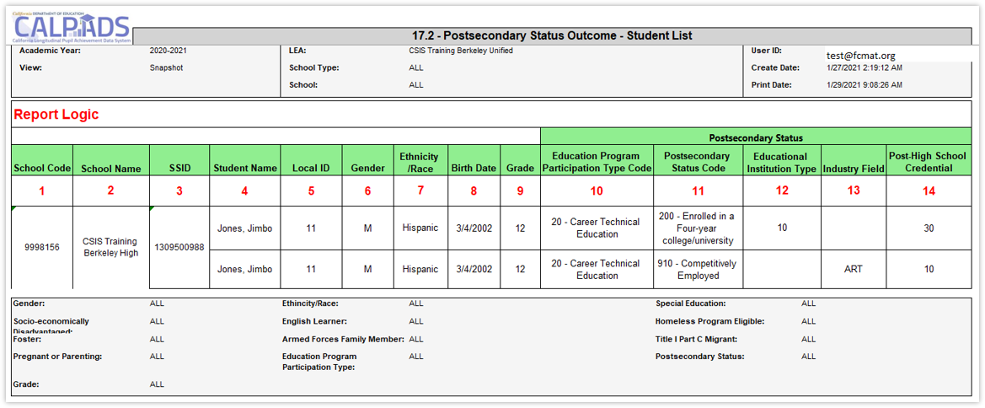
Report 17.2 - Postsecondary Status Outcome – Student List
Notes:
Captures and reports the postsecondary survey outcomes for CTE/CPA (CA Partnership Academy) students.

Slide 83

ASSIGNMENT MONITORING
Review CALPADS Flash 201 to ensure data is compliant to CALSAAS Assignment Monitoring compliance
Notes:
Flash #201 - https://www.cde.ca.gov/ds/sp/cl/calpadsupdflash201.asp

Slide 84
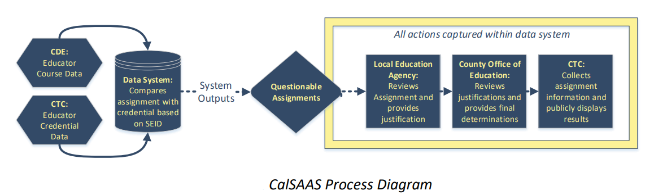
CALSAAS Process
Potential misassignments can be evaluated and corrected by LEAs and COEs after CALSAAS identification
84
Notes:
CalSAAS works through an interface where the Commission’s credentialing data is compared with CDE’s California Longitudinal Pupil Achievement Data System (CALPADS) educator assignment data based on the educator’s unique Statewide Educator Identifier (SEID) number. Each educator’s credentials are evaluated for their assignments as reported by their employing local education agency (LEA). Educators who are assigned to courses in which they do not clearly hold an appropriate credential authorization for the course are identified through the system as “exceptions.” Exceptions are not necessarily misassignments; there are multiple reasons why an educator may be otherwise legally authorized for an assignment outside of their credential area. CalSAAS users review exceptions and justify the exceptions through documentation and comments for the assignment.
https://www.ctc.ca.gov/docs/default-source/commission/agendas/2020-04/2020-04-6b.pdf?sfvrsn=70332cb1_2

Slide 85
Assignment Monitoring Data
Staff Demographic File
Staff Assignment File
Course Section Enrollments
Student Course Section Enrollments
SEID, Names, Birthdates, Gender, Race/Ethnicity, Employment data etc.
Staff job classification (teacher, administrator, pupil services), specific non-classroom based assignments
Which courses are being taught at a school, which teachers are teaching them
Which students are enrolled in each course?
Notes:
Both staff and both course file types will be used to provide data for assignment monitoring.

Slide 86
Get a Head Start
Pull a report of staff course assignments from your local SIS
Work with CALPADS Administrator to upload Staff and Course Files earlier, then review ODS Report 4.3 – Staff Teaching Assignment Detail
Looking at staff assignments early in the year will allow time to:
Correct State Course Codes or other course characteristics that resulted in CALPADS Error determinations in the prior year
Ensure Local Assignment Options are in place by Census Day
Correct misassignments prior to Census Day

Slide 87
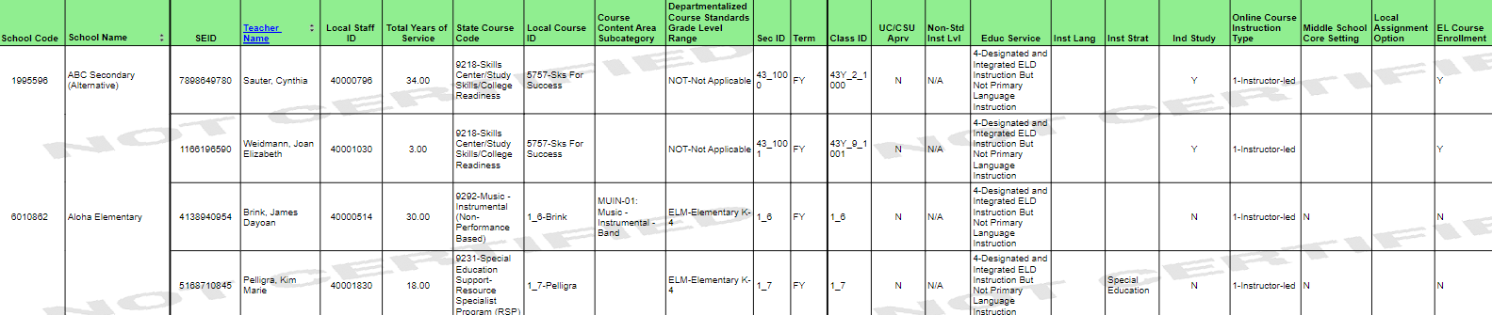
Review Report 4.3
Verify course information is CORRECT
  State Course Code and Content Subcategory are correct
  Standards grade level range is correct
  Special course characteristics (college course, English learner services provided, instructional language, instructional strategy, independent study, Online instruction type)
  Use an “as of” date of 10/1/2025 to reflect assignments effective on Census Day
Notes:
Curriculum and instruction staff should first verify the course information is correct by taking the following steps:
Verify that the State course code and content area subcategory (if applicable) represent the correct content area the teacher is teaching based on the standards used to develop the course. This should never be based on what that teacher is authorized to teach.
Verify that the grade level standards range represents the grade level standards being taught in the course and NOT necessarily the grade levels of the students enrolled in the course.
Check all the special course characteristics to ensure that they are accurate, as they will affect whether or not a teacher is appropriately assigned:
Non-Std Inst Lvl: Is this a college credit only (23) or dual credit (24) course?
Educ Service and EL Course Enrollment: Are there English learners enrolled in the course and are there English learner services being provided in the course? If so, is the value in this field correct?
Inst Lang: Is this course taught in a language other than English? If so, is the value in this field correct?
Inst Strat: Is this course a course designed specifically for students with disabilities or is it part of a home/hospital program? If so, does it have a value of 700 (Special Education) or 300 (Home/Hospital)? Is this a general education course? If so, then this column should be blank.
Ind Study: Is this course taught as part of a traditional or course-based independent study program? If so, is the value “Y” in this column?
Online Course Instruction Type: Is this course an online course and if so, is it instructor-led, facilitated, or learner-led?

Slide 88
CALSAAS Exception Types
Exception type | Description | Notes
CALPADS Code | This exception is based solely on if the educator has the proper credential authorizations for the assigned CALPADS code. CalSAAS will generate one Course Code exception per combination of Educator (SEID), School (CDS Code), and CALPADS Course or Assignment Code reported. | This type of exception should only occur in General Education or Service Assignments. If this is occurring for other assignments
Special Education Services | Education Specialists are able to teach all subjects to their students, provided their credential authorizes them to serve within the disability areas of the students served. Special education teachers are evaluated to determine if their credential authorization(s) authorize service for students within their primary disability areas. | When courses are reported with "Special Education" as the Instructional Strategy Code through CALPADS, the educator will be checked for the appropriate special education authorization to cover their student's primary disability
EL Service Code | CalSAAS will output one English Learner (EL) exception per combination of educator (SEID), school (CDS Code), and Education Service Code, which is the CALPADS field that collects the level of EL service. | If Primary Language Instruction and Designated and Integrated English Language Development (ELD) Instruction was selected, CalSAAS will perform one additional check to assure that the educator assigned to the course has the proper bilingual authorization to teach in the language of instruction.

Slide 89
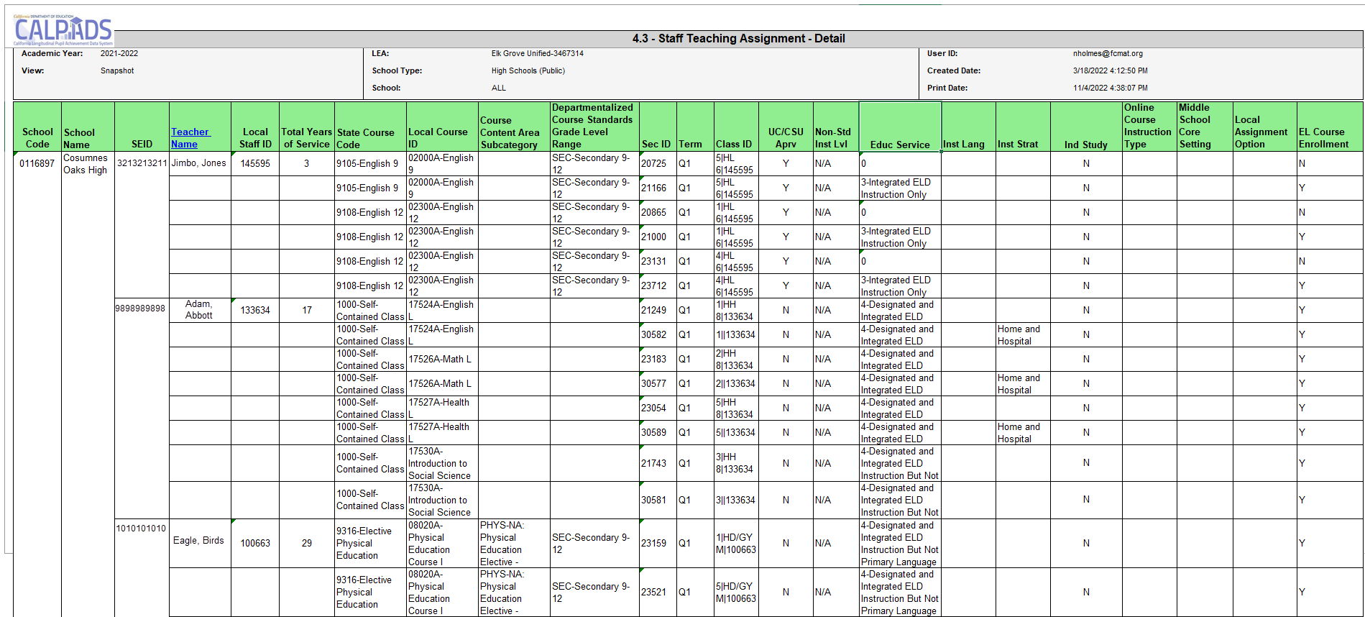
Report 4.3 – Staff Teaching Assignment Detail
CALPADS CODE
School Code, SEID #, Course Code
Special Ed
Special Education Services
SEID #, Instructional Strategy Code
EL Service Code
SEID #, Education Service Code, Language of Instruction
Notes:
Appropriate Credential Authorizations for CALPADS Coding
Course Assignment HandoutOpen PDF in current window.
Appropriate Credentials for CALPADS State Course Codes
Appropriate Credentials for Special Education Disability Categories
Appropriate Credentials for English Learner Services
Appropriate Credentials for Non Classroom Based Assignments

Slide 90
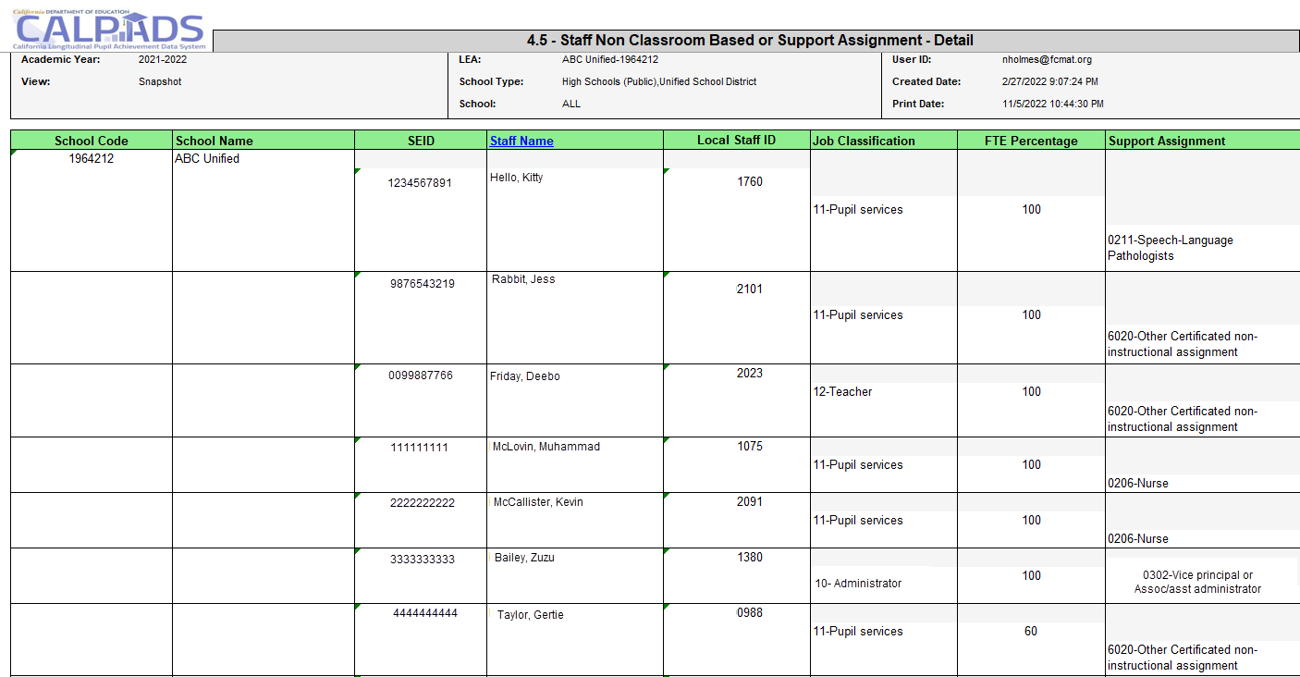
Report 4.5 – Staff Non-Classroom Based or Support Assignment - Detail
CALPADS CODE
School Code, SEID #, Course Code
Notes:
https://www.ctc.ca.gov/credentials/calsaas-information/Appropriate-credentials-nonclassroombased

Slide 91

Wrap Up
Key Points, Resources and Support

Slide 92

Summary
Teacher of record should be reported. Substitutes should only be reported for vacant positions
All staff must have an SDEM record submitted every year. If for no other reason than to update the years of service
Staff without SEIDs that should be reported may obtain SEIDS from the CTC with a certificate of clearance
Staff assignments are reported by school and job classification
Student Course data should be submitted for all students TK-12 enrolled on census day
EL students must be enrolled in at least 1 course section where the Education Service code is populated, to show they are receiving services
PSTS data should only be for CTE completers, SWD PSTS records should be submitted for EOY 4
Students may have more than 1 postsecondary outcome

Slide 93

Strategies for Success
Do not hesitate, submit Fall 2 records now
Identify staff that can provide and verify data (HR, school site, curriculum, EL program, CTE program Staff being reported)
Use Data Discrepancies to resolve errors for faster processing
Attend weekly CALPADS Q&A
Use local resources (COE and other LEAs), similar students, similar systems, similar challenges

Slide 94



Suggested Milestones
2025 - 26 Fall 2 Timeline
Now – 1/10
Complete Fall – 2 data population in local SIS
Now – 2/6
Submit and post SDEM, SASS, CRSE, SCSE, PSTS records. Resolve submission and DD errors. Resolve CDD and Certification errors
Don’t Forget!
2/13 – 2/20
Review snapshot reports and update records as needed
Send reports to local data stewards, site leaders and administrators for approval
Certification and CDD Errors
Feb 6, 2026*
2/21 – 2/27
Certify Fall-2 (No Amendment Window)
*Recommended date for zero errors
2/27
Certification Deadline
Notes:
Sometimes it is difficult to determine how to pace yourself through the CALPADS work because the deadlines start off so far in advance. Here we’ve provided a sequence of suggested milestones that you can use to break up the work and use as a checklist. Note that you should adjust the dates based on staff availability and other factors.

Slide 95





Support
http://www2.cde.ca.gov/calpadshelp/default.aspx
Web
calpads-support@cde.ca.gov
Email
916-325-9210
Phone
http://www.cde.ca.gov/ds/sp/cl/listservs.asp#listservs
You can get help through these channels.
Listserv

Slide 96





Resources
Here are some important resources related to Fall 2 reporting
  https://learn.fcmat.org/
https://www.youtube.com/channel/UCA9oRTiyVECCCzOxpmJheZw
https://documentation.calpads.org/Support/References
https://www.ctc.ca.gov/
https://www.cde.ca.gov/ci/pl/tamoreportsvideos.asp

Slide 97

Feedback
Please complete survey…
https://bit.ly/2MXsECg
“
”
Notes:
Please take the time to complete our training survey. Your responses assist in improving our trainings.
We review these surveys on a regular basis—in fact due to LEAs’ suggestions we have changed our survey, have included more visual aids, and demonstrations in our trainings.
If you experience any technical difficulty with accessing the survey, please try the alternative long URL:
Long URL: https://forms.office.com/Pages/ResponsePage.aspx?id=k1b3XxqV6E2E3dWxsESwNX2FYi3dRZNNt8LpvkF_wmhUNVRLOVBDVkoySE01UTJSRk42VTlaUUFIQi4u
Short URL: https://bit.ly/2MXsECg
Thank you for providing us the opportunity to evaluate our trainings.

Slide 98






Thank You
CSIS Training
+1 916 325 9201
csistraining@fcmat.org
https://csis.fcmat.org/

