Slide 1



EOY 4
Reporting & Certification
Special Education
Special Education Program
Non-Participation Postsecondary Status
Notes:
Welcome to End of Year 4 Reporting and Certification, Special Education.

Slide 2
CALPADS Training Road Map
Introduction
System Overview
Basics
Submission: Data Population
File Type: Data Population
Data Collections
Fall 1-2 Reporting and Certification
EOY 1-4 Reporting and Certification
Skill Building
Skill Building
Data Privacy
Data Population
CALPADS Basics
CALPADS Basics (SELPA)
4 Year Cohort
Notes:
The CSIS training model is designed to be segmented to provide organization of specific topics and concise delivery. We aim to provide focused trainings with relevant information and instruction.
- This slide reflects the CALPADS course catalog. In the top we have the various Subject Areas and their respective Programs shown below each one. The first three skill areas contain programs that are the prerequisite for the Data Collection programs and the EOY-4 Reporting & Certification is part of the EOY 1-4 Reporting and Certification program, which you are attending today. We also have the Skill Building program consisting of courses which are available in self-paced format.

Slide 3

Target Audience
LEA SIS and SEDS Data Coordinators
Notes:
This training is intended for provide LEA data coordinators who submit data to CALPADS. Both Student Information System (SIS) and Special Education System (SEDS) may benefit from today’s training.

Slide 4




Objective
Identify
Perform
Resolve
Analyze
key data elements and stakeholders in preparation of the the EOY 4 submission
(Data Leadership)
the EOY 4 submission process based on an internal schedule considering staff availability and competing priorities
(Project Management)
certification errors using analytical mindfulness and review reports for completeness and reasonability
(Critical Thinking)
certification reports to assess the flow of data across the ecosystem and evaluate how well data is leverage in informed decision making
(Coalition Building)
Notes:
Today’s training has been developed with specific objectives in mind that highlight essential skills needed during the CALPADS Submission process.
(Data Leadership)
Identify key data and stakeholders in preparation of the EOY 4 submission
(Project Management)
Perform the EOY 4 submission process based on an internal schedule considering staff availability and competing priorities
(Critical Thinking)
Resolve certification errors using analytical mindfulness and review reports for completeness and reasonability
(Coalition Building)
Analyze certification reports to assess the flow of data across the ecosystem and evaluate how well data is leverage in informed decision making

Slide 5





Agenda
Overview
Submission Data
Certification Process
Wrap-Up
Here is the agenda for this training. We will discuss the following
Notes:
Here is the agenda for this training. We will discuss the following:
An overview of the submission
Introduce the key data fields related to SWD information review resources that will assist during the submission
We will discuss the Certification process by:
Reviewing the two-tiered approval process
Discuss the certification error validations
Spend some time on the reports
As always, we will conclude the training with a wrap up summarizing key points and presenting reminders.

Slide 6



Overview
Discuss the big picture of EOY 4 submission
Notes:
First, we will start with some general information related to the CALPADS data submission and then introduce key concepts related to the data collected.

Slide 7


Why EOY 4?
As required by the Individuals with Disabilities Education Act (IDEA)
Counts for students with participating and receiving services from a special education plan
Counts of students Special Education Status and Non-Participation Reason
Count of students with disabilities identified postsecondary (PSTS) survey outcomes
Notes:
The End of Year (EOY) 4 data collection provides information required for students with disabilities for the federal Individuals with Disabilities Education Act (IDEA) reporting. Specifically,
Counts for students with participating and receiving services from a special education plan (IFSP,IEP,ISP).
Counts of students Special Education Status (child find) and Non-Participation Reason (exits)
Count of students with disabilities identified Postsecondary (PSTS) survey outcomes

Slide 8





How Is The Data Used?
Special Education (SWDS, MEET, PLAN)
  Student counts for IDEA
  Special Education Monitoring
  DSEA – Dashboard accountability
Special Education Services (SERV)
  Special Education Monitoring
Postsecondary Status (PSTS)
  Post-school outcomes for IDEA; outcomes of SWD who exited secondary education in 2023-24
Notes:
The SPED data collected for SWD provides information for accountability and is required by legislation.
Special Education (SPED)
Student counts and program exits for IDEA
Special Education Monitoring
DSEA – Dashboard accountability
Special Education Services (SSRV)
Special Education Monitoring
Postsecondary Status (PSTS)
Post-school outcomes for IDEA; outcomes of SWD who exited secondary education in 2023-2024

Slide 9

  Key Dates
Snapshot
starts
May 6, 2025
Certification Deadline
July 25, 2025
Amendment Window Deadline August 8, 2025
Error Free & Review Reports July 11, 2025
The End of Year reporting period is July 1, 2024– June 30, 2025
Notes:
Our goal is to help LEAs build their local capacity. Therefore:
The expectation is for each LEA to resolve all fatal errors by July 12th and Approve by end of July.
The EOY snapshot reports will generate on — May 6th
The EOY error resolution is — July 11th
The EOY submission window deadline is — July 25th
The FINAL amendment deadline is August 8th
Also, these dates can change so it is best to check the CDE’s calendar using the link on this slide.
Minimize data cleanup in CP. If you are cleaning data (resolving validation and CDDs) for more than 2 weeks in CALPADS, that is an indication there are local issues that need to be addressed. CDE will always reconsider the timelines if the system is not performing as expected.

Slide 10
Data Collection Window for 2024-25
Census Day
Certification Deadline
Final Deadline
Initial ELPAC Testing Window opens
July 1, 2024
ODS Cohort Pull
Oct 2, 2024
Dec 17, 2024
January 24, 2025
August 15, 2025
CAASPP Testing
Amendment
1/14 to 6/30/2025
Fall 1 Submission
ELPAC Summative Testing
2/3 to 5/31/2025
Cohort Processing - ongoing
Nov
Dec
Jan
Feb
Apr
May
Jun
Jul
Aug
Sep
2023
AY 25-26
Oct
Mar
Fall 2 Submission
GAP
EOY Submissions
Submit Fall 2 Data
Amendment
Fall 2 Deadline
Start of Submission
March 21, 2025
May 6, 2025
Certification Deadline
Final Deadline
July 25, 2025
August 8, 2024
https://www.cde.ca.gov/ds/sp/cl/rptcalendar.asp
Notes:
Use the gap period to continuously update student profile data for testing requirements, monitor SPED students, internally prepare/ validate EOY related data in your SIS and submit available data to CALPADS

Slide 11
EOY 4 ROLES
LEA SEDS Data Coordinator
LEA SIS Data Coordinator
EOY 4 Reports
SPED
PSTS
SSID SEARCH
SENR View
Data Collection Certifier
EOY 4 Reports
Data Collection Certifier
SENR
SINF
SELA
SPRG
SPED
PSTS
File View and Edit roles are required to submit data (SPED, PSTS, etc.)

Slide 12
KEY Stakeholders
SPED Program Staff
School Site Staff
CALPADS LEA Admin Responsibilities
Create and maintain Sped User Access
Establish proper enrollment procedures for school sites to follow
Provide CALPADS Support/ Resource to SPED Users
Include SPED team in communication with CSIS Monitors
SELPA Data Coordinator
SEDS Data Coordinator
SIS Data Coordinator
District Administrator
NPS School Coordinator
CSIS Monitor

Slide 13
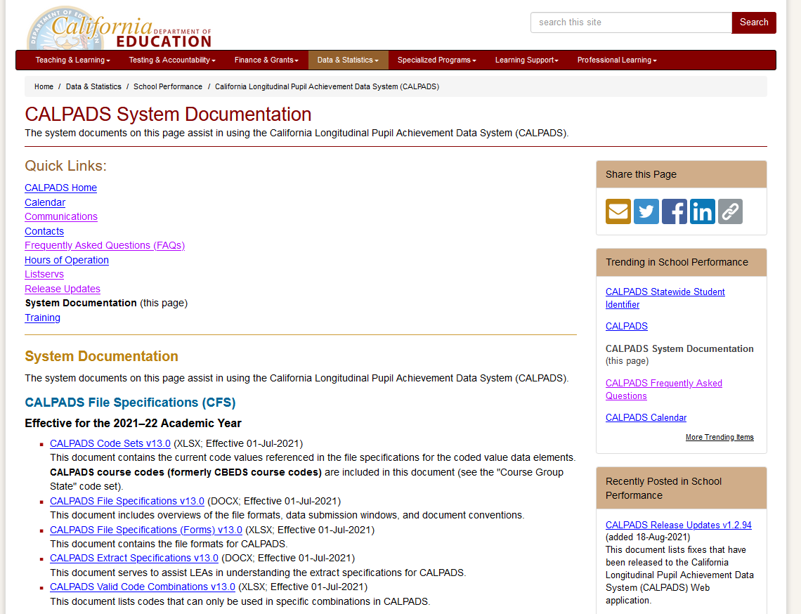
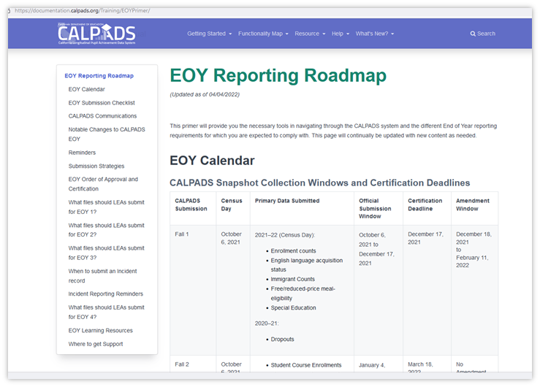
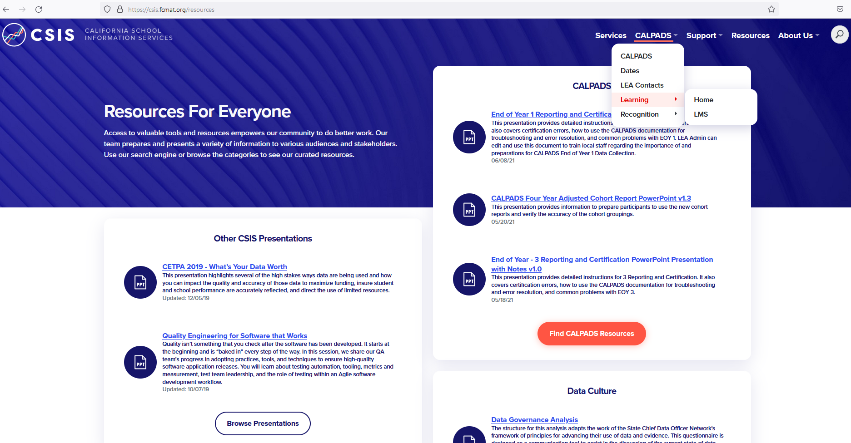
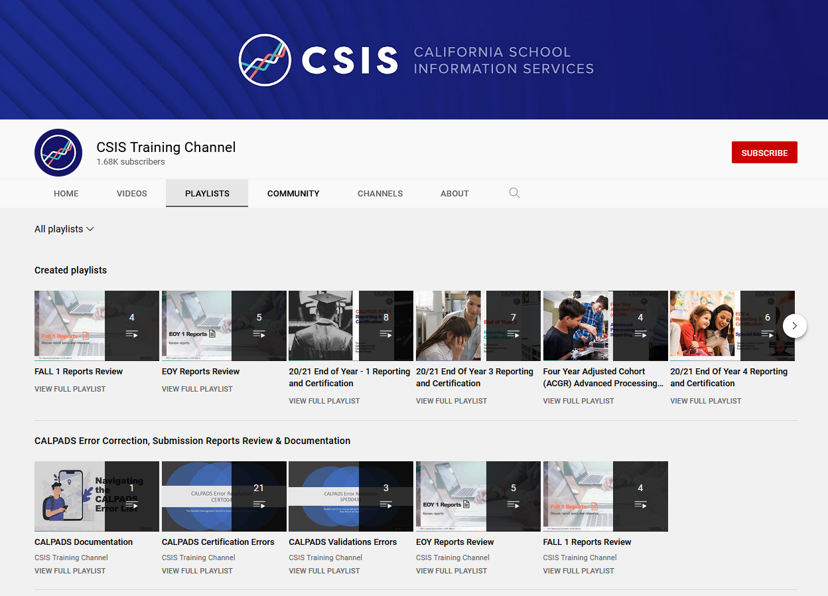
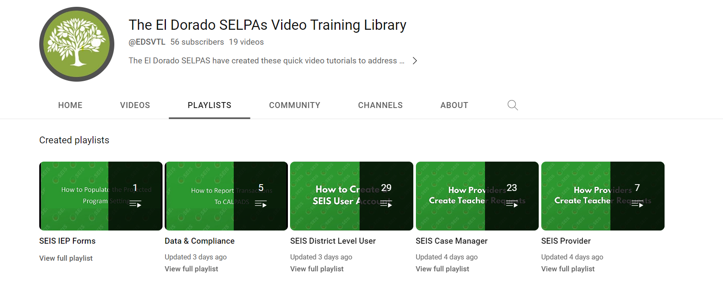
EOY 4 Survival Kit
Where do I find information about the data collection?
Where are the key dates and submission timeline located?
How can I audit or track the tasks involved for completion?
Does my SEDs vendor or SELPA have training resources on report/managing SPED transactions?
Notes:
LEAs should also be aware that there are excellent reference documents available to download for guidance on different aspects of CALPADS reporting. Another skill required for successful submissions that we did not mention was data literacy. Even though you as a SIS data coordinator is not expected to submit special education data, you need to be able to understand the submission and communicate with your SEDS data coordinator and the SELPA. Understanding and communicating the data and the information is provides is data literacy. The CALPADS training and system documentation will help improve your data literacy.
Getting started let us look at a few places to find information that will assist in data population.
Documentation
User Manual
CALPADS Code Sets
File Specifications Form
Error List
Data Guide
Valid Code Combinations
Every submission requires some planning to be successful. EOY typically requires more planning because of the size of the data collection and limited staff availability. Here are some questions that need to be answered prior to the start of your EOY submission.
Where do I find information about the data collection?
Where are the key dates and submission timeline located?
How can I audit or track the tasks involved for completion?
It is important to know which resources that provide this information and have a referential understanding of the contents. You should know which document to go to when researching, not specifically recalling the answer.
Instructions for the presenter:
Introduce the CALPADS system documents page and the CALPADS User Manual
Show the EOY 3 details in the CFS (docx)
Show the EOY timeline in the CALPADS Calendar
Highlight the EOY Roadmap
Walk through the EOY checklist

Slide 14

EOY 4 Submission
Status, Meetings, Plans, Services
Notes:
The Postsecondary submission is for students who were CTE pathway completers at any time during high school.

Slide 15
Record Relationships
SENR
23-24
Student Enrollment
Reporting LEA
SSID
Enrollment Start Date
MEET*
SWDS*
SSID
Meeting Date
SSID
PLAN Effective Start Date
Reporting LEA
Postsecondary
PLAN
Special Education Services
Notes:
*SWDS Effective Start Date only needs to overlap with the SENR Enrollment Start Date if the SWDS Status = Eligible and Participating (1)
*MEET record does not have to be reported by the current LEA. As long as a current meet record reflecting the correct status overlaps the SWDS effective date, it should be valid. LEA do not need to report their own MMET record if current record is still relevant.

Slide 16
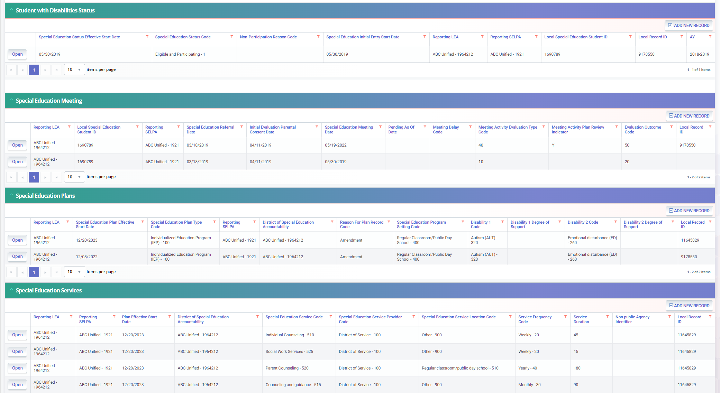
SWD Profile Data
Only Submit SWDS when status changes
MEET records must correspond with the PLAN type
PLAN records can be submitted with enrollment or plan changes
Services should correspond with PLAN changes by date
Notes:
If LEA submits a SWDS record with a Status of “Eligible and Participating”, student must have a Student Enrollment record at same LEA where the SWDS Status Start Date falls within the Enrollment Start and Exit Dates. Other statuses do not require a SENR. Typically, the only time an LEA would submit a status of Eligible and Participating is after a student is initially evaluated or if they exit then re-enter special education.
Once an INITIAL meeting is held, a SWDS record is expected. MEET records with Pending as of Date populated do NOT require SWDS record. The Meeting Activity - Evaluation Type Code must correspond with the PLAN record’s Special Education Plan Type Code.
Student must have a Student Enrollment record with Enrollment Start and Exit Dates that overlap the Plan Effective Start Date at the same LEA
Student must have SERV records with same SSID, Reporting LEA, SELPA, and Plan Effective Date

Slide 17


Student with Disability Status
The Students with Disabilities Status (SWDS) helps identify students who have been evaluated for special education throughout the year and provides a reason for nonparticipation of services
Count of students with disabilities who exited special education
Count of students with disabilities served who exited special education by exit reason and age
Count and percent of students with disabilities who exited special education by exit reason and race/ethnicity
Count and percent of female and male students with disabilities who exited special education by exit reason
Count and percent of non-English Learner and English Learner (EL) students with disabilities who exited special education by exit reason
Notes:
The Students with Disabilities Status helps identify students who have been evaluated for special education throughout the year and provides a reason for nonparticipation of services. The SWDS provides data relevant to the Child Find legal requirement under the Individuals with Disabilities Education Act (IDEA), that mandates LEAs to identify, locate, and evaluate all children with disabilities, birth through age 21, who are suspected of having disabilities. Also, the nonparticipation reason data is required by IDEA as exit information for students with disabilities is needed for many reports.

Slide 18
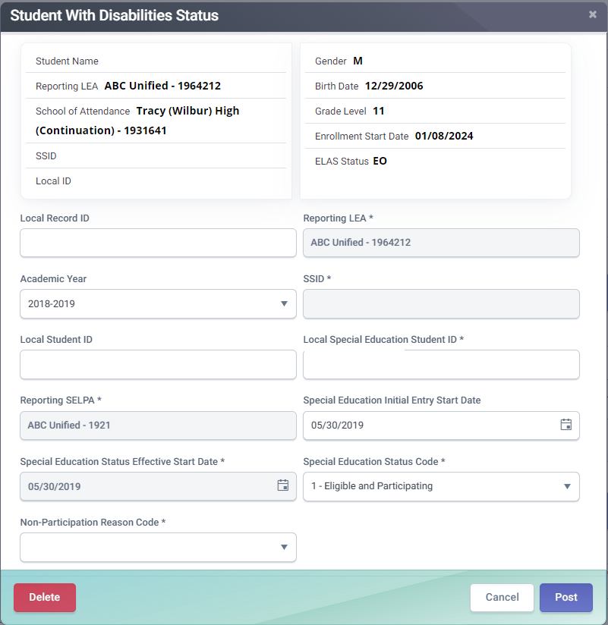
SWDS Record Key Fields
Special Education Status Effective Start Date is the date when a student's special education status became effective in California
Special Education Status Code represents student's eligibility for special education. Special Education Status Code and Non-Participation Code must be a valid combination
Non-Participation Reason Code represents the reason an evaluated student is not participating in special education.
1
2
3
Notes:
The Special Education Status Effective Start Date is the date when a student's special education status became effective in California. For students who are being initially evaluated, this would be the date a determination was made.
For students whose status is changing, it would be the date the student's status changed.
For students who are identified as eligible outside of CA and then transfer in, this would be the date the student first entered a CA public school.
For students who were determined eligible in CA, left out of state and were exited from special education out of state, then come back to CA, this would be date the student's exit status was recorded in CA.
The Special Education Status Code is a code value representing the status of a student's eligibility for special education. The Special Education Status Code and Non-Participation Code must be a valid combination as defined in the CALPADS Valid Code Combinations document. The Students must not be enrolled on the Special Education status Effective start date if Special Education Status Code = Eligible and Not Enrolled
The Non-Participation Reason Code A coded value representing the reason a student who was evaluated and is not participating in special education.

Slide 19

Special Education Meeting
The Special Education Meeting record provides information of whether schools are completing initial evaluations for students with disabilities within the required timeframe
  Count of students for whom parental to evaluate was received consent
  Count of students whose evaluations were completed within 60 days
Notes:
The Students with Disabilities Status helps identify students who have been evaluated for special education throughout the year and provides a reason for nonparticipation of services. The SWDS provides data relevant to the Child Find legal requirement under the Individuals with Disabilities Education Act (IDEA), that mandates LEAs to identify, locate, and evaluate all children with disabilities, birth through age 21, who are suspected of having disabilities.

Slide 20
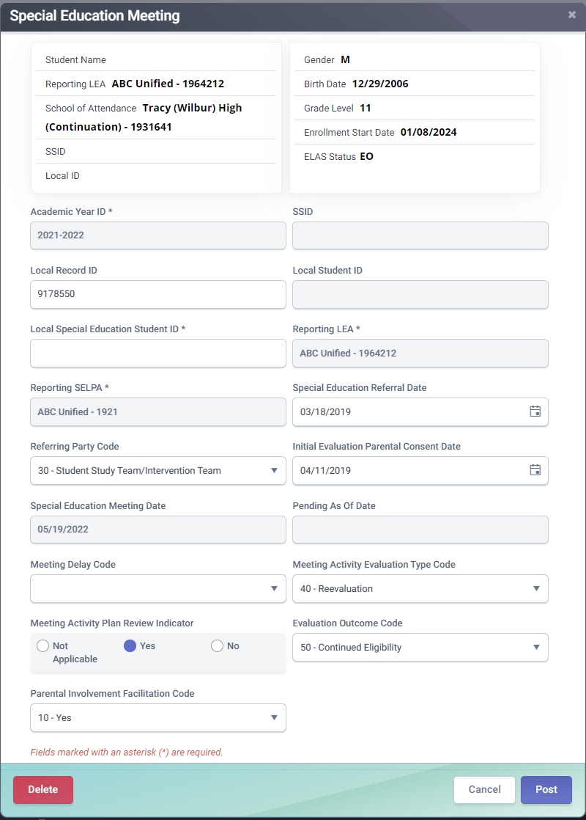
MEET Record Key Fields
Special Education Meeting Date is used to determine whether or not statutorily required meetings for the student are being held in a timely manner
Meeting Activity Evaluation Type Code represents the type of special education evaluation being held
Evaluation Outcome Code represents the outcome of a student's special education eligibility evaluation
1
1
2
3
Notes:
The Special Education Meeting Date is the date of the Individualized Family Service Plan (IFSP), Individualized Education Program (IEP), or Individual Service Plan (ISP) team meeting to review the initial evaluation, Annual Education or Service Plan Meeting, or eligibility re-evaluation to determine eligibility for special education services. The date captured in this field is used to determine whether or not statutorily required meetings for the student are being held in a timely manner.
The Meeting Activity - Evaluation Type Code is a coded value representing the type of special education evaluation being conducted during a special education meeting - Initial Part B Evaluation, Initial Part C Evaluation, or Re-evaluation of eligibility. If no evaluation occurred during a meeting, this field should be left blank.
The Evaluation Outcome Code is a coded value representing the outcome of a student's special education eligibility evaluation.

Slide 21

Special Education Plan
Special Education Plan records provide data to ensure that students with disabilities have a timely transition from one program to the next or have a well-developed IEPs that help them transition from high school to adulthood
Count of IFSP (Part C) students who were eligible, and an IEP (Part B) was implemented by their third birthday
Count of IFSP students who were referred but not eligible for IEP (Part B)
Count of students whose parents declined to provide consent, caused delays or exceptions applied
Count of students ages 16 and above with IEPs that contain each of the required components for secondary transition
Notes:
Special Education Plan records provide data to ensure that students with disabilities have a timely transition from one program to the next or have a well-developed IEPs that help them transition from high school to adulthood. The State Performance Plan Indicators (SPPI) that provided data for the Annual Performance Report (APR) that is derived form the Special Education Plan records reported in the CALPADS End of year EOY 4 data submission are:
Indicator 12: Early Childhood Transition
Measures whether children transitioning from early intervention programs (such as Part C services for infants and toddlers) to preschool special education services (Part B) have a timely transition by their third birthday. It ensures that there’s no gap in services when a child moves from one program to the next.
Indicator 13: Secondary Transition
Examines whether students with disabilities aged 16 and older have a well-developed Individualized Education Program (IEP) that includes goals and services to help them transition from high school to adulthood. This includes preparing for higher education, employment, and/or independent living.

Slide 22
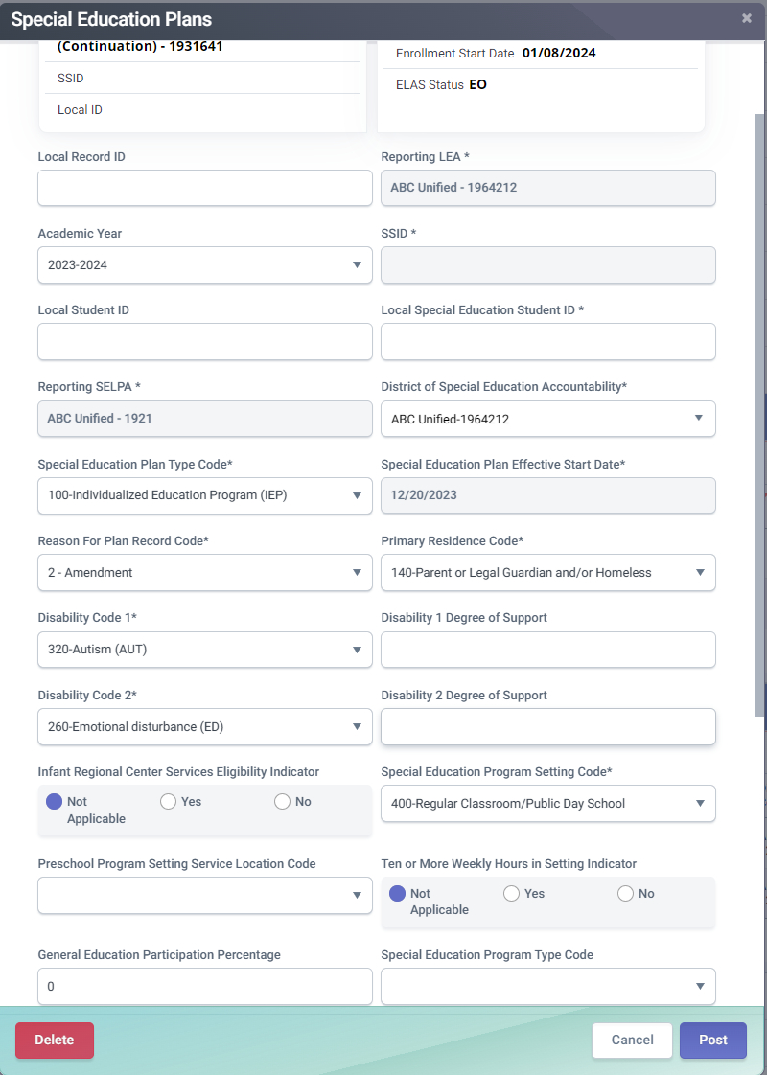
PLAN Record Key Fields
Special Education Plan Type Code represents the type of special education plan, Individualized Education Program (IEP), Individual Family Service Plan (IFSP), or an Individual Service Plan (ISP)
Special Education Plan Effective Start Date is the date that a student's special education plan (IFSP, IEP, ISP) became effective including any plan changes (amendments, re-affirmed)
Disability 1 Code represents the category of a student's primary disability qualifying the student for services under one of the 13 eligibility categories in the IDEA
Special Education Program Setting Code represents the special education program setting in which the student is receiving or has received the majority of special education and related services
General Education Participation Percentage represents the percentage of time a student with disabilities participates in general education
1
2
3
4
5
Notes:
The Special Education Plan Type Code is a coded value representing the type of special education plan by which the student is receiving special education services, Individualized Education Program (IEP), Individual Family Service Plan (IFSP), or an Individual Service Plan (ISP), or other code as appropriate.
The Special Education Plan Effective Start Date is the date that a student's special education plan: Individual Family Service Plan (IFSP), Individualized Education Program (IEP), or Individual Service Plan (ISP) became effective. Anytime a student's special education plan either changes (including any plan amendments) or is re-affirmed, LEAs would submit a new PLAN record with a new Special Education Plan Effective Start Date.
The Disability 1 Code is a coded value representing the category of a student's primary disability. A disability means the student has qualified for services under one of the 13 eligibility categories in the IDEA and needs special education or related services.
The Special Education Program Setting Code is a coded value representing the special education program setting in which the student is receiving or has received the majority of special education and related services according to the student's Individual Family Service Plan (IFSP), Individualized Education Program (IEP), or Individual Service Plan (ISP).
The General Education Participation Percentage A numerical value representing the percentage of time a student with disabilities participates in general education.
State Performance Plan (SPP)/Annual Performance Report (APR) information: https://www.cde.ca.gov/sp/se/fp/sppapr-overviewfeedback.asp#:~:text=The%20SPP%20is%20the%20overall,compliance%20indicators%20and%20performance%20indicators.

Slide 23

Special Education Services
Special Education Service records do not provide certified data in EOY 4, however they are required to provide corresponding information for each education plan record. SERV records may be used for compliance monitoring
Notes:
If a student is enrolled with a LEA and the student has a Special Education Status of “Eligible and Participating”, CALPADS requires that the LEA submit a Special Education Plan (PLAN) and associated Student Services (SERV) records. The Student’s enrollment start and end dates must overlap the PLAN and SERV Effective Start Dates. There is an exception for PLAN and SERV records with Effective Dates that that fall between June 1 and August 31 annually to account for students whose enrollments are not open during the summer.

Slide 24
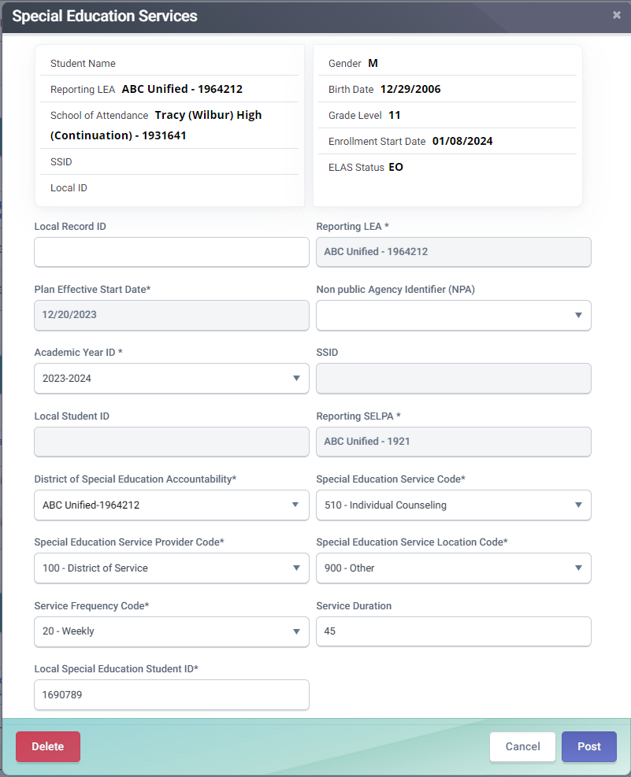
SERV Record Key Fields
Special Education Service Code represents a special education service or related service received by the student
Special Education Service Provider Code represents the provider of the service
Special Education Service Location Code represents the location where the student receives the service
1
2
3
Notes:
The Special Education Service Code is a coded value representing a special education service or related service received by the student, regardless of which agency pays for the service. There is no limit on how many services the student or infant can receive. For students receiving a duplicate service, a separate provider must be entered.
The Special Education Service Provider Code is a coded value representing the provider of the service in the Special Education Service Code field.
The Special Education Service Location Code is a coded value representing the location where the student receives the service entered in the Special Education Service Code field, for each service reported

Slide 25

Postsecondary Status
Postsecondary status data provides insight into how effectively schools prepare students with disabilities to transition to adulthood by identifying gaps in services or supports
Counts of former students with disabilities Enrolled in higher education
Counts of students with disabilities enrolled in higher education B or competitively employed
Counts of students with disabilities enrolled in higher education, or some other postsecondary education/training program; or competitively employed or in some other employment
File extracted from SEDS.
If SEDS do not have the ability to store multiple responses, add additional responses directly in CALPADS.
Notes:
EOY 4 Postsecondary Status records provides data for the State Performance Plan Indicator 14: Post-School Outcomes.
Monitors outcomes of students with disabilities one year after leaving high school. It examines whether these students are enrolled in higher education, have competitive employment, or are in some other form of education or training.

Slide 26

Which Students Require Postsecondary Status in EOY 4?
Students who exited secondary education in AY 23-24 with one of the following exit or school completion status codes and who did not re-enroll in any CA public school in AY 2024-25:
School Completion Status Code
  Graduated, standard HS diploma (100)
  Students with Disabilities Certification of Completion (120)
  Adult Ed High School Diploma (250)
  Received a High School Equivalency Certificate (and no standard diploma) (320)
  Passed CHSPE (and no standard diploma) (330)
  Completed grade 12 without completing graduation requirements, not grad (360)
Or alternatively, if a student exits using one of the following exit reasons:
  No known Enrollment – Truant (E140)
  Prior completion of Special Education (E125)
  Expelled No known Enrollment (E300)
  Other or Unknown (E400)
  Medical Reasons (E410)
  Transferred to College (T280)
Resources:
User Manual PSTS Page
PSTS Survey Template Guide
PSTS for SPED Survey Template
Notes:
Instructions for presenter:
Got to Flash #203 Reporting Postsecondary Status (PSTS) File in End-of-Year 4 for Special Education in 2020-21. https://www.cde.ca.gov/ds/sp/cl/calpadsupdflash203.asp and to the PSTS DP, https://www.youtube.com/watch?v=-96LrPQNFwg&list=PLsnFpLOXpp4L9MlVjpW9tANzckYJ8PwQT.
The Postsecondary Status (PSTS) file is used by LEAs to submit postsecondary outcome data to CALPADS for students who have exited secondary education in the prior school year. In End-of-Year (EOY) 4, outcomes are collected for students with disabilities (SWD) who exited secondary education in the prior year. LEAs are required to survey SWD who exited secondary education in 2019−20 with one of the following exit or school completion status codes:
School Completion Status Code
Graduated, standard High School (HS) diploma (100)
Students with Disabilities Certification of Completion (120)
Adult Ed High School Diploma (250)
Received a High School Equivalency Certificate (and no standard diploma) (320)
Passed California High School Proficiency Exam (CHSPE) (and no standard diploma) (330)
Completed grade 12 without completing graduation requirements, not grad (360)
Or alternatively, if a student exits using one of the following exit reasons:
No known Enrollment – Truant (E140)
Prior completion of Special Education (E125)
Expelled No known Enrollment (E300)
Other or Unknown (E400)
Medical Reasons (E410)
Transferred to College (T280)

Slide 27
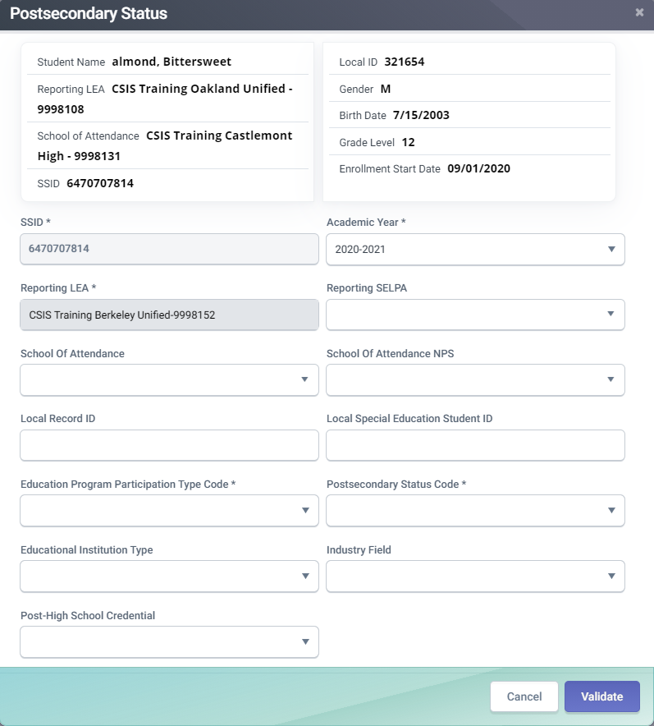
PSTS Record Key Fields
Education Program Participation Type Code: indicates the program completed requiring a survey ( SPED, CTE CPA). For EOY 4 only submit Education Program Participation Type Code 30 (Special Education)
Postsecondary Status Code: A coded value representing the student's postsecondary outcome. Multiple outcomes require multiple records
2
1
Notes:
LEAs should only submit Postsecondary Status (PSTS) records for students with disabilities with Education Plan Type 100 (IEP) who exited secondary education in the prior year. The key data fields are the:
Education Program Participation Type Code: indicates the program completed requiring a survey ( SPED, CTE CPA). For EOY 4 only submit Education Program Participation Type Code 30 (Special Education).
Postsecondary Status Code: A coded value representing the student's postsecondary outcome. Multiple outcomes require multiple records.

Slide 28

SIS Data Coordinator Responsibilities
Enrollment and Exit information
Notes:
Let's discuss what how SIS data coordinators contribute to EOY 4.

Slide 29
Enrollment For Students Still Pending
 | SENR | SINF | SWDS | MEET | PLAN | SPRG | SELA | SINC | SIRS | SOFF
Discipline Rate | X | X | X | X | X | X | X | X | X | X
LRE | X | X | X | X | X | X | X
PS LRE | X | X | X | X | X | X | X
Parent Involvement | X | X | X | X | X | X | X
Disproportionality | X | X | X | X | X | X | X
Timely Eligibility | X | X | X | X | X | X | X
Postsecondary Transition Goals | X | X
Notes:
Here is a quick look at the CALPADS data source used in Compliance Monitoring (CIM) reports by the California Special Education Technical Assistance Network (CALTAN). The California Special Education Technical Assistance Network (CalTAN) is developed in association with California’s Statewide System of Support and funded by the California Department of Education.
The Special Education monitoring framework uses a tiered system that differentiates the level of monitoring and technical assistance supports for each local educational agency (LEA) based on data analyses and to determine the LEA’s need for support and intervention.
https://caltan.info/
What we hope to make evident with this table is how much of our students with disabilities data comes from the SIS rather than the SEDS.
Link to table: https://caltan.info/resource/calpads-data-files-needed

Slide 30

Which LEA Is Responsible For Reporting SWD Data?
The LEA that provides the majority of special education instruction and related services is responsible for submitting all data to CALPADS including special education data. This is almost always where the student attends school
Even for Students with disabilities being served by an LEA other than the District of Special Education Accountability (DSEA) the data in CALPADS should always be submitted by the LEA that provides the majority of special education and related services
Students not subject to compulsory education law and not attending school, then the reporting LEA generally provides Special Education services
Notes:
The LEA that provides the majority of special education instruction and related services is responsible for submitting all data to CALPADS including special education data. This is almost always where the student attends school, if the student is enrolled and attending.
Students not subject to compulsory education law and not attending school, then the reporting LEA generally provides Special Education services.

Slide 31

Student Enrollment
Student Enrollment fields relevant to the SPED Submission:
Reporting LEA – The 7-digit CDS code for the LEA providing SPED services.
Enrollment status - Primary (10) for IEP, Non-ADA (50) for IFSP or ISP students.
School of attendance - For NPS students use 0000001. For a private school, use 000000002. For a district level enrollment use 7-digit CDS code.
NPS school of attendance – A valid CDS value or code “9999999” for Noncertified NPS schools.
Notes:
The Reporting LEA is responsible for reporting special education data to CALPADS. This is the Reporting LEA is where the student “attends school” or receives the majority of their instruction. Student with Disabilities (SWD) require the Student Enrollment (SENR) and accompanying student profile data (SINF, SPRG, SELA) to be submitted to CALPADS, LEAs may then submit a SPED file from their special education data system (SEDS).
Reporting LEA – The 7-digit CDS code is reported for the LEA providing SPED services
Enrollment status - Primary (10) for IEP, PS -12 public school enrollments. Use Non-ADA (50) for IFSP students in grade levels IN and TD or private school K-12 enrollments.
School of attendance - For a student who is attending a certified NPS school use NPS group code 0000001. For a student attending private school, use private school group code 000000002. For students in a district level enrollment use 7-digit school code
NPS school of attendance – A valid CDS value is required for students attending non-public schools referenced in the California School Directory. For noncertified schools use code of “9999999.” for “Noncertified Nonpublic Nonsectarian School.”

Slide 32

Best Practices for Obtaining Data Needed for SSID Creation
For infant and preschool-age students, require that parents complete the same enrollment packet that is required for TK-12 students
Some LEAs have indicated that getting all data required for a full student profile (all data needed for Student Enrollment [SENR] and Student Information [SINF] Files) is difficult for infants or preschool-age children who:
  Are referred from regional centers
  Are not attending a LEA-operated preschool program
In these cases, LEAs should gather the MINIMUM data required to create a SSID in CALPADS
Notes:
One of the primary issues we hear from CALPADS administrators and special education data coordinators is that often times, there is not enough information from the parents to create an SSID. This typically happens for infants who are being referred from regional centers or preschool-age students being evaluated who will not be attending preschool because the parents are not typically required to complete enrollment paperwork.
Many LEAs are not aware that only a subset of the student demographic information is necessary to create an SSID.

Slide 33

Completing The Demographic Profile
Once the SSID is created, LEAs MUST complete the demographic profile to view students on CALPADS Snapshot Reports, however the inability to obtain a FULL demographic profile should NOT impede the creation of a SSID needed to submit special education files to CALPADS
The full demographic profile is submitted to CALPADS via the Student Information (SINF) File
Notes:
The remainder of the student demographic profile should be submitted through the Student Information (SINF) file. The SINF file contains information such as student ethnicity and race, birth country and state, parent/guardian information, as well as student address.
Obtaining this information needed for the full student profile should NOT impede the creation of the SSID, which is needed to submit special education files to CALPADS.

Slide 34
Minimum Data Required To Create An SSID
Minimally, the following data are required to create a SSID for a student in CALPADS:
1.04 – Reporting LEA | 1.12 – Student Legal Last Name
1.05 – School of Attendance | 1.17 – Student Birth Date
1.06 – School of Attendance NPS (only if student is enrolled at an NPS School) | 1.18 – Student Gender Code
1.07 – Academic Year | 1.22 – Enrollment Start Date
1.09 – Local Student ID (district identifier assigned by student information system) | 1.23 – Enrollment Status Code
1.10 – Student Legal First Name | 1.24 – Grade Level Code
Notes:
The following are the minimum data elements required to create a brand new SSID. The SSID is obtained by submitting the Student Enrollment (SENR) file to CALPADS. Although, these data elements are the minimum data needed to create the SSID, it is important that LEAs obtain the necessary data to complete the student profile, otherwise the student will not be visible on any CALPADS Snapshot Reports.

Slide 35
SWD Enrollments
Age | Enrollment Status | Enrollment Start Date | Grade Level | School of Enrollment
Zero to 35 months | 50 – Non- ADA Enrollment | Date of parental consent for Part C initial evaluation | IN - Infant | District-level enrollment
3 to 5 years, preschool (private schools additionally serving grades TK and above– student served on ISP) | 50 – Non- ADA Enrollment | Student’s third birthday or Date of parental consent for evaluation, whichever comes later | PS - Preschool | School 0000002 – Private School Group
3 to 5 years, preschool (public, served on IEP) | 10 - Primary | Student’s third birthday or date of parental consent for evaluation, whichever comes later | PS - Preschool | Private preschool or no specific preschool CDS Code - District-level enrollment Preschool with specific CDS code – Enroll at preschool
5-21, Transitional Kindergarten through 12 (public) | 10 - Primary | First day of enrollment | TK-12 – Transitional Kindergarten through 12 | School of enrollment
5-21, Transitional Kindergarten through 12 (private) | 50 – Non- ADA Enrollment | Date of parental consent for Part B initial evaluation | TK-12 – Transitional Kindergarten through 12 | School 0000002 – Private School Group
Notes:
The following table outlines, for each age/grade level group, which enrollment status to use, what the Enrollment Start Date represents, what grade level should be used, and which school the student should be enrolled at.
There is a distinction specifically for students that are being NEWLY evaluated for Part B. If the student has a current Part C record in CALPADS because they are currently being served by an LEA on Part C, and is being evaluated for Part B prior to their third birthday in CALPADS, the Enrollment Start Date should be the student’s third birthday.
If the student has no Part C records in CALPADS, the Enrollment Start Date should represent the data parental consent for evaluation was received.
Updated guidance for Local Educational Agencies (LEAs) regarding "Equitable Services for Parentally Placed Students with Disabilities in Private School (Ages 3-21)" is now available on the California Department of Education," Equitable Services for Students with Disabilities" web page, at https://www.cde.ca.gov/sp/se/as/ideaeqservices.asp.

Slide 36

Maintaining Enrollments for Newly Evaluated Students
If after initial evaluation, the student was determined to be eligible and participating:
  Enrollment should be maintained for the duration of the academic year and then exited at the end of the year
If after evaluation, the student was:
    determined ineligible or
    the parent declines special education and services, or
    the student will not participate in special education and services for other reasons, then
  the enrollment can be exited with a No-Show (N470) and Exit Date should equal the Enrollment Start Date
Notes:
After initial evaluation, if students are determined eligible and participating, enrollments should be maintained for the duration of the academic year then exited annually. However, if the student is not eligible or will not be participating, then the enrollment can be exited as a No Show.

Slide 37
Exiting Enrollments for SWDs
Age | Enrollment Status | Grade Level | Eligibility Determination | Exit Code | Exit Date
Zero to 35 months | 50 – Non- ADA Enrollment | IN - Infant | Eligible and participating | E170 – Non-Primary Enrollment Exit | Exited annually at the end of the year
3 to 5 years, preschool (public) | 10 - Primary | PS - Preschool | Eligible and participating | E450 – Pre-K Exit OR any other appropriate exit | Exited annually at the end of the year
3 to 5 years, preschool (private schools additionally serving grades TK and above– student served on ISP) | 50 – Non- ADA Enrollment | PS - Preschool | Not Eligible | N470 – No Show | Same date as Enrollment Start Date
5-21, Kindergarten (inc. TK) through 12 (public) | 10 - Primary | K-12 – Kindergarten through 12 | Eligible and participating | Appropriate exit code | Exited annually at the end of the year
5-21, Kindergarten (inc. TK) through 12 (private) | 50 – Non- ADA Enrollment | K-12 – Kindergarten through 12 | Eligible and participating | E170 – Non-Primary Enrollment Exit | Exited annually at the end of the year
ALL | ALL | ALL | Not Eligible or Not Participating | N470 – No Show | Same date as Enrollment Start Date
Notes:
This table outlines the specific Exit Reason codes that should be used to exit the student’s enrollment and when the students should be exited.

Slide 38
Adult-age SWD In Transition Program
Students with an active IEP are eligible to receive services until one of the following happens:
  The student graduates with a standard high school diploma (E230 – Completer Exit/100 – Standard High School Diploma); OR
  The parent/guardian revokes consent for special education and services; OR
  The student turns 22 years old
If a SWD does not receive a standard high school diploma in their initial cohort year and the student:
  Will remain enrolled in pursuit of a high school diploma
    Enroll student annually at school of residence
  Will remain enrolled solely for transition services and is not in pursuit of a high school diploma – even if student enrolls in an adult program
    Enroll student at the district-level in CALPADS (grade level of 12, Primary Enrollment [10])
Field 1.34 – Adult Age Student with Disabilities in Transition Status is captured in the Student Enrollment (SENR) File which comes from the SIS
  Required to be populated if:
    Student age >= 17; AND
    Grade level = 12; AND
    Special Education Status = 1 – Eligible and Participating AND
    Special Education Plan Type = 100 – Individualized Education Program
Notes:
LEAs are also required to track enrollments for students with disabilities in transition programs. These students are student who have completed their initial cohort year, are no longer in pursuit of a high school diploma, and will continue to enroll annually until they exit special education or age out of the program at age 22. These students should be enrolled at the district-level if the student will not remain enrolled in a K-12 school, should have an enrollment status of primary – 10, and a grade level of 12.
Field 1.34 – Adult Age Student with Disabilities in Transition Status is a field that is NOT reported by the SEDS, but rather the SIS. This field is captured in the Student Enrollment (SENR) file. CALPADS administrators should coordinate with their special education data coordinators to ensure this field is populated correctly.

Slide 39

Proactive Steps
  Resolve common/ frequently occurring errors
    SENR0606E4 – Missing PLAN record for enrolled Eligible and Participating Student
    PLAN0390E4-0397E4 – Missing Transition Indicators
    SENR04391 - Adult Age Students with Disabilities in Transition Status is required for this record
Use Monitoring Report 16.21 to monitor timelines
Account for SWD completers
  Graduates (Alternate Pathways)
  Certificate of completion
Notes:
Data discrepancies are not visible in Siras or your Special Education data system. Work with your Special Education data coordinator to resolve common/ frequently occurring errors:
SENR0606E4 – Missing PLAN record for enrolled Eligible and Participating Student
PLAN0390E4-0397E4 – Missing Transition Indicators
Use Monitoring Report 16.21 to monitor timelines – Monitoring Report 16.21 and your SEDS

Slide 40

EOY 4 Certification Process
CERT and CDD Error Resolution
LEA and SELPA Approval

Slide 41




Certification Workflow
Error Correction
Resolve Cert errors and CDDs before reviewing reports.
Refer to the downloadable CALPADS Error List on suggested resolutions
Report Review
Generate reports and disseminate to appropriate staff responsible for the data.
Utilize report mapping guide to check for data inclusion and column count source
Review Reports
LEA Approval
LEA Submission Process
CERT Error Correction
SELPA Approval
Submit files
All files are submitted from your SIS
Any corrections should be done in the SIS system and resubmitted to CALPADS.
LEA & SELPA Approvals
Generate reports and disseminate to appropriate staff responsible for the data.
Review all aggregate reports to activate checkbox
Check box to activate approval button
Click on LEA Approve to signal SELPA your data is ready for their approval
Notes:
EOY 4 has a streamlined certification process, the LEA will:
Submit student records and resolve validation errors
After the submission is complete the LEA will resolve certification errors including anomalies
Once all certification errors are resolved the LEA will disseminate reports for review
After the reports have been reviewed, the LEA can click on LEA Approve which signals the SELPA that they need to review the reports and consequently Approve.
Resource:
Certification Process: https://documentation.calpads.org/CertificationStatus/CertificationStatusLEAApproval/
Video: https://www.youtube.com/playlist?list=PLsnFpLOXpp4Itub_qeFnInTgT0zJulxUb

Slide 42
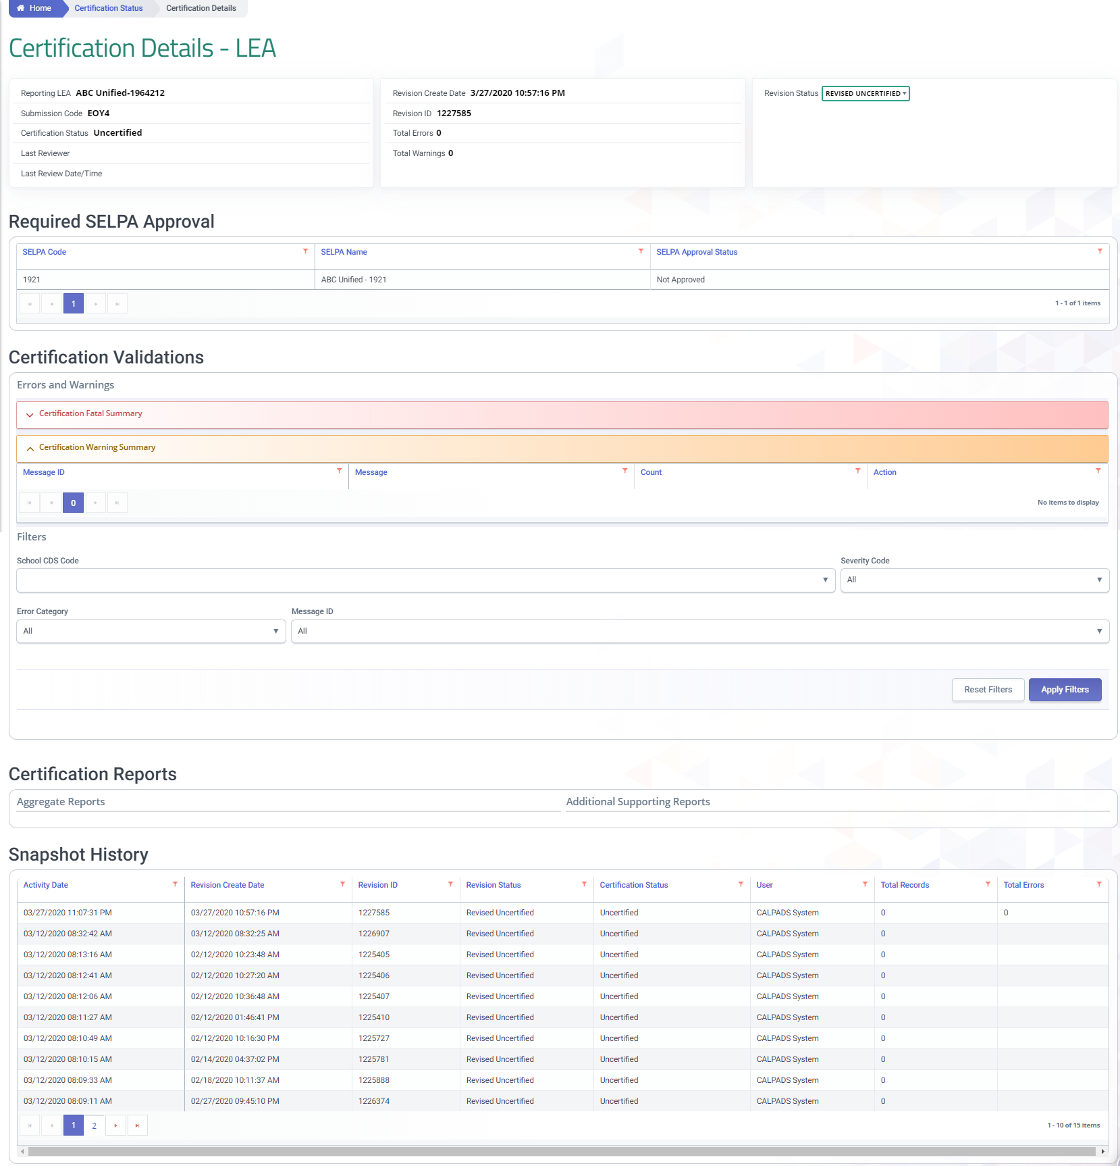
Certification Details
Select revision
Certification Errors and warnings
Indication of SELPA approval
Snapshot processing history
Scroll down to see SWD reports

Slide 43

LEA Approval

Slide 44
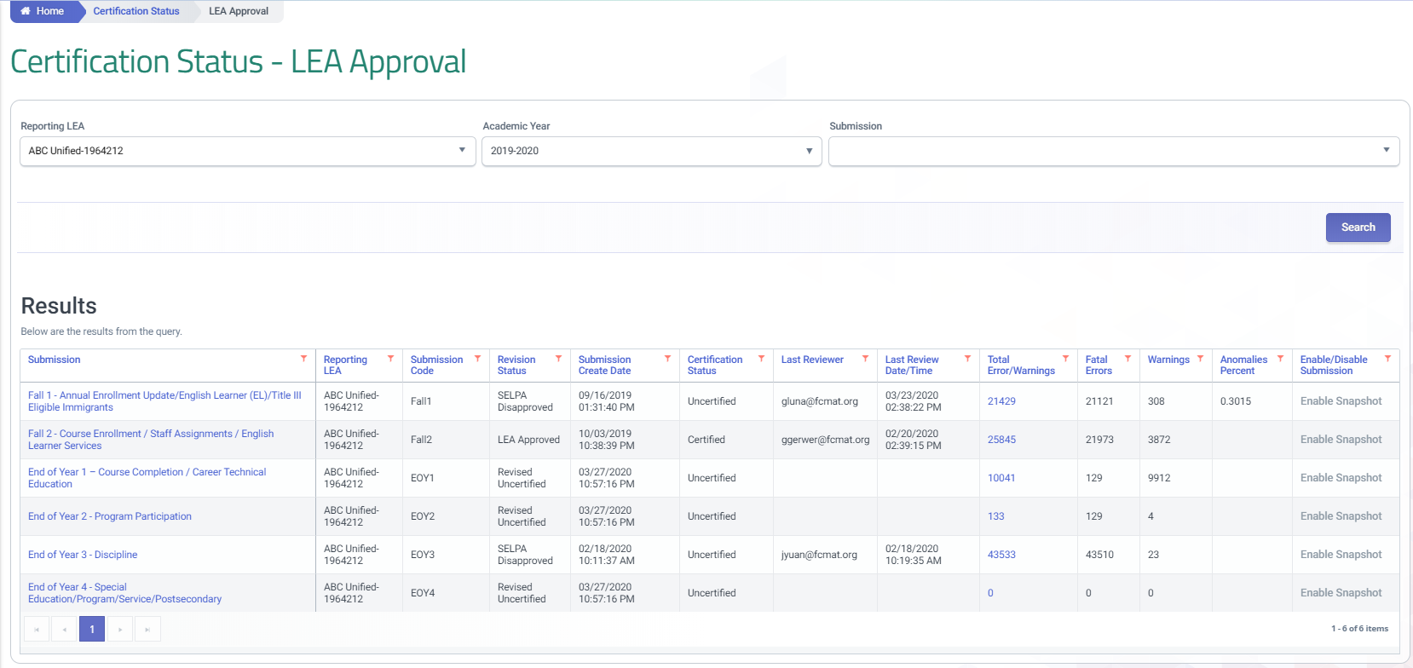
Certification Status
Notes:
The certification status can be reviewed by:
Using the left navigation, select Certification Status
Decide which Submission you want to work with
3. From the certification Status screen scroll down to the Results table
This will display the current Revision status. Each Revision includes the Fatal Error counts, and snapshot reports.
Warnings should be reviewed as they can impact the data on your 8 aggregate reports
44

Slide 45
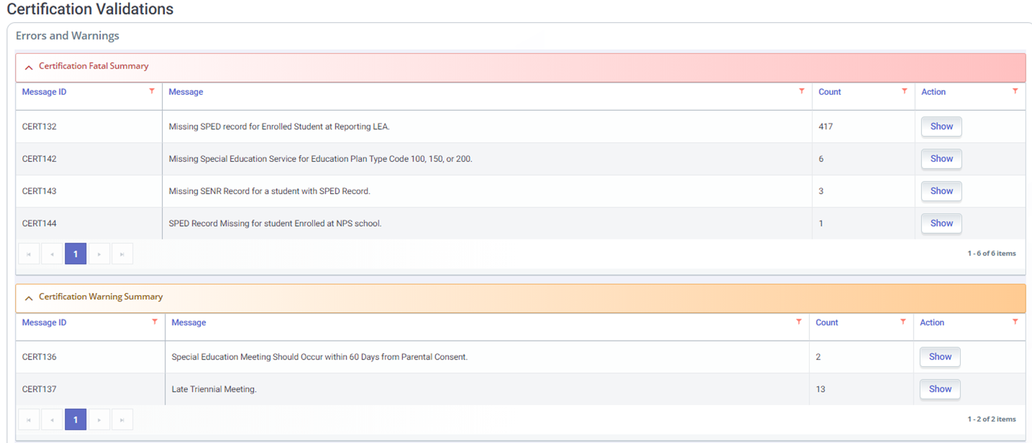
Certification Errors
Notes:
Certification errors and warnings must be reviewed and resolved by the CALPADS data coordinator prior to approval. Fatal errors will prevent certification. This means that cooperation and collaboration will need to continue even after the submission of SWD data. It will require a team effort to certify the data as a whole.

Slide 46
EOY 4 Errors
Error # | Error Name | Severity | Error Type
CERT170 | No SPED PSTS (EOY 4) Data Submitted for a School | W | CVR
SENR0317E4 | Student Enrollment Record in Previous AY Not Exited | F | CDD
SENR0439E4 | Adult Age Students with Disabilities in Transition Status is required for this record | F | CDD
SENR0606E4 | Missing Plan Record for Enrolled Eligible and Participating Student with Disabilities | F | CDD
SENR0646E4 | Student enrolled at NPS school MUST have Eligible and Participating SWDS record | F | CDD
SENR0650E4 | Invalid Special Education Status Code for enrolled student | F | CDD
SENR0661E4 | Invalid Student Race Missing Indicator and Student Race Code Combination | F | CDD
SENR0716E4 | Invalid Student Ethnicity Missing Indicator and Student Hispanic Ethnicity Indicator | F | CDD
SENR0717E4 | Missing overlapping SINF record | F | CDD
SWDS0370E4 | Invalid Student Age for Special Education Non-Participation Reason code Max Age | F | CDD
SWDS0605E4 | Missing Meeting Record for Evaluated Student with Disabilities | F | CDD
SWDS0621E4 | Missing Enrollment Record for Eligible and Participating Special Education Student | F | CDD
SWDS0714E4 | Special Education Status Effective Start Date is less than student birthdate | F | CDD
MEET0421E4 | Special Education Referral Date is less than student birthdate | F | CDD
MEET0624E4 | Missing Special Education Status Record | F | CDD
PLAN0366E4 | Invalid Student Age for Special Education Plan Type Code 100 (IEP) or 200 (ISP) | F | CDD
Notes:
Here is a List or the CVRs that trigger during EOY 4. The Highlighted error was reenabled and can potentially trigger on existing data requiring clean up. CERT142 increased severity and now will prevent snapshot approval. Additional Data Discrepancy Error codes will trigger as CVRs in EOY. Below are a description of the changed EOY 4 CVRs:
CERT167 (W) - General Education Participation Percentage Range Code must be Populated
CERT168 (W) – Special Education Program Setting Code must be Populated
CERT004 (F) – Missing Race/Ethnicity to trigger for Enrollment Status 50
CERT132 (W) - reactivated
CERT140 (F) – “Missing SPED record for a student with a SSRV record” removed academic year from logic. - Triggers when a student has an SSRV record and no corresponding SPED program record. Students must have an associated SPED record at the same LEA in the same academic year with the same Student Special Education Meeting or Amendment Identifier where the meeting type is 10 (Part B Initial), 15 (Part C Initial Evaluation), or 20 (Annual Education or Service Plan Meeting).
Note: Do not submit SSRV for Plan type 300, 700, 800, 900.
CERT141 (W) – updated validation name and logic
CERT160 (W) – “Missing Private School Enrollment record for Education Plan Type Code 200 (ISP)” updated logic to allow for SPED records in future AY or meeting dates in June

Slide 47
Certification Errors (CVR)
Error # | Error Name | Severity | Error Type
PLAN0367E4 | Invalid Student Age for Established Medical Disability 1 Code | F | CDD
PLAN0368E4 | Invalid Student Age for Established Medical Disability 2 Code | F | CDD
PLAN0390E4 | Missing IEP Includes Postsecondary Goals Indicator | F | CDD
PLAN0391E4 | Missing Postsecondary Goals Updated Annually Indicator | F | CDD
PLAN0392E4 | Missing Postsecondary Goals Age Appropriate Transition Assessment Indicator | F | CDD
PLAN0393E4 | Missing Transition Services in IEP Indicator | F | CDD
PLAN0394E4 | Missing Supportive Services Indicator | F | CDD
PLAN0395E4 | Missing Transition Services Goals in IEP Indicator | F | CDD
PLAN0396E4 | Missing Student IEP Participation Indicator | F | CDD
PLAN0397E4 | Missing Agency Representative IEP Participation Code | F | CDD
PLAN0620E4 | Missing Eligible and Participating Status Record for a Plan record | F | CDD
PLAN0673E4 | Missing SWDS Record for a student with a Plan record | F | CDD
PLAN0680E4 | Invalid DSEA - LEA cannot be closed | F | CDD
PLAN0714E4 | Special Education Plan Effective Start Date is less than student birthdate | F | CDD
PSTS0479E4 | Missing Special Education record | F | CDD
PSTS0481E4 | SPED student must be older than 16 and have an exited SENR record | F | CDD
Notes:
Here is a List or the CVRs that trigger during EOY 4. The Highlighted error was reenabled and can potentially trigger on existing data requiring clean up. CERT142 increased severity and now will prevent snapshot approval. Additional Data Discrepancy Error codes will trigger as CVRs in EOY. Below are a description of the changed EOY 4 CVRs:
CERT167 (W) - General Education Participation Percentage Range Code must be Populated
CERT168 (W) – Special Education Program Setting Code must be Populated
CERT004 (F) – Missing Race/Ethnicity to trigger for Enrollment Status 50
CERT132 (W) - reactivated
CERT140 (F) – “Missing SPED record for a student with a SSRV record” removed academic year from logic. - Triggers when a student has an SSRV record and no corresponding SPED program record. Students must have an associated SPED record at the same LEA in the same academic year with the same Student Special Education Meeting or Amendment Identifier where the meeting type is 10 (Part B Initial), 15 (Part C Initial Evaluation), or 20 (Annual Education or Service Plan Meeting).
Note: Do not submit SSRV for Plan type 300, 700, 800, 900.
CERT141 (W) – updated validation name and logic
CERT160 (W) – “Missing Private School Enrollment record for Education Plan Type Code 200 (ISP)” updated logic to allow for SPED records in future AY or meeting dates in June

Slide 48
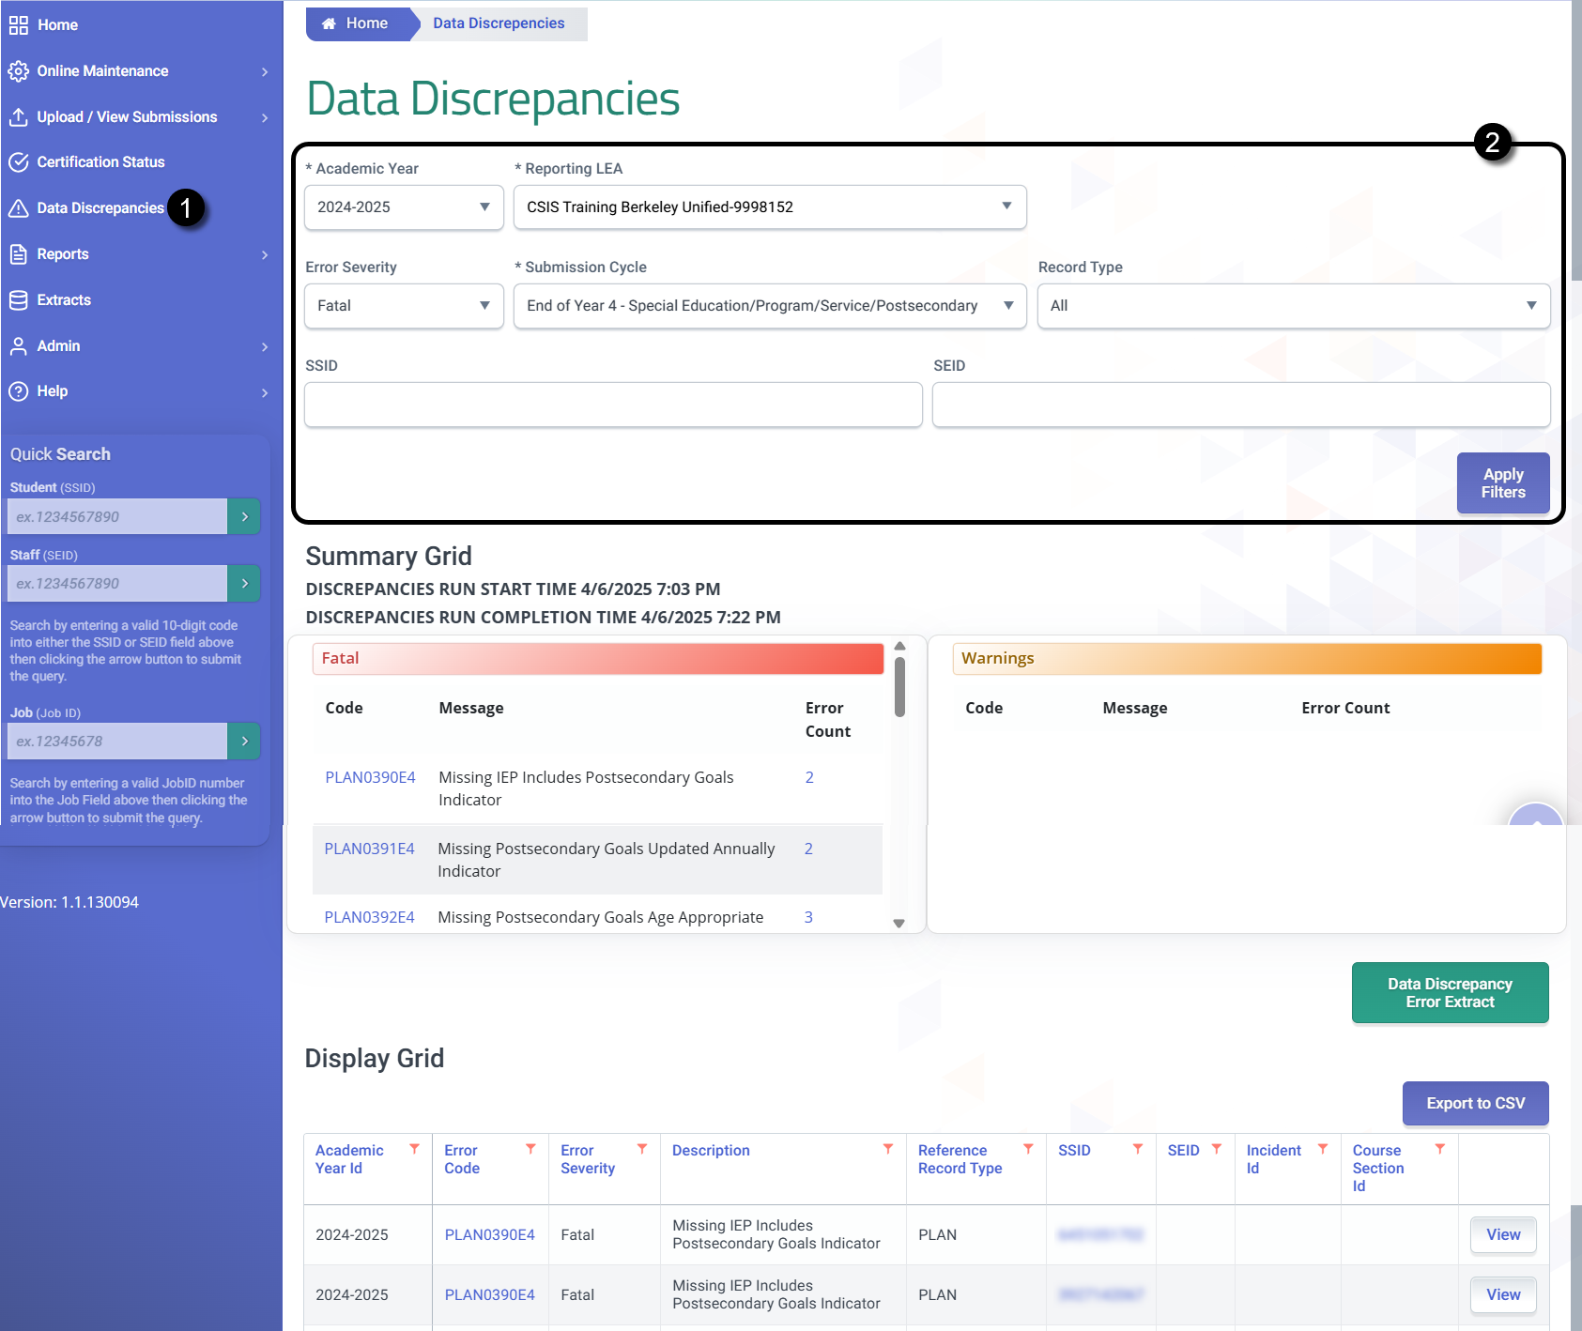
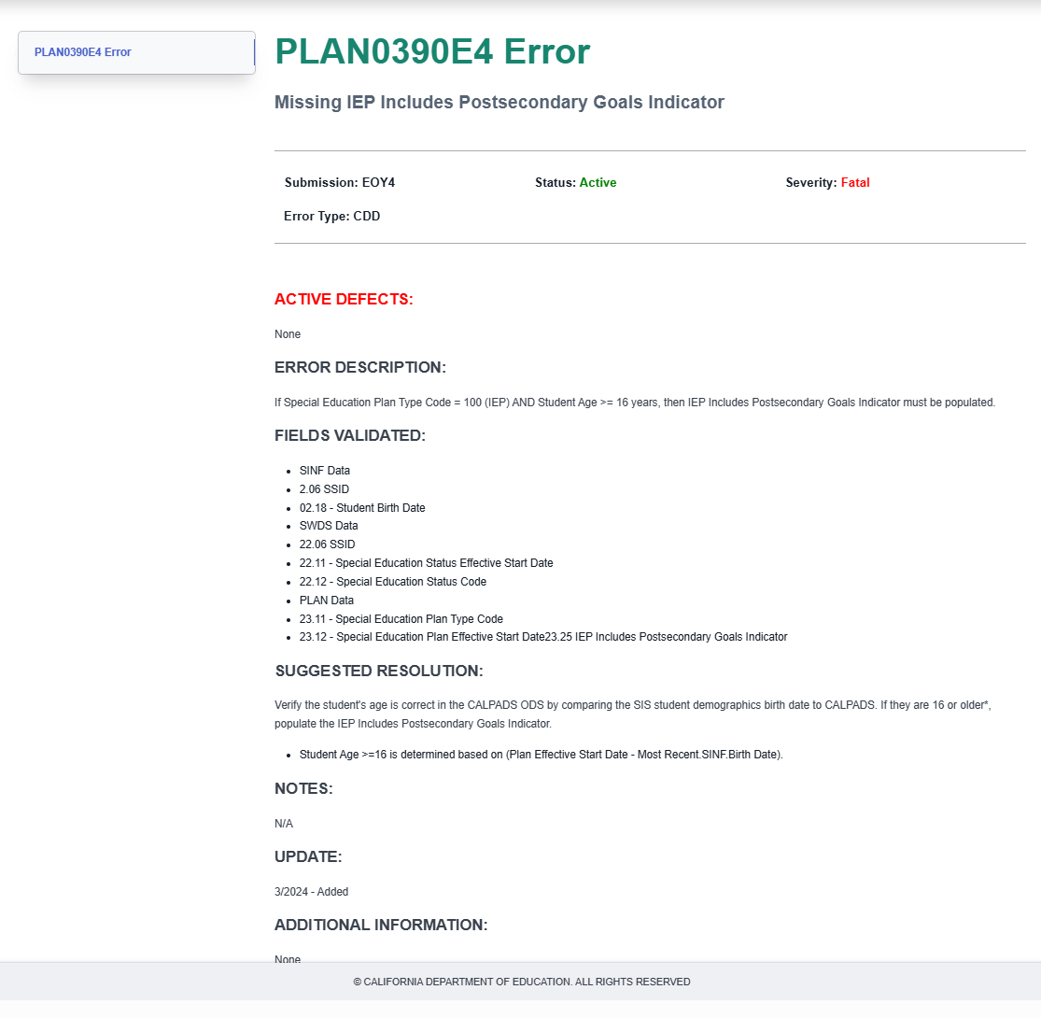
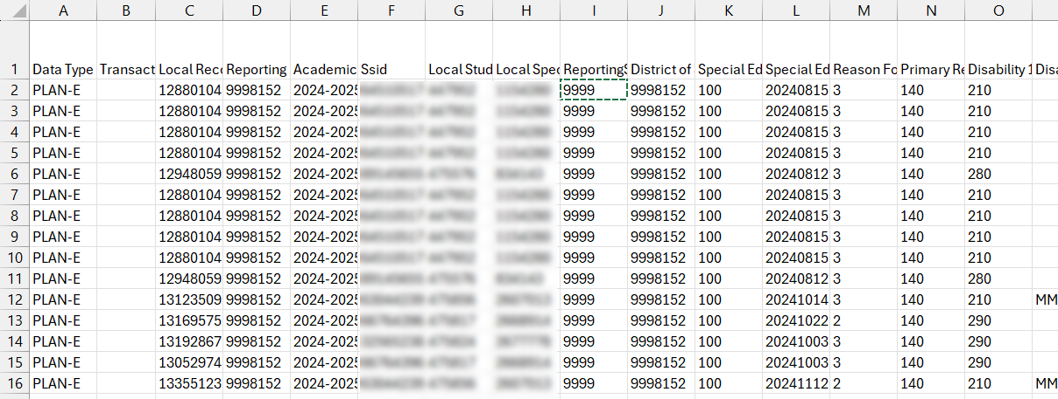
CALPADS Functionalities To Get Ahead
Use the DD page to clear errors ahead of the snapshot
You may extract the rejected records as reference or to create a correction file

Slide 49
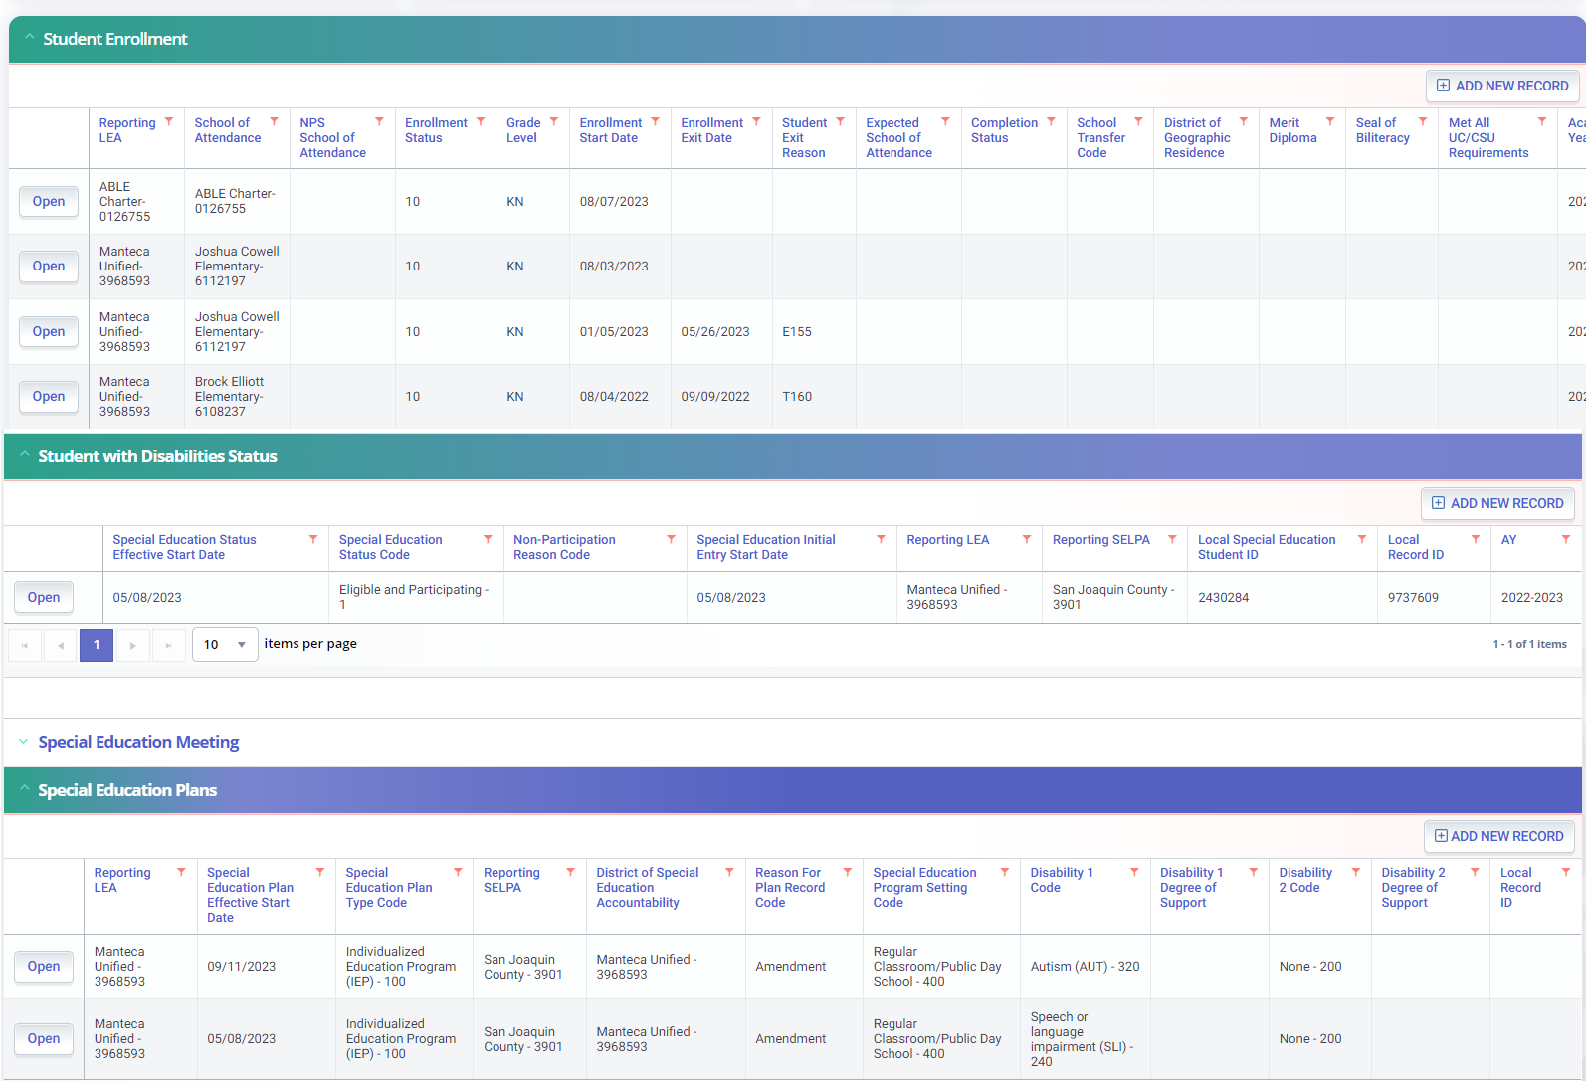
SENR0606E4
Missing Plan Record for Enrolled Eligible and Participating Student with Disabilities
All SWD enrolled in the LEA with an Eligible and Participation SWD status must have a PLAN record
The most recent PLAN record must correspond with the active enrollment to show adoption of plan or that a meeting was held to develop a plan
Notes:
SENR0606E4 – Missing Plan Record for Enrolled Eligible and Participating Student with Disabilities was the single most problematic error from the SPED redesign. The error has a SENR prefix but triggers based on a students SWDS and PLAN records. This error most often occurs when students transfer into the district from another LEA, from a private school located inside or outside of the LEA, or from out of state and the PLAN is not record reported by the new LEA. Monitoring report 16.21, the Data Discrepancy User Interface or the SSID Extract can help to identify students enrolled in your LEA with active PLAN records in CALPADS that don’t have PLAN records reported by your LEA Collaborate with CALPADS and SIS coordinators to identify these students on a regular basis – it is recommended at least weekly

Slide 50
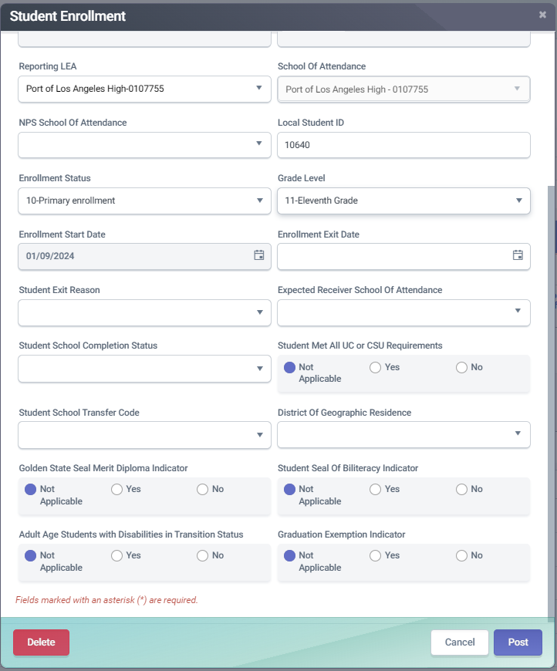
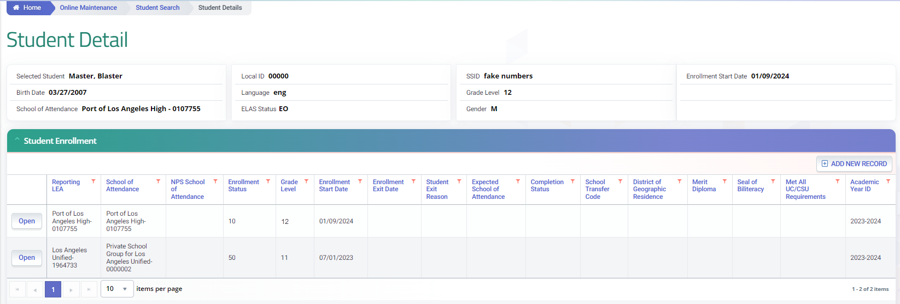
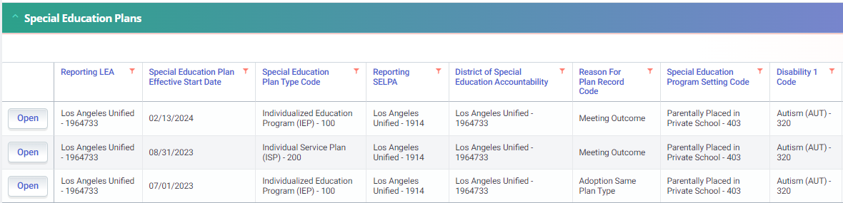
SENR0439E4
Adult Age Students with Disabilities in Transition Status is required for this record
For students in their initial 12th grade year the indication should be “N”. When A “Y” is indicated their must be a previous grade 12 SENR record
All 12th Grade SWD with an active IEP must have the transition status indicated
Notes:
The SENR0439E4 Error triggers if SWD is at least 17 years old, and is in grade 12, with an Active Plan) but no Adult Age Students with Disabilities in Transition Status is indicated. This field must be populated for all 12th grade students with disabilities, however a student is not in transition their initial 12th grade year. The indicator should be populated with a N. For Students with disability repeating the 12th grade the status may be Y or N depending on whether they are receiving transition services.
A “Y” indicates that a SWD:
1) completed 12th grade in their initial cohort year; and
2) is re-enrolling in the subsequent year and participating in a program to assist in the student's transition from school to adult life, including education and training, employment and independent living; and
3) is no longer taking any coursework towards a standard high school diploma.

Slide 51
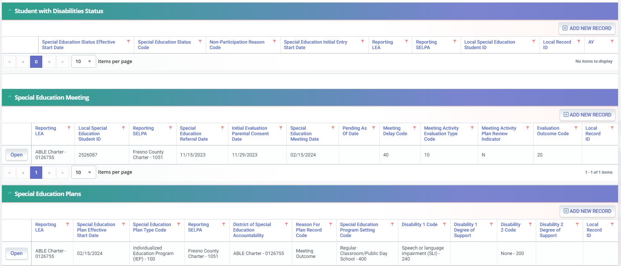
PLAN0620E4
Missing Eligible and Participating Status Record for a Plan record
A SWD status is required for all Students who have been evaluated for Special education eligibility
MEET0624E4
Missing Special Education Status Record
A status is required for all MEET records unless they are pending an initial evaluation
A Student with an effective PLAN record must have a SWDs of Eligible and Participating
Notes:
The PLAN0620E4 triggers when there is an effective PLAN record, but no SWDS of eligible and participating reported. Retrieving data. There must be a SWDS record of eligible and participating that overlaps the Plan Effective Start Date. This student was newly evaluated for Part B (Meeting Activity Evaluation Type Code 10) and was found eligible. There is a meeting delay code (40, school break) so we can understand how initially no status was reported. When the student was found eligible (Evaluation outcome 20) the status should have been updated with the PLAN.
The MEET0624E4 goes hand in hand with the PLAN0620E4. the Missing Special Education Status Record error trigger when there is a MEET record and no SWDS reported. This is only allowed when there is a records of a pending evaluation. From the evaluation outcome the status is determined.

Slide 52
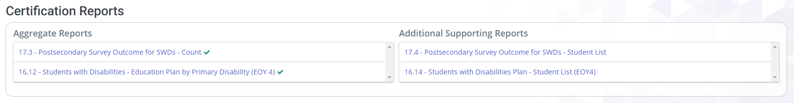
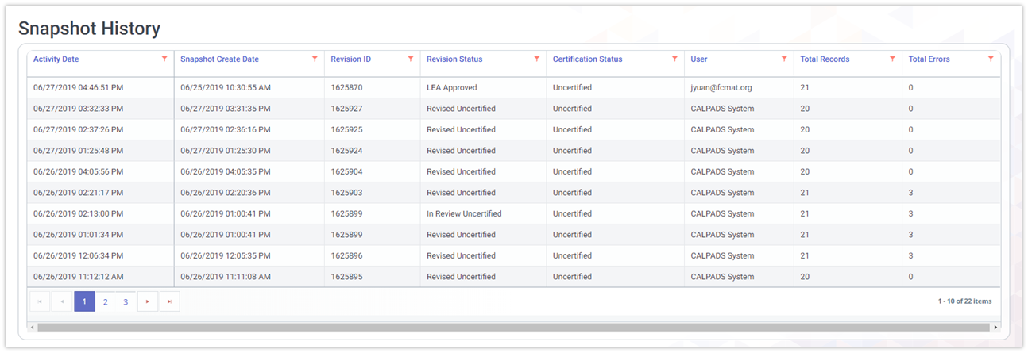
Review Reports

Slide 53

SELPA Approval

Slide 54
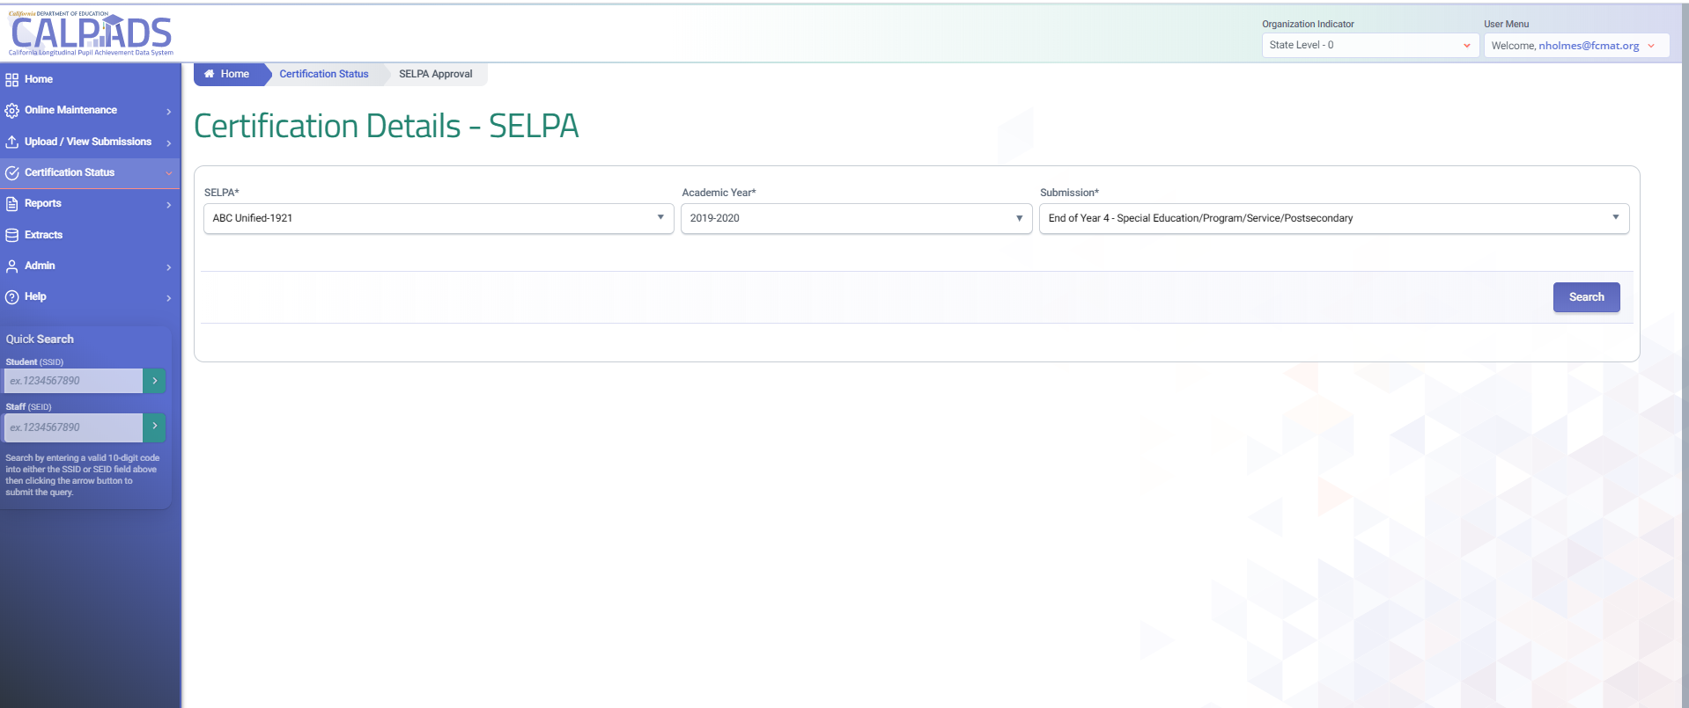
Certification Details UI for SELPA
1
2
3
Select the
1. Academic Year filter or
2. Submission filter as EOY 4
3. Search criteria to access the certification details for a specific submission
Notes:
Nate

Slide 55
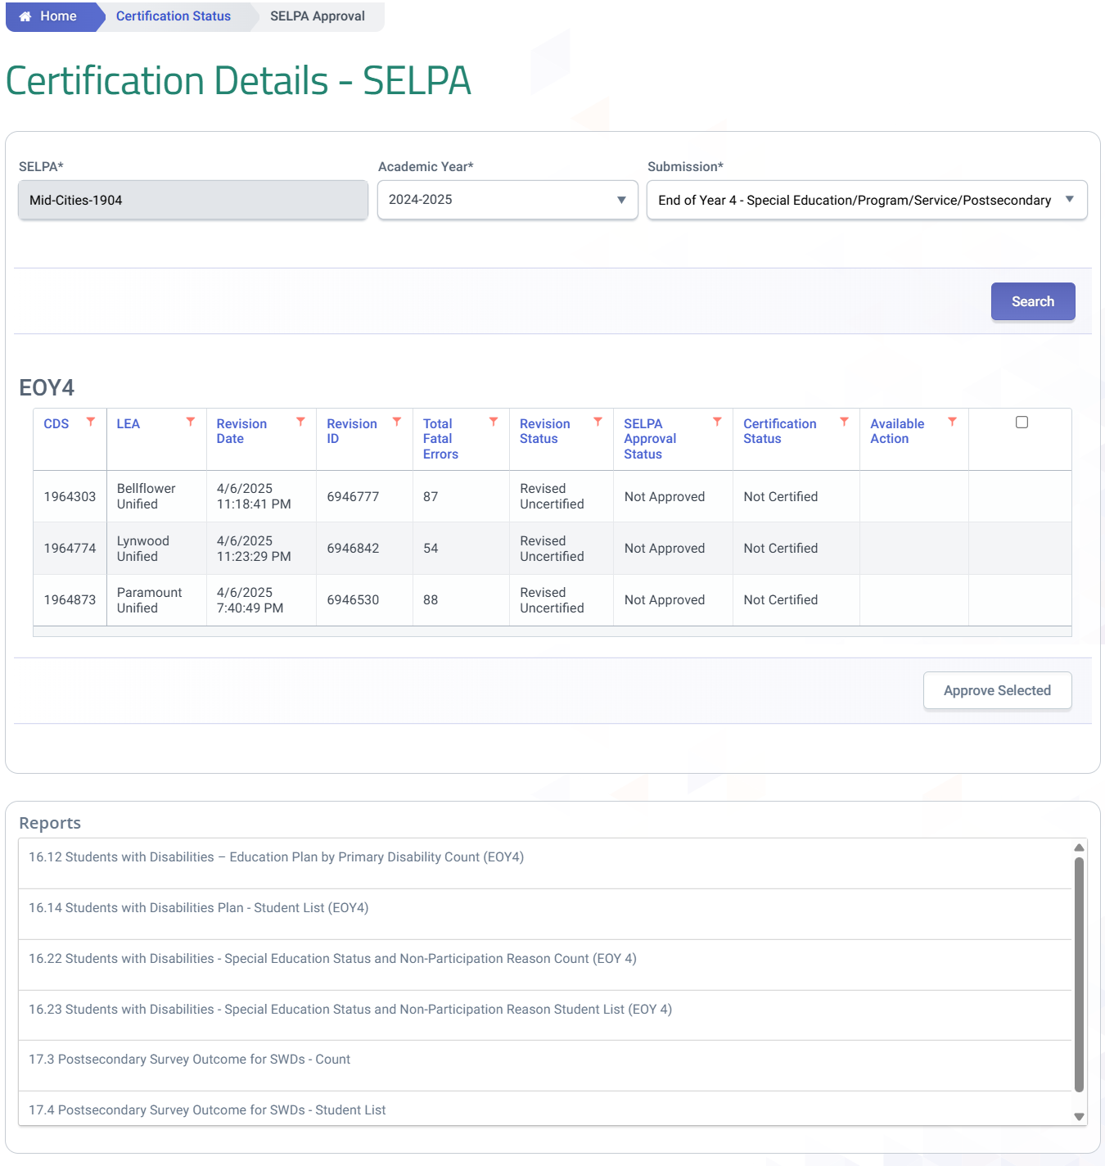
SELPA Approval Tips
LEA and SELPA should communicate as to what Snapshot Revision ID should be reviewed.
SELPAs can approve LEAs individually or en masse, assuming they have zero fatal errors.
By default, SELPAs will see the version of reports based on the default status of the revision. LEA and SELPA should communicate as to what Snapshot Revision ID and version of each report should be reviewed.
Notes:
After an LEAs has approved a revision SELPAs can then approve the LEAs revision. While the approval functionality is only permitted after an LEA approves their revision, SELPAs can access reports prior to an LEA approval. A final review of reports should be made by SELPAs prior to approving any LEA revision. SELPAs multiple LEAs will have each LEA listed along with their status. SELPAs can approve LEA revisions one by one or in mass.

Slide 56

Syncing EOY 3&4 Revisions
Many special education exits required for EOY 4 are derived from the student’s enrollment (SENR) record, This necessitates certifying EOY 3 and 4 together with the same revision. LEAS should align EOY 3 and EOY 4 by verifying revision IDs and timestamps and coordinating LEA approval to ensure the EOY 3 and 4 are in sync
Notes:
Many special education exits required for EOY 4 are derived from the student’s enrollment (SENR) record, This necessitates certifying EOY 3 and 4 together with the same revision. It is important to ensure no changes are made after certifying EOY 4 that may impact records for student with disabilities. To mitigate differences or discrepancies in data from the EOY data collections, EOY 2,3 and 4 will be combined and certified in a single submission next year. This year in 24-25 LEAS should align EOY 3 and EOY 4 by verifying revision IDs and timestamps and coordinating LEA approval to ensure the EOY 3 and 4 are in sync.

Slide 57

Certification Reports

Slide 58
Certification Reports
All Reports will be available to both LEA and SELPA Users
All Reports will be available to both LEA and SELPA Users
Report 16.14
Students with Disabilities - Plan Student list (EOY4)
Report 16.12
Students with Disabilities - Education Plan by Disability (EOY4)
Report 17.3
Postsecondary Survey Outcome for SWDs - Count
Report 17.4
Postsecondary Survey Outcome for SWDs - Student List
Legend
Aggregate Report
Supporting Report
Report 16.13
Students with Disabilities - Federal Setting Count (EOY4)
Report 16.22
Students with Disabilities - Non- Participating Status Report – Count (EOY4)
Report 16.23
Students with Disabilities - Non- Participating Status Report - Student Details (EOY4)

Slide 59
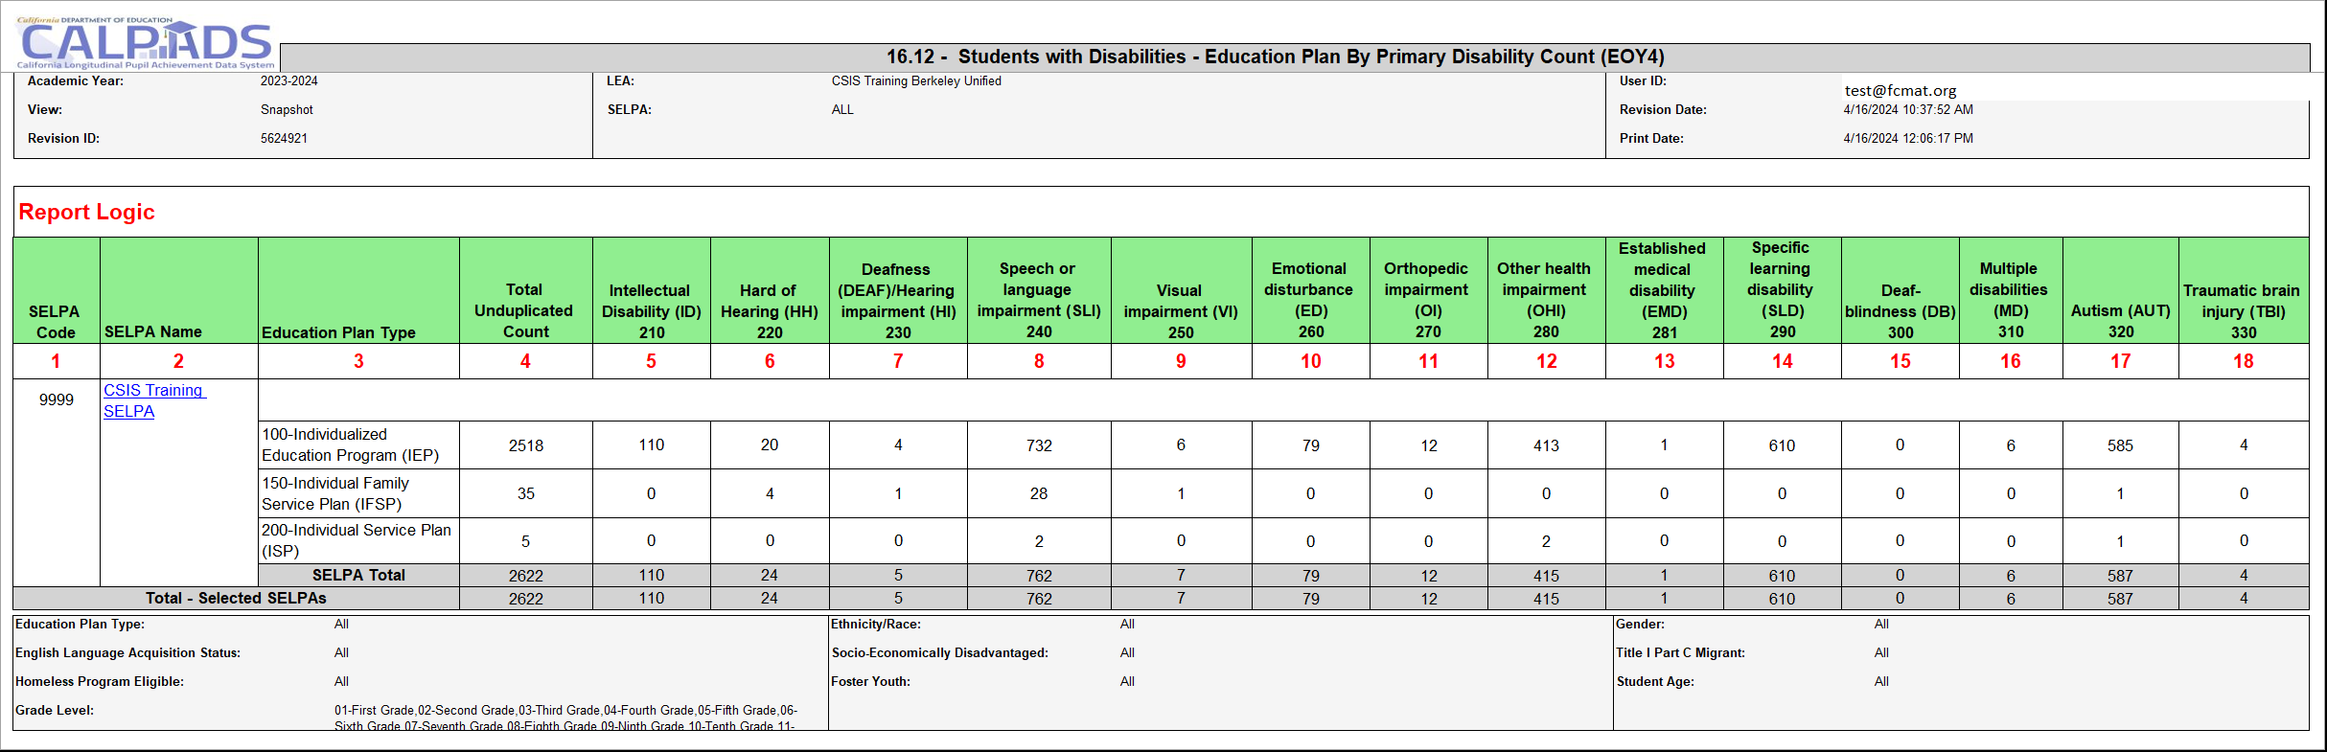
Report 16.12 – Students with Disabilities – Education Plan by Primary Disability Count (EOY 4)
Description: Reports unduplicated counts of Students with Disabilities by Education Plan Type and Primary Disability Category
Notes:
Reports unduplicated counts of Students with Disabilities by Education Plan Type and Primary Disability Category. This Report excludes Meeting Type 40 – Triennial records from being displayed in the report. The records being displayed in the 16.1 and 16.2 reports reflect the most recent Special Education Meeting Types: 10 – Part B Initial Evaluation, 15 – Part C Initial Evaluation, or 20 – Annual, 30 - Pending record for the student on the report date.
Note: that if the most recent record is 30 – Pending, since a primary disability has not yet been identified, report 16.1 will show no data in the primary disability columns, and report 16.2, since it is aggregated by primary disability, the 30 – Pending records will not display.

Slide 60
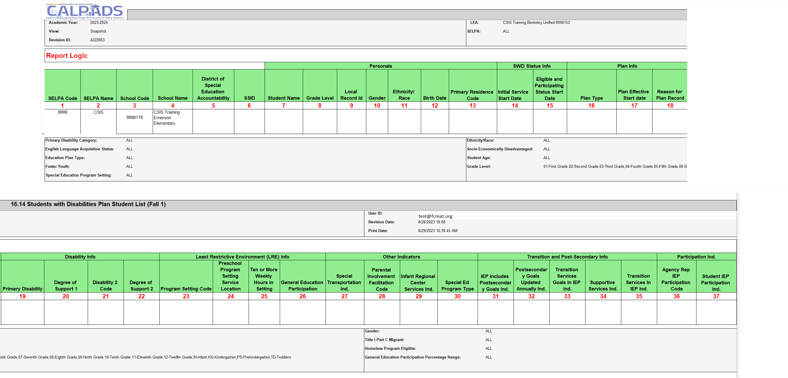
Report 16.14 Students with Disabilities Plan Student List (EOY 4)
Notes:
Reports a list of students with disabilities and associated meeting, plan, and other SPED-related information.

Slide 61
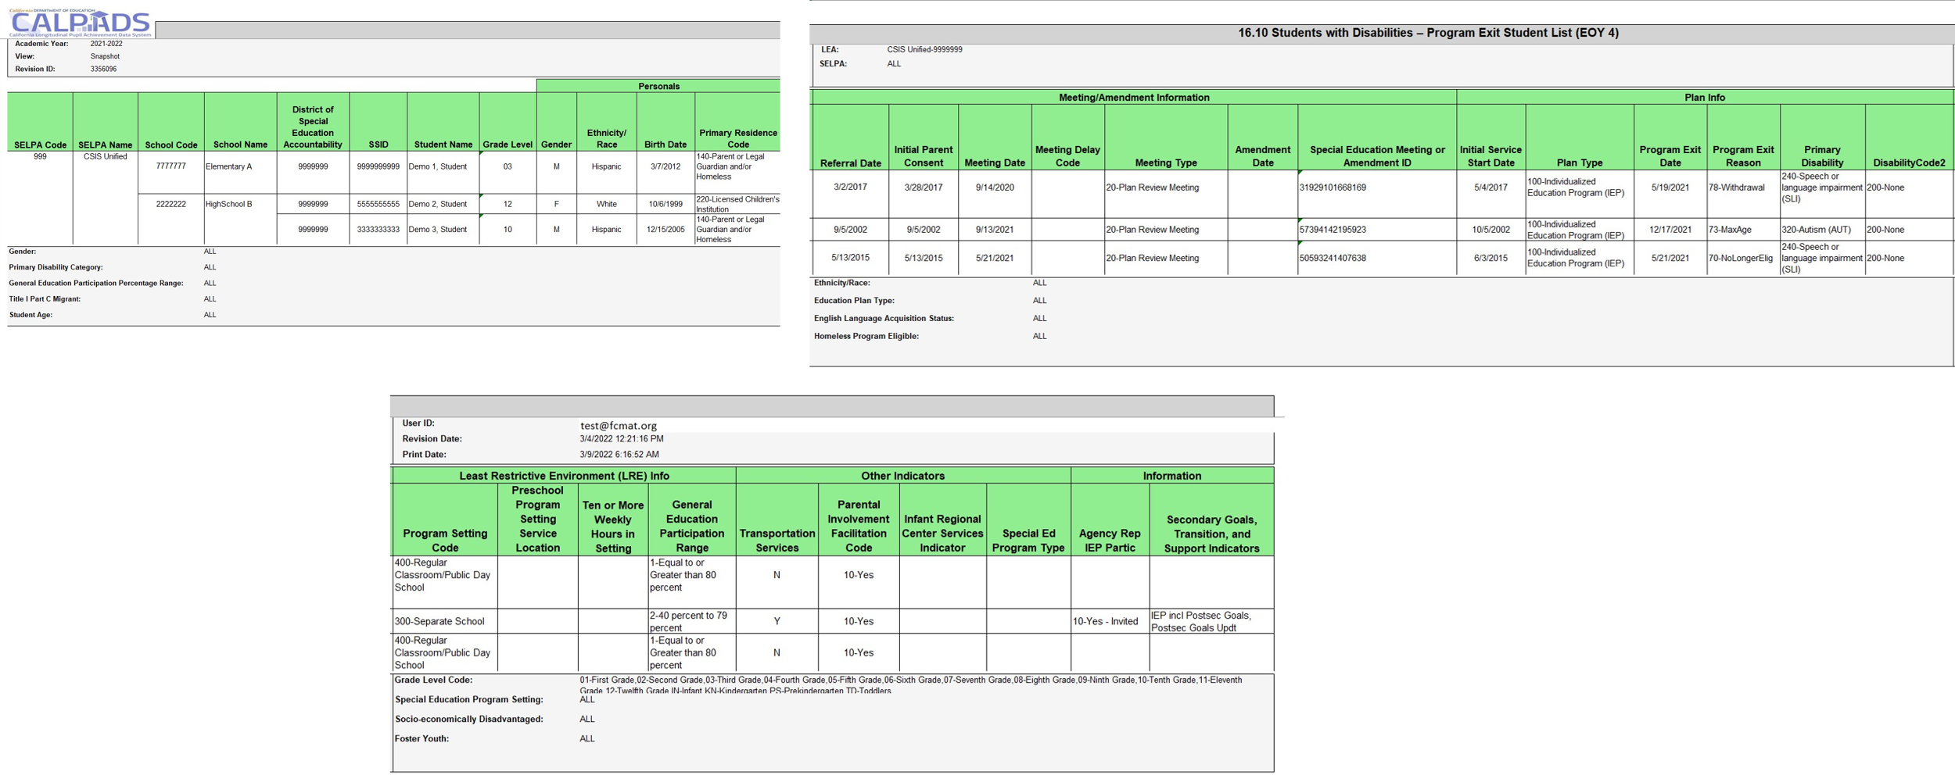
16.22 - Students with Disabilities Non-Participation Status Count (EOY 4)
Notes:
Reports of Students with Disabilities by Primary Disability Category who have exited from the Special Education program due to no longer being eligible, reaching maximum age, withdrawal, or not receiving parental consent to continue from Part C to Part B.

Slide 62
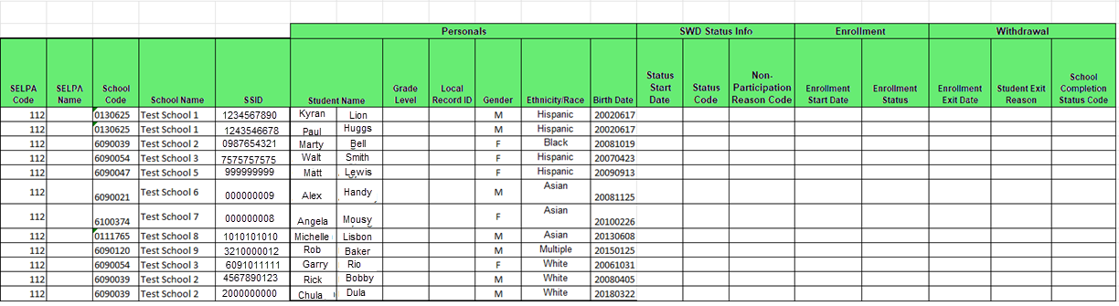
Report 16.23 Students with Disabilities – Non-Participating Status Student List (EOY 4)
Notes:
Reports unduplicated count of students with disabilities by Primary Disability Category as of Fall Census Day in the selected year compared to the prior Academic Year.

Slide 63
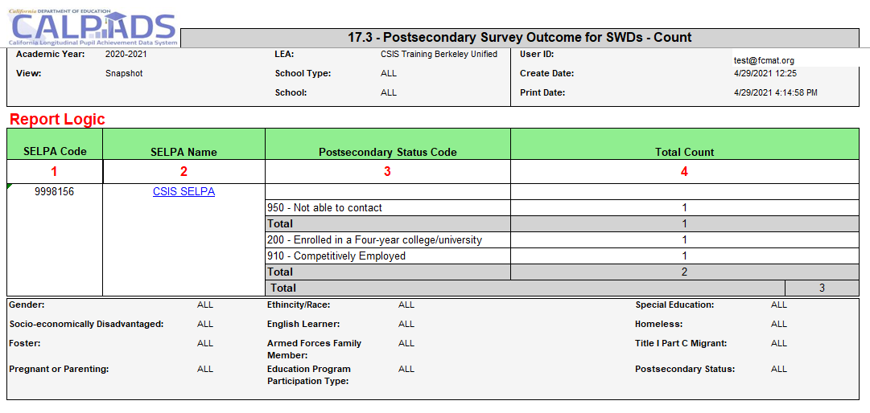
Report 17.3 - Postsecondary Survey Outcome for SWDs - Count
Reports the total number of students with disabilities identified in the Postsecondary (PSTS) survey outcome.

Slide 64
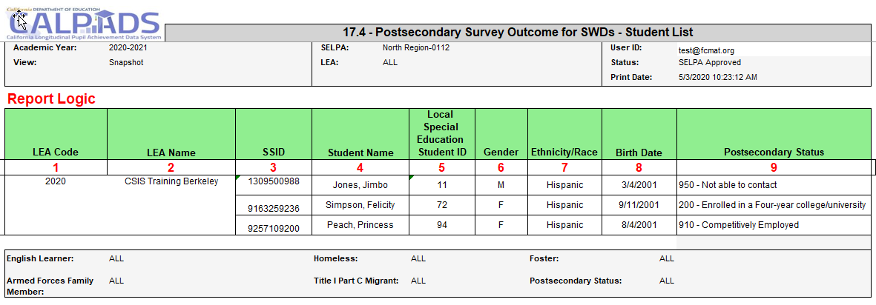
Report 17.4 Postsecondary Status-Student List
Reports the details for students with disabilities identified in the Postsecondary (PSTS) survey outcome

Slide 65
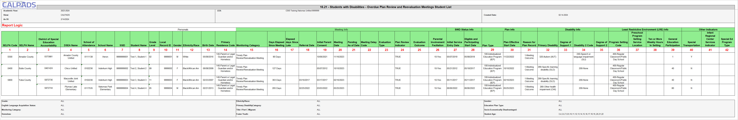
Monitoring Reports (ODS)
Report 16.21 – SWDs – Overdue Plan Review and Revaluation Meetings Student List
Description: Reports student details of students who are Eligible and Participating Students with Disabilities who are either
1) overdue on Plan Review or Reevaluation meeting as of the Report As Of Date,
2) their most recent plan review or reevaluation meeting was held late, or
3) their meetings are on-time.
Notes:
16.7 Mapping Guide - https://documentation.calpads.org/Reports/Accountability/Report16.7_StudentwithDisabilities-MonitoringCounts/

Slide 66

Wrap Up
Key Points, Resources and Support

Slide 67

Submission
Summary
EOY 4 not only requires the SWDS, MEET, PLAN, SERV, PSTS records be posted from the SEDS, but other student related records from the SIS as well
Student with disabilities data should be updated on an ongoing basis throughout the year
The data in EOY 4 is reflective of the entire academic year
SWD Exits come from the SWDS and the SENR records
The MEET record identifies students who have been evaluated for special education and PLAN records identify students on active plans
The PSTS file is created from survey results from students who left school in the previous academic year without any subsequent enrollment in CALPADS.
Some key points to remember
Notes:
READ SLIDE

Slide 68
Spring 2025 Special Education Data Roadshows
Date of Roadshow | Hosting Agency | Start Time | End Time | In-Person Registration link | Virtual Registration link (if providing a virtual option) | Notes
4/25/2025 | Shasta SELPA | 9:00 AM | 12:00 PM | https://www.shastacoe.org/forms/~form-uuid/87d35117-0b3b-46a1-bb24-074d3e58b9ca | N/A
4/28/2025 | Ventura County SELPA | 9:00 AM | 12:00 PM | https://vcoe.k12oms.org/1630-254138 | https://vcoe.k12oms.org/1630-254138
4/29/2025 | Orange County Department of Education | 8:30 AM | 11:30 AM | http://ocde.k12oms.org/1268-262448 | N/A
4/29/2025 | Los Angeles County Office of Education | 1:00 PM | 4:00 PM | http://lacoe.k12oms.org/1894-262336 | http://lacoe.k12oms.org/1894-262338
5/5/2025 | Tulare County Office of Education | 8:30 AM | 11:30 AM | https://tulare.k12oms.org/146-258130 | N/A
5/8/2025 | Fresno County Superintendent of Schools | 8:30 AM | 11:30 AM | http://fresno.k12oms.org/131-262266 | http://fresno.k12oms.org/131-262266 | Access Code: 0508
5/12/2025 | Contra Costa SELPA | 9:00 AM | 12:00 PM | https://forms.gle/ZdxJhRoEUTp3TmtSA | N/A
5/19/2025 | Sacramento County Office of Education | 1:00 PM | 4:00 PM | https://proflearn.scoe.net/Home/Register/736 | TBD
5/19/2025 | San Joaquin County Office Of Education | 9:00 AM | 12:00 PM | https://forms.gle/APzJ8BJWbWhcZL176 | N/A
5/20/2025 | Madera County Superintendent of Schools | 9:00 AM | 12:00 PM | https://madera.k12oms.org/eventdetail.php?id=262532 | https://madera.k12oms.org/eventdetail.php?id=262532
5/23/2025 | East County SELPA – San Diego | 9:00 AM | 12:00 PM | http://sdcoe.k12oms.org/1035-262350 | N/A

Slide 69




Suggested Milestones
Now – 5/6
Complete Data Population in local SIS
Now – 6/19
Submit and post files. Review IVR and Data Discrepancy errors and reconcile as needed.
6/20 – 7/10
Resolve Certification and Data Discrepancy errors. Review snapshot reports and update records as needed
7/11
Recommended Date for Zero Errors
EOY
2024-2025
7/11– 7/18
Send reports to local data stewards, site leaders and administrators for approval (Send earlier if possible)
7/22 – 7/25
LEA Approve by Certification Deadline
(EOY 3 & 4 should be SELPA Approved if possible)
Amendment Deadline
(EOY 3 & 4 require SELPA Approval)
7/26 – 8/8
8/15
Cohort Deadline
(Collected from the ODS Data)

Slide 70



Resources
Here are some important resources related to SELA reporting.
  https://learn.fcmat.org/
https://www.youtube.com/channel/UCA9oRTiyVECCCzOxpmJheZw
https://documentation.calpads.org/Support/References
https://www.cde.ca.gov/ds/sp/cl/index.asp

Slide 71
SPED Specific Resources
Here are some important resources related to Student with disabilities reporting
Reporting Data for Students with Disabilities: https://www.cde.ca.gov/ds/sp/cl/swdreporting.asp
Special Education File Submission Scenarios: https://www.cde.ca.gov/ds/sp/cl/spededfilesubscenarios.asp
Documentation for the new special education files can be found at the following CDE website: https://www.cde.ca.gov/ds/sp/cl/systemdocs.asp
Special Education Data Fall 2023 Roadshow recording: https://www.youtube.com/watch?v=kNARoriIIAI&list=PLsnFpLOXpp4Jjx9zMz-J42-zp1GYuyBsS
New frequently asked questions (FAQs) have been developed for the special education data: https://www.cde.ca.gov/ds/sp/cl/calpadsfaqs.asp#f1top

Slide 72





Support
http://www2.cde.ca.gov/calpadshelp/default.aspx
Web
calpads-support@cde.ca.gov
Email
916-325-9210
Phone
https://csis.fcmat.org/ListServ
You can get help through these channels.
Listserv

Slide 73
Feedback
I have a question…
“
”
Please complete survey…
https://bit.ly/2MXsECg
“
”

Slide 74






Thank You
Presenter Name
916-325-9200
csistraining@fcmat.org
https://csis.fcmat.org/

