Slide 1



End of Year 3
Reporting and Certification
Submission
Certification Errors
Reports
Notes:
Welcome to EOY 3 Reporting and certification. In today’s training we will cover the business rules related to the data submission and review the certification process.

Slide 2
CALPADS Training Road Map
Introduction
System Overview
Basics
Submission: Data Population
File Type: Data Population
Data Collections
Fall 1-2 Reporting and Certification
EOY 1-4 Reporting and Certification
Skill Building
Skill Building
Data Privacy
Data Population
CALPADS Basics
CALPADS Basics (SELPA)
4 Year Cohort
Notes:
The CSIS training model is designed to be segmented to provide organization of specific topics and concise delivery. We aim to provide focused trainings with relevant information and instruction.
- This slide reflects the CALPADS course catalog. In the top we have the various Subject Areas and their respective Programs shown below each one. The first three skill areas contain programs that are the prerequisite for the Data Collection programs and the EOY Advanced is part of the EOY 1-4 Reporting and Certification program, which you are attending today. We also have the Skill Building program consisting of courses which are available in self-paced format.

Slide 3


Target Audience
Data Coordinators
Administration
Notes:
This training is intended for LEA data coordinators, those doing the routine maintenance and submission of CALPADS records. It may also be beneficial for administrators to attend so that they can understand the scope of work and time required to complete the EOY 3 data collection.

Slide 4




Objective
Identify
Perform
Resolve
Analyze
key data and stakeholders in preparation of the the EOY 3 submission
the EOY 3 submission process based on an internal schedule considering staff availability and competing priorities
certification errors using analytical mindfulness and review reports for completeness and reasonability
(Critical Thinking)
certification reports to assess the flow of data across the ecosystem and evaluate how well data is leverage in informed decision making
(Data Leadership & Coalition Building)
(Project Management)
(Coalition Building & Critical Thinking)
Notes:
Today’s training has been developed with specific objectives in mind that highlight essential skills needed during the CALPADS Submission process.
(Data Leadership)
Identify key data and stakeholders in preparation of the EOY 3 submission
(Project Management)
Perform the EOY 3 submission process based on an internal schedule considering staff availability and competing priorities
(Critical Thinking)
Resolve certification errors using analytical mindfulness and review reports for completeness and reasonability
(Coalition Building)
Analyze certification reports to assess the flow of data across the ecosystem and evaluate how well data is leverage in informed decision making

Slide 5





Agenda
Overview
Reporting Requirements
Certification Process
Wrap-Up
Where do we go from here?
Notes:
We will begin with an overview of EOY 3, then we will delve into the details of the submission. Of course, we will discuss the 2-step approval, certification errors and reports before concluding with a wrap up.

Slide 6

Overview
Discuss EOY 3 data collection & reporting timeline
Notes:
Now, let’s ever so briefly look at EOY 3 with a big picture focus.

Slide 7
Data Collection Window for 2024-25
Census Day
Certification Deadline
Final Deadline
Initial ELPAC Testing Window opens
July 1, 2024
ODS Cohort Pull
Oct 2, 2024
Dec 17, 2024
January 24, 2025
August 15, 2025
CAASPP Testing
Amendment
1/14 to 6/30/2025
Fall 1 Submission
ELPAC Summative Testing
2/3 to 5/31/2025
Cohort Processing - ongoing
Nov
Dec
Jan
Feb
Apr
May
Jun
Jul
Aug
Sep
2023
AY 25-26
Oct
Mar
Fall 2 Submission
GAP
EOY Submissions
Submit Fall 2 Data
Amendment
Fall 2 Deadline
Start of Submission
March 21, 2025
May 6, 2025
Final Deadline
Certification Deadline
July 25, 2025
August 8, 2024
https://www.cde.ca.gov/ds/sp/cl/rptcalendar.asp
Notes:
Use the gap period to continuously update student profile data for testing requirements, monitor SPED students, internally prepare/ validate EOY related data in your SIS and submit available data to CALPADS

Slide 8

  Key Dates
Snapshot
starts
May 6, 2025
Certification Deadline
July 25, 2025
Amendment Window Deadline August 8, 2025
Error Free & Review Reports July 11, 2025
The End of Year reporting period is July 1, 2024– June 30, 2025
Notes:
Our goal is to help LEAs build their local capacity. Therefore:
The expectation is for each LEA to resolve all fatal errors by July 11th and Approve by July 25th.
The EOY snapshot reports will generate on — May 6th
The EOY error resolution is — July 11th
The EOY submission window deadline is — July 25th
The FINAL amendment deadline is August 8th
Also, these dates can change so it is best to check the CDE’s calendar using the link on this slide.
Minimize data cleanup in CP. If you are cleaning data (resolving validation and CDDs) for more than 2 weeks in CALPADS, that is an indication there are local issues that need to be addressed. CDE will always reconsider the timelines if the system is not performing as expected.

Slide 9






  End of Year 3
  Behavioral Incidents
    SINC, SIRS & SOFF Files
  Absenteeism
    STAS File
  Cumulative Enrollment
    SENR (Exit) File
  Homeless Program
    SPRG File
  EL Reclassified (RFEP)
    SELA File
  One Year Grad
    SENR (Exit) File
Notes:
EOY 3 requires the submission of:
Behavioral Incidents
Student Absenteeism
Cumulative Enrollment
Homeless Program and the recently moved
RFEP counts

Slide 10
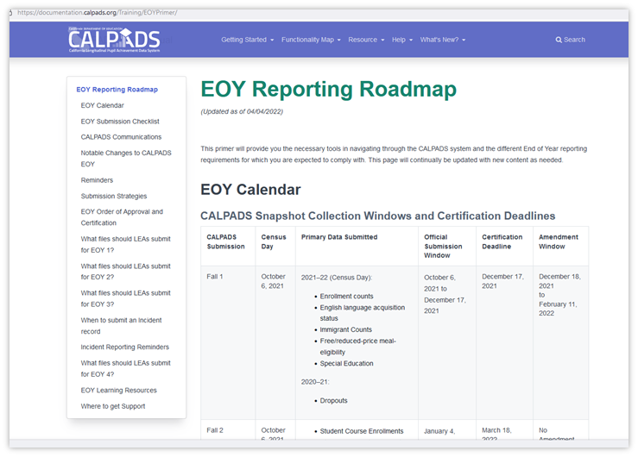
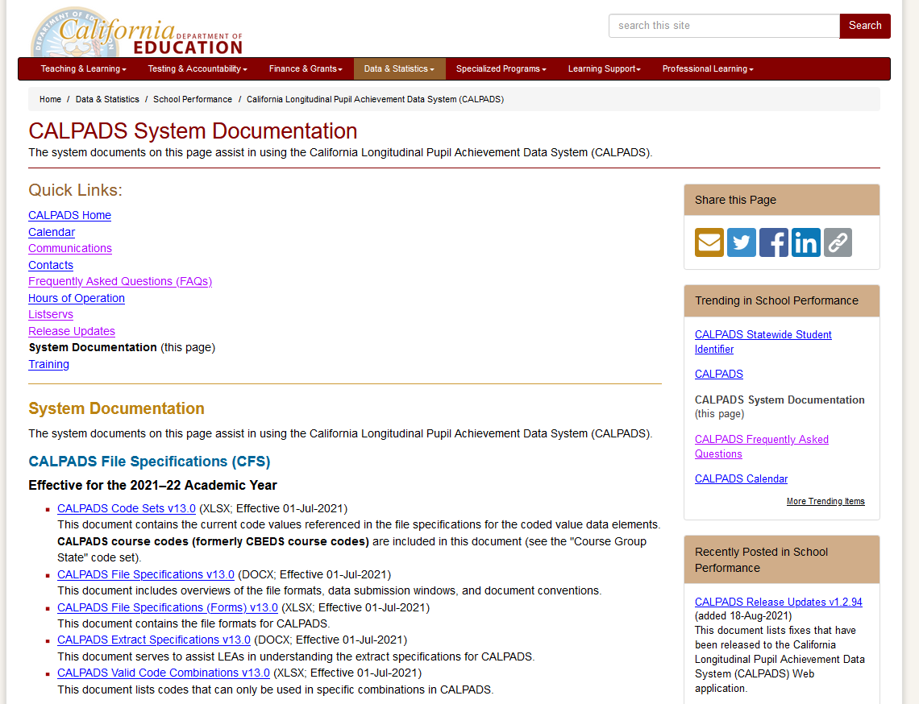
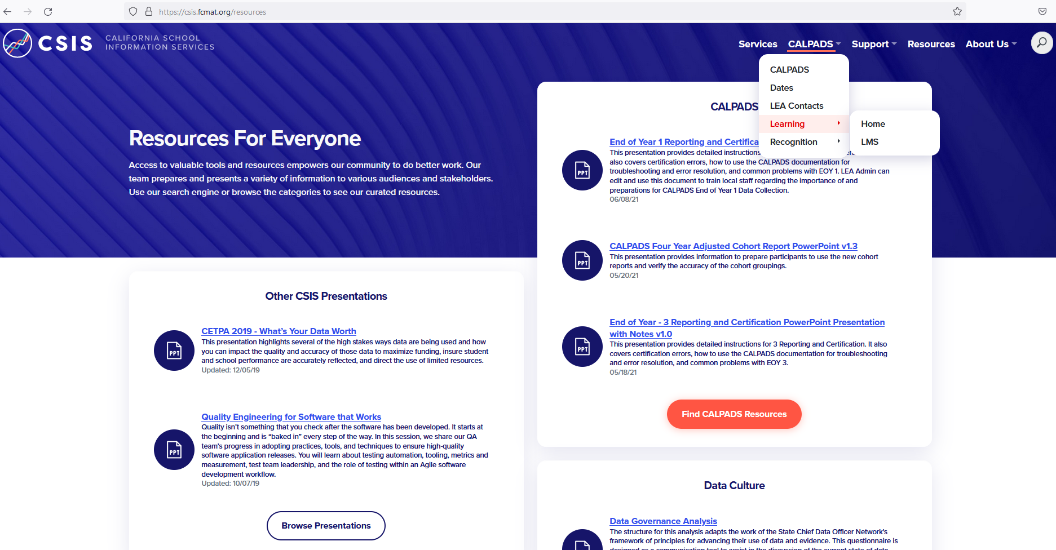
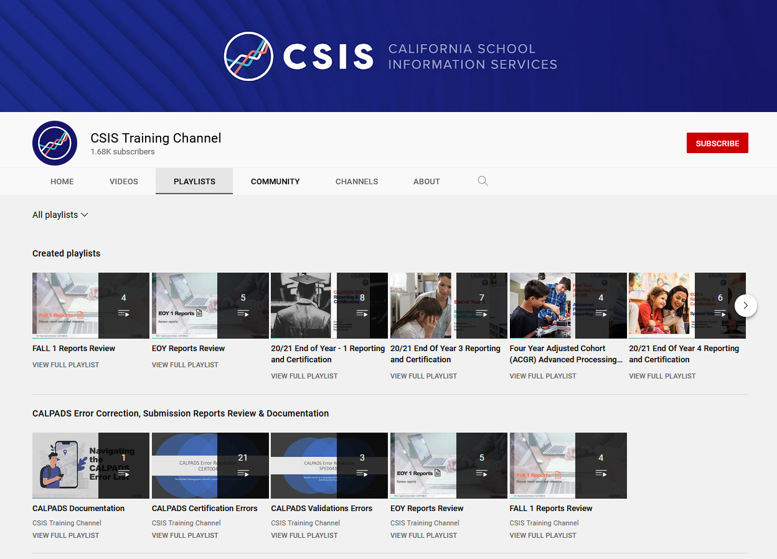
EOY 3 Survival Kit
Let’s build your CALPADS Data Literacy!
Where do I find information about the data collection?
Where are the key dates and submission timeline located?
How can I audit or track the tasks involved for completion?
Notes:
LEAs should also be aware that there are excellent reference documents available to download for guidance on different aspects of CALPADS reporting.
Getting started let us look at a few places to find information that will assist in data population.
Documentation
User Manual
CALPADS Code Sets
File Specifications Form
Error List
Data Guide
Valid Code Combinations
Every submission requires some planning to be successful. EOY typically requires more planning because of the size of the data collection and limited staff availability. Here are some questions that need to be answered prior to the start of your EOY submission.
Where do I find information about the data collection?
Where are the key dates and submission timeline located?
How can I audit or track the tasks involved for completion?
It is important to know which resources that provide this information and have a referential understanding of the contents. You should know which document to go to when researching, not specifically recalling the answer.
Instructions for the presenter:
Introduce the CALPADS system documents page and the CALPADS User Manual
Show the EOY 3 details in the CFS (docx)
Show the EOY timeline in the CALPADS Calendar
Highlight the EOY Roadmap
Walk through the EOY checklist

Slide 11

Behavioral Incidents
Discuss background of behavioral incidents submission
Notes:
Let’s look at the Behavioral incident submission.

Slide 12


Collection Purpose
CA Dashboard and DataQuest
Dashboard State Indicators
Academic Performance
English learner Progress
Chronic Absenteeism
Graduation Rate
Suspension Rate
College/Career
Provide Student expulsion and suspension information to satisfy requirements related to "persistently dangerous" schools
Provide student suspension and expulsion counts and related information for students with disabilities
CA AB 2657
CA Dashboard will use Chronic Absenteeism and suspensions
Provide information on the use of restraint and seclusion for students fulfill statutory requirements of
Notes:
The behavioral incident submission
Provides student expulsion and suspension information to satisfy Every Student Succeeds Act (ESSA) requirements related to "persistently dangerous" schools and the Uniform Management Information Reporting System (UMIRS)
To determine persistently dangerous schools
Provides student suspension and expulsion counts and related information for students with disabilities for federal Individuals with Disabilities Education Act (IDEA) reporting.
Provides information regarding the use of restraint and seclusion for students receiving either general education or special education to the fulfill statutory requirements of AB 2657
Chronic absenteeism is one of the state indicators California School dashboard as such is one of the measures used to meet the requirements of the Every Student Succeeds Act (ESSA)

Slide 13
















Terminology
Incident - An event resulting in the use of physical restraint, mechanical restraint, or seclusion or a statutory offense is committed. Each incident may have multiple students involved, and each student may commit multiple offenses during a single incident
Incident Result - Outcome or result of an incident for a specific student
Statutory Offense – Student violations outlined in Education Code Sections 48900 and 48915 (Student Offenses in the CALPADS Code Set document)
Seclusion - the involuntary confinement of a pupil alone in a room or area from which the pupil is physically prevented from leaving
Behavioral Restraint
  Mechanical Restraint – Use of a device or equipment to restrict a pupil’s freedom of movement
  Physical Restraint – A personal restriction that immobilizes or reduces the ability of a pupil to move his or her torso, arms, legs, or head freely
Notes:
Discuss the terms relevant to the audience.

Slide 14



Reporting Basics
What is the reporting period?
From July 1, 2024 – June 30, 2025
Incident records are reported for:
Enrollment:
  Primary enrolled (10)
  Secondary enrolled (20) and
  Short term enrolled (30) students
Grade Level: TK-12
Who can report Incident data?
All School sites within a LEA
NPS schools are expected to gather the data but LEA will report to CALPADS on their behalf*
* See Notes
Notes:
LEAs and NPS schools must have policies and procedures in place to identify, document, and report incidents involving restraint and seclusion for students with disabilities
LEAs and NPS schools should ensure that all staff are appropriately trained
CALPADS Administrators should not have to determine what discipline records are reportable incidents

Slide 15


Reporting Incidents
Report all 48900 and 48915 violations even if it did not result in suspension or expulsion
Report all instances of restraint or seclusion even if it was not the result of a violation of 48900 or 48915
Report all results for each incident for each student
Report any increment of a day for suspensions for all students
Report the duration of all:
  Suspensions (in and out of school)
  Expulsion
Duration is not required for any other incident results
California Education Code Section 49005.1 for specific definitions of restraint and seclusion
Notes:
LEAs and NPS schools must have policies and procedures in place to identify, document, and report incidents involving restraint and seclusion for students with disabilities
LEAs and NPS schools should ensure that all staff are appropriately trained
CALPADS Administrators should not have to determine what discipline records are reportable incidents

Slide 16
Restraint and Seclusion
All incidents occurring in the academic year resulting in the use of behavioral restraints or seclusion even if they were not a result of a violation of Education Code Sections 48900 and 48915 (suspension and expulsion offenses)
This collection is one piece of larger annual collection of incidents
Incidents involving violations of Education Code 48900 and 48915
Incidents resulting in restraint or seclusion even if they were not associated with E.C. 48900 or 48915
Restraint and Seclusion data should be reported to fulfill the statutory requirements of Education Code § 49005.1.
Involved students (Gen Ed or SWD) must be reported.
Notes:
Purpose of Restraint and Seclusion Data Collection
CDE collects information regarding the use of restraint and seclusion for students receiving either general education or special education to fulfill the statutory requirements of Education Code § 49005.1
Data certified in the 2024-25 EOY 3 submission will be used to make monitoring determinations in the 2026 monitoring year.
Downloadable Restraint and Seclusion files can be found at the following web page:
https://www.cde.ca.gov/ds/ad/filesrsd.asp

Slide 17

Monitoring Restraint and Seclusion Data
The Courts have mandated that the Special Education Division use certified Restraint and Seclusion data as an additional data point in making its annual monitoring determinations:
LEAs reporting more than 2 restraints or seclusions per pupil (>2:1 ratio) will be asked to perform student record reviews
LEAs that:
  Report zero incidents of restraint or seclusion and have greater than 100 students with disabilities; or
  Report zero incidents of restraint or seclusion and have greater than 100 students with disabilities enrolled at Nonpublic Nonsectarian Certified Schools (NPS); or
  Fail to certify the CALPADS EOY 3 submission
  will be flagged for questionable data quality and will have to complete monitoring activities associated with data quality

Slide 18

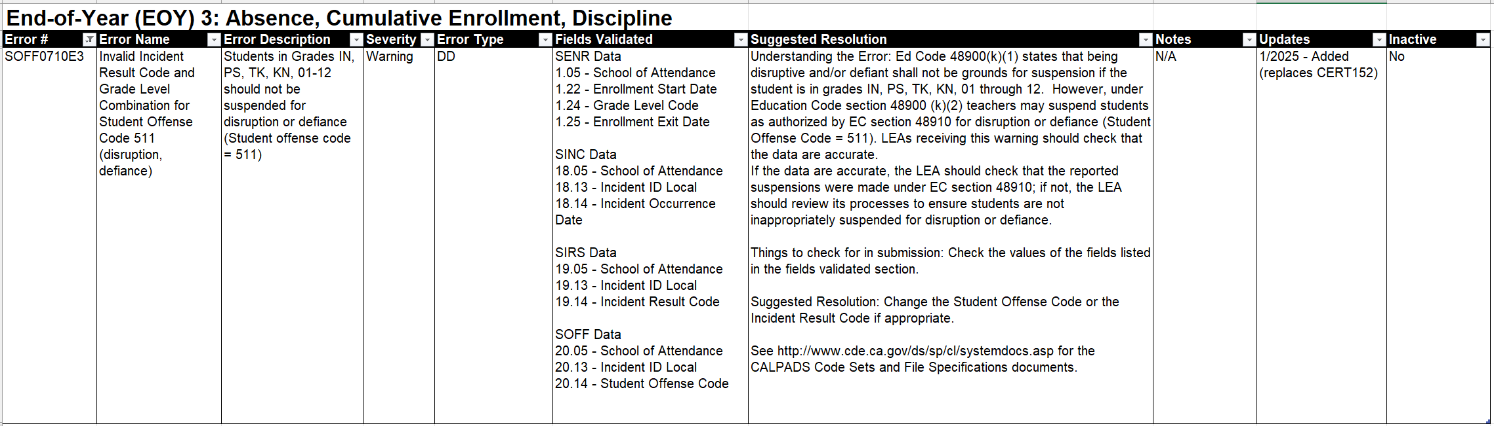
Defiance Law
Since July 1, 2020, the law prohibits*:
Recommended expulsion of students TK-12 due to willful defiance
Suspending students in grades TK-5 for willful defiance
Suspending students in grades 6-12 for committing defiance,
    This clause will become inoperative on July 1, 2029 unless further extended again. (SB-274)
Charter schools from suspending and expelling students for defiance
    The same law is applied to charter schools
*Except as provided in the authority provided to teachers in EC Section 48910
Notes:
See https://leginfo.legislature.ca.gov/faces/billNavClient.xhtml?bill_id=202120220AB181 for ed code.
In addition to adding TK grade level, SB- 274 is amending to include grades 9-12 (previously grades K-8 were included in 2020). https://leginfo.legislature.ca.gov/faces/billTextClient.xhtml?bill_id=202320240SB274

Slide 19

Clarifying Teacher Suspension
Defined in EC section 48910, a teacher may suspend any pupil from class, for any of the acts in section 48900, for the day of the suspension and the day following.
The teacher shall immediately report the suspension to the principal for appropriate action.
Notes:
SB 274 Section 48900 excerpts
(1) Disrupted school activities or otherwise willfully defied the valid authority of supervisors, teachers, administrators, school officials, or other school personnel engaged in the performance of their duties.
(2) Except as provided in Section 48910, a pupil enrolled in kindergarten or any of grades 1 to 5, inclusive, shall not be suspended for any of the acts specified in paragraph (1), and those acts shall not constitute grounds for a pupil enrolled in kindergarten or any of grades 1 to 12, inclusive, to be recommended for expulsion.
(3) Except as provided in Section 48910, a pupil enrolled in any of grades 6 to 8, inclusive, shall not be suspended for any of the acts specified in paragraph (1). This paragraph is inoperative on July 1, 2029.
(4) Except as provided in Section 48910, commencing July 1, 2024, a pupil enrolled in any of grades 9 to 12, inclusive, shall not be suspended for any of the acts specified in paragraph (1). This paragraph is inoperative on July 1, 2029.
California Education code section 48910 states:
(a) A teacher may suspend any pupil from class, for any of the acts enumerated in Section 48900, for the day of the suspension and the day following. The teacher shall immediately report the suspension to the principal of the school and send the pupil to the principal or the designee of the principal for appropriate action. If that action requires the continued presence of the pupil at the school site, the pupil shall be under appropriate supervision, as defined in policies and related regulations adopted by the governing board of the school district. As soon as possible, the teacher shall ask the parent or guardian of the pupil to attend a parent-teacher conference regarding the suspension. If practicable, a school counselor or a school psychologist may attend the conference. A school administrator shall attend the conference if the teacher or the parent or guardian so requests. The pupil shall not be returned to the class from which he or she was suspended, during the period of the suspension, without the concurrence of the teacher of the class and the principal.
(b) A pupil suspended from a class shall not be placed in another regular class during the period of suspension. However, if the pupil is assigned to more than one class per day this subdivision shall apply only to other regular classes scheduled at the same time as the class from which the pupil was suspended.
(c) A teacher may also refer a pupil, for any of the acts enumerated in Section 48900, to the principal or the designee of the principal for consideration of a suspension from the school.

Slide 20

NPS Reporting Expectations
LEAs and NPS schools must have policies and procedures in place to identify, document, and report incidents involving restraint and seclusion for students with disabilities
LEAs and NPS schools should ensure that all staff are appropriately trained
CALPADS Administrators should not have to determine what discipline records are reportable incidents
See Notes for resources.
Notes:
Are LEAs required to submit data for students at Nonpublic schools?
YES – LEAs are required to submit incident data that occurred at Nonpublic schools
LEA need to work with the NPS to collect and report the data that reflects the time the student attended the NPS during the school year
Video: https://youtu.be/82aN0lgEUPU?si=FTlqDuzCczHPTuoq
PPT Resource: https://documentation.calpads.org/Support/docs/2021-22/StudentDisciplineNPSReporting.pptx

Slide 21



Student Incident Submission
CONTEXT
Student enrollment must exist in the CALPADS ODS at the school of attendance for the academic year
SENR
Student Incident (SINC) File, LEAs will report all incidents at the school of attendance
Student Incident Results (SIRS) File, LEAs will report all results for each incident
SINC
SIRS
SOFF
Student Offense (SOFF) File, LEAs will report the statutory offense committed
A combination of a SINC and SIRS is required for an incident to be visible in CALPADS Student Details and Incident Data UIs
Notes:
The Incident submission, first requires student enrollment at the LEA. The Incident must be reported at the corresponding school of attendance in the enrollment record using the Student Incident file. After the incident has been posted to CALPADS the Student Incident Results (SIRS) File and the Student Offense (SOFF) File can be submitted. The values for student’s SSID as well as the Incident ID, School of attendance and Academic year are used to tie the students to incidents offenses and results.
The SINC is required to report all incidents and students involved in the incident. Each student involved in an incident will also be required to have at least one results record. Students who commit a statutory offenses should also have a student offense record. Student offenses are mapped to Ed codes 48900 and 48915.
Article 48900 reads:
ARTICLE 1. Suspension or Expulsion [48900 - 48927]
A pupil shall not be suspended from school or recommended for expulsion, unless the superintendent of the school district or the principal of the school in which the pupil is enrolled determines that the pupil has committed an act as defined pursuant to any of subdivisions (a) to (r), inclusive…
https://leginfo.legislature.ca.gov/faces/codes_displaySection.xhtml?sectionNum=48900.&lawCode=EDC
So, you can see that in most cases, one would expect to see a student offense record for students with incident records. Of course, incidents involving restraints or seclusions not with standing. They key is to ask yourself, if a student did not commit a statutory offense, meaning they did not have commit any violations that are described in the ed code, does this record need to be reported.

Slide 22
Incident Data Gathering
Incident
Incident date
Students involved
Incident Results
Suspension, expulsion, restraint, seclusion, etc.
Student Offense
Reportable E.C. 48900 or 48915
LEAs should record the detailed information for each incident
Notes:
The federal requirements required discipline data to be reported at the Incident level.
Incident: The event that occurred (food fight, fight etc.)
Offense: The infringement or violation of Ed code the student committed within the Incident

Slide 23
Incident Scenarios
Result
Scenario 2
Student
Student
Offense 2
Offense 1
Results
Incident
Incidents may be reported for a single student with no offense or with multiple students and multiple offenses
Student
Offense
Result
Scenario 1
Student 2
Student 1
Result 1
Result 1
Scenario 3
Offense 1
Result 2
Scenario 4
Offense 2
Offense
Notes:
Incidents can be reported any number of ways, with multiple students, multiple offenses. Conversely an incident may consist of a single student with no offense.
Scenarios:
A single student incident where the student committed multiple offensives.
A single student incident where no offenses (violation of ed code 48915 0r 48900) was committed.
A single student incident with a single offense.
A multiple student incident, with multiple offense committed.

Slide 24

Student Absenteeism
Discussion of the STAS submission
Notes:
The Student Absenteeism submission has gone unchanged but let's review the business rules related to the submission to make sure that we have a clear understanding.

Slide 25
Chronic Absenteeism Defined
A student who is a "chronic absentee“ misses 10% of the school year for any reason including excused and unexcused absences.
The student is a Chronic Absentee
Student misses 18 days during a 180-day school year. All absences unexcused.
The student is a Chronic Absentee
Student misses 18 days during a 180-day school year. Half the absences are excused, half are unexcused.
The student is a Chronic Absentee
Student misses 18 days during a 180-day school year. All absences are excused.
Notes:
A student who is a "chronic absentee“ misses 10% of the school year for any reason including excused and unexcused absences.
A "chronic absentee" has been defined in California Education Code (EC) Section 60901(c)(1) as "a pupil who is absent on 10 percent or more of the school days in the school year when the total number of days a pupil is absent is divided by the total number of days the pupil is enrolled and school was actually taught in the regular day schools of the district, exclusive of Saturdays and Sundays."

Slide 26




STAS Reporting Basics
What is the reporting period?
From July 1, 2024 – June 30, 2025
New this year! STAS from NPS schools should no longer be submitted.
STAS records are required for enrollment:
Primary enrolled (10) and
Short term enrolled (30) students
Grade Level: TK-12, who attended at least 1 day during the academic year
Who may be reported with a Y Exempt Indicator ?
Home Hospital students can be exempted
Student only attending college classes
Students who come back and have an enrollment to annotate a graduation
Adult-age SWDs enrolled in Transition Services
What Attendance type is included?
Include all students for whom attendance is reported as daily, hourly or project-based/coursework (independent study)
Notes:
STAS reporting is part of the EOY 3 data collection. Students included in the STAS reports will have an enrollment that was open at some point in the EOY reporting window. That is any enrollment that overlaps this reporting period of 7/1/2023 – 6/30/2024.
STAS record required for primary enrolled (10) and short term enrolled (30) students in grade levels TK-12, who attended at least a single day during the academic year. Adult, preschool, toddlers and infants are excluded.
The STAS record is required for students enrolled at all school types. Students enrolled at NPS schools and Home Hospital students are expected to be reported but use the exempt indicator if appropriate .

Slide 27

STAS Data 101
Exemptions are records that do not have attendance and absence fields populated
STAS in school and out of school suspension days are validated against the SINC record
In-school-suspensions count as attendance days
Out-of-school suspension days are added to absences
Emergencies and disasters should not count negatively against students, the expected attendance days should be adjusted
Notes:
Information about STAS records:
Exemptions are records that do not have attendance and absence fields populated
STAS in school and out of school suspension days are validated against the SINC record
In-school-suspensions count as attendance days
Out-of-school suspension days are added to absences
Emergencies and disasters should not count negatively against students, the expected attendance days should be adjusted

Slide 28
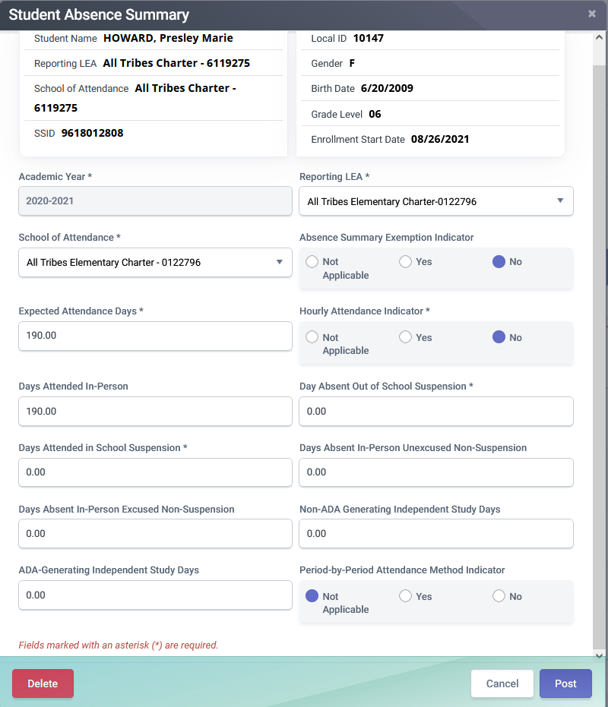
STAS Data
Data indicators
Data collection exemption
Hourly attendance school type
Attendance information
Expected attendance days
Days Attended
In-school suspension days attended
Absence information
Excused
Unexcused
Incomplete independent study days
Days absent out of school suspension
Notes:
Each STAS record features data indicators, attendance information and absence information

Slide 29
Independent Study Days
Field # | Field Name | Description
13.21​ | Non-ADA-Generating Independent Study Days​ | Total number of days the student did not satisfy statutory and regulatory requirements necessary to generate a day of attendance for either traditional (Education Code Section 51747.5) or course-based (Education Code Section 51749.5) independent study.​
13.22​ | ADA-Generating Independent Study Days​ | Total number of days the student satisfied statutory and regulatory requirements necessary to generate a day of attendance for either traditional (Education Code Section 51747.5) or course-based (Education Code Section 51749.5) independent study.​ ​

Slide 30
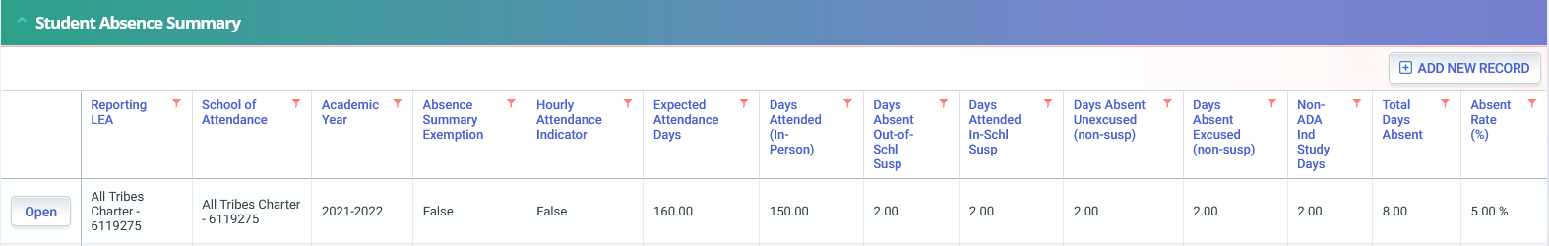
STAS Summary
Absent Rate is calculated by dividing the Expected Attendance Days by the Total Days Absent
Expected Attendance Days must equal Total Days Attended and Total Days Absent
Days Attended In-School Suspension are added with the Days Attended in person in calculations
Days Attended are reported from SIS data
Absent categories are reported from SIS data
Total days absent is a calculation of the
days absent fields and Incomplete Independent Study Days
Notes:
The Student Absence Summary allows you to see a students Absence Summary History. All the fields displayed are populated from LEA submission with the exceptions of the two fields on the far right of the screen. The Total Days Absent and Absent Rate are calculations by the system derived from the data submitted.

Slide 31
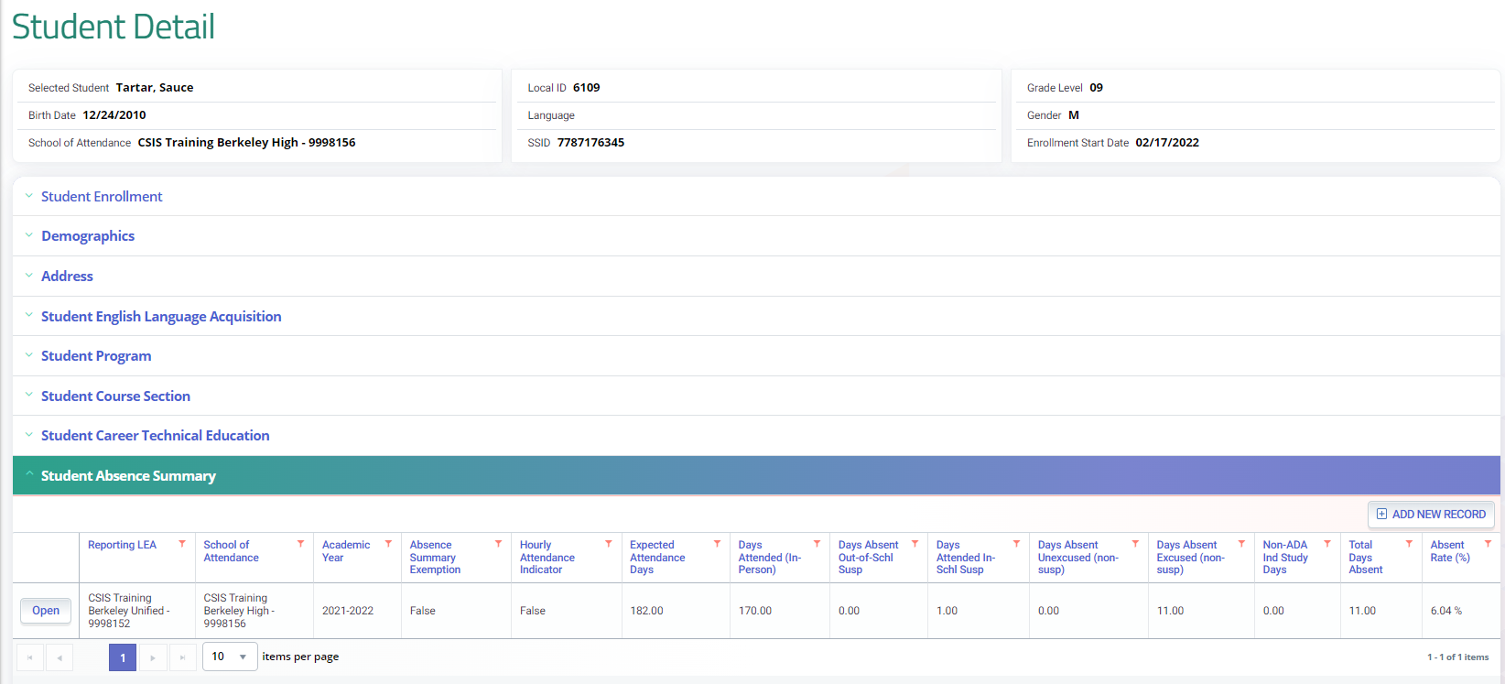
STAS Calculation
Total Days Absent divided by Expected Attended Days is calculated by the system to determine the Absent Rate
Notes:
Like other files the STAS has data fields that are used to match LEA and School as well as student demographic information.
All these fields are explained in the data population course and the CALPADS File Specifications.
As a Reminder:
The Data Collection Exemption Indicator allows you to identify NPS and home hospital students that should be excluded from STAS reporting. If the field is blank or has a N (No) value, all other fields below it are required to be populated. If the filed is populated with a Y (Yes), then all fields below should be empty.

Slide 32

Cumulative Enrollment, Homeless & Reclassified Fluent Proficient
Discuss Cumulative Enrollment, Homeless, RFEP, program

Slide 33

Cumulative Enrollment
  Cumulative Enrollment is a count of all students with an open enrollment at any time during the report period. It may include enrollments from prior academic year with exits extending until 8/15
  Adjusted Cumulative Enrollment is a count of students with an open enrollment that starts in the current academic year (07/01).
Note: Cumulative enrollment counts are determined by the SENR records submitted throughout the year. LEAs that perform ongoing maintenance of student data will not need to re-submit enrollment records for EOY 3, however SENR records will be required to exit students
Notes:
Cumulative Enrollment is a count of all students with an open enrollment at any time during the academic year. EOY 4 reports have a filter for the adjusted cumulative enrollment. The Adjusted Cumulative Enrollment is a count of students with an open enrollment that starts in the current academic year (07/01). The adjusted count is a subset of the Cumulative Enrollment that excludes students whose enrollment started in the previous academic year. e.g., students attending summer school to Complete 12th grade graduation requirements
The adjusted count is a subset of the Cumulative Enrollment that excludes students whose enrollment started in the previous academic year.

Slide 34

Cumulative Enrollment Uses
The cumulative enrollment count is used as a measurement of school and district size and in several data rate calculations
Suspension Rate
Expulsion Rate
Chronic Absenteeism Rate
Truancy Rate
Stability Rate
Notes:
Cumulative enrollment is used as a measurement of school and district size, by CalEdfacts. https://www.cde.ca.gov/ds/sd/cb/ceflargesmalldist.asp and also used when calculating:
Suspension Rate Formula
Number of Students Suspended for an Aggregate Total of One Full Day in Current Year divided by Cumulative Enrollment
Expulsion rate Formula
The unduplicated count of students expelled divided by the cumulative enrollment at the selected entity for the selected student population
Chronic Absenteeism Rate
The unduplicated count of students determined to be chronically absent (Chronic Absenteeism Count) divided by the Chronic Absenteeism Enrollment at the selected entity for the selected population using the available filters.
Truancy Rate
The number of truant students divided by the cumulative enrollment, multiplied by 100.

Slide 35

Homeless Counts
Collected in compliance to McKinney-Vento Homeless Assistance Act which is a federal legislation that ensures the educational rights and protections of children and youths experiencing homelessness.
Reminders:
Include Homeless students who were identified anytime between July 1 and June 30 of the academic year
Reconfirm students’ homeless status at the beginning and at the end of each school year to ensure that they are properly identified
Notes:
The homeless subgroup is part of many DataQuest and Dashboard accountability metrics that are sourced from EOY 3 (e.g., suspension and chronic absenteeism rates that both depend on the EOY 3 cumulative enrollment).
Resource:
California Education Codes (EC) have been amended to align to federal McKinney-Vento Act statute. Some of the California EC sections that are pertinent to homeless education:
Sections 48412, 48850, 48852.5, 48852.7, 48859, 48915.5, 48918.1, 49073, 49076, 51421, 51421.5, 51225.1, 51225.2, and 52052
48851 requires that district provide a homeless questionaries to all students at least once annually
(a) As required pursuant to Section 11432(g)(6)(A)(i) of Title 42 of the United States Code, a local educational agency shall ensure that each school within the local educational agency identifies all homeless children and youths and unaccompanied youths enrolled at the school.
(b) (1) A local educational agency shall administer a housing questionnaire for purposes of identifying homeless children and youths and unaccompanied youths, as those terms are defined in Section 11434a(2) of Title 42 of the United States Code, in accordance with the federal McKinney-Vento Homeless Assistance Act (42 U.S.C. Sec. 11303 et seq.). By the end of the 2021–22 school year, a local educational agency shall ensure that the housing questionnaire is based on best practices developed by the department pursuant to subparagraph (A) of paragraph (1) of subdivision (f) of Section 48852.5. The housing questionnaire shall include an explanation of the rights and protections a pupil has as a homeless child or youth or as an unaccompanied youth. The housing questionnaire shall be available in paper form.
(2) A local educational agency shall annually provide the housing questionnaire described in paragraph (1) to all parents or guardians of pupils and to all unaccompanied youths of the local educational agency.
(3) If the primary language of a pupil’s parent or guardian or an unaccompanied youth is not English, either of the following shall occur:
(A) The housing questionnaire shall be made available in the primary language of the unaccompanied youth or the pupil’s parent or guardian pursuant to Section 48985.
(B) An appropriate translation of the housing questionnaire shall be provided upon request of a pupil’s parent or guardian or an unaccompanied youth.
(4) A local educational agency shall collect the completed housing questionnaires that it administered pursuant to this section, and shall annually report to the department the number of homeless children and youths and unaccompanied youths enrolled.
(Amended by Stats. 2022, Ch. 912, Sec. 1. (AB 2375) Effective January 1, 2023.)

Slide 36

Homeless Program
Education Program Code: 191
Program Start Date: Date a student was identified as homeless at any school in California.
Program End Date: Date a student was identified as being no longer homeless
Additional Data:
Dwelling Type
Unaccompanied Youth
Homeless due to the recent wildfires, please refer to Flash #295 for additional guidance.
Notes:
Homeless records are not required to be closed at the end of the year or for students who are exiting. However, best practice is that homelessness be verified annually and LEAs can opt to close and then reopen these records annually if it helps to facilitate the reverification process. The homeless subgroup is part of many DataQuest and Dashboard accountability metrics that are sourced from EOY 3 (e.g., suspension and chronic absenteeism rates that both depend on the EOY 3 cumulative enrollment).

Slide 37
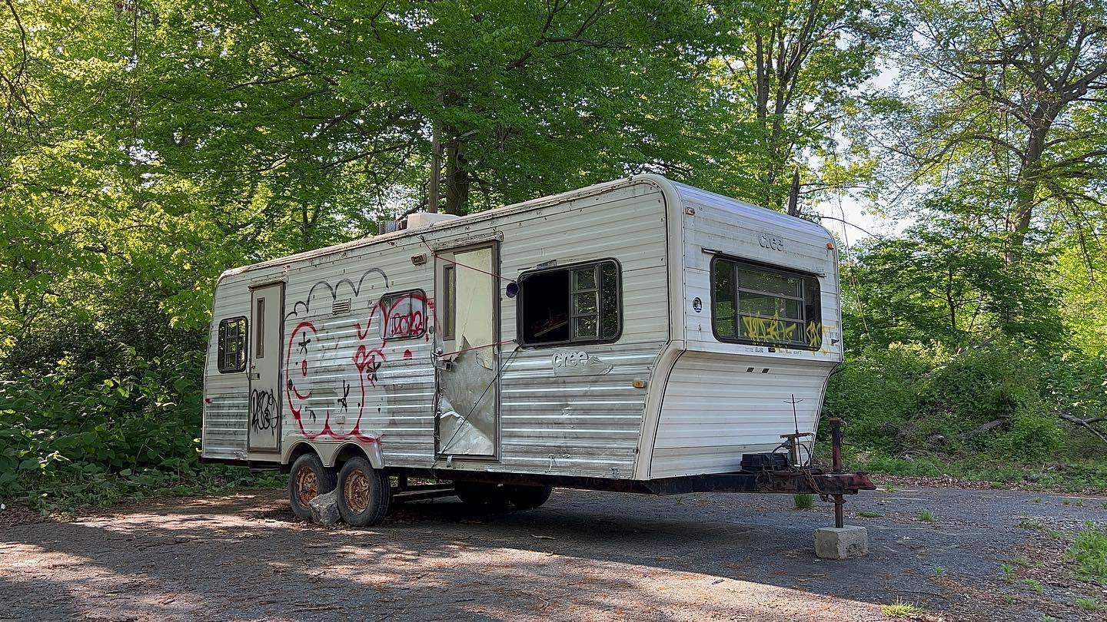
Homeless Dwelling Type
Dwelling Type
The McKinney-Vento Act defines homeless children and youth as individuals who lack a fixed, regular, and adequate nighttime residence. This definition also includes:
Housing Type
Hotels/Motels means living in a hotel or motel due to not having a fixed, permanent residence.
Temporarily Doubled-Up means living with relatives or friends, due to economic hardship (including unaccompanied youth and runaways).
Temporary Shelters means living in transitional housing.
Temporarily Unsheltered means living in abandoned buildings, campgrounds, vehicles, trailer parks, Federal Emergency Management Agency (FEMA) trailers, bus and train stations, or is abandoned in the hospital.

Slide 38


RFEP Status
When an EL student has met all four criteria specified in Education Code section 313(f) for being reclassified including receiving an Overall Performance Level of 4 on the Summative ELPAC
Upon reclassifying students to Fluent English Proficient (RFEP), LEAs should update CALPADS with a SELA update
RFEP students are not required to take the summative ELPAC
No longer “At Risk” of becoming a LTEL
Notes:
These RFEP counts will be reported as part of EOY 3 on reports:
2.16 - English Language Acquisition Status - ELs Reclassified RFEP
2.17 - English Language Acquisition Status - ELs Reclassified RFEP Student List
This will align the RFEP count with the timeframe used for the English Learner Progress Indicator (ELPI) on the California School Dashboard. In the past the CDE has received many questions regarding differences between the reclassified fluent English proficient (RFEP) counts posted on DataQuest compared to those RFEP counts posted on the California School Dashboard.
https://www.cde.ca.gov/ds/sp/cl/calpadsupdflash126.asp
EL policy is part of federal law. As required by the Every Student Succeeds Act (ESSA) in 2015, accountability for EL progress toward and attainment of English language proficiency is integrated into Title I accountability. Identifying RFEPs provides evidence of student learning outcomes.
RFEP’d students are redesignated from EL to FEP status according to the multiple criteria, standards, and procedures adopted by the district and demonstrate that students being redesignated have an English language proficiency comparable to that of average native English speakers.
https://dq.cde.ca.gov/dataquest/gls_learners.asp
English learners come from a range of educational and learning histories; districts and schools can vary considerably in the composition of their English learners. The state data system has made available a differentiated view of English learners with varying number of years in EL programs or services (“EL 0–3 years,“ “At-Risk 4–5 years,“ and [Long-Term English Learner] “LTEL 6+ years,“ “EL 4+ years not at risk of LTEL,“ [Reclassified Fluent English Proficient] “RFEP,“ and “Ever-EL“ [current plus former English learners]), as well as various state-specified statuses.
https://cabe2018.gocabe.org/wp-content/uploads/2018/03/CDE_EL_Roadmap_Guidance.pdf
EL4+ is an EL student in kindergarten through grade 12 who has been enrolled in a U.S. school for 4+ years and who has been determined to not meet the criteria for being “At-Risk” or LTEL, either because they are not in the applicable grade levels or because they have made progress on the English language development test and English language arts standards-based achievement test.
https://www.cde.ca.gov/Ds/sd/sd/fsltel.asp
Regardless of the reason that LTEL students have not reached grade-level proficiency or acquired necessary language skills, the primary defining characteristic of a LTEL student is that he or she struggles academically, rather than an inability to communicate in English more broadly (as may be the case with newcomer EL students). These students are not “progressing in English language development as would normatively be expected, and they struggle with the academic work expected of them. Typically, the gaps in performance are usually too wide to overcome using standard means.
https://portal.ct.gov/-/media/SDE/ESSA-Evidence-Guides/Effective_Interventions_for_Long-Term_English_Learners

Slide 39

Reclassification
Key points:
Students should be reclassified when they meet all four criteria for reclassification and the English Language Acquisition Start Date should reflect that.
Students reclassified after last day of school who WILL NOT be returning should have RFEP date = last day of school.
Students reclassified after last day of school who WILL be returning should have RFEP date = enrollment date for next school year.
Notes:
Flash 219 (https://www.cde.ca.gov/ds/sp/cl/calpadsupdflash219.asp) gives guidance on when to submit RFEP records and when they will be counted for state reporting purposes
Key points:
Students should be reclassified when they meet all four criteria for reclassification and the English Language Acquisition Start Date should reflect that
Students reclassified after last day of school that WILL NOT be returning should have RFEP date = last day of school
Students reclassified after last day of school that WILL be returning should have RFEP date = enrollment date for next school year
Key points:
Students assessed with the Initial ELPAC and Initial Alternate during the summer must have the following data submitted:
A Student Enrollment (SENR) record with the student's actual start date (expected first day of school).
A Student English Language Acquisition (SELA) record with:
English Language Acquisition Status (ELAS) of "TBD"
ELAS Start Date of the current date
Primary language other than English or American Sign Language.
A Student Information (SINF) record with the student's address, if the LEA wants the student address to be printed on the Student Score Report (SSR) to facilitate mailing the SSRs to parents/guardians.

Slide 40

SELA Status Reminders
2024–25 Summative ELPAC or Summative Alternate ELPAC Ends May 31, 2025
  Students will no longer be able to use 2023–24 results for reclassification after May 31, 2025.
  For students who may be reclassified based on their 2023–24 Summative ELPAC or Summative Alternate ELPAC scores we recommend testing them no later than May 15, 2025 this will ensure that all eligible students are tested as required by law.
Recommend LEAs Update RFEP Status in CALPADS by May 15, 2025
  Ensure students transferring have updated records in CALPADS within 10 days
Reminder to Assess TBD Students with Initial ELPAC Within 30 Days of Enrollment
Refer to CALPADS Flash #298 for more details.

Slide 41
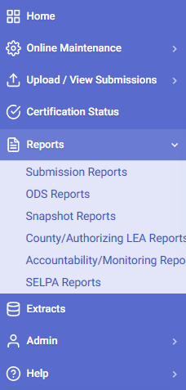
One Year Grad and Completer Collection
1.22 Graduates and Completers – Count
Report Period: 8/16/2024 to 8/15/2025
These reports provide a count of graduates and completers, which is used for publicly reporting one-year graduates and completers on DataQuest and helps LEAs identify potential issues with their graduate counts before certification.
1.23 Graduates and Completers – Student List

Slide 42
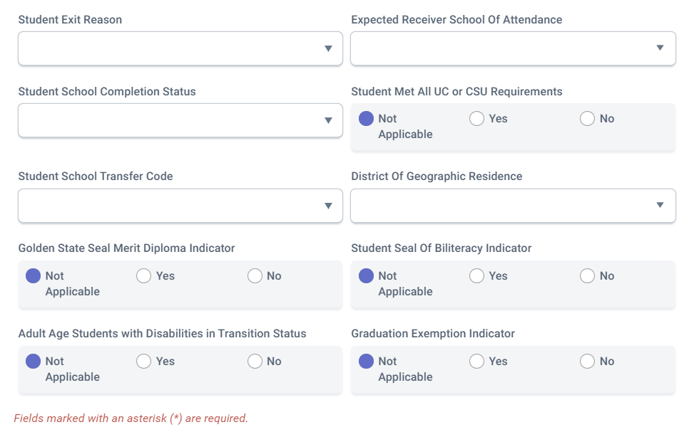
SB – 532 Graduation Exemptions
LEAs are required to collect data on students who graduated with an exemption from local graduation requirements.
  This indicator field should be marked “Y” for students who, in the current school year, graduated with an exemption from the LEA’s graduation requirements that are in addition to the statewide coursework requirements.
  Students should be exited with an E230/100 exit reason completion status combination
Eligible Student Sub-Group | Eligible Time for Exemption
Foster | Entered the school After 2nd year of High school
Homeless | Entered the school After 2nd year of High school
Former Juvenile Court school | Entered the school After 2nd year of High school
Military Family | Entered the school After 2nd year of High school
Migrant | Entered the school After 2nd year of High school
EL | New Immigrant and in 3rd or 4th Year of High school
Notes:
SB 532 Resource: https://legiscan.com/CA/text/SB532/id/2609430
Flash 260 : https://www.cde.ca.gov/ds/sp/cl/calpadsupdflash260.asp

Slide 43

Cohort Re-enrollment Reminder
LEAs with students included in this year’s 4-year cohort who are expected to be re-enrolling in AY 2025-26, must submit their 2025-26 SENR record by August 15, 2025.
Failure to do so will classify the students as a Cohort Dropout.
https://documentation.calpads.org/Glossary/Cohort/CohortGlossaryMain/#dropouts

Slide 44

EOY 3 Certification Process
CERT and CDD Error Resolution
LEA and SELPA Approval

Slide 45




Certification Workflow
Error Correction
Resolve Cert errors and CDDs before reviewing reports.
Refer to the downloadable CALPADS Error List on suggested resolutions
Report Review
Generate reports and disseminate to appropriate staff responsible for the data.
Utilize report mapping guide to check for data inclusion and column count source
Review Reports
LEA Approval
LEA Submission Process
CERT Error Correction
SELPA Approval
Submit files
All files are submitted from your SIS
Any corrections should be done in the SIS system and resubmitted to CALPADS.
LEA & SELPA Approvals
Generate reports and disseminate to appropriate staff responsible for the data.
Review all aggregate reports to activate checkbox
Check box to activate approval button
Click on LEA Approve to signal SELPA your data is ready for their approval
Notes:
EOY 3 and 4 has a streamlined certification process, the LEA will:
Submit student records and resolve validation errors
After the submission is complete the LEA will resolve certification errors including anomalies
Once all certification errors are resolved the LEA will disseminate reports for review
After the reports have been reviewed, the LEA can click on LEA Approve which signals the SELPA that they need to review the reports and consequently Approve.
Resource:
Certification Process: https://documentation.calpads.org/CertificationStatus/CertificationStatusLEAApproval/
Video: https://www.youtube.com/playlist?list=PLsnFpLOXpp4Itub_qeFnInTgT0zJulxUb

Slide 46
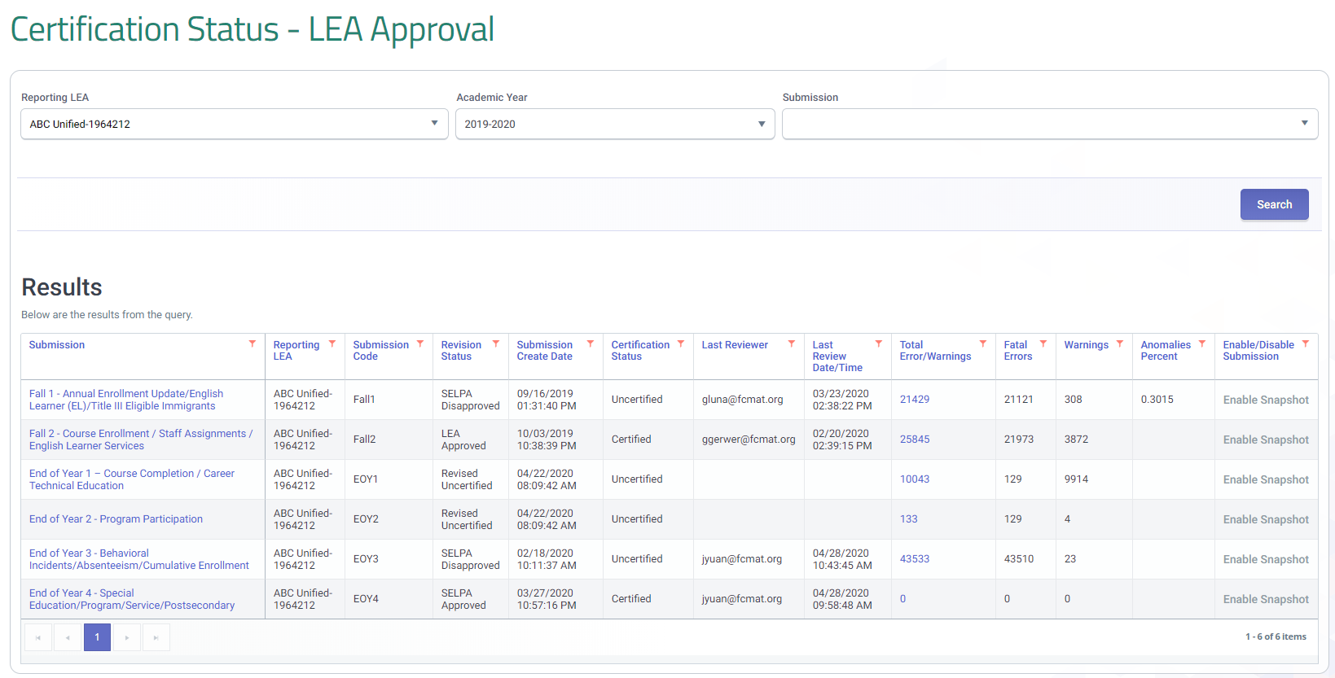
EOY 3 Certification Status
Notes:
Select the EOY 3 Snapshot from the certification status screen to see the certification details.

Slide 47
General EOY 3 Errors
Error # | Old Error # | Error Name | Severity | Error Type
CERT001 |  | Enrollment Data Missing for Expected Open School | F | CVR
CERT114 |  | No Enrollment following E150 exit | F | CVR
CERT148 |  | No Student Incident Data Submitted for a School | W | CVR
CERT155 |  | Missing Student Offense (SOFF) Record for Student | F | CVR
CERT175 |  | Significant Change in Percent of Graduates | W | CVR
CERT176 |  | Significant Change in Percent of Graduates Completing UC/CSU Requirements | W | CVR
SELA0054E3 |  | English Language Acquisition Status Start Date Less Than Birth Date | F | CDD
SENR0026E3 |  | Invalid Birth Date or Grade for CHSPE Completion | F | CDD
SENR0286E3 |  | E150 exit requires new enrollment at same school within 1 day | F | CDD
SENR0317E3 | CERT112 | Student Enrollment Record in Previous AY Not Exited | F | CDD
SENR0320E3 |  | Missing Student School Transfer Code for District of Choice Transfer | F | CDD
SENR0454E3 |  | Student must have previous Grade 12 SENR record | F | CDD
SENR0519E3 |  | Special Education Exit Code for Student without Disabilities | F | CDD
SENR0526E3 | CERT165 | Invalid "EL" English Language Acquisition Status Code | F | CDD
SENR0607E3 |  | Invalid Adult Age with Students with Disabilities Transition | F | CDD

Slide 48
General EOY 3 Errors (more)
Error # | Old Error # | Error Name | Severity | Error Type
SENR0643E3 | CERT067 | ELAS Student Not Reported | F | CDD
SENR0654E3 |  | EL student enrolled during the reporting period has invalid Student Initial US School Enrollment Date K-12 | F | CDD
SENR0656E3 | CERT113 | Missing Student Initial US School Enrollment Date | F | CVR
SENR0660E3 | CERT166 | Invalid "TBD" English Language Acquisition Status Code | F | CDD
SENR0661E3 | CERT004 | Invalid Student Race Missing Indicator and Student Race Code Combination | F | CDD
SENR0696E3 | CERT131 | Student Enrollment Record in Active AY Not Exited | F | CDD
SENR0714E3 | CERT106 | Invalid "TBD" English Language Acquisition Status Code | W | DD
SENR0715E3 | CERT131 | Student Enrollment Record in Active AY Not Exited | F | CDD
SENR0716E3 | CERT004 | Invalid Student Ethnicity Missing Indicator and Student Hispanic Ethnicity Indicator | F | CDD
SINF0452E3 |  | Missing Student Birth Country Code | F | CDD
SINF0453E3 |  | Missing Parent Guardian Highest Education Level Code | F | CDD

Slide 49
Incident Errors
Error # | Old Error # | Error Name | Severity | Error Type
SENR0697E3 | CERT150 | Missing Expulsion Incident Result Record | W | DD
SENR0712E3 | CERT149 | Missing Expulsion or Suspension Incident Result Record | W | DD
SINC0699E3 | CERT153 | Missing Student Incident Result (SIRS) Record for Student | F | CVR
SINC0700E3 | CERT154 | Missing Student Offense (SOFF) Record for Student | F | CDD
SINC0701E3 | CERT157 | Invalid Incident Result Code and Removal to Alternative Setting Reason Code combination | F | CVR
SINC0702E3 | CERT158 | Missing Removal to Interim Alternative Setting Reason Code | F | CVR
SIRS0703E3 | CERT154 | Missing Student Incident (SINC) Record for Student with Student Results Record (SIRS) | F | CDD
SIRS0704E3 | CERT162 | Missing Student Offense (SOFF) Record for suspended and/or Expelled Student | F | CVR
SIRS0705E3 | CERT163 | Missing Student Instructional Support Indicator | F | CDD
SOFF0709E3 | CERT151 | Invalid Student Offense and Incident Result Code Combination | W | DD
SOFF0710E3 | CERT152 | Invalid Incident Result Code and Grade Level Combination for Student Offense Code 511 (disruption, defiance) | W | DD

Slide 50
More Incident Errors
Error # | Old Error # | Error Name | Severity | Error Type
SOFF0711E3 | CERT154 | Missing Student Incident (SINC) Record for Student with Student Offense Record (SOFF) | F | CDD
SINC0494E3 |  | Duplicate Student Incident Record Exist for the Same Student | F | CDD
SINC0499E3 |  | Removal to Interim Alt Setting Populated for Non-Special Education Student | W | DD
SINC0516E3 |  | Mismatch of Student Incident Attributes | F | CDD
SINC0653E3 |  | Student should not have the same Incident ID in two different schools | W | DD
SIRS0488E3 |  | Invalid Incident Local ID | F | CDD
SIRS0490E3 |  | Missing Incident Result Authority Code | F | CDD
SIRS0505E3 |  | Invalid No Action (400) Incident Result Code | F | CDD
SIRS0506E3 |  | Invalid Law Enforcement Referral Incident Result Code | F | CDD
SOFF0502E3 |  | Invalid Incident ID | F | CDD

Slide 51
STAS Errors
Error # | Old Error # | Error Name | Severity | Error Type
SENR0695E3 | CERT128 | Missing Absence Summary Data for Student | F | CDD
STAS0706E3 | CERT126 | Missing Primary or Short-term Enrollment record for a student with Absence Summary Data | F | CDD
STAS0707E3 | CERT129 | Expected Attendance Days is greater than Total Enrollment Days | F | CDD
STAS0708E3 | CERT156 | Missing Suspension Data for a student who was reported as absent due to either out-of-school suspension or in-school suspension | F | CDD

Slide 52
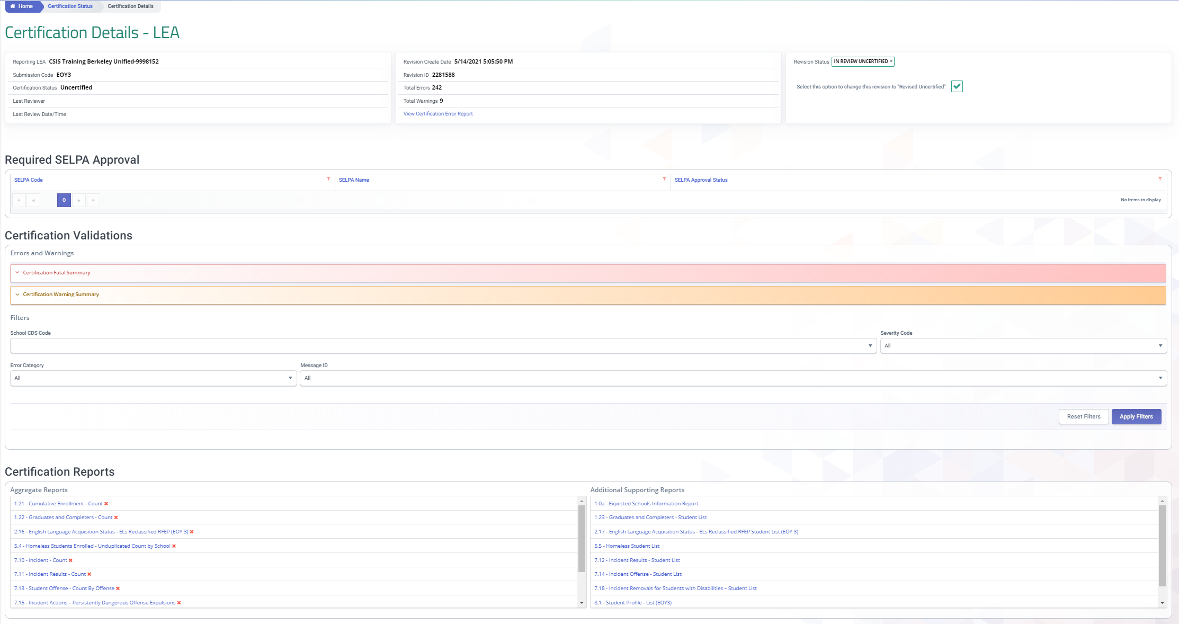
LEA Approval
Approval Requirements
Resolve Fatal errors
Review Certification reports
Notes:
The LEA must resolve all fata errors and review the certification reports to enable an approval button. The certification details screen features supporting reports, warnings, snapshot history and a revision status filter in addition to the fatal errors and certification reports. Every feature on the certification details screen has been added to assist LEAs in ensuring the accurate reporting of data.

Slide 53
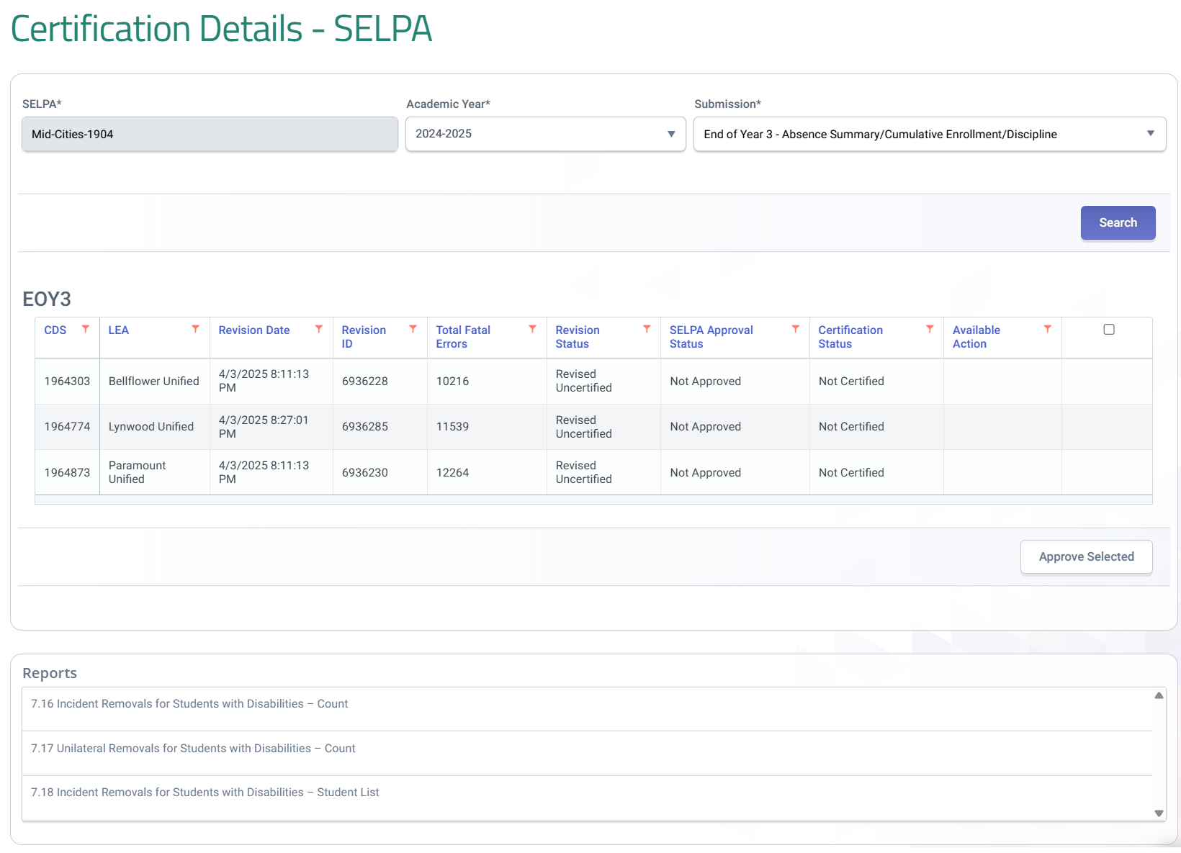
SELPA Approval
LEA and SELPA should communicate as to what Snapshot Revision ID should be reviewed.
All LEAs and status are listed for the SELPA
Approval button becomes functional after LEA status changes to approved
Notes:
After an LEAs has approved a revision SELPAs can then approve the LEAs revision. While the approval functionality is only permitted after an LEA approves their revision, SELPAs can access reports prior to an LEA approval. A final review of reports should be made by SELPAs prior to approving any LEA revision. SELPAs multiple LEAs will have each LEA listed along with their status. SELPAs can approve LEA revisions one by one or in mass.

Slide 54

Certification Reports

Slide 55
EOY 3 Reports
Report 1.21
Report 8.1 (EOY 3)
Cumulative Enrollment – Count
Student Profile - List (EOY3)
Report 7.10
Report 7.12
Incident Count
Incident Results - Student List
Report 1.22
Report 1.23
Graduates and Completers Count
Graduates and Completers Student List
Report 7.11
Incident Result – Count
Report 7.13
Report 7.14
Student Offense - Count by Offense
Incident Offense– Student List
Report 2.16
Report 2.17
ELA Status – ELs Reclassified RFEP (EOY 3)
ELA Status – ELs Reclassified RFEP Student List (EOY 3)
Legend
Report 7.15
Incident Results- Persistently Dangerous Offense Expulsions
Aggregate Report
Supporting Report
Report 5.4
Report 5.5
Homeless Students Enrolled - Unduplicated Count by School
Homeless Student List
Report 7.16
Report 7.18
Incident Removals for Students with Disabilities – Count
Incident Removals for Students with Disabilities – Student List
Report 14.1
Report 14.2
Student Absenteeism - Count
Student Absences – Student List
Report 7.17
Unilateral Removals for Students with Disabilities - Count

Slide 56
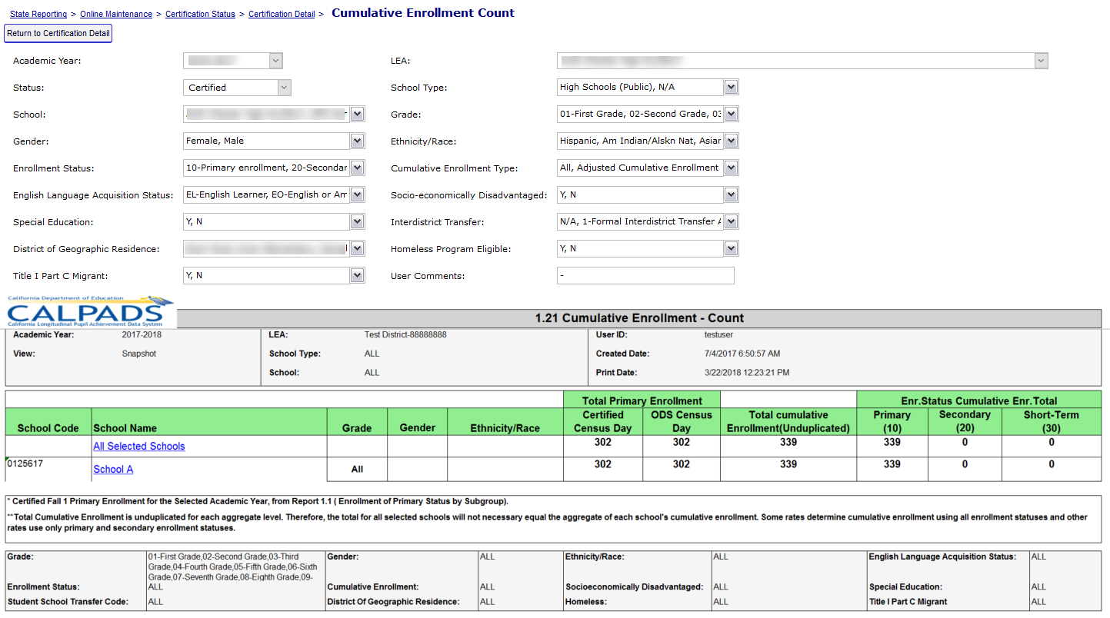

Report 1.21 Cumulative Enrollment - Count
  The Cumulative enrollment report in EOY 3 prior to 2020-21 will include one-year graduate counts. For 2020 onwards it will be replaced by Report 1.22/ 1.23
Notes:
Report 1.21, Cumulative Enrollment counts the number of students with an enrollment record in the academic year. The total primary, secondary and short term enrollment counts are grouped. All students with enrollment at any time during the Report Period for the Academic Year are included. Primary, Secondary, Short-term cumulative count is used to calculate suspension/expulsion rates. Just primary and short-term cumulative count is used to calculate attendance rates.
The certified census day enrollment count column is listed for comparison. The cumulative enrollment should be greater than or equal to certified primary enrollment.
A new filter on the Cumulative enrollment report in EOY 3 will be provided to view one-year graduate counts

Slide 57
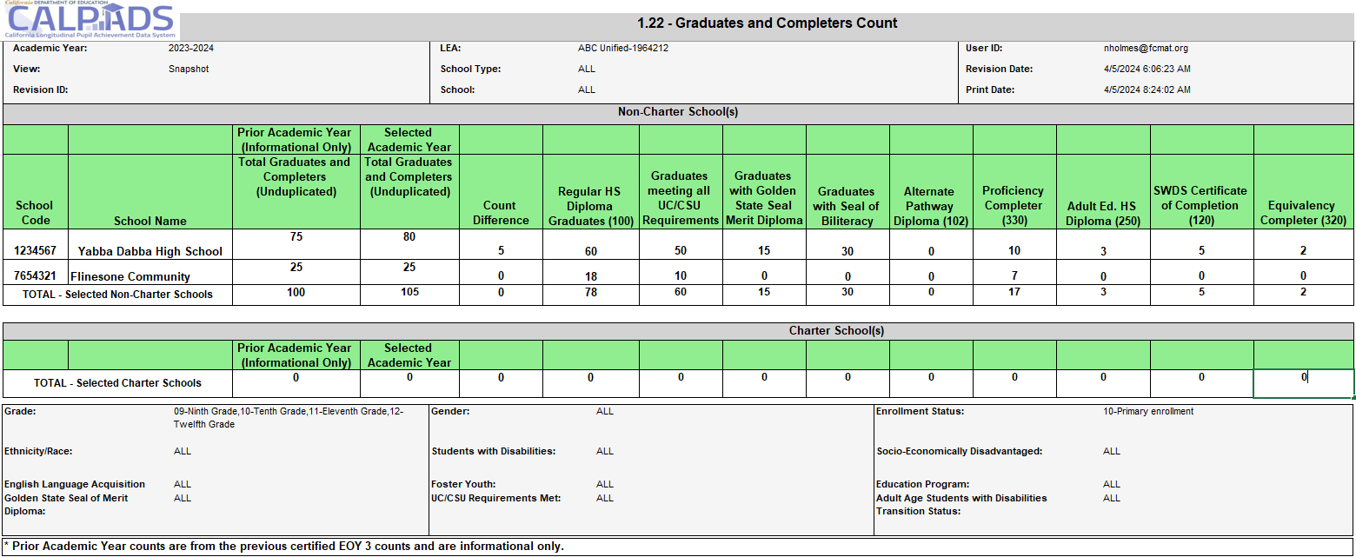
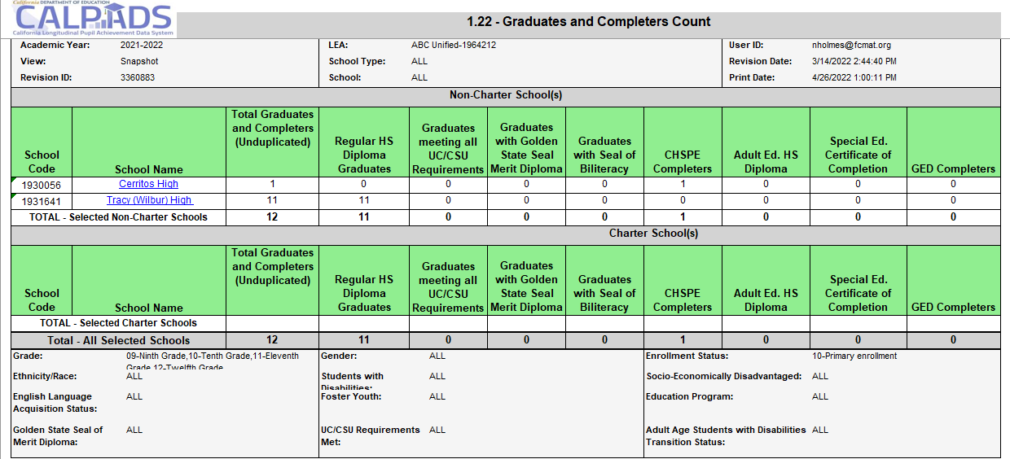
Report 1.22 – Graduates and Completers
Notes:
Three new columns added to the LEA Certification and County/Authorized LEA (C/A) report 1.22 Graduates and Completers - Count
Count of Graduates Meeting UC/CSU Requirements
Count of Graduates with Golden State Seal Merit Diploma
Count of Graduates with Seal of Biliteracy
These counts were previously available in the now retired 1.9 Completers and Dropouts Counts report.

Slide 58
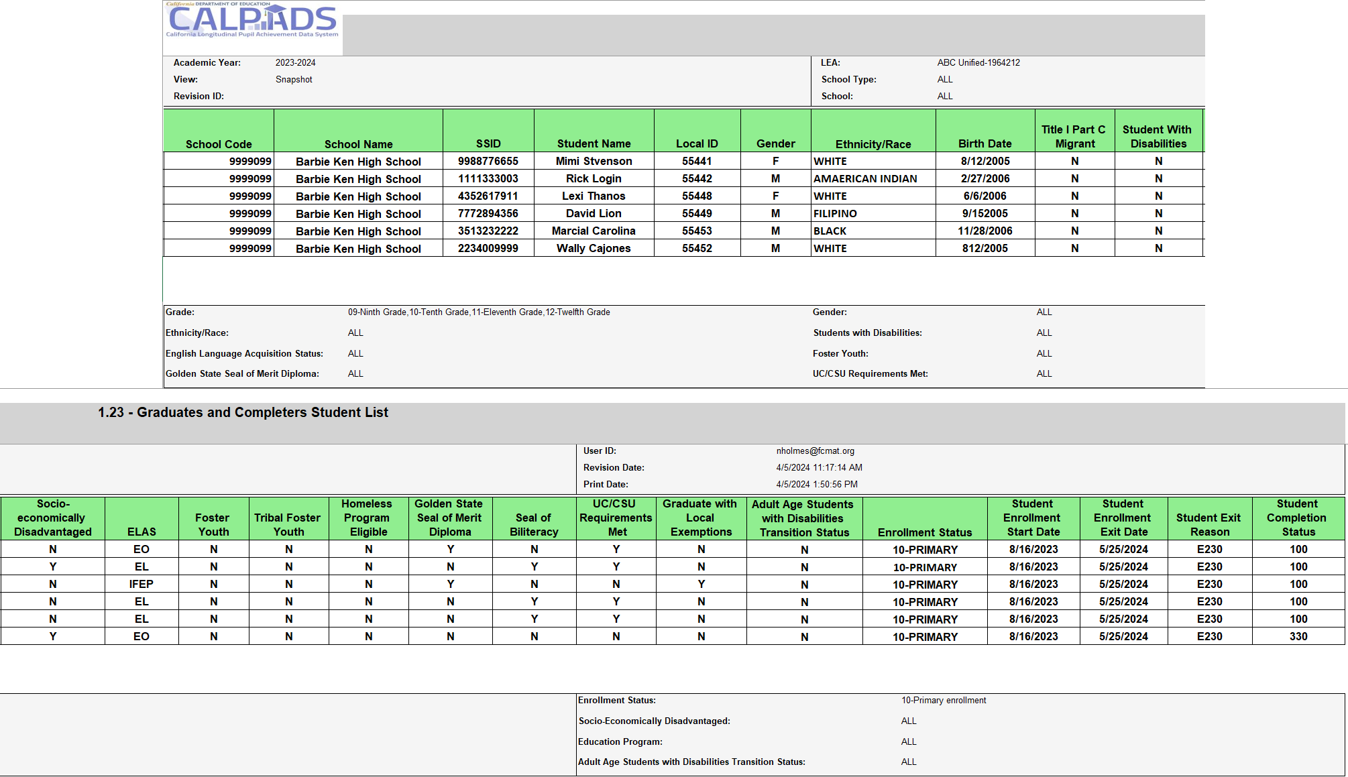
Report 1.23 – Graduates and Completers Student List

Slide 59
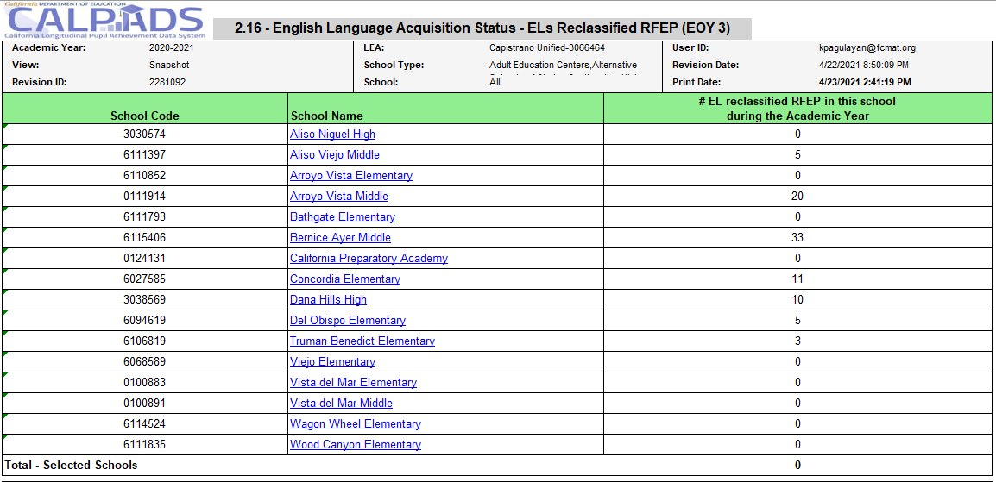
Report 2.16 ELA Status – Els Reclassified RFEP (EOY 3)

Slide 60
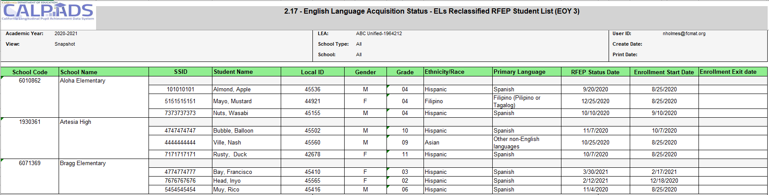
Report 2.17 ELA Status
Els Reclassified RFEP Student List

Slide 61
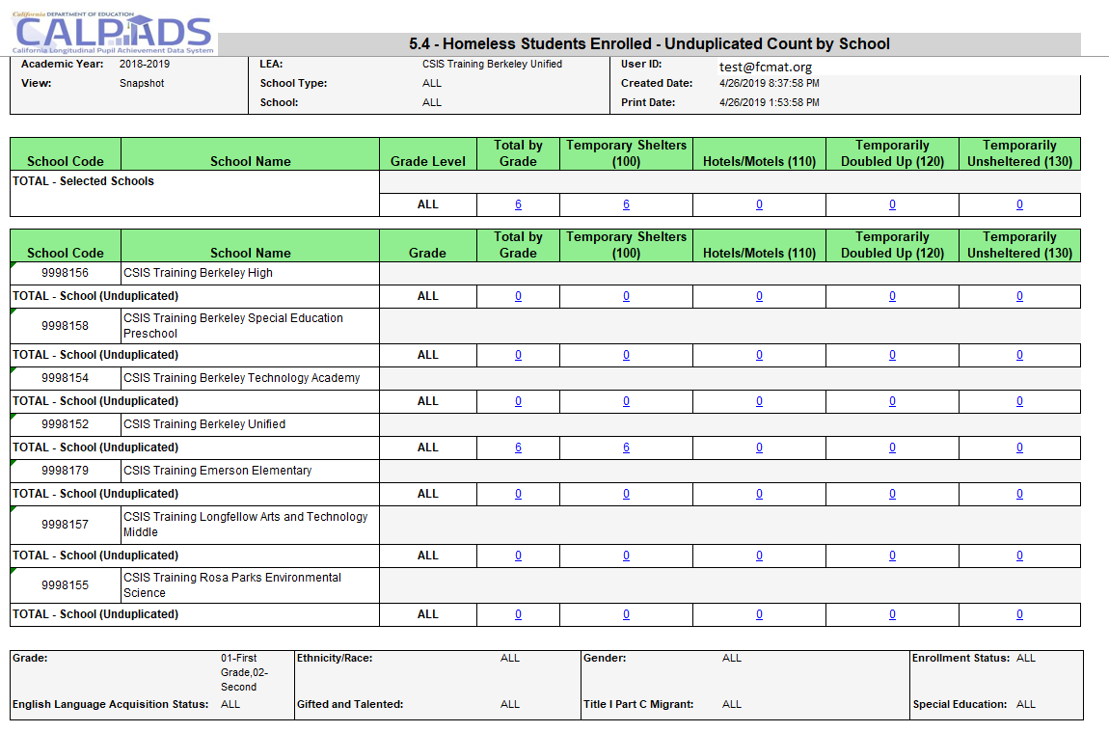
Report 5.4 –Homeless Students Enrolled
Homeless program records should be submitted for any infants, toddlers, and pre-K children who are homeless, as these students are included in all homeless reports in CALPADS.
Notes:
The 5.4 reports your posted homeless program records.
The report first summarizes the data for your LEA.
All the grade levels within your LEA. (Point out TK grade level)
Total by grade level
Total # of students reported homeless with dwelling type 100
Total # of students reported homeless with dwelling type 110
Total # of students reported homeless with dwelling type 120
Total # of students reported homeless with dwelling type 130
And then the individual school sites aggregate data is listed. This allows you to review by each site the homeless data to your local system.
Note: If student moves from 1 district to another during an AY, the student will be reported homeless at both districts. If student moves from 1 site to another, the count will be at the site with the most recent enrollment record.

Slide 62

Report Review
Will the same students reported as homeless in Fall 1 be reported in EOY?
  If yes, why?
  If no, Why not?
How can you determine which students will be included on the report?
Notes:
Instructions to the presenter:
Use the report mapping guide in the CALPADs User Manual.
Look at report 5.4 or 5.5.
Look at the Students included section.
Verbally identify the students included in the report with the audience.
Go to report 1.17 or 1.18. Look at the students included section.
Identify homeless inclusion verbally with the audience.
Reiterate the conclusion identifying similarities and differences.

Slide 63
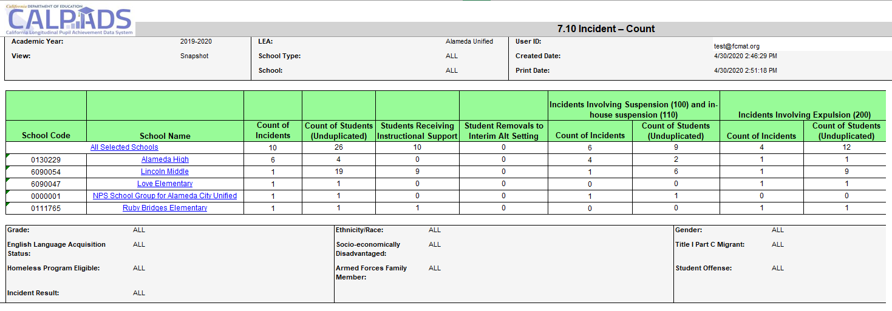
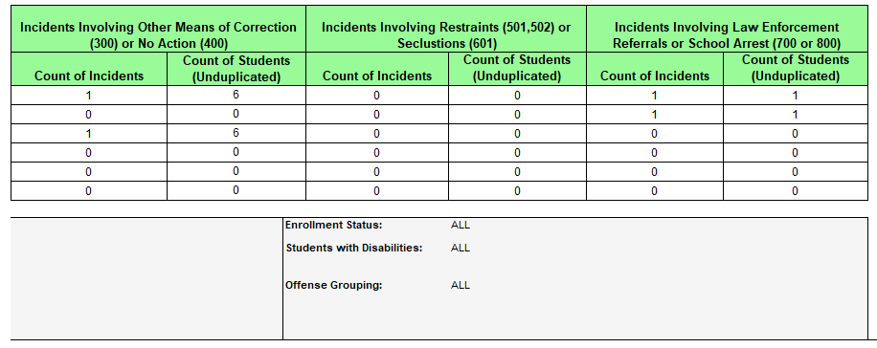
Report 7.10 Incident - Count
Notes:
Reports the counts of incidents occurring at the LEA by each school of attendance, the number of students involved an incident, the number of students receiving instructional support, and the number of students removed to interim alternative setting. Counts of incidents and students involved in incidents are displayed by Incident Result categories.

Slide 64
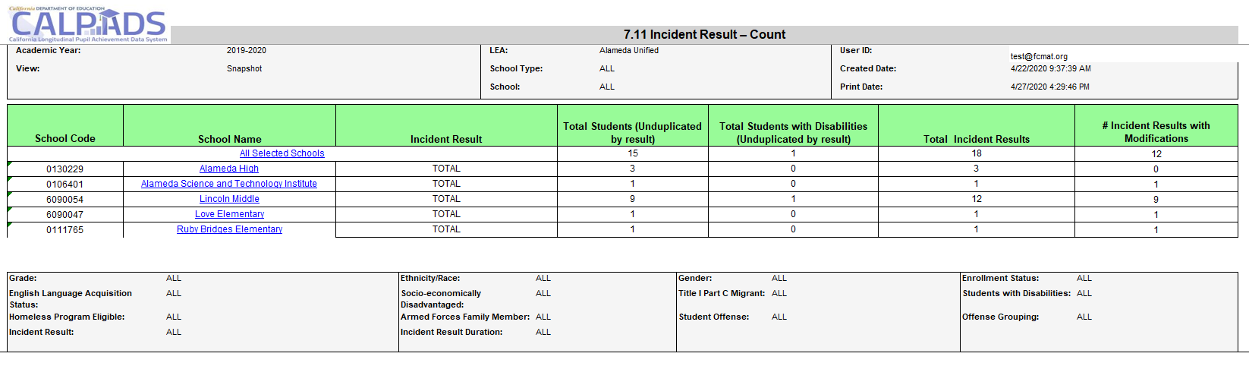
Report 7.11 Incident Result - Count
Notes:
Reports an unduplicated count of students and Students with Disabilities by Incident Result type, total of count of each incident result, and the number of incident results that were modified all by School of Attendance.

Slide 65
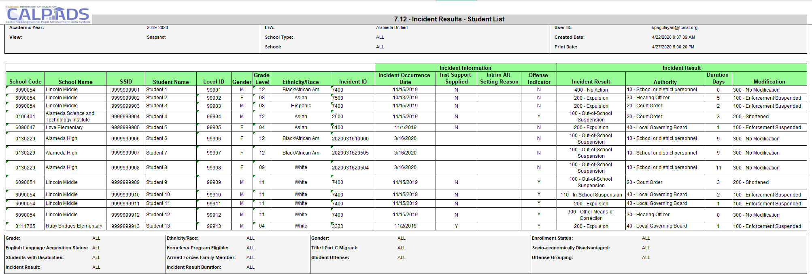
Report 7.12 Incident Results –Student List
Notes:
Reports students regardless of enrollment status, who were involved in an incident. Also reports information about each incident, including the incident result, duration days, and cumulative duration days.

Slide 66
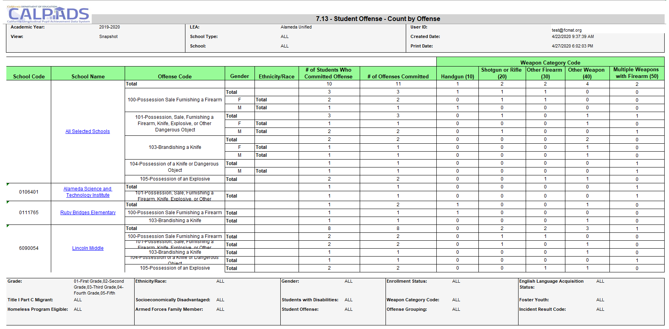
Report 7.13 Student Offense – Count by Offense
Notes:
Reports an unduplicated count of students who committed offenses, total count of offenses committed by each offense code, and a breakdown of offenses involving a weapon by gender and ethnicity/race

Slide 67
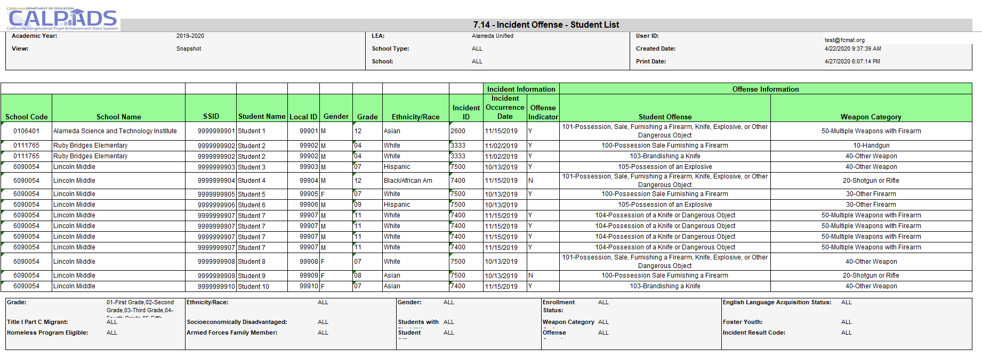
Report 7.14 Incident Offense – Student List
Notes:
Reports students in grades TK, 01-12, who were involved in discipline incidents including the disciplinary action taken. (Drill down from report 7.13)

Slide 68
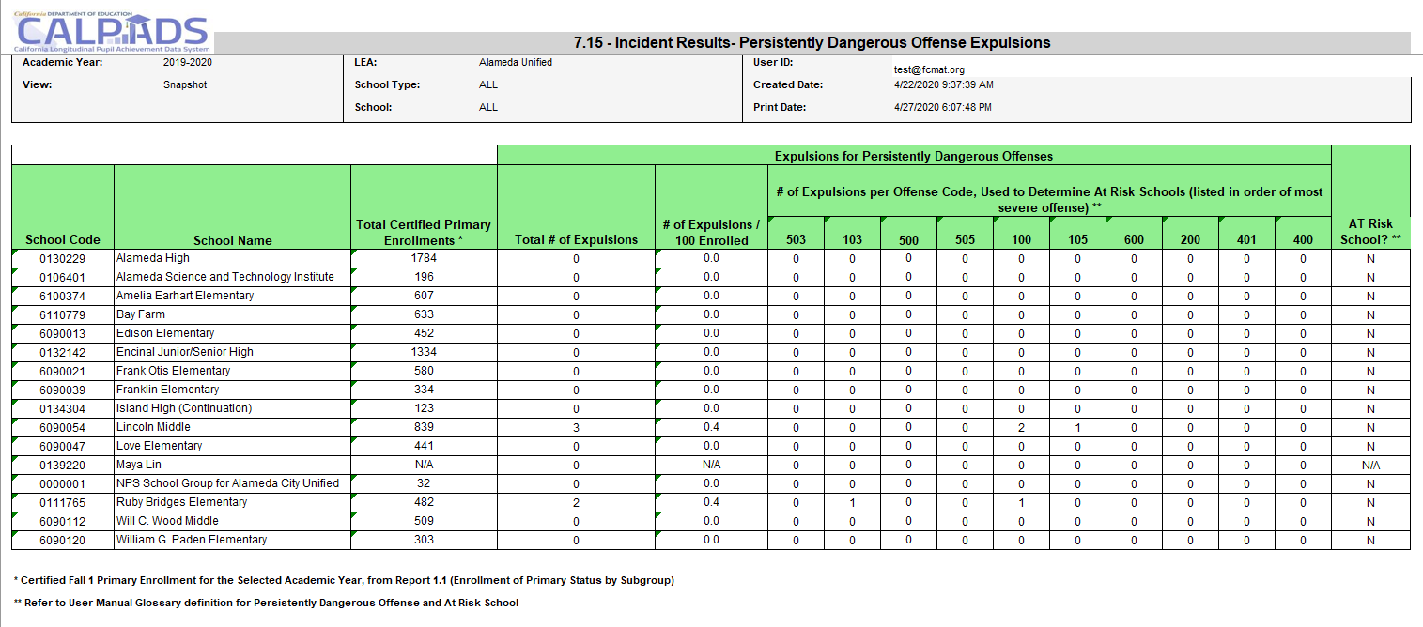
Report 7.15 Incident Results Persistently Dangerous Expulsions
Notes:
Reports the counts of TK-12 expulsions for the applicable Persistently Dangerous Schools California Education Code violations. Reports the counts of expulsions for the Persistently Dangerous Schools California Education Code violations. By school, it includes the total number of expulsions, the # of expulsions per 100 enrolled students (based on the selected year’s certified Fall 1 enrollment), and the # of expulsions per offense codes that are applicable in determining At-Risk Schools. It also indicates whether a school is an At-Risk School.

Slide 69
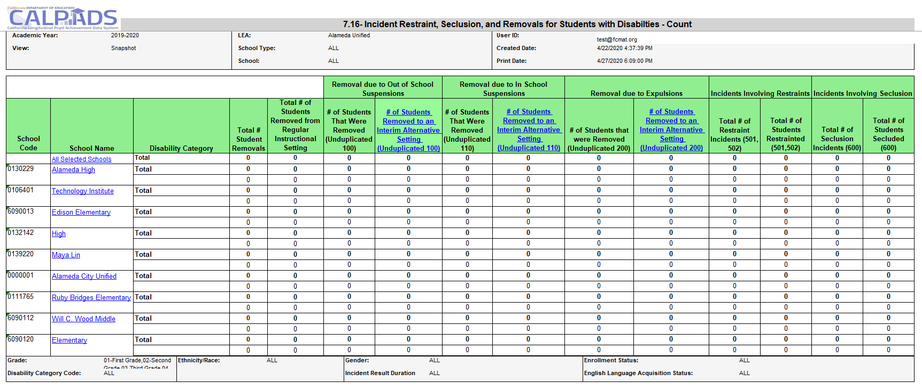
Report 7.16 Incident Restraints, Seclusion, and Removals for Student with Disabilities - Count
Notes:
Reports the number of students with disabilities who were removed from their regular instructional setting for disciplinary reasons, regardless of enrollment status. It also reports the total number of removals and the number of students with disabilities who commit offenses that resulted in no suspension or expulsion, by disability category.

Slide 70
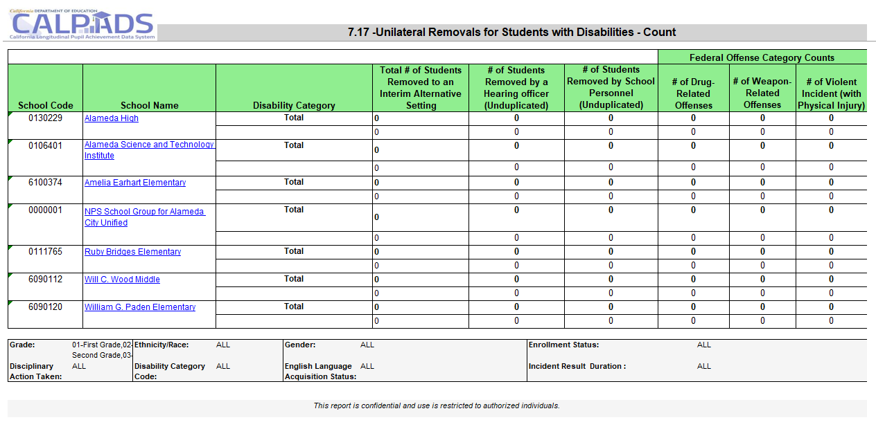
Report 7.17 Unilateral Removals for Students with Disabilities - Count
Notes:
Reports the number of students with disabilities (by Primary Disability Category) who were removed from their regular instructional setting to an interim alternative setting for disciplinary reasons, regardless of enrollment status. It also reports the counts of removals to interim alternative setting by federal offense category.

Slide 71
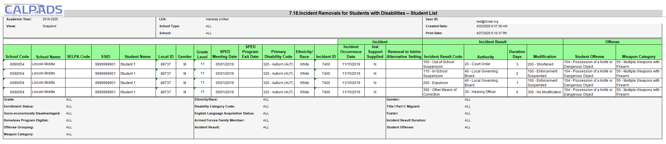
Report 7.18 Incident Removals for Students with Disabilities – Student List
Notes:
Reports students with disabilities who were removed from their regular instructional setting for disciplinary reasons, regardless of enrollment status. It also reports characteristics about each student and each incident including the Incident Results and Incident Result modifications.

Slide 72

Report Review
How do you find the number of suspensions?
  What report/s do you look at?
  Is that information readily available or does it require some manipulation or a process?
Notes:
After reviewing all of the Incident reports describe how to use 7.12 to accomplish the task. If possible, walk through demonstrate using TEST to download the report in excel. Then filter for results.

Slide 73

Incident Information for IDEA
SELPA Staff will need to review several reports from EOY 3 because they feature the:
Count of students with disabilities (SWD) removed to an interim alternative educational setting.
Count of SWD unilaterally removed by school personnel (not IEP team) from their current educational placement to an interim alternative educational setting due to offenses related to drug, weapon, or serious bodily injury.
Count of SWD suspended or expelled, and the duration of the disciplinary action
Unduplicated count of SWD subject to any kind of disciplinary removal
Total number of times SWD were subject to any kind of disciplinary removal
Notes:
SELPAs must review incident reports of LEA data that have relevant information about students with disabilities because they feature the:
Count of students with disabilities (SWD) removed to an interim alternative educational setting.
Count of SWD unilaterally removed by school personnel (not IEP team) from their current educational placement to an interim alternative educational setting due to offenses related to drug, weapon, or serious bodily injury.
Count of SWD suspended or expelled, and the duration of the disciplinary action
Unduplicated count of SWD subject to any kind of disciplinary removal
Total number of times SWD were subject to any kind of disciplinary removal

Slide 74
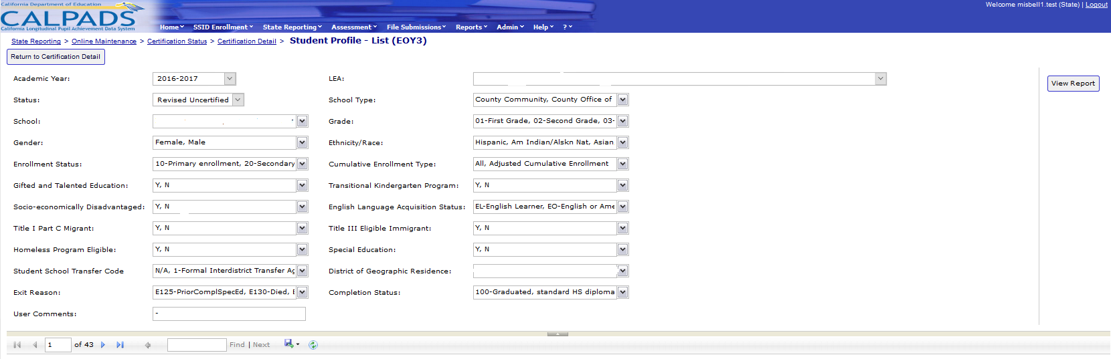
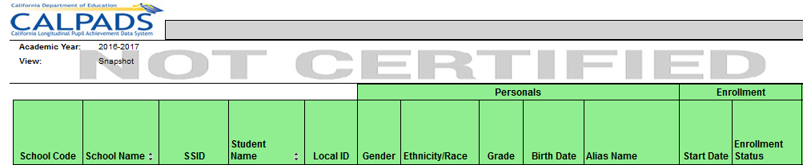
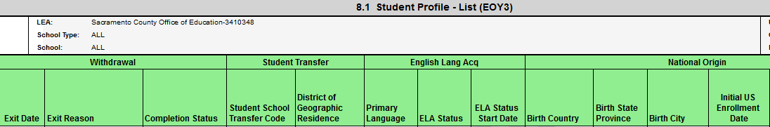
Report 8.1 Student Profile – List (EOY 3)
Notes:
Report 8.1 Student profile reports a lists individual student data in support of the Cumulative Enrollment report. Students listed on this report have had an open or closed enrollment record within the LEA at any time during the Academic Year.

Slide 75
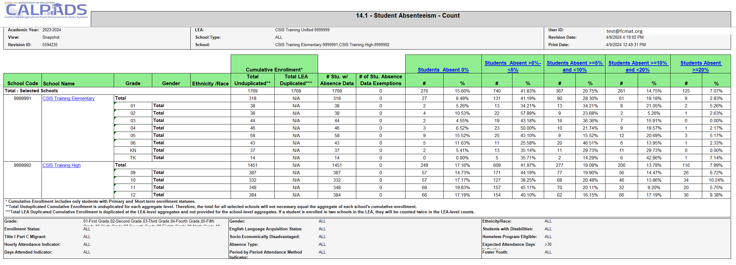
Report 14.1- Student Absenteeism - Count
Notes:
Report 14.1, Student Absenteeism counts positive attendance and student absenteeism as a percentage of the total cumulative enrollment by school for the LEA. The report includes all students with a primary or short- term enrollment at any time during the Academic Year. The report shows counts by school, with grade level and student demographic filters. Calculations for absenteeism rates of less than 5 percent, 5 to 10 percent, 10 to 20 percent and 20 percent or more are provided.

Slide 76
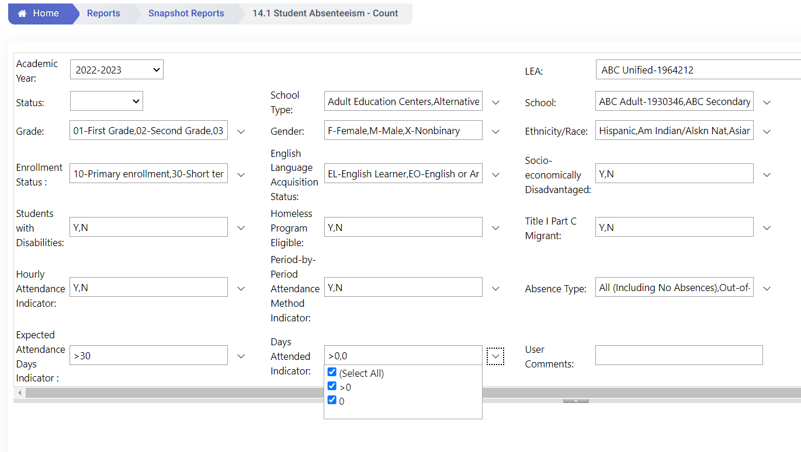
Report 14.1- Functionality Change
Default: All
- Includes all Students groups including 100% ADA Independent Study
>0: Excludes 100% ADA Independent Study
Notes:
Report 14.1, Student Absenteeism counts positive attendance and student absenteeism as a percentage of the total cumulative enrollment by school for the LEA. The report includes all students with a primary or short- term enrollment at any time during the Academic Year. The report shows counts by school, with grade level and student demographic filters. Calculations for absenteeism rates of less than 5 percent, 5 to 10 percent, 10 to 20 percent and 20 percent or more are provided.

Slide 77
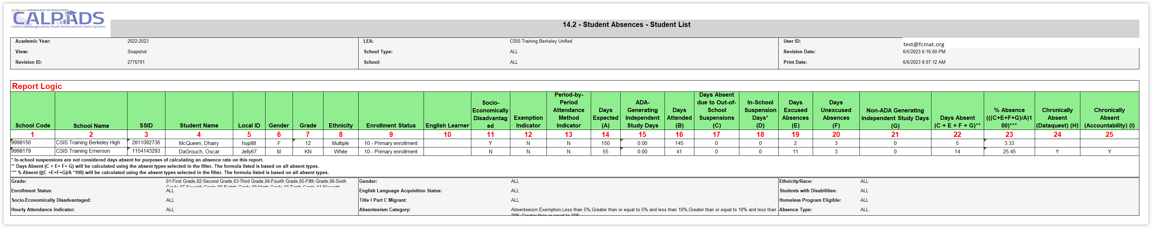
Report 14.2 Student Absence - Student List
The student will be included on the Absenteeism reports on Dataquest
The student will be included in the Dashboard Calculation
Notes:
Report 14.2, Student Absence is a list of students counted in report 14.1. Specific School and demographic information is provided along with details about attendance and absences. Each student has an absence percentage and an indication if they are considered chronically absent.

Slide 78




EOY 3 – What are the data used for?
Let’s build your CALPADS Data Literacy!
Notes:
What is the data used for?
Provide student expulsion and suspension information to satisfy Every Student Succeeds Act (ESSA) requirements related to "persistently dangerous" schools and the Uniform Management Information Reporting System (UMIRS)
To determine persistently dangerous schools
Provide student suspension and expulsion counts and related information for students with disabilities for federal Individuals with Disabilities Education Act (IDEA) reporting.
Provide chronic absenteeism rates to satisfy federal requirements under Every Student Succeeds Act (ESSA) and to calculate a statewide performance indicator as required by the Local Control Funding Formula (LCFF) statute.
Provide an LEA count of homeless students enrolled over the course of the academic year
Provide the number of English Learner (EL) students reclassified FEP (i.e. RFEP) during the academic year (See CALPADS User Manual Glossary: Reclassified Fluent English Proficient Count)
Provide an LEA count of student who graduated from LEA schools during the academic year, as well as other school completers (see the CALPADS User Manual Glossary for a definition of Graduates and Completers)

Slide 79
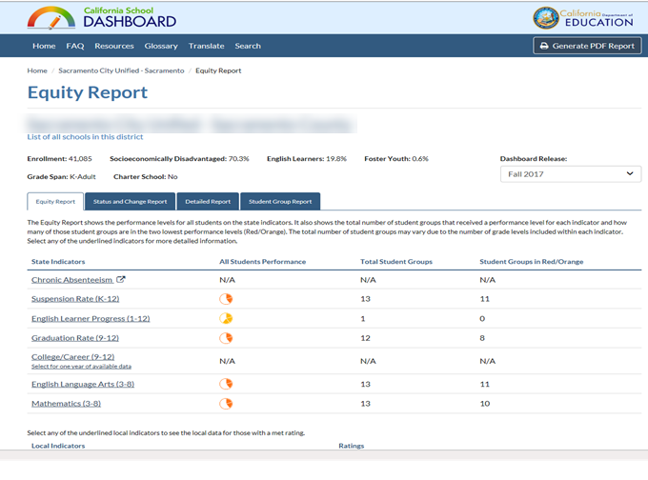
EOY 3 and the CA Dashboard (Chronic Absenteeism)
Chronic absenteeism rate calculation
Non-ADA-Generating Independent Study Days + In-Person Days Absent Excused + In-Person Days Absent Unexcused + Out-of-School Suspension Days
DIVIDED BY
Expected In-Person Attendance Days (includes in-school suspension days) + ADA-Generating Independent Study Days
EOY 3
Report 14.1 Student Absenteeism counts
CA Dashboard
Chronic Absenteeism rate compares with previous year
DataQuest
Reflects chronic absenteeism rate based certified EOY 3 reports
Chronic Absenteeism Rate Change Formula
Status (2024–25 Chronic Absenteeism Rate) minus 2023–24 Chronic Absenteeism Rate
Fall 2025 Chronic Absenteeism rates on the dashboard WILL NOT be a one-to-one reflection of STAS records certified in EOY 3 AY 2024-25, it is a trend comparison between last academic year’s Chronic Absenteeism rates to certified EOY 3 data this year.
So how are you trending?
Notes:
This slide illustrates the relationship of your AY 2024-25 STAS data to the CA Dashboard.
Your certified EOY 3 student absence summary data will be posted in Dataquest which will reflect your Chronic Absenteeism rate for 2024-25. The CA dashboard will then show in Fall 2025 report a trend comparison chronic absenteeism rate change between AY 2023-24 and AY 2024-25.
CA dashboard Resources:
https://www.cde.ca.gov/ta/ac/cm/
https://www.caschooldashboard.org/#/resources

Slide 80
EOY 3 and the CA Dashboard (Suspension Rate)
CALPADS Suspension rate calculation
Total unduplicated number of students suspended at a school
Total unduplicated number of students enrolled at the school during the year (cumulative enrollment)
EOY 3
Report 7.12 Incident Results –Student List
CA Dashboard
Include Out-of-School and In-school Suspensions in rate computation
DataQuest
Reflects suspension rate based certified EOY 3 reports
Suspension Rate Change Formula
Status (2024–25 Suspension Rate) minus 2023–24 Suspension Rate
Fall 2025 Suspension rates on the dashboard is NOT a one-to-one reflection of incident record certified in EOY 3 AY 2024-25, it is a trend comparison between last academic year’s suspension rates to certified EOY 3 data this year.
So how are you trending?
Notes:
This slide illustrates the relationship of your AY 2023-2024 suspension data to the CA Dashboard.
Your certified EOY 3 suspensions will be posted in Dataquest which will reflect your suspension rate for 2023-2024. The CA dashboard will then show in Fall 2024 report a trend comparison suspension rate change between AY 2022-23 and AY 2023-24.
CA dashboard Resources:
https://www.cde.ca.gov/ta/ac/cm/
https://www.caschooldashboard.org/#/resources

Slide 81


Wrap Up
Key Points, Resources, Support
Notes:
First, we will start with some general information related to the CALPADS data submission and then introduce key concepts related to the data collected.

Slide 82

Submission
Summary
EOY 3 requires the SINC, SIRS, SOFF, STAS, SPRG, SELA and SENR records be posted
Behavioral Incidents for Student with disabilities requires EOY 3 to be approved by the SELPA
The data in EOY 3 is reflective of the entire academic year
STAS exemptions are submitted in a STAS record. Every primary and short-term enrolled student must have a STAS record
STAS records should NOT be reported for NPS students
1-year graduate counts are listed in dedicated Reports 1.22 & 1.23
All students must be exited at the end of the year (SENR0696E3)
Students that have a program 191 record during the year will be counted as homeless regardless of their current living situation
Some key points to remember
Notes:
READ SLIDE

Slide 83




Suggested Milestones
Now – 5/6
Complete Data Population in local SIS
Now – 6/19
Submit and post files. Review IVR and Data Discrepancy errors and reconcile as needed.
6/20 – 7/10
Resolve Certification and Data Discrepancy errors. Review snapshot reports and update records as needed
7/11
Recommended Date for Zero Errors
EOY
2024-2025
7/11– 7/18
Send reports to local data stewards, site leaders and administrators for approval (Send earlier if possible)
7/22 – 7/25
LEA Approve by Certification Deadline
(EOY 3 & 4 should be SELPA Approved if possible)
Amendment Deadline
(EOY 3 & 4 require SELPA Approval)
7/26 – 8/8
8/15
Cohort Deadline
(Collected from the ODS Data)

Slide 84



Resources
Here are some important resources.
  https://learn.fcmat.org/
https://www.youtube.com/channel/UCA9oRTiyVECCCzOxpmJheZw
https://documentation.calpads.org/Support/References
https://www.cde.ca.gov/ds/sp/cl/index.asp

Slide 85




Support
http://www2.cde.ca.gov/calpadshelp/default.aspx
Web
calpads-support@cde.ca.gov
Email
916-325-9210
Phone
https://csis.fcmat.org/ListServ
You can get help through these channels.
Listserv

Slide 86
Feedback
I have a question…
“
”
Please complete survey…
https://bit.ly/2MXsECg
“
”

Slide 87






Thank You
CSIS Training
(916) 325- 9210
Calpads-support@fcmat.org
https://csis.fcmat.org/

