Slide 1
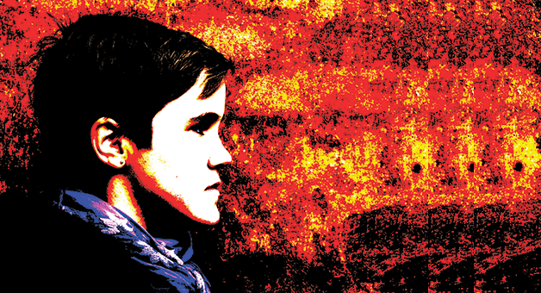


Student Discipline for Non Public Schools (NPS)
2021 - 2022
Overview
Requirements
File Layouts
Implementation
Tony Thurmond
State Superintendent of Public Instruction

Slide 2

Meeting Materials
The materials referenced in today’s presentation can be found at the following link: https://cde.box.com/s/glnty5gbmp6jpl1q8cnb1iu3tsv3nwha

Slide 3

Presenters
Shiyloh Duncan-Becerril, Associate Director, Special Education Division, California Department of Education
Nathaniel Holmes – Client Services, California School Information Services
Brandi Jauregui – CALPADS Operations Office, California Department of Education

Slide 4


Purpose
Provide student expulsion and suspension information to satisfy Every Student Succeeds Act (ESSA) requirements related to "persistently dangerous" schools and the Uniform Management Information Reporting System (UMIRS)
To determine persistently dangerous schools
Provide student suspension and expulsion counts and related information for students with disabilities for federal Individuals with Disabilities Education Act (IDEA) reporting.
Provide information regarding the use of restraint and seclusion for students receiving either general education or special education to the fulfill statutory requirements of AB 2657

Slide 5
Required Data
Incidents resulting in the use of behavioral restraints and seclusion even if they were not a result of a violation of Education Code Sections 48900 and 48915
California Education Code Section 49005.1 for specific definitions of restraint and seclusion
Refer to FLASH #159 for a summary of the discipline file restructuring
Incidents involving violations of Education Code Sections 48900 and 48915 even if they did not result in suspension or expulsion and;
LEAs should refer to:

Slide 6
What the Prior Year Data Have Shown
 | 2019-2020 | 2020-2021
Number of records were submitted | 8,272 | 2,381
Number of LEAs that reported | 313 | 173
Number of LEAs that did not report | 1,631 | 1,795
Instances of restraint reported | 7,468 | 2,179
Physical Restraint | 7,367 | 2,173
Mechanical Restraint | 101 | 6
Instances of seclusion reported | 804 | 202

Slide 7

Expectations
The CDE will collect incident data from LEAs as part of its End-of-Year (EOY) 3 submission. LEAs should be currently collecting student incident data in their local systems including the use of restraints and seclusion. The EOY submission, is a cumulative collection that includes all incidents that occurred between July 1 and June 30 of the academic year.
NPS schools are expected to track incident data for all students referred by their districts of special education accountability (DSEA) and provide the data back to the DSEA to meet federal reporting requirements for IDEA.

Slide 8

Expectations
LEAs and NPS schools must have policies and procedures in place to identify, document, and report incidents involving restraint and seclusion for students with disabilities
LEAs and NPS schools should ensure that all staff are appropriately trained
CALPADS Administrators should not have to determine what discipline records are reportable incidents
Notes:
LEAs must have policies and procedures in place to identify, document, and report incidents involving restraint and seclusion for students with disabilities. However, because these data will be collected for all students, it is imperative that LEAs ensure that all staff are appropriately trained. It is also important for site administrators to be actively involved in ensuring that policies and procedures are followed and that CALPADS Administrators are not having to determine what constitutes incidents Involving statutory offenses or those of restraint and seclusion that must be reported as described in AB 2657.

Slide 9
















Terminology
Incident - An event resulting in the use of physical restraint, mechanical restraint, or seclusion or a statutory offense is committed. Each incident may have multiple students involved, and each student may commit multiple offenses during a single incident
Incident Result - Outcome or result of an incident for a specific student
Statutory Offense – Student violations of Education Code Sections 48900 and 48915
Seclusion - the involuntary confinement of a pupil alone in a room or area from which the pupil is physically prevented from leaving
Behavioral Restraint
  Mechanical Restraint – Use of a device or equipment to restrict a pupil’s freedom of movement
  Physical Restraint – A personal restriction that immobilizes or reduces the ability of a pupil to move his or her torso, arms, legs, or head freely

Slide 10
Incident Scenarios
Result
Scenario 2
Student
Student
Offense 2
Offense 1
Results
Incident
Incidents may be reported for a single student with no offense or with multiple students and multiple offenses
Student
Offense
Result
Scenario 1
Student 2
Student 1
Result 1
Result 1
Scenario 3
Offense 1
Result 2
Offense 2
Offense
Scenario 4
Notes:
Incidents can be reported any number of ways, with multiple students, multiple offenses. Conversely an incident may consist of a single student with no offense.
Scenarios:
A single student incident where the student committed multiple offensives.
A single student incident where no offenses (violation of ed code 48915 0r 48900) was committed.
A single student incident with a single offense.
A multiple student incident, with multiple offense committed.

Slide 11
Incident Data Gathering
Incident
Incident date
Students involved
Incident Results
Suspension, expulsion, restraint, seclusion, etc.
Student Offense
E.C. 48900 or 48915 if applicable
LEAs should record the detailed information for each incident
Notes:
The federal requirements required discipline data to be reported at the Incident level.
Incident: The event that occurred (food fight, fight etc.)
Offense: The infringement or violation of Ed code the student committed within the Incident

Slide 12
Discipline File Types
Student Incident (SINC) File, LEAs will report all incidents:
In which a statutory offense is committed AND
Resulting in the use of physical restraint, or seclusion even without a statutory offense
Student Incident Results (SIRS) File, LEAs will report all results for each incident
Each incident should have at least one corresponding SIRS record for each student who was restrained or secluded, or who committed an offense
Student Offense (SOFF) File, LEAs will report the statutory offense committed
LEAs are required to report all statutory offenses committed regardless of the result type, e.g. regardless of whether the student was suspended or expelled

Slide 13




Record Relationships
Student enrollment must exist in the CALPADS ODS at the school of attendance for the academic year
Incident is created at the school of attendance
SSID
School of Attendance
Academic Year
SENR
Incident ID
School of Attendance
Academic Year
SINC
Student offense (if applicable) is linked to incident
SOFF
SSID
Incident ID
School Of Attendance
Academic Year
SIRS
The incident results are linked to the student and incident

Slide 14
Student Incident (SINC) File
Record Type Code | Transaction Type Code | Local Record ID | Reporting LEA | School of Attendance | Academic Year ID | SSID | Local Student ID | Student Legal First Name | Student Legal Last Name | Student Birth Date | Student Gender Code | Incident ID Local | Incident Occurrence Date | Statutory Offense Indicator | Student Instructional Support Indicator | Removal to Interim Alternative Setting Reason Code
SINC |  | 00001 | 1234567 | 0000001 | 2019-2020 |  |  | Pseudo | Student |  |  | 2019-001 | 7/1/2019 | Y | Y
SINC |  | 00002 | 2345678 | 0000001 | 2019-2020 |  |  | Phony | Pupil |  |  | 2019-001 | 7/1/2019 | Y | Y
SINC |  | 00004 | 1234567 | 0000001 | 2019-2020 |  |  | Fake | Child |  |  | 2019-002 | 8/1/2019 | Y | N
SINC |  | 00005 | 2345678 | 0000001 | 2019-2020 |  |  | Faux | youth |  |  | 2019-002 | 8/1/2019 | N | N
Incident 1
Incident 2
Key Fields
Incident ID Local - Identifier must be unique for the incident, within the School of Attendance and Academic Year. NPS sites should create their own unique identifiers in the system of record, however when LEAs enter these incidents into the SIS, this ID may change.
Incident Occurrence Date - The date on which a Incident occurred.
Statutory Offense Indicator - An Indicator of whether or not the incident involved one or more students committing at least one reportable offense pursuant to Education Code 48900/48915. Determines whether or not Student Offense records are required for a student for an incident.
Student Instructional Support Indicator - An indicator of whether or not a student is receiving instructional support from the local educational agency during a disciplinary action. A Y would indicate that the student is receiving instructional support; an N would indicate that the student is not receiving any instructional support (a total cessation of educational services). For students with disabilities this is an indication that the student is receiving instructional support per their Individualized Education Program (IEP).
Removal to Interim Alternative Setting Reason Code - A coded value representing the reason a student was removed to an interim alternative setting for 45 days or less (45 day placements).

Slide 15
Student Incident Results (SIRS) File
Record Type Code | Transaction Type Code | Local Record ID | Reporting LEA | School of Attendance | Academic Year ID | SSID | Local Student ID | Student Legal First Name | Student Legal Last Name | Student Birth Date | Student Gender Code | Incident ID Local | Incident Result Code | Incident Result Authority Code | Incident Results Duration Days | Incident Result Modification Code
SIRS |  | 00001 | 1234567 | 0000001 | 2019-2020 |  |  | Pseudo | Student |  |  | 2019-001 | 100 | 10 | 5 | 300
SIRS |  | 00002 | 2345678 | 0000001 | 2019-2020 |  |  | Phony | Pupil |  |  | 2019-001 | 110 | 10 | 5 | 300
SIRS |  | 00004 | 1234567 | 0000001 | 2019-2020 |  |  | Fake | Child |  |  | 2019-002 | 300 | 10 | 0 | 300
SIRS |  | 00005 | 2345678 | 0000001 | 2019-2020 |  |  | Faux | youth |  |  | 2019-002 | 501 | 10
Incident 1
Incident 2
Key Fields
Incident ID Local - Identifier must be unique for the incident, within the School of Attendance and Academic Year.
Incident Result Code - A coded value representing the actions taken against the student for a specific incident.
Incident Result Authority Code - An Incident Result Authority is an agency which authorizes any Incident Result for a student.
Incident Results Duration Days - The length of time, in school days, that an Incident Result for a student for a specific incident lasted. (Not required for restraint or seclusion)
Incident Result Modification Code - An Incident Result Modification is a code describing a modification made to a disposition, such as shortening the term of the suspension or expulsion.

Slide 16
Student Offense (SOFF) File
Record Type Code | Transaction Type Code | Local Record ID | Reporting LEA | School of Attendance | Academic Year ID | SSID | Local Student ID | Student Legal First Name | Student Legal Last Name | Student Birth Date | Student Gender Code | Incident ID Local | Student Offense Code | Weapon Category Code
SOFF |  | 00001 | 1234567 | 0000001 | 2019-2020 |  |  | Pseudo | Student |  |  | 2019-001 | 506
SOFF |  | 00002 | 2345678 | 0000001 | 2019-2020 |  |  | Phony | Pupil |  |  | 2019-001 | 510
SOFF |  | 00004 | 1234567 | 0000001 | 2019-2020 |  |  | Fake | Child |  |  | 2019-002 | 513
Incident 1
Incident 2
Key Fields
Incident ID Local - Incident ID Local - Identifier must be unique for the incident, within the School of Attendance and Academic Year. NPS sites should create their own unique identifiers in the system of record, however when LEAs enter these incidents into the SIS, this ID may change.
Student Offense Code - A Student Offense is a category describing an allegation or reason for which a student was suspended or expelled from school. In rare cases, a Student Offense may not result in a suspension or expulsion.
Weapon Category Code - A Weapon Category is category describing which type of firearm or other weapon was used in an incident occurring within the jurisdiction of a local educational agency.

Slide 17
Complete Submission
Record Type Code | Transaction Type Code | Local Record ID | Reporting LEA | School of Attendance | Academic Year ID | SSID | Local Student ID | Student Legal First Name | Student Legal Last Name | Student Birth Date | Student Gender Code | Incident ID Local | Incident Occurrence Date | Statutory Offense Indicator | Student Instructional Support Indicator | Removal to Interim Alternative Setting Reason Code
SINC |  | 00001 | 1234567 | 0000001 | 2019-2020 |  |  | Pseudo | Student |  |  | 2019-001 | 7/1/2019 | Y | Y
SINC |  | 00002 | 2345678 | 0000001 | 2019-2020 |  |  | Phony | Pupil |  |  | 2019-001 | 7/1/2019 | Y | Y
SINC |  | 00004 | 1234567 | 0000001 | 2019-2020 |  |  | Fake | Child |  |  | 2019-002 | 8/1/2019 | Y | N
SINC |  | 00005 | 2345678 | 0000001 | 2019-2020 |  |  | Faux | youth |  |  | 2019-002 | 8/1/2019 | N | N
Incident 1
Incident 2
Record Type Code | Transaction Type Code | Local Record ID | Reporting LEA | School of Attendance | Academic Year ID | SSID | Local Student ID | Student Legal First Name | Student Legal Last Name | Student Birth Date | Student Gender Code | Incident ID Local | Incident Result Code | Incident Result Authority Code | Incident Results Duration Days | Incident Result Modification Code
SIRS |  | 00001 | 1234567 | 0000001 | 2019-2020 |  |  | Pseudo | Student |  |  | 2019-001 | 100 | 10 | 5 | 300
SIRS |  | 00002 | 2345678 | 0000001 | 2019-2020 |  |  | Phony | Pupil |  |  | 2019-001 | 110 | 10 | 5 | 300
SIRS |  | 00004 | 1234567 | 0000001 | 2019-2020 |  |  | Fake | Child |  |  | 2019-002 | 300 | 10 | 0 | 300
SIRS |  | 00005 | 2345678 | 0000001 | 2019-2020 |  |  | Faux | youth |  |  | 2019-002 | 501 | 10
Record Type Code | Transaction Type Code | Local Record ID | Reporting LEA | School of Attendance | Academic Year ID | SSID | Local Student ID | Student Legal First Name | Student Legal Last Name | Student Birth Date | Student Gender Code | Incident ID Local | Student Offense Code | Weapon Category Code
SOFF |  | 00001 | 1234567 | 0000001 | 2019-2020 |  |  | Pseudo | Student |  |  | 2019-001 | 506
SOFF |  | 00002 | 2345678 | 0000001 | 2019-2020 |  |  | Phony | Pupil |  |  | 2019-001 | 510
SOFF |  | 00004 | 1234567 | 0000001 | 2019-2020 |  |  | Fake | Child |  |  | 2019-002 | 513

Slide 18
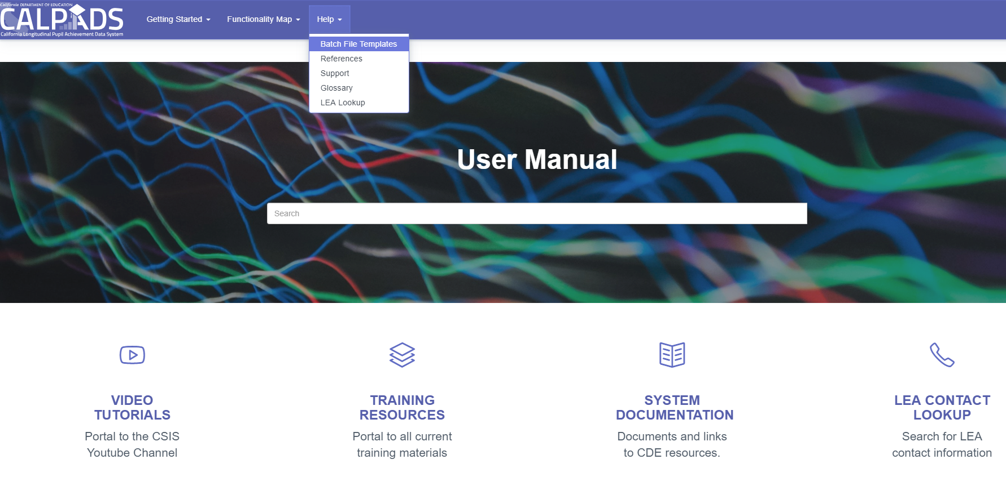
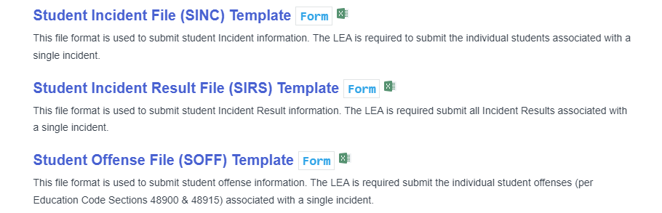
The CALPADS User Manual provides instructions and tips for using batch file templates
The batch file templates are located in the CALPADS User manual under the Help menu
https://documentation.calpads.org/Support/FileTemplates/
Notes:
The CALPADS user manual features links to the Batch file template in CALPADS in the help menu.

Slide 19
CALPADS File Specifications (CFS)
This document contains:
CALPADS file formats.
Data element definitions.
Information required for submitting files.
Public Name | Field Type | Max Length | Definition | Code Set | Comments | Validation | Required
Statutory Offense Indicator | CS | 1 | An Indicator of whether or not the incident involved one or more students committing at least one reportable offense pursuant to Education Code 48900/48915. | Y/N | If Y, then SOFF and SIRS record(s) must be submitted for the incident and students involved. If N, then SIRS record(s) must be submitted for the incident. |  | Y
Student Instructional Support Indicator | CS | 1 | An indicator of whether or not a student is receiving instructional support (e.g., homework) from the local educational agency during a disciplinary action. A Y would indicate that the student is receiving instructional support; an N would indicate that the student is not receiving any instructional support (a total cessation of educational services). | N/A | For students with disabilities, instructional support services include providing all services on the student's IEP during the duration of his/her suspension regardless of the number of days. The services may be provided in the home; however, providing homework does not meet the definition of instructional support for students with disabilities. |  | 1) If Statutory Offense Indicator = Y, Then Y; Else N

Slide 20
Code Set
This document contains all codes used in CALPADS
Code Set Name | Coded Value | Name | Definition
Student Incident Result | 400 | No Action | An individual committed an offense as defined in Education Code 48900 or 48915, was not suspended or expelled, and the matter was addressed with disciplinary action at all.
Student Incident Result | 501 | Physical Restraint | The use of a personal restriction that immobilizes or reduces the ability of a pupil to move his or her torso, arms, legs, or head freely when a pupil presents an immediate danger to self or to others as defined by Education Code Section 49005.1. It does not include a physical escort, which means a temporary touching or holding of the hand, wrist, arm, shoulder, or back for the purpose of inducing a pupil who is acting out to walk to a safe location.
Student Incident Result | 502 | Mechanical Restraint | The use of a device or equipment to restrict a pupils freedom of movement when a pupil presents an immediate danger to self or to others as defined by Education Code section 49005.1.
Student Incident Result | 600 | Seclusion | The involuntary confinement of a pupil alone in a room or area from which the pupil is physically prevented from leaving. “Seclusion” does not include a timeout, which is a behavior management technique that is part of an approved program, that involves the monitored separation of the pupil in a nonlocked setting, and is implemented for the purpose of calming.
Student Incident Result | 700 | School-related Arrest | A student, as a result of an incident, was referred to and arrested by law enforcement.

Slide 21
Reporting Timelines – Key Dates
NPS sends SINC, SOFF, SIRS files to LEAs
LEA Approval
SELPA Approval
EOY Submission Window Opens
Fall 1
Deadline
EOY Amendment Deadline
July 1 – June 15
May 9 (DELAYED)
July 15
July 29
August 26
2022
2022
2022
2022
2022

Slide 22

Next Steps – Things to consider
Where and how will this information be tracked?
  Are there changes needed to the student information system to track this?
Who will be responsible for tracking the information?
Who will be responsible for getting this information to the LEAs and assisting in the resolution of errors?
  Find an LEA’s CALPADS Administrator: https://csis.fcmat.org/calpads-lea-contacts

Slide 23
Communicate
NPS school staff and the public agency they contract with should have established communications.
It is expected that the first resource be LEA personnel (SPED and SIS data coordinators)

Slide 24
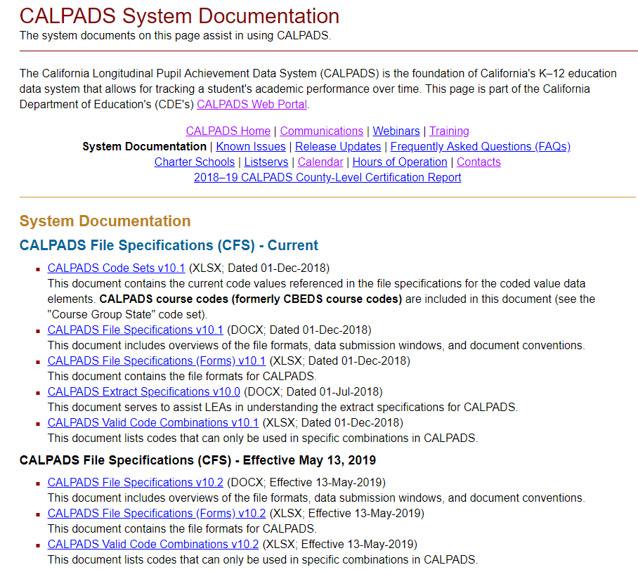


Additional Resources
Here are some important resources related to Student Discipline reporting.
https://www.cde.ca.gov/ds/sp/cl/systemdocs.asp
https://www.cde.ca.gov/ds/sp/cl/systemdocs.as
https://documentation.calpads.org/Support/References
https://csis.fcmat.org/resources/

Slide 25





Support
http://www2.cde.ca.gov/calpadshelp/default.aspx
Web
calpads-support@cde.ca.gov
Email
916-325-9210
Phone
https://www.cde.ca.gov/ds/sp/cl/systemdocs.as
You can get help through these channels.
LEA Listserv

Slide 26


Thank You

